Slide 1
MP3 Player
Marium Baig
Syed Muhammad Maaz
Khubaib Ahmed

Slide 2
Motivation
Since MP3 player is an everyday-use application , we were curious to learn its fundamentals and to design it on our own.

Slide 3
Solution Areas
Mobile phones
Laptops
Consoles

Slide 4
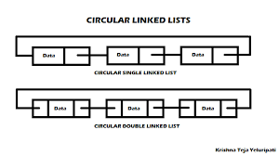
Data Structure Diagram

Slide 5
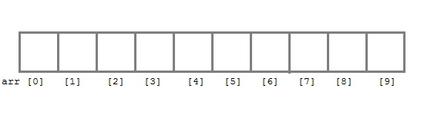
Data Structure Diagram (Continued)

Slide 6
Big O Analysis
Merge Sort | Searching from Array | Insertion of file in DLL
O(n log n) | O(n) | O(1) [tail]
Best(n log n) | Best(1) | Best(1)
Deletion of file from DLL
O(1)
Best(1)

