Slide 1
Predicting Automobile Risk Ratings
-Mohamed Abdrabo
-Mazen mohamed
Under the supervision of Dr. Nour

Slide 2
Table of contents
Introduction
Abstract
Model/methodology
Results
Conclusion

Slide 3

Introduction
Why do we need to predict the automobile risk rating ?
Predicting a car’s safety rating is vital for improving road safety, reducing accidents, and guiding consumer decisions. It helps manufacturers design safer vehicles and allows buyers to make informed choices. Insurance companies also use these ratings to set accurate premiums. This approach saves lives and minimizes financial losses.

Slide 4
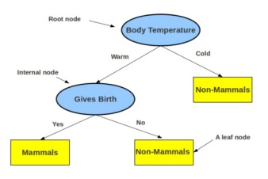
Introduction
Classifiers
1-Decision tree
A decision tree is a flowchart-like structure used to visualize and make decisions based on a series of choices and their potential outcomes. It's a powerful tool in various fields, including machine learning, data mining, and statistics.

Slide 5
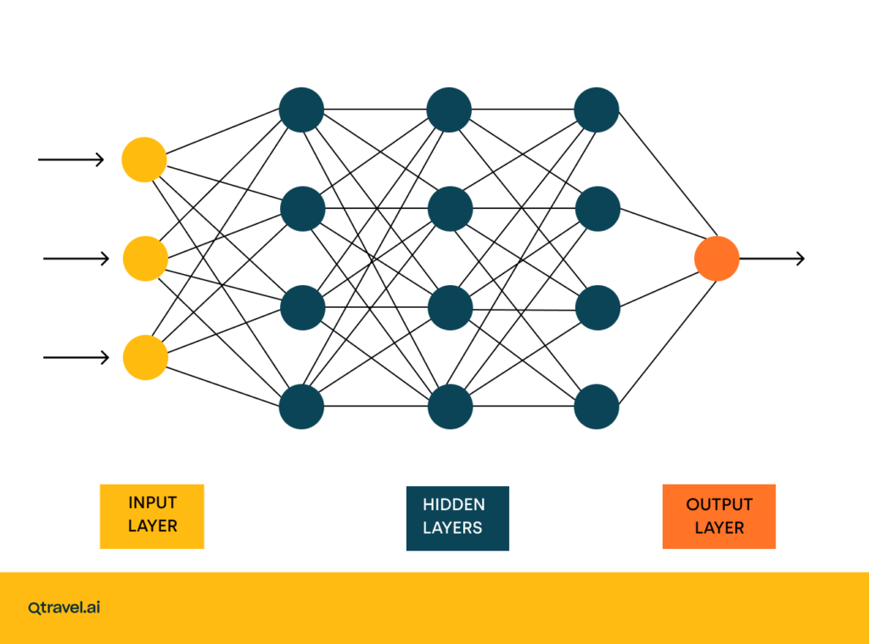
Introduction
Classifiers
2-Neural network
Neural networks are a powerful class of machine learning algorithms inspired by the structure and function of the human brain. They consist of interconnected nodes (neurons) organized in layers, enabling them to learn complex patterns and make predictions..

Slide 6
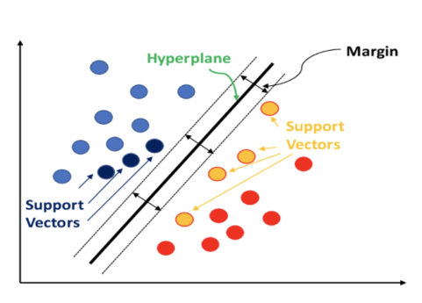
Introduction
Classifiers
3-Support vector machine
aims to find the best boundary (called a hyperplane) that separates data points of different classes in a dataset. It seeks to maximize the margin, which is the distance between the hyperplane and the nearest data points of any class (called support vectors).

Slide 7
Abstract
This paper is predicting the risk rating of automobiles that is using three classifier models: “Decision Tree”, “Support Vector Machine (SVM)”, and “Neural Network” to get the higher accuracy. Our dataset includes 205 samples with 26 features such as: hourse power, drive-wheels, stroke, compression-ratio, and etc…. . The target variable, `symboling`, categorizes cars as unsafe (-3) or safe (3). Preprocessing steps like handling nulls by replacing them with mode and mean, encoding the features, and dropping the unneeded columns. The highest accuracy was 87 percent using decision tree. This paper demonstrates the potential of machine learning in automotive safety analysis, with future efforts focused on enhancing performance.

Slide 8
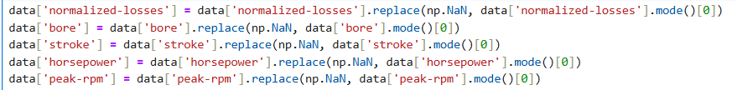
Methodology
drop the unnecessary columns using cross correlation
Check nulls and replace them

Slide 9

Methodology
Check the column data type “string, integer/float”
Encode strings to numbers
Drop the target column

Slide 10
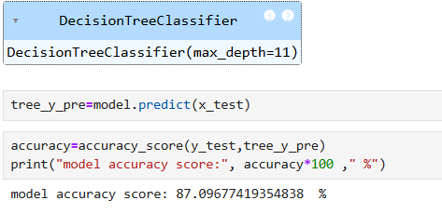


Results
According to the three models
Decision tree
SVM
Neural network

Slide 11
Conclusion
After applying three machine learning models—“Decision Tree,” “Support Vector Machine (SVM),” and “Neural Network”—we observed the highest accuracy of 87% using the Decision Tree classifier. This result was achieved by following key preprocessing steps such as handling missing values by replacing them with the mode and mean, encoding categorical features, and removing unnecessary columns. Our paper highlights the promising role of machine learning in automotive safety analysis, with future efforts aimed at further improving model performance.

Slide 12

Any questions?

Slide 13

Thank you

