Slide 1
Project 5
Matias Becker Burgos & Sam Hurenkamp

Slide 2
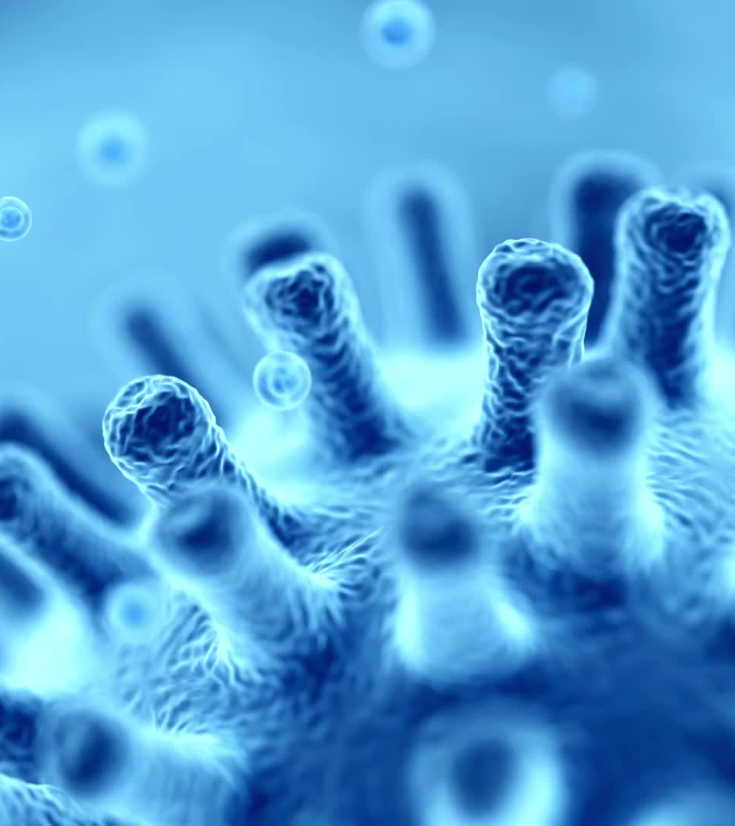
Intro: IAVs
Influenza A viruses (IAVs) are zoonotic pathogens
Infect broad range of species
Common pathogens in Wild Birds (common Host)
Can occasianaly jump to a new species.

Slide 3
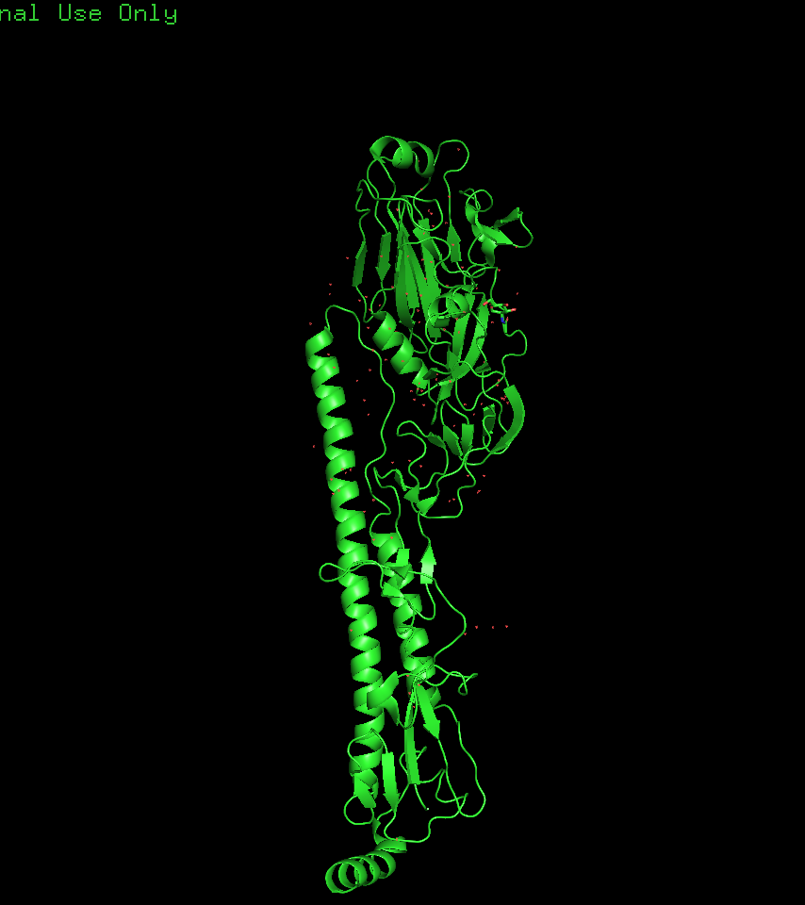
Hemaglutinin
Well known crucial component in adaptation to new hosts
But other protein subunits play a role in the adaptation of IAVs to different Host.
BUT OTHER PROTEIN SUBUNITS ARE IMPORTANT

Slide 4
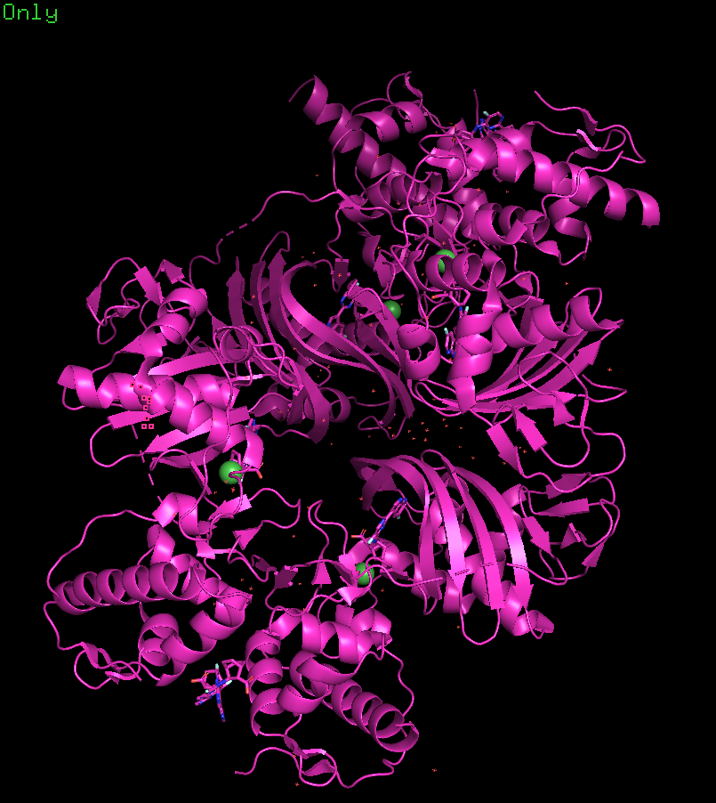
AIM
The goal of this study is to find markers associated with human and avian hosts in Polymerase PB2 proteins.

Slide 5
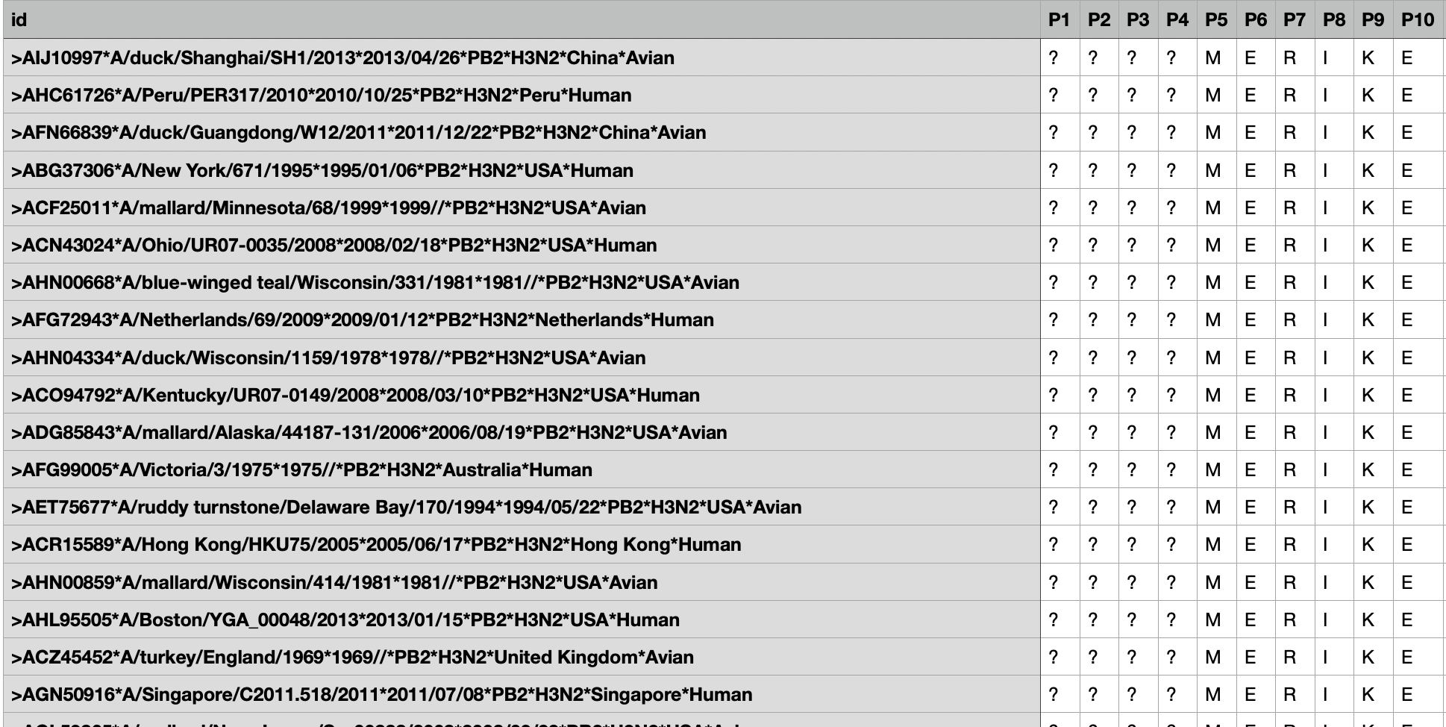
DATA
Data is a decision tables of multiple sequence alignement of the protein
Decision class (Host) is Avian or Human
Dimension of the data: 272x778

Slide 6
DATA Formating
Get rid of “?”
Specify non logical features

Slide 7
MCFS

Slide 8
ROSETTA

Slide 9
VISUNET

