Slide 1
US Energy Consumption
and CO₂ Emissions
Team Members:
Todd Auman, Jamie Lam, David Lynch, Mabel Duran-Sanchez
Notes:
Mabel

Slide 2
Intro
We wanted to look at the relationship between energy consumption and CO₂ emissions. The main motivation behind this topic is a shared interest in clean energy sources and how renewable energy sources can help mitigate climate change.
Questions: 1. Are CO₂ emissions directly related to energy consumption?
2. Does use of renewable energy sources reduce CO₂ emissions?
How we answered these questions:
Determine the residential, commercial, and industrial energy consumption patterns in each state in the US from 2000-2015.
Examine the relationships between energy consumption and CO₂ emissions and the influence that solar energy consumption has on CO₂ emissions.
Notes:
Mabel

Slide 3

Data Generation, Cleaning, and Exploration
We obtained our data from the US Energy Information Administration API Query Browser (https://www.eia.gov/opendata/).
For each state we were able to pull (including residential, commercial and industrial sectors):
total energy consumption
solar energy consumption
CO₂ emissions data
We cleaned the data sets to include only the 50 US States (excluding Washington DC) for the years 2000 - 2015.
When exploring our data, we looked at total energy consumption, CO₂ emissions, and solar energy consumption in the US as well as state breakdowns.
Each data set was saved as a .csv for future analyses.
Notes:
Mabel

Slide 4
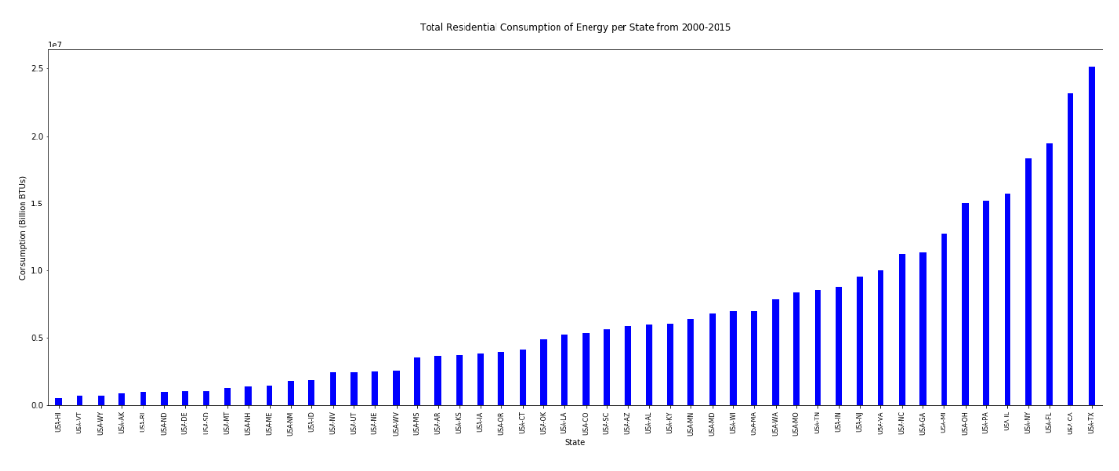
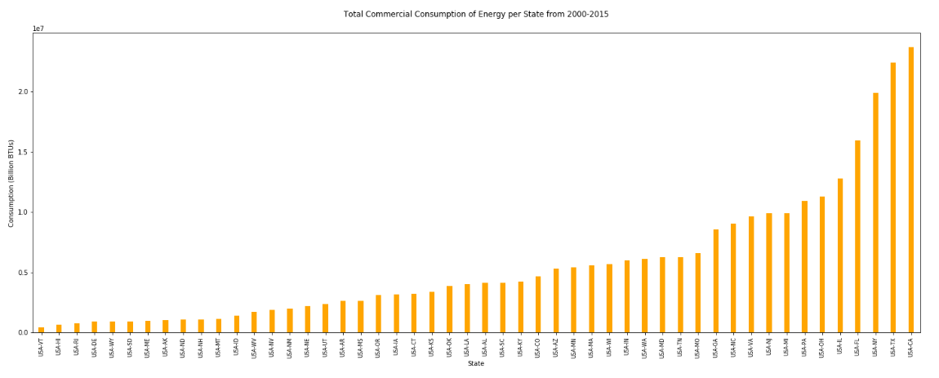
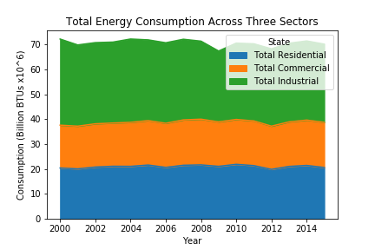
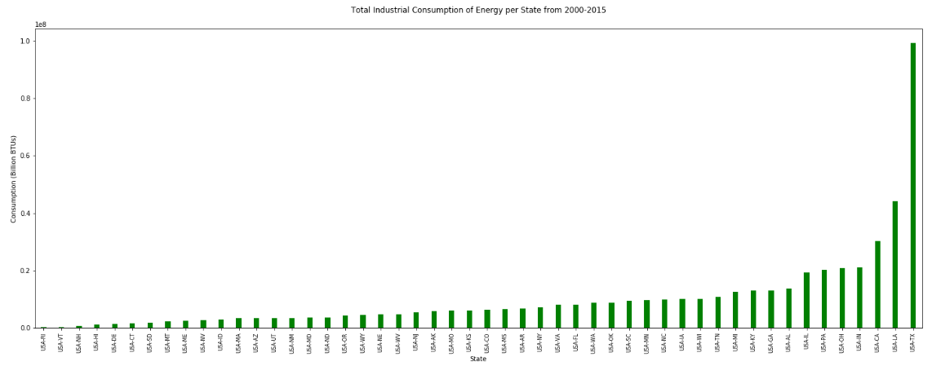
Residential, Commercial, & Industrial Energy Consumption
Notes:
Jamie

Slide 5
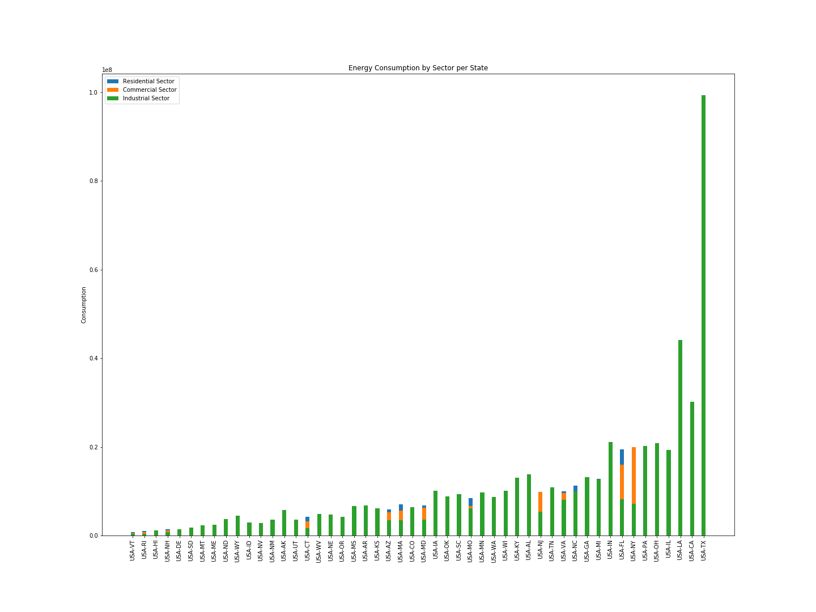
Consumption by Sector by State
Notes:
Jamie

Slide 6
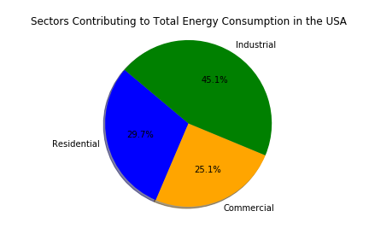
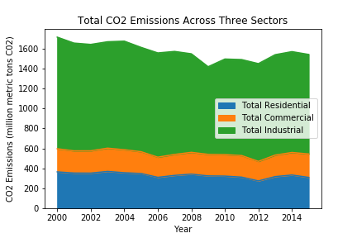
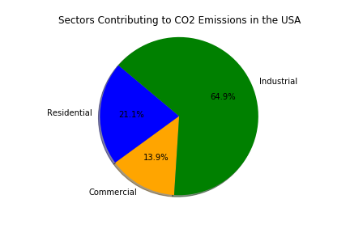
CO₂ Emissions
Notes:
David

Slide 7
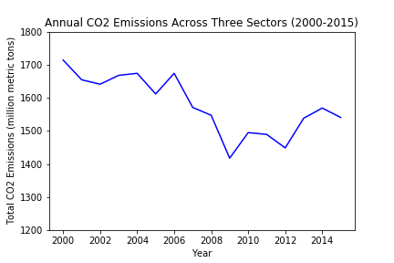
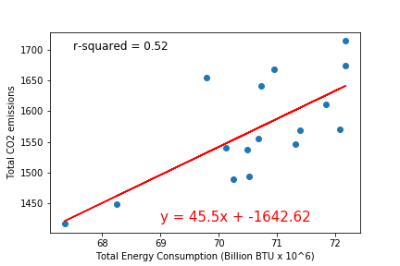
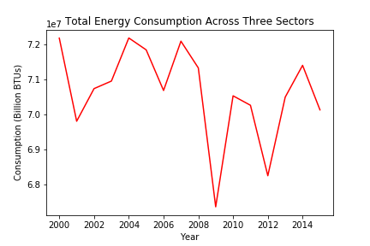
Regression of CO₂ Emissions by
Total Energy Consumption
2000-2015
-11%
2000-2015
-3%
Notes:
David

Slide 8
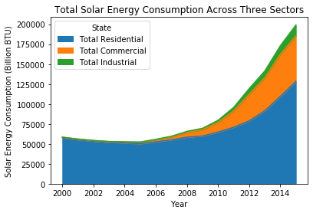
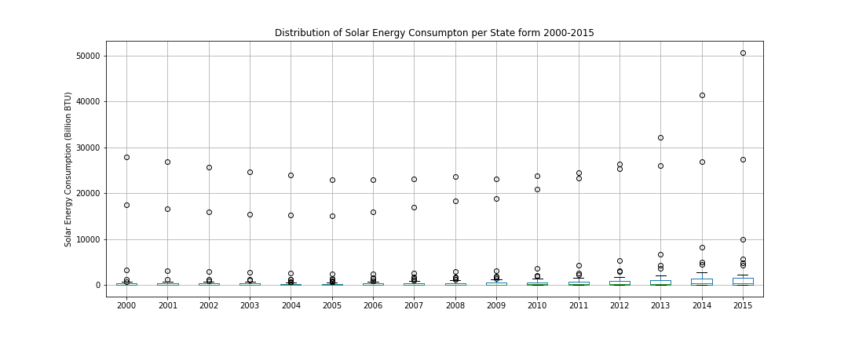
Solar Energy Consumption
Notes:
Todd

Slide 9
What is the effect of solar energy consumption on CO2 emissions?
High solar energy: ⬇ slope
⬇ r-squared
Low solar energy: ⬆ slope
⬆ r-squared
Notes:
Todd

Slide 10
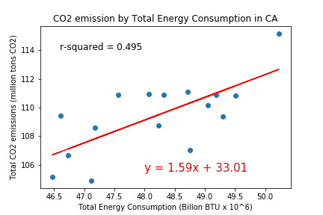
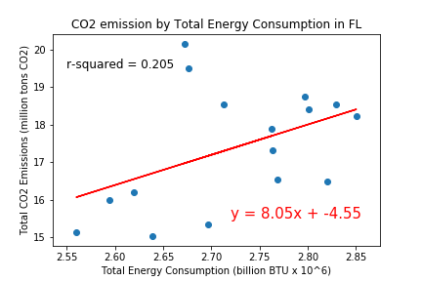
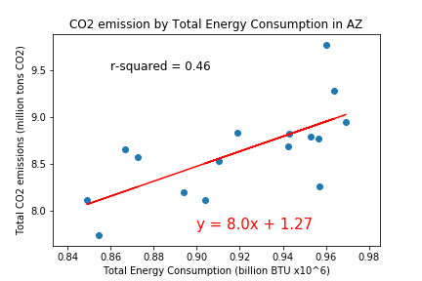
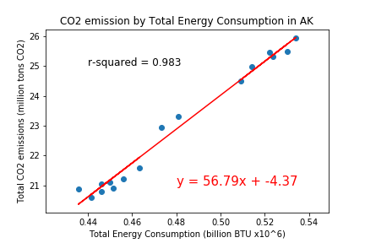
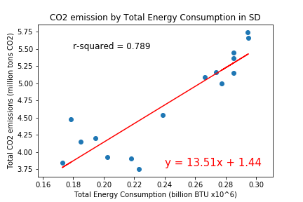
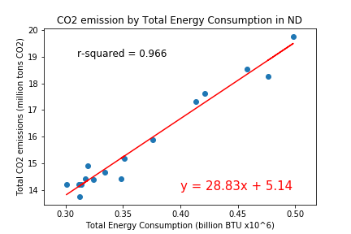
States with Highest Solar Energy Consumption
States with Lowest Solar Energy Consumption
Notes:
Todd

Slide 11
Conclusions
The 50 states vary widely in their energy consumption with Texas consuming the most.
By far the most CO₂ emissions come from the industrial sector.
There is a positive correlation between CO₂ emissions and energy consumption.
The data suggests that the use of renewable energy sources reduces CO₂ emissions
Limitations:
A limited time period was selected.
We understand that right in the middle of our timeline the financial crisis hit and we do not necessarily address this.
There are many forms of renewable energy apart from solar energy.
We did not account for all sources of energy consumption and CO₂ emissions which will affect this model (i.e. Transportation).
Notes:
Mabel

