Slide 1

Bus Management SYSTem

Slide 2

AGENDA
Agenda
Executive Summary
Design Analysis Process
Entity Relationship Diagram
Table Designs – Data Dictionary
Reference

Slide 3

Executive summary
Problem Domain: inefficient scheduling, lack of real-time updates, poor passenger information services.
Bus Management System (BMS) is designed to streamline and enhance the efficiency of public transport services
Based on the time frame, project scope focuses on bus driver and administrator only

Slide 4

Design Analysis Process
Business case
Aims to : - Enhancing operational efficiency
- Improving users' satisfaction
- Reducing waiting time
- Reducing cost
Offer to: - Update Schedule automatically
- Optimize bus routes and schedule based on real-time data
- Update bus location and estimate arrival times

Slide 5
Design Analysis process
B. Development Life Cycle
The Bus Management System was being built with Agile method of Software Development Life Cycle
1. Sprint 0 - Requirement Gathering & Planning
•Define user stories for Driver, Bus, Routes, etc.
•Plan sprints and prioritize features.
2.Sprint 1 - Design
•Design system architecture, database, and relationships (Driver ↔ Bus, Routes ↔ Schedule).
3. Sprint 2 - Development
• Develop core features in iterations (e.g., route management, driver assignment, scheduling).
• Deliver increments after each sprint.
4. Sprint N - Testing
• Continuous testing after each sprint (unit, integration, user testing).
5. Sprint N+1 - Deployment
• Deploy and release features incrementally.
6. Maintenance
• Gather feedback, fix bugs, and enhance features in future sprints.

Slide 6
Design Analysis process
C. Actors
There is a plenty of actors who are involved in our bus management system which are mentioned below:
Driver: the one who will operate the buses
Administrator: their works will be keeping the record which can be regarding routes or maintenance of bus

Slide 7
Design Analysis process
D. User Stories
We follow to format: “As a …, I want to …so that I can …” to build up user stories for 2 main entities bus driver and administrator.
For example:
As a bus driver, I want to view my assigned routes and schedules so that I can plan my day and ensure I am on time for each trip
As a driver, I want to check in at the start of my shift, so that the system knows I’m available to drive.
As an administrator, I want to create and update bus schedules so that I can ensure all routes are covered and buses run on time
As an administrator, I want to generate and view reports, so that I can monitor bus operations, track performance, and make informed decisions

Slide 8
Design Analysis process
E. User Cases
1. User cases for Drivers:
- View assigned routes and schedules
- Report maintenance issues with the bus
- Receive real-time traffic updates
- Log into the system
- Reports any mechanical or operational issues with the bus that may affect its performance or safety
- Update the trip status into the system
2. User case for Administrators:
- Create bus schedules into system
- Update bus schedules into system
- Monitor the performance of the bus management system
- Manage user accounts for passengers and drivers
- Assign drivers to specific routes and shifts
- Generate and view reports on bus operations, such as route performance, driver performance, and ticket sales.

Slide 9
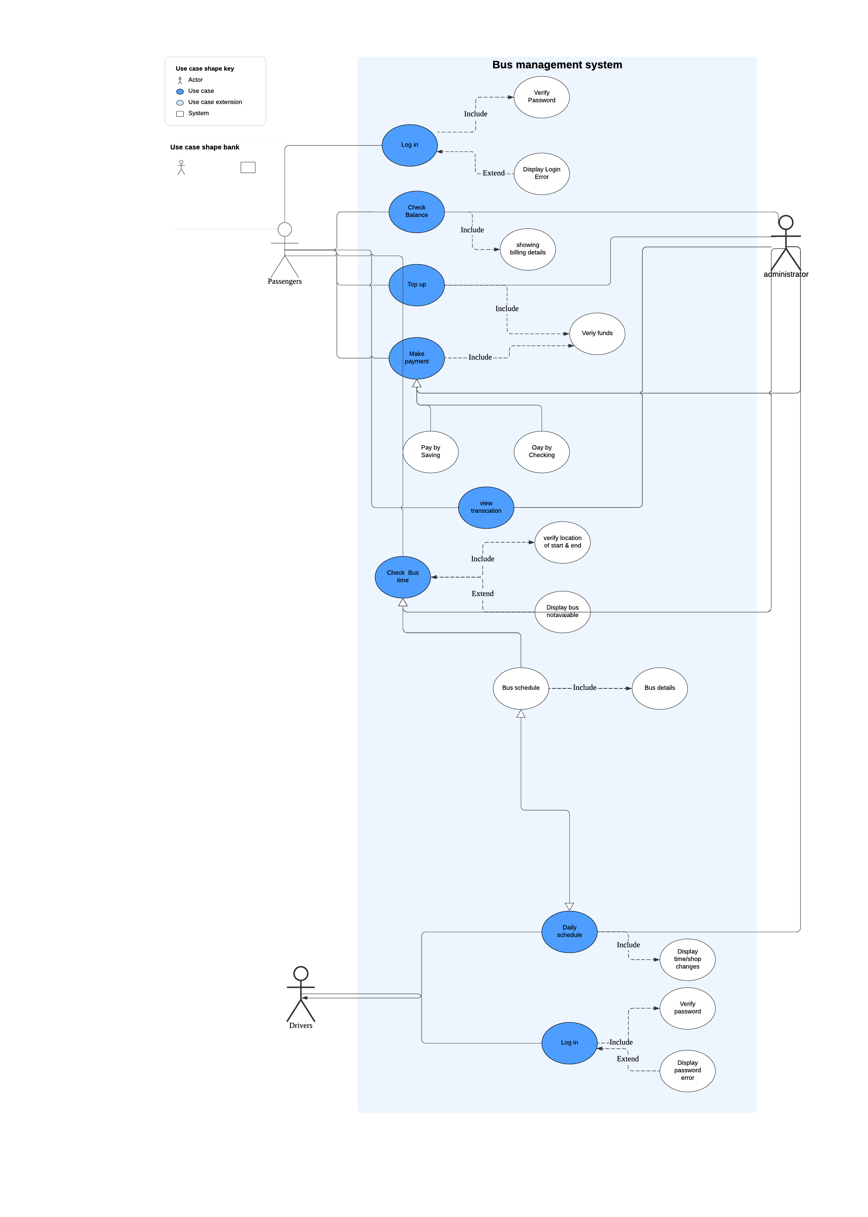
Design Analysis process
F. User Case Diagram

Slide 10
Design Analysis process
G. Functional and Non-Functional requirement
1. Functional:
- Automated Scheduling: automatically generate bus schedules based on historical data, current demand, and traffic conditions.
- Manual Adjustments: Allow administrators to manually adjust schedules as needed.
- Real-Time Updates: Provide real-time updates to schedules based on delays or changes in traffic conditions.
- Notification System: Notify drivers of schedule changes via SMS, email, or mobile app notifications.
- Route Optimization: Optimize bus routes to minimize travel time.
- Route Management: Allow administrators to create, modify, and delete routes.
2. Non-Functional:
- Performance: The system must process the access speech within a specified time (e.g., two seconds).
- Security: All sensitive data (e.g., passenger information) should be encrypted.
- Usability: The system should have a user-friendly interface adhering to accessibility standards.
- Reliability: The system must function correctly over time, ensuring availability and fault tolerance.
- Scalability: It should handle increased loads and be expandable for future growth.
- Compliance: Adherence to regulatory, legal, and industry standards

Slide 11
Design Analysis process
H. Events
1. Internal:
- Schedule Creation: Triggered when a new bus schedule is created within the system.
- Maintenance Scheduling: Initiated when a bus is scheduled for maintenance.
- Route Assignment: Occurs when a bus is assigned to a specific route.
- Incident Report: Triggered when a driver reports an incident during a run.
- Performance Monitoring: Regular checks on bus performance metrics like speed and adherence to schedule.
2. External:
- Traffic Updates: Real-time traffic information affecting bus routes.
- Weather Alerts: External weather conditions that might impact bus operations.
- Emergency Alerts: External emergencies such as accidents or road closures that require immediate attention.

Slide 12
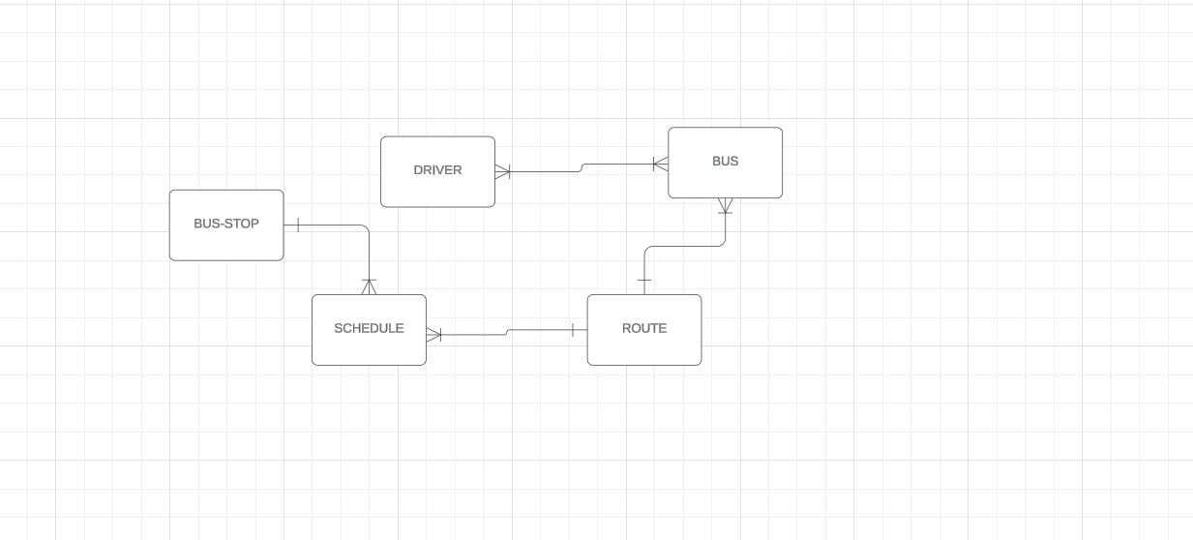
Entity relationship diagram
Logical Diagram

Slide 13
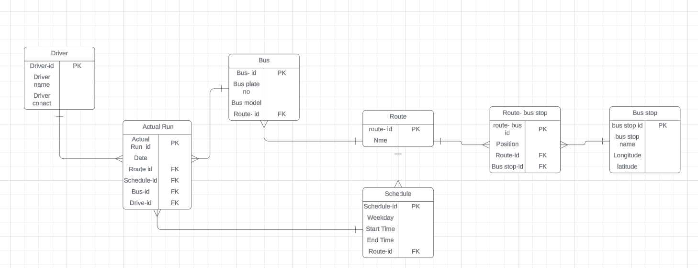
Entity relationship diagram
Physical Diagram

Slide 14
Table designs – data dictionary
Based on Physical Diagram, this project has 7 tables. However, we only show 1 table as example. The rest tables will refer in final report.

Slide 15
Table designs – data dictionary
Attribute Name | Description | Data Type | Key Field | Constraint | Actual
Schedule_id | Unique identifier for the schedule | Integer | PK | Primary key (Not null) | S500
Weekday | Day of the week for the schedule | Text |  | Not Null | Monday
Start_Time | Start time for the bus route | Text |  | Not Null | 08:00
End_Time | End time for the bus route | Text |  | Not Null | 20:00
Route_id | Foreign key linking to Route table | Integer | FK | Foreign Key | R100

Slide 16
references
https://at.govt.nz/media/1976700/route-22n-new-lynn-to-city-centre-via-new-north-rd.pdf
https://at.govt.nz/media/1976701/route-22r-rosebank-rd-to-city-centre-via-new-north-rd.pdf
https://at.govt.nz/media/ayklspze/auckland-transport-new-north-road-bus-timetable.pdf
GitHub Repository: https://github.com/MabelNguyenLe/Group-4

Slide 17

THANK YOU
Group 4
Aryan Bains | Le Y Thao | Suyang Gao | Smit Sureshbhai Patel | Shubham Kataria

