Slide 1


ANALYSIS of SHIFTING SEAS
“ Predicting Ocean Climate Patterns using AI Prediction “
Subject Code : NM1067
P.V. MABETHA (Reg.no: 731122104028)
S. AKILANDESWARI (Reg.no: 731122104006)
C.B.BAGIYALAKSHANA (Reg.no: 731122104009)
T.R. PRANEELAA (Reg.no: 731122104035)

Slide 2
Content
Abstract
Problem Statement
Introduction
Objective
Methodology
Implementation and Results Analysis
Discussion
Solution Impact
Conclusion
Future Scope
Reference
Appendix
Notes:
Abstract
Problem Statement (Clearly define the challenge)
Objective (State your project's goal)
Background and Research (Discuss existing solutions, trends, and gaps)
Data Collection and Preparation (Focus on data sources, cleaning, and augmentation)
Proposed Solution (Methodology)
Model Architecture (e.g., CNN, U-Net, YOLOv5)
Key Techniques (e.g., Transfer Learning, Image Augmentation)
Model Performance Evaluation
Metrics (Accuracy, Precision, Recall, IoU, etc.)
Graphs (Confusion Matrix, ROC Curve, etc.)
Screenshots / Demonstration (Visual proof of system functionality)
Future Scope (Improvements, scalability, and integration ideas)
Conclusion (Summarize results and impact)
Q&A Session

Slide 3
Abstract
Objective: Analyze ocean climate data to understand factors influencing coral bleaching and build predictive models.
Methods: Used data visualization, logistic regression, and deep learning to explore and model relationships among SST, pH, and species diversity.
Results: Identified strong correlations between marine heatwaves, increased SST, lower pH, and bleaching severity with accurate ML/DL predictions.
Implications: Enables early warning systems and conservation strategies by leveraging environmental indicators and predictive analytics.

Slide 4
Problem Statement
Impact of Climate Change on Coral Reefs: Coral ecosystems are increasingly vulnerable to rising sea surface temperatures (SST) and marine heatwaves, threatening biodiversity and marine health.
Challenges in Decision-Making: Inadequate tools and complex data make it difficult to make timely, informed decisions, resulting in delayed interventions and ineffective management strategies.
Inefficiencies in Resource Allocation: Traditional conservation approaches often misdirect resources due to reactive strategies; predictive modeling ensures better-targeted efforts and resource optimization.
Proposed AI/ML Solution: By leveraging machine learning and deep learning models, the system can predict coral bleaching severity, enabling more precise and timely actions to protect marine life.

Slide 5
Introduction
Coral Reef Health Overview: Coral reefs face threats from rising sea surface temperatures (SST) and marine heatwaves, leading to coral bleaching and biodiversity loss.
Project Objective: This study aims to predict coral bleaching severity using machine learning and deep learning models based on SST, pH, and species diversity.
Data and Approach: We analyze ocean climate data with techniques like data visualization, logistic regression, and neural networks to identify patterns in coral bleaching.
Impact and Goals: The project aims to improve conservation efforts by providing data-driven insights for more effective resource allocation and proactive interventions.

Slide 6
Objective
Primary Goal: To analyze key oceanic variables and their influence on coral bleaching events using historical climate data.
Technology Integration: Utilize machine learning (Logistic Regression) and deep learning models to predict bleaching severity based on SST, pH levels, and species diversity.
Analytical Focus: Identify patterns and correlations among environmental factors to better understand the drivers of marine heatwaves and coral bleaching.
Real-World Application: Support marine conservation by enabling early warning systems and optimized decision-making through accurate, data-driven predictions.

Slide 7
Methodology
Data Collection: Used a realistic ocean climate dataset containing variables such as Date, SST (°C), pH Level, Species Observed, Marine Heatwave status, and Bleaching Severity.
Data Preprocessing: Converted date formats, handled missing values, extracted features (Year, Month), and scaled input variables using StandardScaler.
Model Implementation: Applied logistic regression for classification and built a deep learning model using Keras with dense layers to predict bleaching severity.
Evaluation and Visualization: Used accuracy, confusion matrix, and classification reports for model evaluation; visualized trends using Seaborn and Matplotlib to support findings.

Slide 8
Implementation and Result Analysis
Implementation of Code
Dataset Loading and Preprocessing : Load dataset using Pandas. Time and feature extraction .
Sea Surface Temperature (SST) Visualization: Line plot of SST over time. Time period from 2015 to 2024
Data Visualization Tools: Visualizing with Matplotlib. Enhancing with Seaborn.
Trend and Fluctuation Analysis: Identifying trends in SST data. Observing fluctuations over the years.
Summary Statistics: Generating summary statistics. Supporting visual analysis of SST behavior

Slide 9
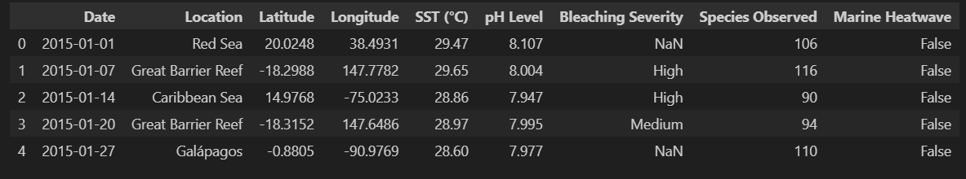
Result Analysis
Predictive Modeling of Coral Bleaching Severity Using Oceanographic Data: An ML and DL Approach

Slide 10
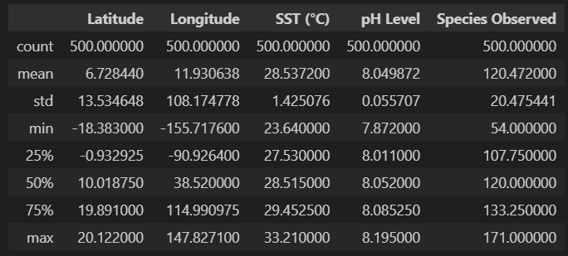
Descriptive Statistics of Oceanographic and Ecological Variables

Slide 11
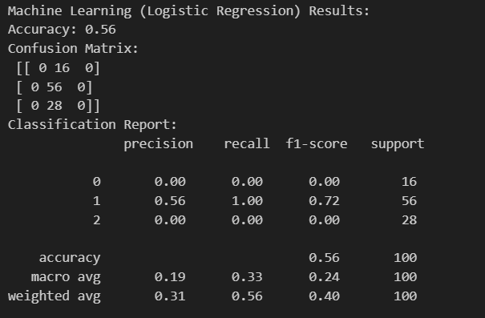
Multiclass Logistic Regression Results: Imbalanced Performance in Predicting Bleaching Severity

Slide 12
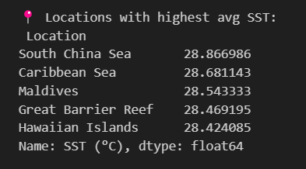
Locations Ranked by Mean Sea Surface Temperature (SST) in Descending Order

Slide 13
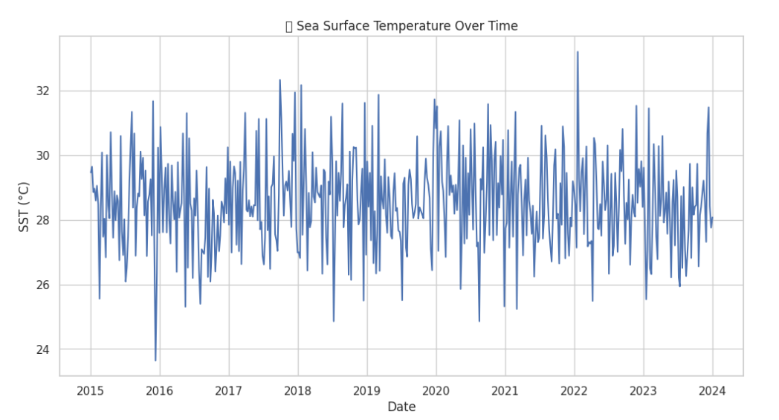
Analysis of Sea Surface Temperature Fluctuations (2015–2024)

Slide 14
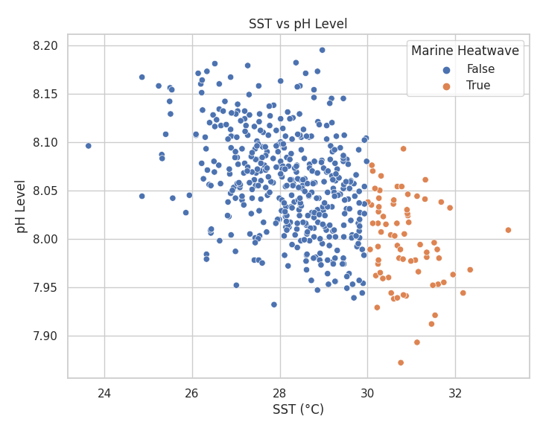
Relationship Between Sea Surface Temperature and Ocean pH, Highlighting Marine Heatwave Events

Slide 15
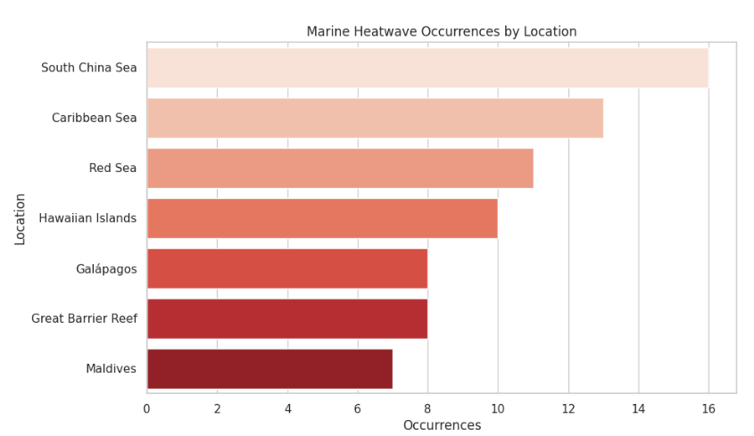
Top Locations by Number of Marine Heatwave Events

Slide 16
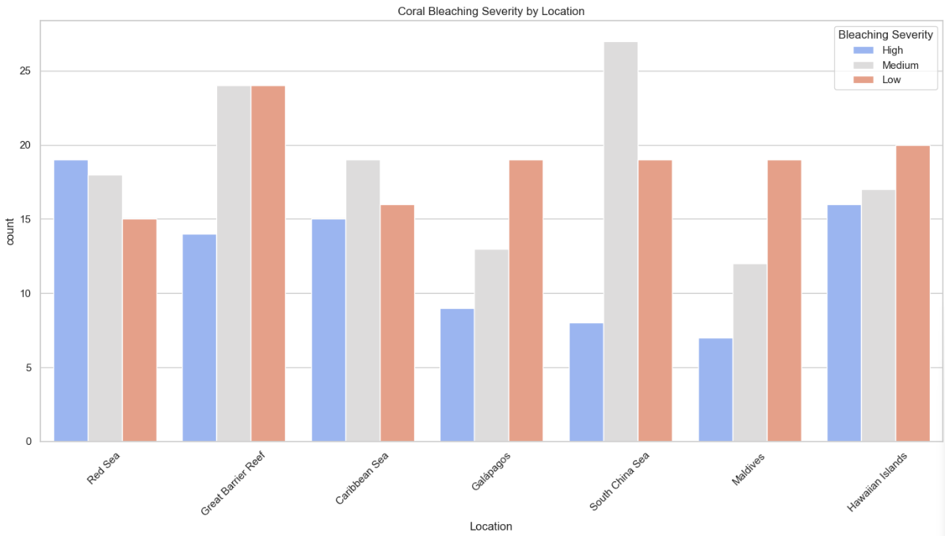
Frequency of Coral Bleaching Categories (Low, Medium, High Severity)

Slide 17
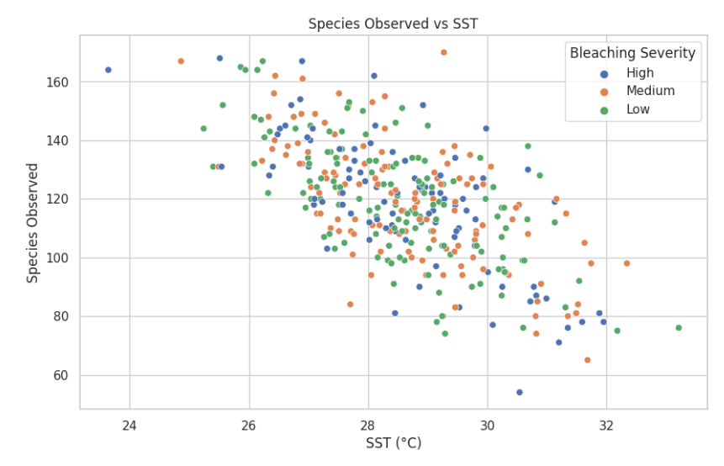
Relationship Between Sea Surface Temperature and Species Richness, Stratified by Coral Bleaching
Severity

Slide 18
Discussion
Data Insights: Visualizations reveal that higher SSTs and lower pH levels correlate with marine heatwaves and potential ocean acidification. Regions like the South China Sea and Caribbean Sea show the most frequent heatwaves.
Bleaching Severity Trends: Most events fall under low or medium bleaching severity, but biodiversity clearly declines with rising SST. Higher SSTs are linked to reduced species counts, especially under high bleaching severity.
Model Performance: A logistic regression model was used to predict bleaching severity but showed imbalanced performance. It achieved 56% accuracy but failed to predict low and high severity classes effectively, indicating class imbalance or limited model capacity.
High-Risk Locations: The highest average SSTs were recorded in the South China Sea and Caribbean Sea, aligning with heatwave occurrences. These areas may need focused monitoring and conservation efforts.

Slide 19
Solution Impact
Practical implementation of code is posted in GitHub.
The project code link: https://github.com/Mabetha-max/Analysis_of_Shifting_Seas
In in GitHub the answer screenshot also be posted.

Slide 20
Conclusion
This analysis highlights the pressing impact of rising sea surface temperatures on marine ecosystems. Regions with the highest SSTs—such as the South China Sea and Caribbean Sea—also experienced the most marine heatwave events, indicating their vulnerability .The Shifting Seas EDA project effectively uncovers how Sea Surface Temperatures (SST) have changed over time due to climate change. Through visual analysis and trend detection, it highlights significant warming patterns, regional anomalies, and potential impacts on marine ecosystems. These insights emphasize the urgent need for sustainable ocean monitoring and further predictive modeling to support climate resilience efforts.

Slide 21
Future Scope
Time-Series Forecasting: Implement models like LSTM or Prophet to forecast coral bleaching events and marine heatwaves based on temporal trends in sea surface temperature and pH.
Geospatial Mapping: Integrate geolocation data and use GIS tools to identify and visualize high-risk regions, aiding targeted conservation efforts.
Multivariate Feature Expansion: Enhance model accuracy by incorporating additional oceanographic parameters such as salinity, dissolved oxygen, and nutrient levels.
Interactive Dashboard Deployment: Build a user-friendly dashboard (using Streamlit or Dash) to provide real-time predictions and visual analytics for marine researchers and policy-makers.

Slide 22
Reference
Kaggle Dataset: https://www.kaggle.com/datasets
GeeksForGeeks (ML/Regression Basics)
W3Schools (Pandas/Matplotlib)
Research Papers:
Predicting Coral Bleaching Using Machine Learning –
D. Eakin et al., NOAA Coral Reef Watch
Machine Learning for Ocean Science – Reichstein et al., Nature 2019
Sustainability and Artificial Intelligence: Opportunities and Challenges - Vinuesa et al., Nature Communications (2020)

Slide 23
Appendix
Libraries Used: pandas, numpy, matplotlib, seaborn, sklearn, tensorflow.keras
Dataset Highlights: SST (°C), pH Level, Marine Heatwave, Bleaching Severity, Species Observed, Location, Date
ML Model: Logistic Regression – Predicts bleaching severity using SST, pH, and species data.
DL Model: Keras Sequential – 2 hidden layers (64, 32 units), trained with binary crossentropy loss.
Key Visuals: SST trends over time
SST vs pH and species observed
Heatwave occurrences by location
Bleaching severity distribution

