Slide 1

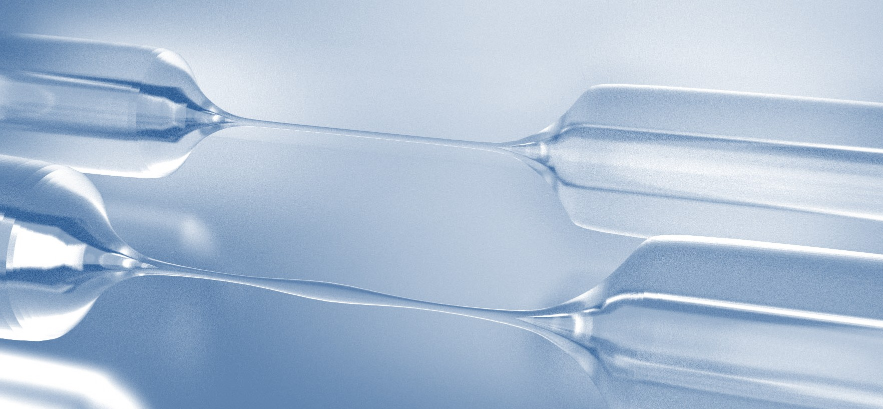


Multimodestrongcouplingofatoms closetoananofibre-basedringresonator
Aisling Johnson, Martin Blaha, Alexander Ulanov, Jürgen Volz, Philipp Schneeweiss, Arno Rauschenbeutel
EOSAM 2018, Delft

Slide 2
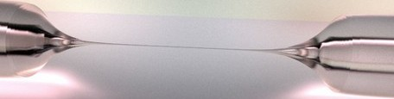
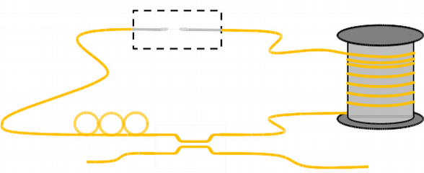
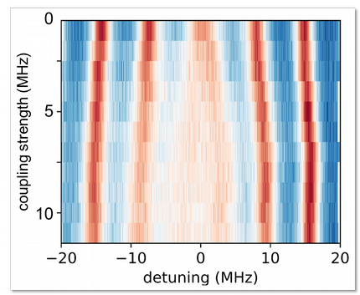
Outline
Nanofibers for multimode cavity QED
Experimental setup
Multimode strong coupling

Slide 3
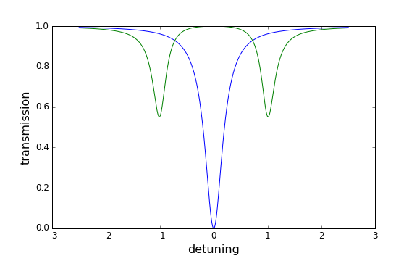

Multimode cavity QED
“Conventional” CQED
Strong coupling criterion
2g

Slide 4


Multimode cavity QED
“Conventional” CQED
Strong coupling criterion
2g
•
Collective coupling: ,
→ Interaction enhancement and new perspectives

Slide 5
Multimode cavity QED
“Conventional” CQED
Strong coupling criterion
2g
•
Collective coupling: ,
→ Interaction enhancement and new perspectives
●
Complexify: add more modes
What if g exceeds the separation between the cavity modes?

Slide 6
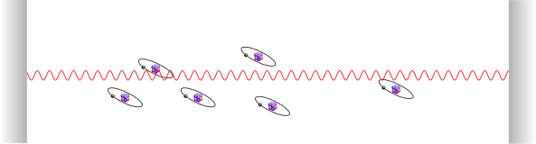
Multimode cavity QED
Strong coupling to many resonator modes
g > FSR, atoms emit into different cavity modes

Slide 7
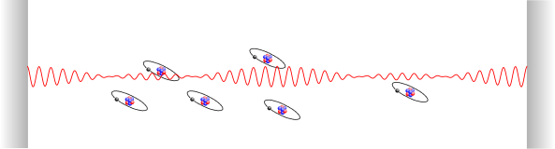
Multimode cavity QED
Strong coupling to many resonator modes
g > FSR, atoms emit into different cavity modes

Slide 8
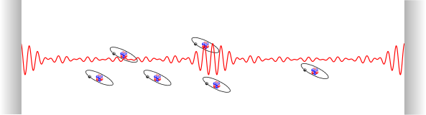
Multimode cavity QED
Strong coupling to many resonator modes
g > FSR, atoms emit into different cavity modes
•
Strongly coupled in a single round-trip: “Superstrong coupling”
D.Meiser, P. Meystre, PRA (2006)

Slide 9
Multimode cavity QED
Strong coupling to many resonator modes
g > FSR, atoms emit into different cavity modes
•
Strongly coupled in a single round-trip: “Superstrong coupling”
D.Meiser, P. Meystre, PRA (2006)
→ Photon modes interact via the atoms
→ Atoms and field don’t interact instantaneously, new dynamics
Overcome some limits of cavity QED with one mode

Slide 10
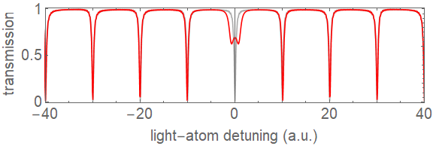
Signature of multimode strong coupling?
strong coupling

Slide 11
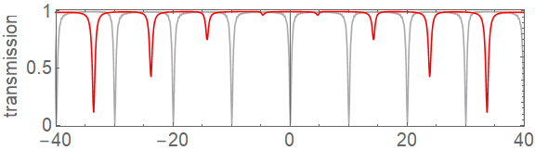
Signature of multimode strong coupling?
strong coupling
multimode strong coupling
detuning (a.u.)

Slide 12
Signature of multimode strong coupling?
strong coupling
multimode strong coupling
detuning (a.u.)
→ atoms interact strongly with many resonator modes
→ experimentally accessible spectrum
See Sundaresan et al., PRX 5, 021035 (2015)

Slide 13
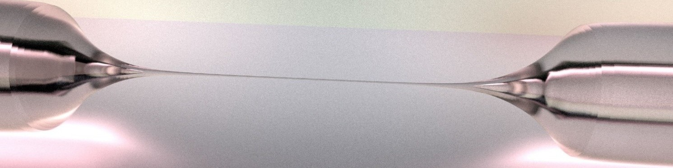
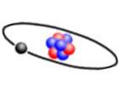
Nanofibres for quantum photonics
400 nm

Slide 14
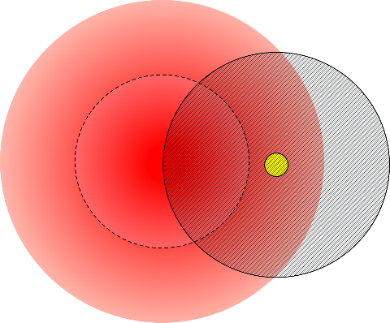
Nanofibres for quantum photonics
400 nm
Small mode volume
High light-atom interaction strength
●
•
atom
fiber mode
cross-section
Compatible with resonator Compatible with optical fibres
●
●
→ include into fibre resonator of desired length

Slide 15



How to reach g > FSR
Length dependence of resonator parameters
•
•
Single atom cooperativity
,
→ Increase l (decrease FSR) at will (almost)

Slide 16
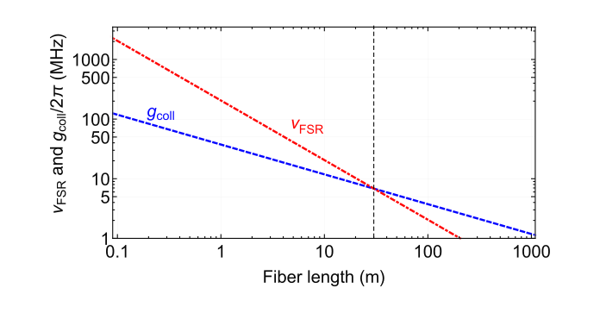

How to reach g > FSR
Length dependence of resonator parameters
•
•
Single atom cooperativity
,
→ Increase l (decrease FSR) at will (almost)
Multimode
Accessible with:
l ~ 30 m
N ~ 300 atoms
●
Schneeweiss et al., Opt. Lett. 42, 85 (2017)

Slide 17
Outline
Nanofibers for multimode cavity QED
Experimental setup
Multimode strong coupling

Slide 18
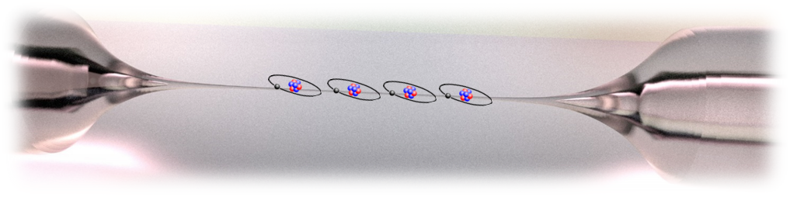
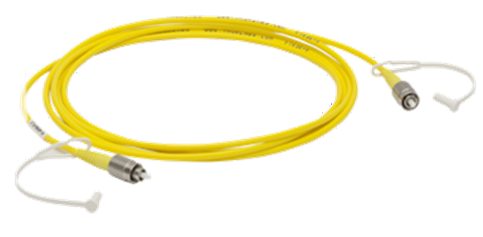
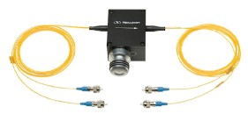
Nanofibre Ring Resonator
Nanofibre
+
25 m
Optical fibre
+
Adjustable fibre beam-splitter
Schneeweiss et al., Opt. Lett. 42, 85 (2017)

Slide 19
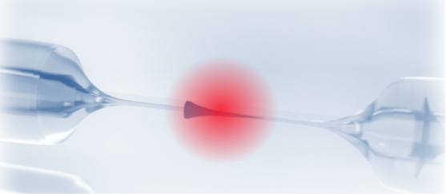


Nanofibre Ring Resonator
tunable eigenpolarization
tunable in-/out coupling
Single photon detector

Slide 20
Nanofibre Ring Resonator
Piezo for locking Passively insulated FSR 7.1 MHz
Linewidth ~ 0.8 MHz
●
●
●
tunable eigenpolarization
●
tunable in-/out coupling
Single photon detector

Slide 21
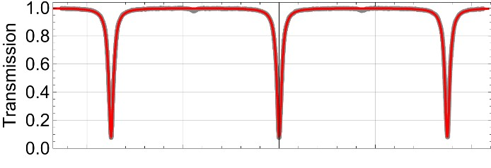
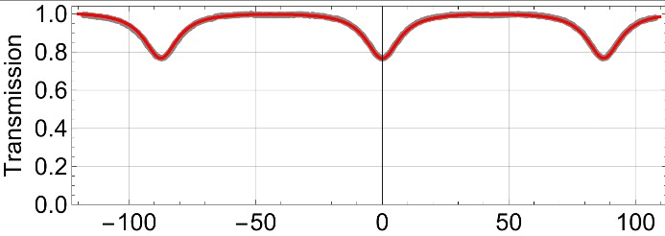
Nanofibre Ring Resonator
Piezo for locking Passively insulated FSR 7.1 MHz
Linewidth ~ 0.8 MHz
●
●
●
tunable eigenpolarization
●
tunable in-/out coupling
Single photon detector
critically coupled
over- coupled
Schneeweiss et al., Opt. Lett. 42, 85 (2017)

Slide 22
Interfacing the nanofibre with atoms
Magneto optical trap
→ reservoir of cold Cs atoms

Slide 23
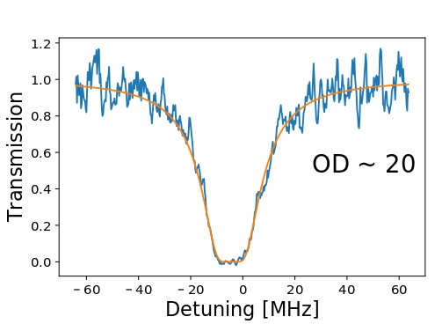
Interfacing the nanofibre with atoms
Magneto optical trap
→ reservoir of cold Cs atoms
Transmission spectroscopy → collective coupling
Set resonator to fully overcoupled
→ single round-trip of light
●
OD = 17.9

Slide 24


Interfacing the nanofibre with atoms
Magneto optical trap
→ reservoir of cold Cs atoms
Transmission spectroscopy → collective coupling
Set resonator to fully overcoupled
→ single round-trip of light
●
From
:
= 12 MHz
●
→
OD per atom ~ 0.05 “effective” atom number ~ 400
●
●
OD = 17.9

Slide 25
Outline
Nanofibers for multimode cavity QED
Experimental setup
Multimode strong coupling

Slide 26
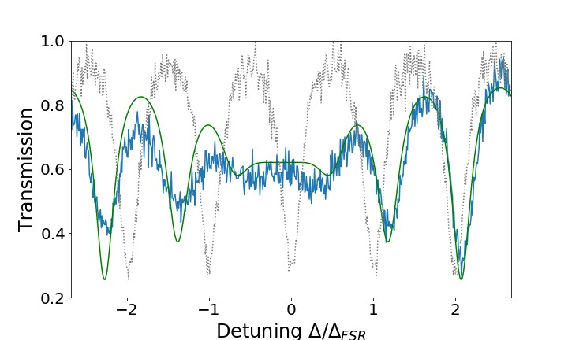
Multimode strong coupling
Measurement (for critical coupling)
Resonator + atoms
empty resonator
1 ms probing pulse with frequency scanned Approx 100 shots
●
●

Slide 27
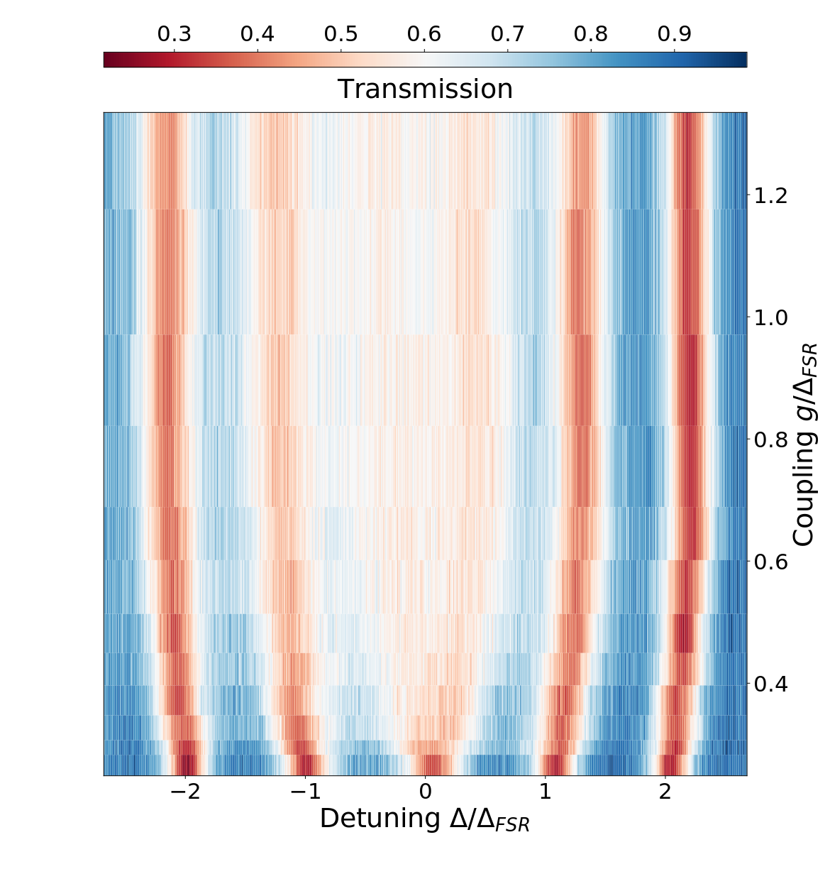
Transition to multimode strong coupling
Tune overlap of MOT with nanofibre, increase g
multimode strong coupling
Increase OD
„conventional“ strong coupling
→ Central splitting up to FSR

Slide 28
Summary
Nanofibre ring resonator
Combining nanofibre quantum interface and fiber ring resonator
→ entering a new regime of CQED Versatile setup
●
●

Slide 29
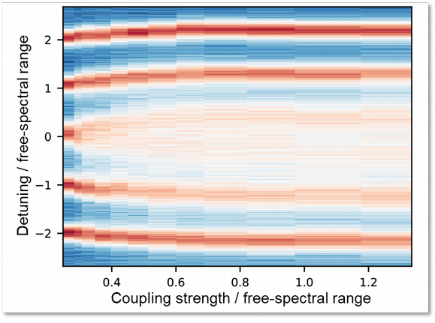
Summary
Nanofibre ring resonator
Combining nanofibre quantum interface and fiber ring resonator
→ entering a new regime of CQED Versatile setup
●
●
Study of multimode strong coupling
Coupling strength exceeds free-spectral range Observation of the transition:
“standard“ → multimode strong coupling
●
●

Slide 30
Outlook
Next experimental steps
Investigate nonlinear properties (g⁽²⁾)
Trapping atoms in evanescent field of the nanofibre Optimizing resonator finesse (reduce linewidth to 100 kHz)
●
●
●

Slide 31
Outlook
Next experimental steps
Investigate nonlinear properties (g⁽²⁾)
Trapping atoms in evanescent field of the nanofibre Optimizing resonator finesse (reduce linewidth to 100 kHz)
●
●
●
And then?
“non-Markovian”
→ new type of photon-resonator dynamics
New types of entangled states, photonic info processing... Taylor interaction range between atoms
→ Self-organisation
●
●
●

Slide 32
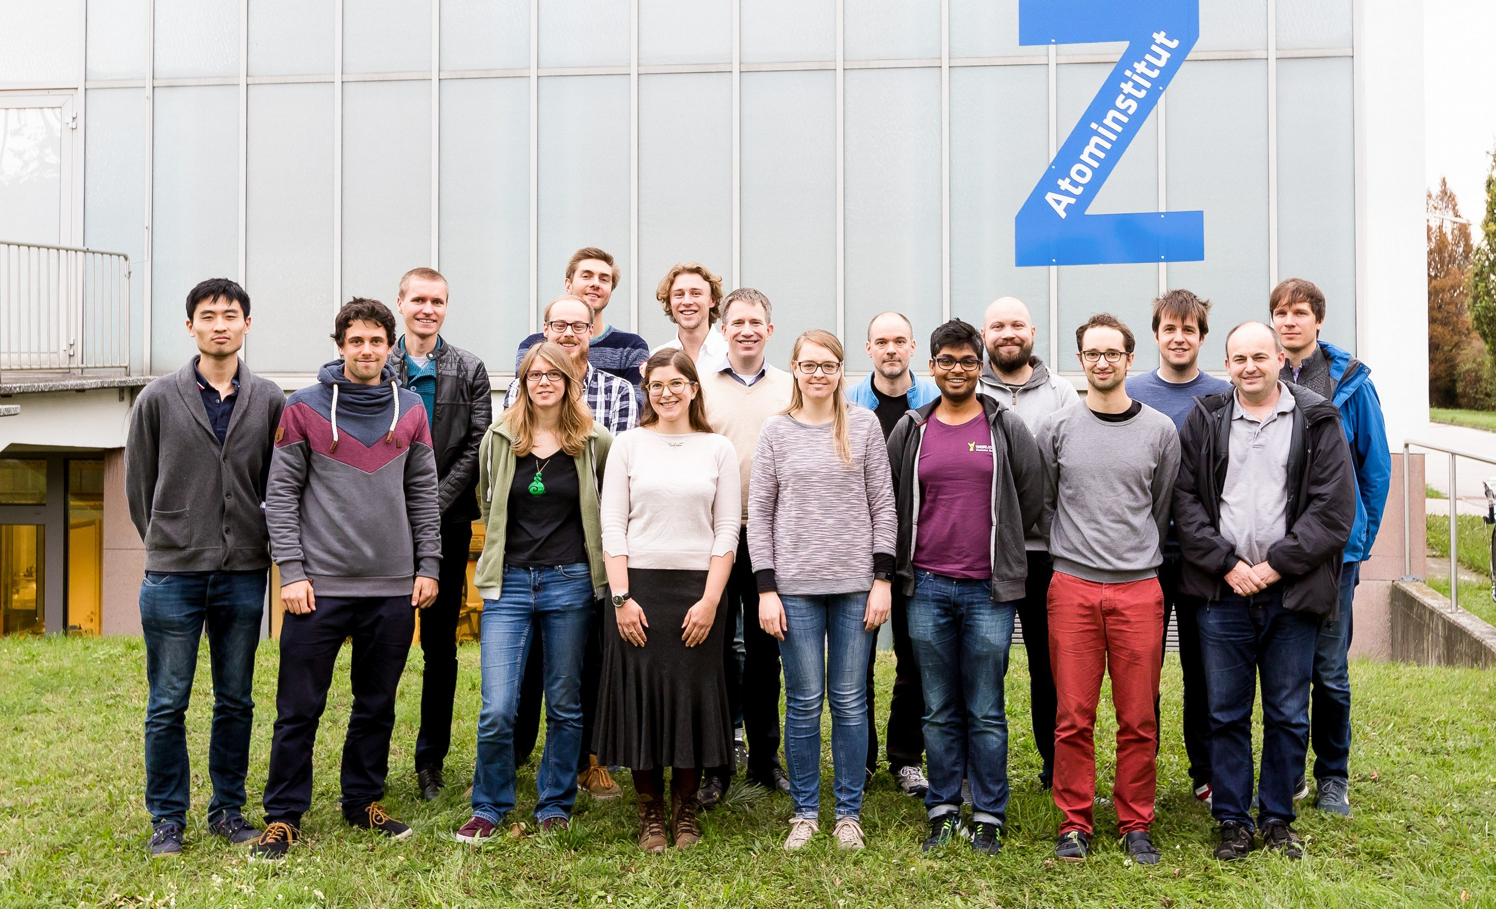




Thank you for your attention
A. Ulanov _{M. Blaha}
A. Rauschenbeutel
P. Schneeweiss
J. Volz
www.nanofiber.at

