Slide 1

ENTRYPOINT
Global Visa Document
Readiness Platform
AI-powered document analysis, readiness scoring, and human oversight — so travellers know exactly what's missing before they apply.
React · TypeScript · FastAPI
Supabase · DeepSeek V4 Pro via Fireworks AI

Slide 2

The Problem
Travellers lack one integrated place to:
EntryPoint's answer:
An earlier, practical
readiness check
Understand visa document requirements for their route
Verify the documents they already hold
Fix problems before travelling — not after rejection
so applicants can prepare with confidence — before an application or border crossing.
This gap costs time and money, and can contribute to unsafe or irregular migration when people cross borders without required documentation.
EntryPoint · Global Visa Document Readiness Platform
2

Slide 3





What EntryPoint Does
One platform for applicants and administrators
Create Applications
Upload & OCR
AI Document Analysis
Select origin, destination, and visa type to load the correct checklist.
Drag-and-drop documents; browser OCR extracts text on the spot.
DeepSeek classifies each document and flags issues or missing data.
Track Readiness
Ask for Help
Admin Oversight
A live readiness score shows exactly what's passed, missing, or flagged.
Applicants query an advisor directly when the AI can't resolve something.
Administrators manage requirements and resolve applicant queries.
EntryPoint · Global Visa Document Readiness Platform
3

Slide 4
System Flow
From country selection to a saved AI-scored readiness result
1
Applicant selects origin, destination, and visa type
2
Platform loads the matching visa checklist
3
Browser OCR (Tesseract.js / PDF.js) reads documents before upload; server OCR is a fallback
4
Supabase stores application records, document metadata, OCR text, and files
5
FastAPI sends extracted text to DeepSeek V4 Pro via Fireworks AI
6
AI classifies each document — confidence, validity, extracted details, issues
7
Score, summary, and classification are saved so progress persists on return
EntryPoint · Global Visa Document Readiness Platform
4

Slide 5
Under the Hood
Services and technologies powering EntryPoint
Area | Service / Technology | Purpose
Web app | React, TypeScript, Vite | Applicant and administrator interface
Styling | Tailwind CSS | Responsive UI
OCR | Tesseract.js, PDF.js, Tesseract, Pillow | Browser and server text extraction
API | Python, FastAPI, Uvicorn | Application, document, analysis, query API
AI | DeepSeek V4 Pro via Fireworks AI | Document classification and analysis
Data | Supabase PostgreSQL | Users, applications, requirements, queries, AI results
File storage | Supabase Storage | Uploaded document files
Auth | bcrypt, custom tokens | Applicant and administrator access
Hosting | AMD Cloud, Docker | Deployment runtime
EntryPoint · Global Visa Document Readiness Platform
5

Slide 6
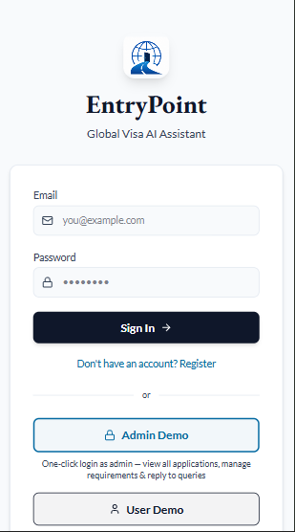
Login & Instant Demos
Frictionless entry for applicants and judges alike
Standard email/password sign-in with registration
One-click Admin Demo — view all applications, manage requirements, reply to queries
One-click User Demo — experience the applicant journey instantly
Removes the barrier of account setup for evaluation and onboarding
EntryPoint · Global Visa Document Readiness Platform
6

Slide 7
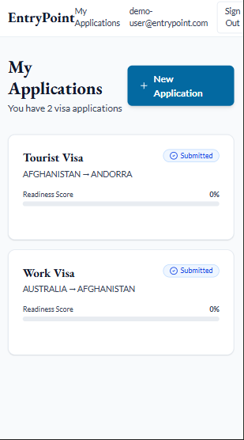
Applicant Dashboard
Every application and its live readiness score, at a glance
Lists all of the applicant's visa applications
Shows route (origin → destination), visa type, and submission status
Readiness score progress bar per application
One tap to start a New Application
EntryPoint · Global Visa Document Readiness Platform
7

Slide 8
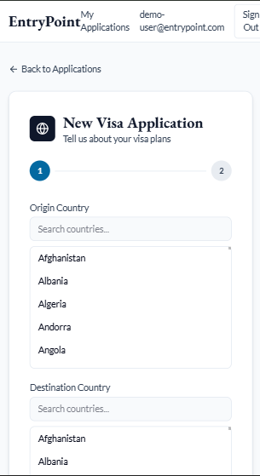
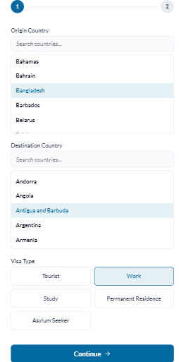
New Application Wizard
Origin, destination, and visa type drive the whole checklist
Step 1 of 2: searchable origin and destination country pickers
Visa type selector — Tourist, Work, Study, Permanent Residence, Asylum Seeker
Selections determine which requirements load next
Clear progress indicator keeps the applicant oriented
EntryPoint · Global Visa Document Readiness Platform
8

Slide 9
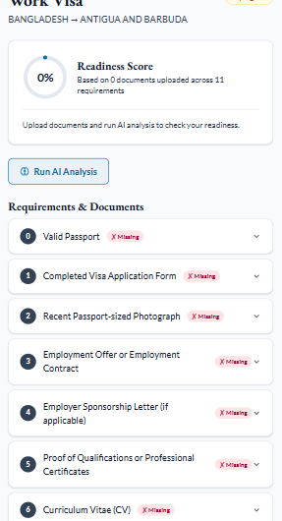
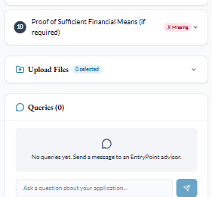
Requirements & Readiness
A live checklist tailored to the applicant's route and visa type
Readiness score starts at 0% and updates as documents are analysed
Every requirement listed — passport, application form, photo, sponsorship letter, and more
Missing items are flagged clearly in red until resolved
An in-app query box lets applicants ask an advisor questions directly
EntryPoint · Global Visa Document Readiness Platform
9

Slide 10
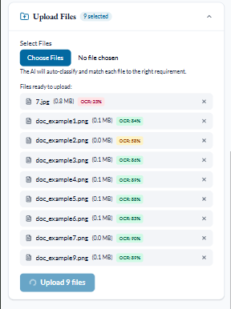
Upload & Browser-Side OCR
Documents are read before they ever reach the server
Drag-and-drop or multi-file selection — PDF, JPG, PNG
Tesseract.js/PDF.js extracts text in the browser, shown as a live OCR confidence % per file
The AI auto-classifies and matches each file to the right requirement
Applicants can review and remove files before committing the upload
EntryPoint · Global Visa Document Readiness Platform
10

Slide 11
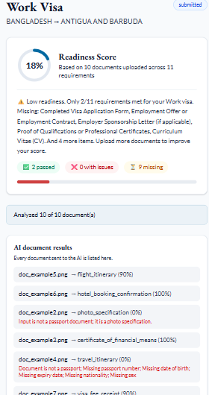
AI Document Analysis
DeepSeek V4 Pro scores every document, not just a pass/fail flag
Readiness score recalculates after analysis — passed / issues / missing counts
Per-document verdicts with a confidence percentage
Specific, actionable issues — e.g. wrong document type, missing passport number, missing dates
A plain-language summary of what's still needed to reach full readiness
EntryPoint · Global Visa Document Readiness Platform
11

Slide 12
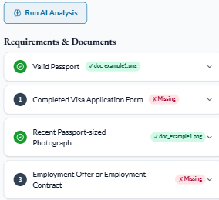
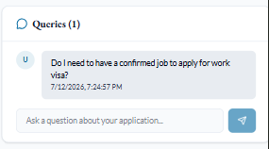
Requirement Matching & Applicant Queries
Every checklist item links to its matched file — and a direct line to an advisor
Matched requirements show a green check and the linked filename
Still-missing requirements stay flagged in red for quick follow-up
Applicants can ask a free-text question about their application
Queries are timestamped and routed straight to the admin queue
EntryPoint · Global Visa Document Readiness Platform
12

Slide 13
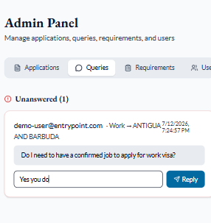
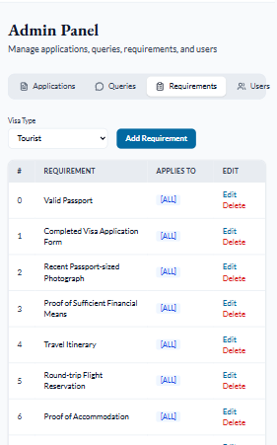
Admin Panel: Human Oversight
Because visa decisions deserve a person, not just a model
Unanswered applicant queries surfaced with route and timestamp
Admins reply directly, resolving the query in place
Requirements are fully manageable per visa type — add, edit, delete
Requirement scope can target specific countries or apply to all
EntryPoint · Global Visa Document Readiness Platform
13

Slide 14



Designed With Human Oversight
The AI shows its confidence, not just an answer — anything uncertain routes to a person before it affects a real application.
Dashboard
Document Mgmt
AI Validation
Readiness Score
Reports
Notifications
Human Review
Support
EntryPoint · Global Visa Document Readiness Platform
14

