Slide 1
Effect of Diversification
How many stocks are needed to diversify a portfolio?
How much data is needed to calculate the covariance matrix?

Slide 2

Portfolio variance
(1)
Where the c_{i,j} denote entries in the covariance matrix C.
Remember that the entries of C along the diagonal (i=j) are variances (=σ_{i,i})
And off the diagonal (i ≠j) they are covariances (σ_{i,j})
So let us rewrite this formula as follows:
(2)

Slide 3
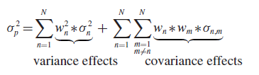
Portfolio Variance
In harmony with this notation,
(1)
can be re-written reorganizing the terms into two groups :
(2)
There are two terms in the calculation:
one group comes from the variance of the eligible investment assets,
i.e. from the diagonal of C, when n=m;
the other group comes from the covariance effects,
i.e. from the off-diagonal elements of C, when n =/=m.

Slide 4
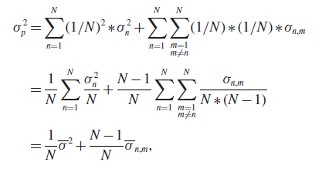
Portfolio Variance
To illustrate the effect of diversifying one’s capital among many assets, assume that 1/Nth of the capital is invested in each of the N assets in the eligible investment universe. Using this assumption we can re-write the portfolio variance as:
(1)
Note that there are N ∗(N −1) off-diagonal terms in the covariance matrix, so dividing the sum of the covariances by
this factor gives the average covariance
(2)
(3)
the average variance.
the average covariance

Slide 5
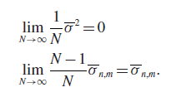
Infinite Asset Investment
Letting N approach infinity gives the following limits:
(1)
(2)
the average covariance
When the investor’s capital is well distributed among the eligible
investment vehicles, the risk that stems from the individual assets is diversified away
and what remains approaches the average covariance. It is seen that the covariance
terms, in this case the average covariance, cannot be diversified away. This part of
the risk is also referred to as the systematic risk of the portfolio.

Slide 6
Effect of Diversification
In reality it is (naturally) not possible to distribute the capital among an infinite number of assets, nor is it necessary for achieving diversification benefits. In most cases, the diversification effect is considerable even when only 15 assets are included in the portfolio and the marginal benefit of including more than 50 assets is for all practical purposes equal to zero

Slide 7
EffectOfDiversification.py
To illustrate the issue of diversification the Python script in the next slide (in EffectOfDiversification.py) simulates a covariance matrix and calculates the variance of portfolios with an increasing number of assets included.

Slide 8
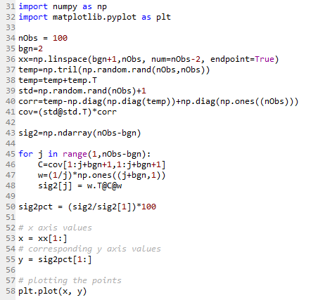
EffectOfDiversification.py (script)
Lines [34]–[36] define the number of entries in the covariance matrix, i.e. the number of assets that are contained by the eligible investment universe. The value for the variable ‘bgn’ in line [35] indicates that two assets should be included in the first calculation. The ‘xx’ in line [36] is simply a counting variable used when plotting the result. Lines [37]–[41] simulate the covariance matrix. Line [37] generates the lower triangular matrix from a matrix of uniformly distributed random variables between zero and one. A covariance matrix is symmetric and therefore the lower triangular part of the matrix is taken so that a symmetric matrix can be generated in line [38]. Line [36] generates a vector of standard deviations, one for each asset; a lower bound of unity of the standard deviation is arbitrarily chosen. In line [40] it is ensured that the diagonal of the correlation matrix is equal to unity. Line [41] generates the covariance matrix following the calculation cov(x1,x2)=std(x1)∗std(x2)∗corr(x1, x2). This is done through element-by-element multiplication of the covariance and correlation matrices. Lines [45]–[48] calculate the portfolio variance for an investment universe that increases in size by one asset from one iteration to the next. The rest of the code plots the results.

Slide 9
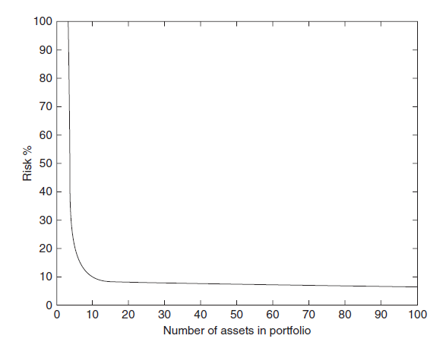
EffectOfDiversification.py (graph)

Slide 10
How much data is needed?
A covariance or correlation matrix can become singular if:
(1) Number of variables is equal or greater than the number of samples
(2) Two or more variables sum up to a constant;
(3) Two variables are identical or differ merely in mean (level) or variance (scale).
Duplicating observations in a dataset will lead the matrix towards singularity. The more times you clone a case the closer is singularity. So, when doing some sort of imputation of missing values it is always beneficial (from both statistical and mathematical view) to add some noise to the imputed data.
Rule of thumb is the number of observations should be: 1/2*N*(N+1) –where N is the number of assets

