Slide 1
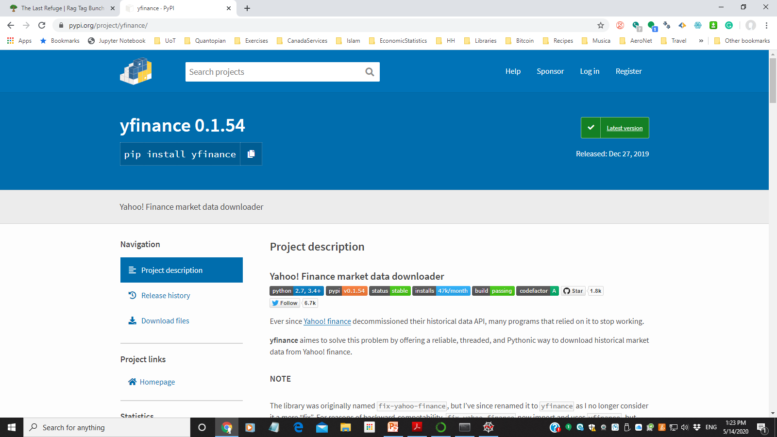
FixYahoo.py
https://pypi.org/project/yfinance/

Slide 2


FixYahoo.py

Slide 3
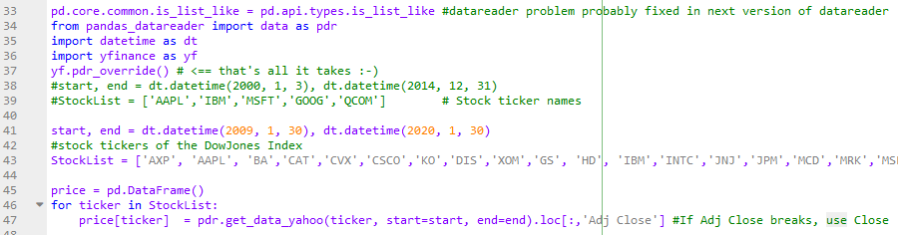
cplex_MAIN.py (in cplex.rar) 1

Slide 4
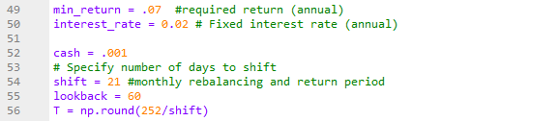
cplex_MAIN.py 2

Slide 5
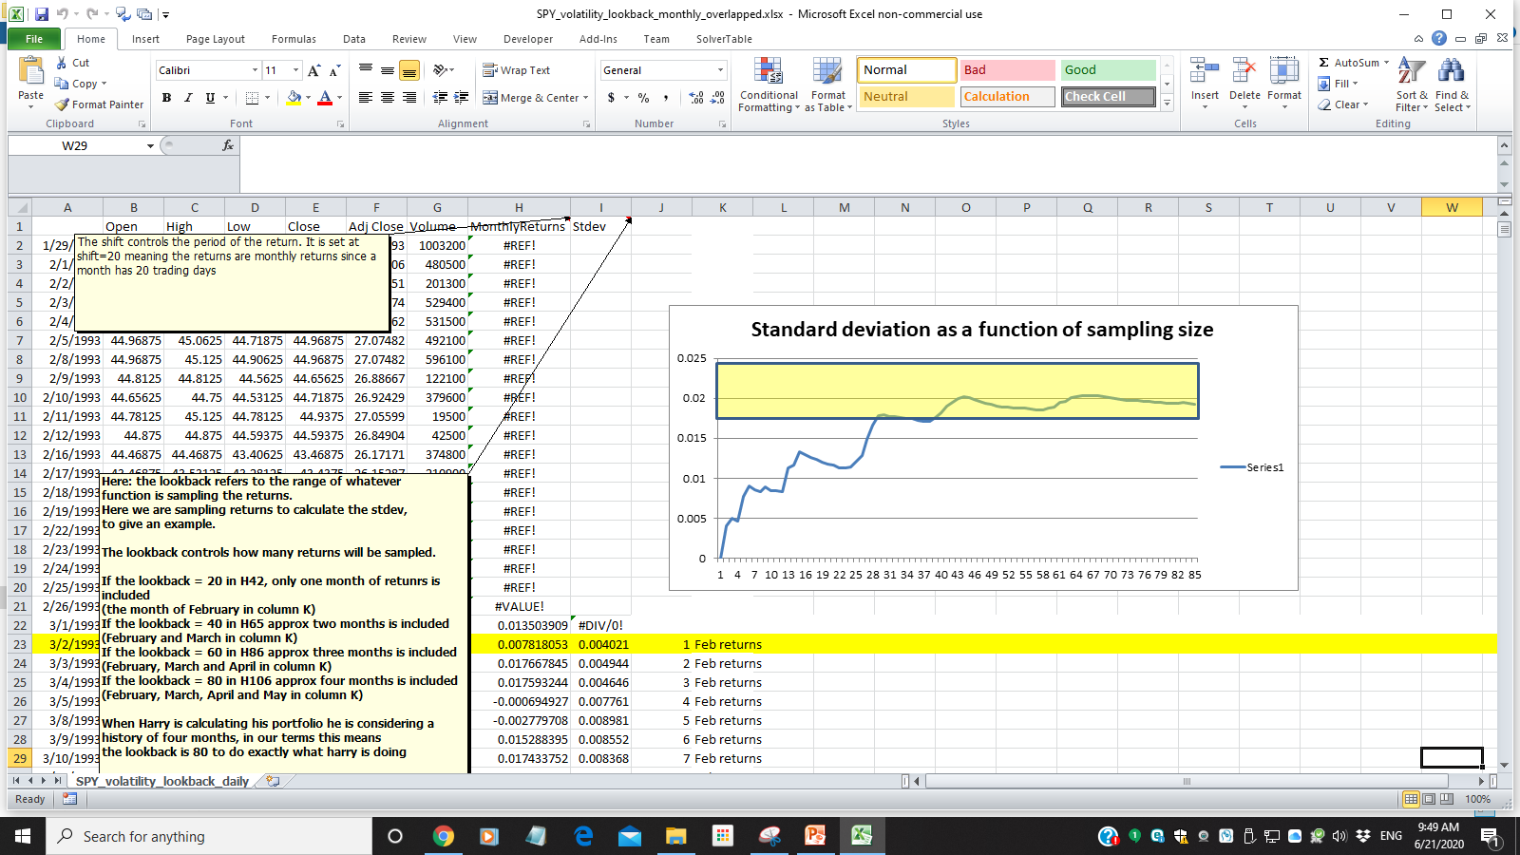
SPY_volatility_lookback_monthly_overlapped.xlsx

Slide 6
cplex_MAIN.py 3

Slide 7
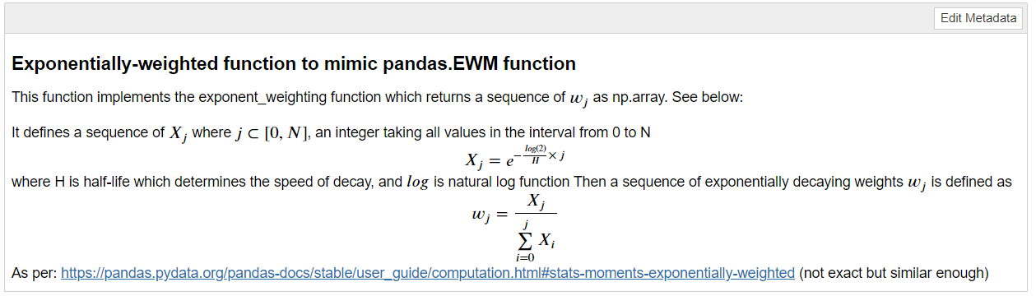
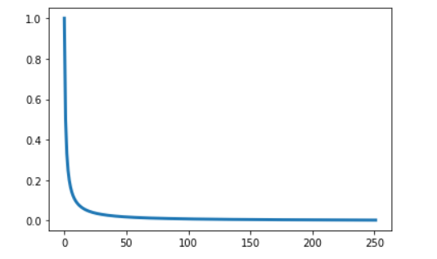
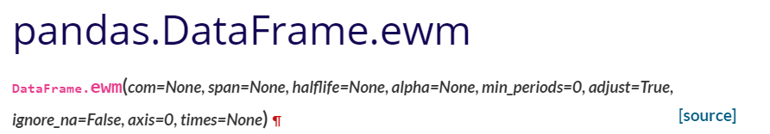
ExponentiallyWeightedMovingAverage.ipynb
https://pandas.pydata.org/pandas-docs/stable/reference/api/pandas.DataFrame.ewm.html

Slide 8
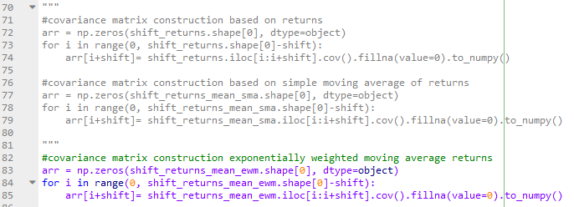
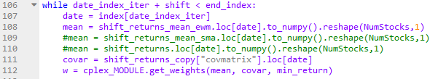
cplex_MAIN.py 4

Slide 9

cplex_MAIN.py 5
If using log returns:
dfP['cum_rets'] = np.cumsum(dfP['log_rets'])
If using percent returns:
dfP[‘cum_rets'] =np.cumprod(1+dfP['percent_rets'])

Slide 10
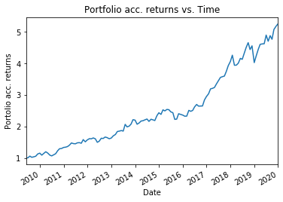
cplex_MAIN.py 6

Slide 11
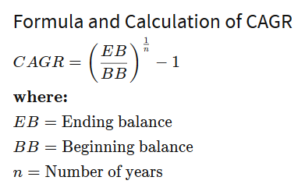
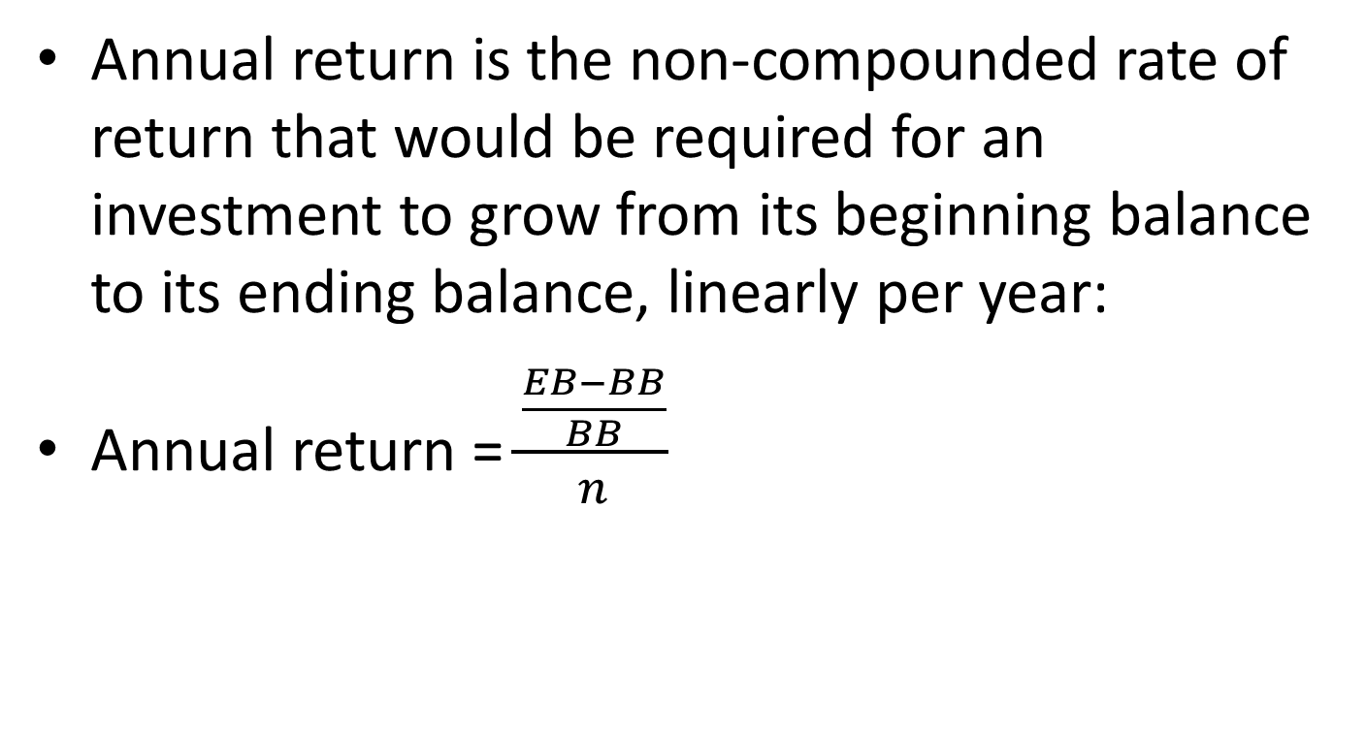
Annual Return
Annual return is the non-compounded rate of return that would be required for an investment to grow from its beginning balance to its ending balance, linearly per year:
Annual return = $\frac{\frac{EB−BB}{BB}}{n}$

Slide 12
CAGR
Compound annual growth rate (CAGR) is the rate of return that would be required for an investment to grow from its beginning balance to its ending balance, assuming the profits were reinvested at the end of each year of the investment’s lifespan.

Slide 13
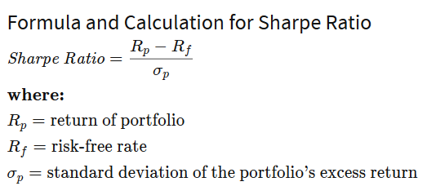
Sharpe Ratio
The ratio is the average return earned in excess of the risk-free rate per unit of volatility or total risk.
Simplified: (period ** (1.0/2.0)) * np.mean(dailyRet) / np.std(dailyRet)
period=365 days in a year
period=252 trading days in a year (stricter)
annualization_factor = period ** (1.0/2.0)

Slide 14
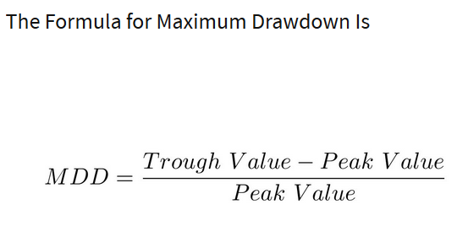
MDD
A maximum drawdown (MDD) is the maximum observed loss from a peak to a trough of a portfolio, before a new peak is attained. Maximum drawdown is an indicator of downside risk over a specified time period.

Slide 15
MDD program
def calculateMaxDD(cumret):
highwatermark = np.zeros(len(cumret))
drawdown = np.zeros(len(cumret))
drawdownduration = np.zeros(len(cumret))
for t in range(1, len(cumret)):
highwatermark[t] = np.max([highwatermark[t-1], cumret[t]])
drawdown[t] = (1+cumret[t]) / (1 + highwatermark[t]) - 1
if (drawdown[t]==0):
drawdownduration[t] = 0
else:
drawdownduration[t] = drawdownduration[t-1] + 1
return np.min(drawdown), np.max(drawdownduration)

Slide 16
Calmar Ratio
The Calmar ratio is a comparison of the average annual compounded rate of return and the maximum drawdown risk of commodity trading advisors and hedge funds. The lower the Calmar ratio, the worse the investment performed on a risk-adjusted basis over the specified time period; the higher the Calmar ratio, the better it performed.
Simplified: -cagr/maxDD

Slide 17

cplex_MAIN.py 6

Slide 18
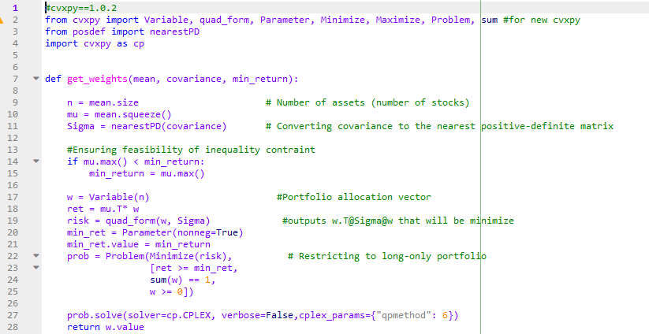
cplex_MODULE.py

Slide 19
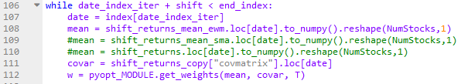
pyopt_MAIN.py (in PyPortfolioOpt.rar)

Slide 20
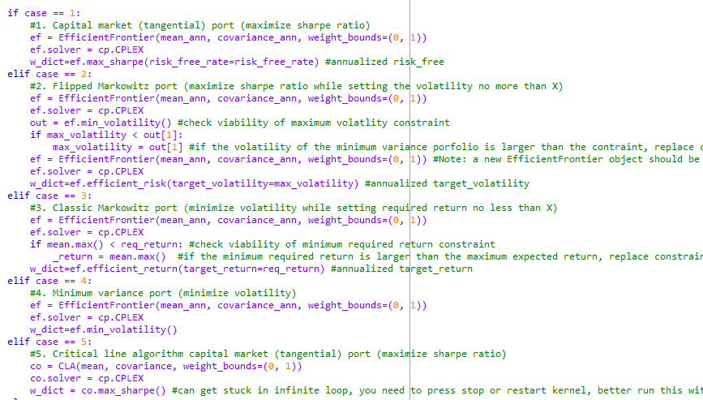
pyopt_MODULE.py

Slide 21

PyPortfolioOpt Documentation
https://pyportfolioopt.readthedocs.io/en/latest/
https://github.com/robertmartin8/PyPortfolioOpt

Slide 22
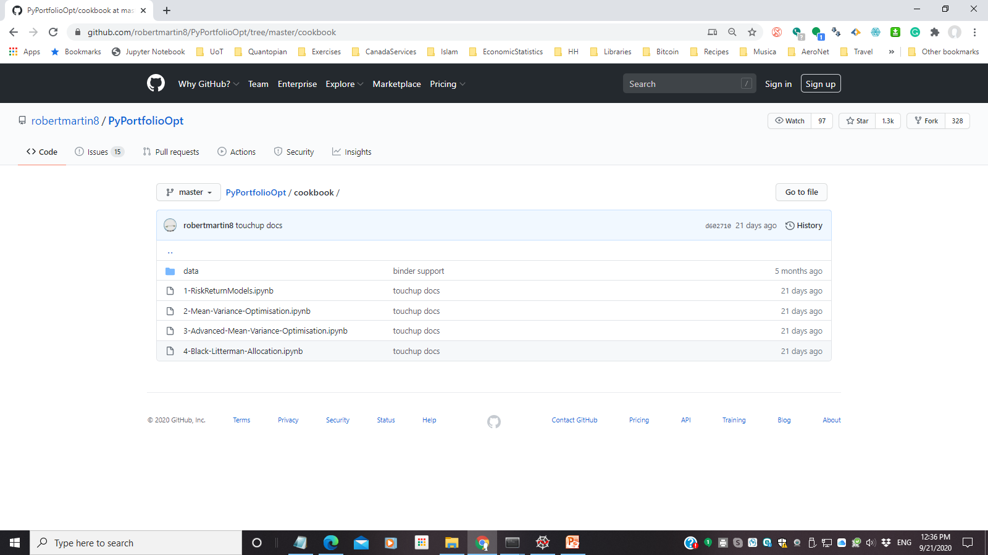
PyPortfolioOpt Cookbook
https://github.com/robertmartin8/PyPortfolioOpt/tree/master/cookbook

Slide 23
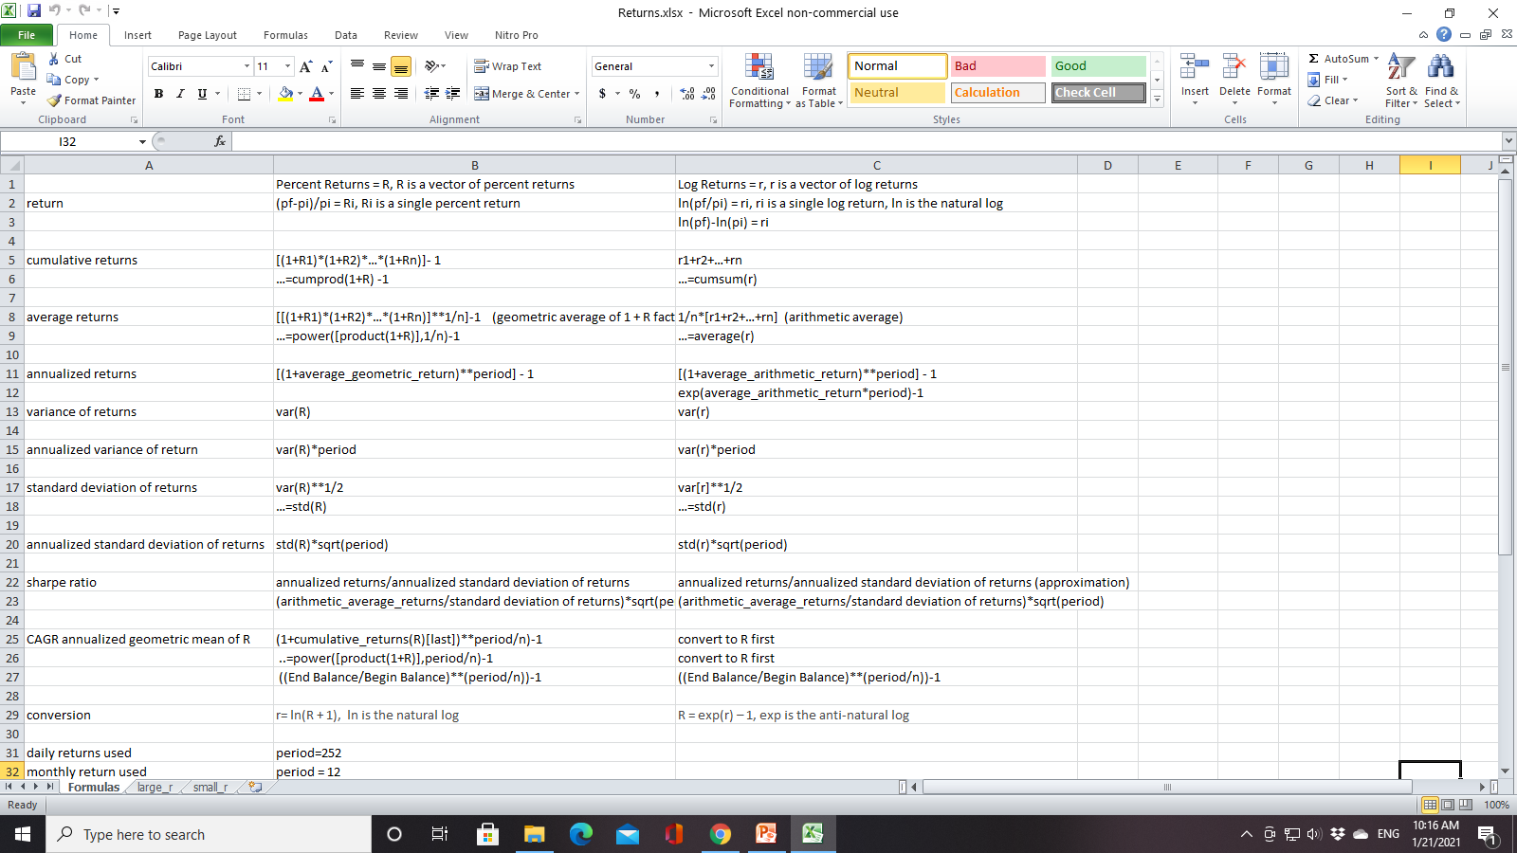
Returns.xlsx

