Slide 1
Python Programming Language

Slide 2
Python Variables
Variable is a name which is used to refer memory location. Variable also known as identifier and used to hold value.
In Python, we don't need to specify the type of variable because Python is a type infer language and smart enough to get variable type.
Variable names can be a group of both letters and digits, but they have to begin with a letter or an underscore.
It is recommended to use lowercase letters for variable name. Rahul and rahul both are two different variables.

Slide 3
Identifier Naming
Variables are the example of identifiers. An Identifier is used to identify the literals used in the program.
The rules to name an identifier are given below.
The first character of the variable must be an alphabet or underscore ( _ ).
All the characters except the first character may be an alphabet of lower-case(a-z), upper-case (A-Z), underscore or digit (0-9).
Identifier name must not contain any white-space, or special character (!, @, #, %, ^, &, *).
Identifier name must not be similar to any keyword defined in the language.
Identifier names are case sensitive for example my name, and MyName is not the same.
Examples of valid identifiers : a123, _n, n_9, etc.
Examples of invalid identifiers: 1a, n%4, n 9, etc.

Slide 4
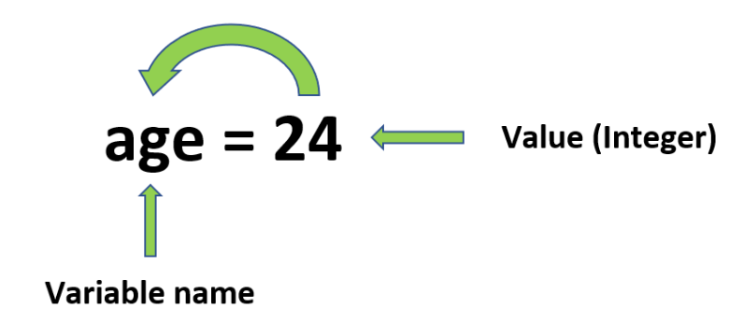
Declaring Variable and Assigning values
Python does not bound us to declare variable before using in the application. It allows us to create variable at required time.
We don't need to declare explicitly variable in Python. When we assign any value to the variable that variable is declared automatically.
A= 10
Name= ‘ravi’
Salary = 20000

Slide 5
Assign Multiple Values
We can apply multiple assignments in two ways either by
assigning a single value to multiple variables
or assigning multiple values to multiple variables
Many Values to Multiple Variables | One Value to Multiple Variables
x, y, z = "Orange", "Banana", "Cherry“ | x = y = z = "Orange“
a,b,c= 50,20,30 | a = b = c = 50

Slide 6
Python Data Types
Variables can hold values of different data types.
Every value in Python has a datatype. Since everything is an object in Python programming, data types are actually classes and variables are instance (object) of these classes.
Python is a dynamically typed language hence we need not define the type of the variable while declaring it. The interpreter implicitly binds the value with its type.
Python enables us to check the type of the variable used in the program. Python provides us the type() function which returns the type of the variable passed.
Consider the following example to define the values of different data types and checking its type.

Slide 7
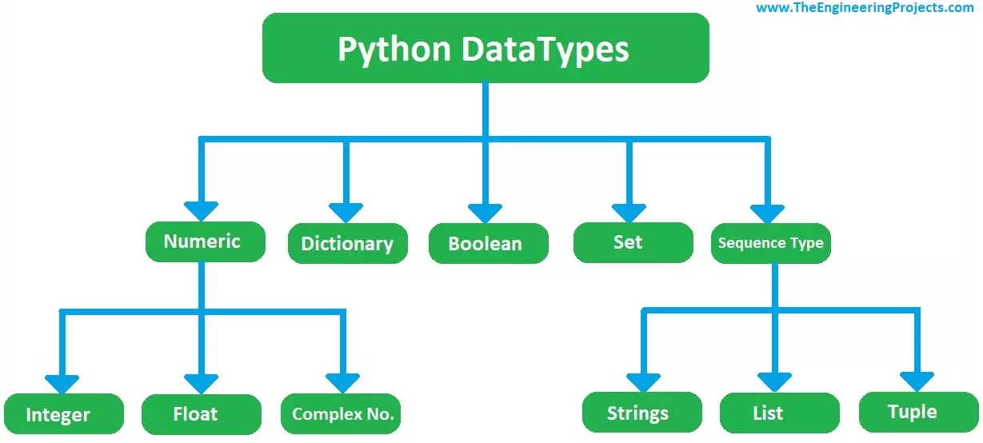

Slide 8
Integer in Python
Integer (int) data type only holds integer numbers, it could be positive or negative.
Here's a declaration of a variable x and it is assigned a value a of integer 20:
x = int(20)
x = 20

Slide 9
Float in Python
Float data types are used to hold decimal numerical values i.e. 2.13, 3.14 etc.
We can also save whole numbers in float data types.
Here's a declaration of a variable x and it is assigned a value a of float 20.5:
x = float(20.5)

Slide 10
Complex Numbers in Python
Complex Number data types is used to keep complex numbers in it. Complex numbers are those numerical values which have real & imaginary part.
That's the versatility of python language, I haven't seen complex number data type in any other programming language.
Here's a declaration of a variable x and it is assigned a complex number 1+3j:
x = complex(1+3j)

Slide 11
Boolean in Python
Boolean is the simplest data type of all and has just two values assigned to it i.e. True or False.
Although it's quite simple but its too handy as we have to use it a lot in IF statements. ( We will cover that later )
Here's a declaration of a variable x, assigned a Boolean data type and it's TRUE:
x = bool(1)

Slide 12
Strings in Python
A string is used to save one or more characters and it's the most commonly used data type.
Let's understand it with a simple example: You must have seen greeting messages on different projects, we save such data in strings.
We will discuss strings in detail in our next slide, where we will perform different operations using strings.
Here's a declaration of a variable x, which is assigned a string "Hello World":
x = str("Hello World")

Slide 13
Cont’d
The string can be defined as the sequence of characters represented in the quotation marks. In python, we can use single, double, or triple quotes to define a string.
String handling in python is a straightforward task since there are various inbuilt functions and operators provided.
In the case of string handling, the operator + is used to concatenate two strings as the operation "hello"+" python" returns "hello python".
The operator * is known as repetition operator as the operation "Python " *2 returns "Python Python ".

Slide 14
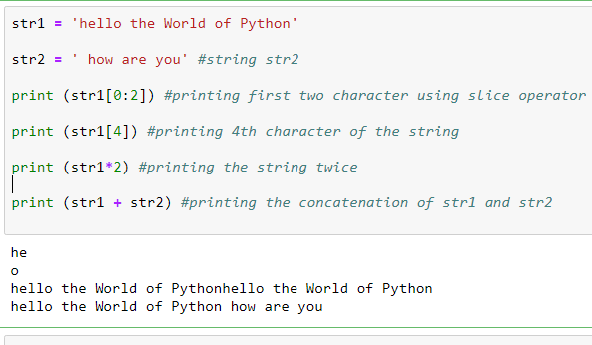

Slide 15
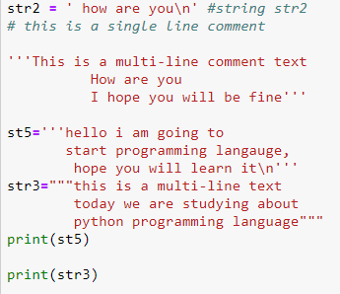

Slide 16
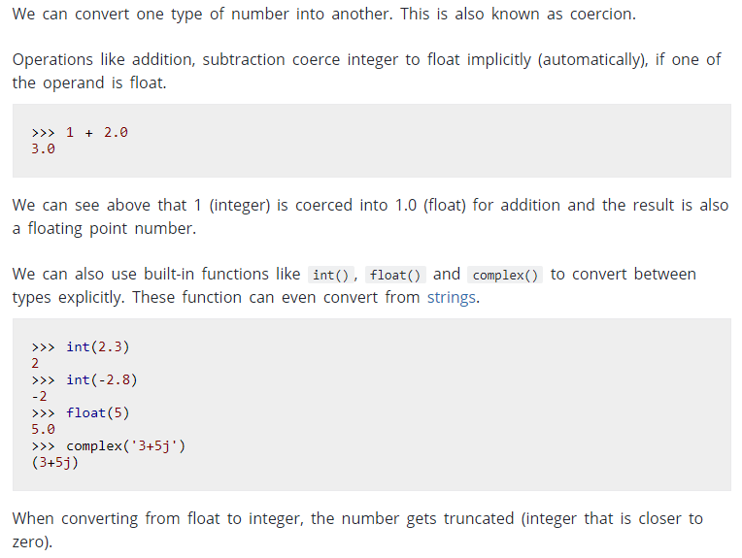
Python Casting
Type Conversion

