Slide 1

Library Project
A Brief Overview
By Mohamed Mabrouk

Slide 2
Introduction
Objective:
The objective of this project is to analyze library usage data to uncover patterns and insights that can inform decision-making and improve library services.
Scope:
This presentation will cover the following:
Background and motivation
Data collection and description
Data cleaning and preparation
Exploratory data analysis (EDA)
Results and interpretation
Recommendations and future work

Slide 3
Background and Motivation
Context:
Libraries are vital community resources, and understanding how patrons use these services can help enhance their offerings.
Problem Statement:
We aim to identify usage patterns and factors influencing library engagement, focusing on total checkouts and renewals.

Slide 4
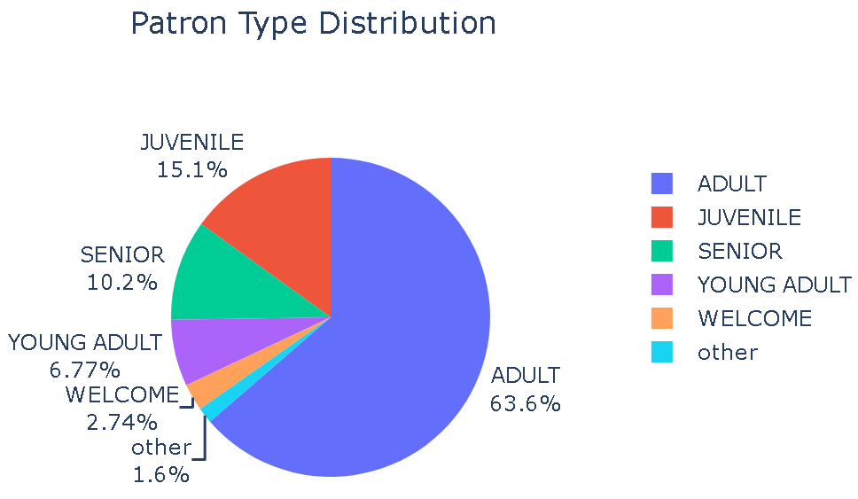
Data Collection
Data Sources:
The dataset was sourced from the library's internal database, including information on patron demographics, checkouts, renewals, and more.
Data Description:
Size: 423,448 records
Key Variables: Patron Type Definition, Total Checkouts,
Total Renewals, Home Library Definition, Circulation Active Year, etc.

Slide 5
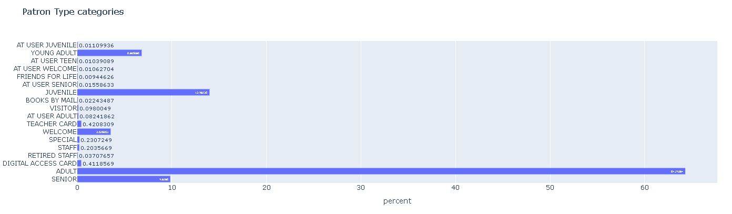
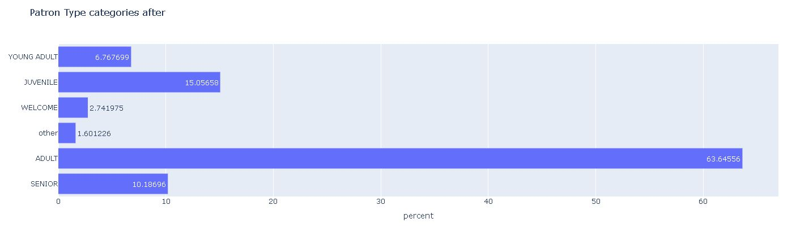
Data Cleaning and Preparation
Data Cleaning Steps:
Removed duplicates
Identified and treated outliers by capping
Combined multiple low impact categories into one e.g. : 'Patron Type Definition' went from 18 categories down to 6
Handled missing values by filling with modes or using forward/backward fill (after analysis)
Tools Used:
Python (Pandas, NumPy), Plotly

Slide 6
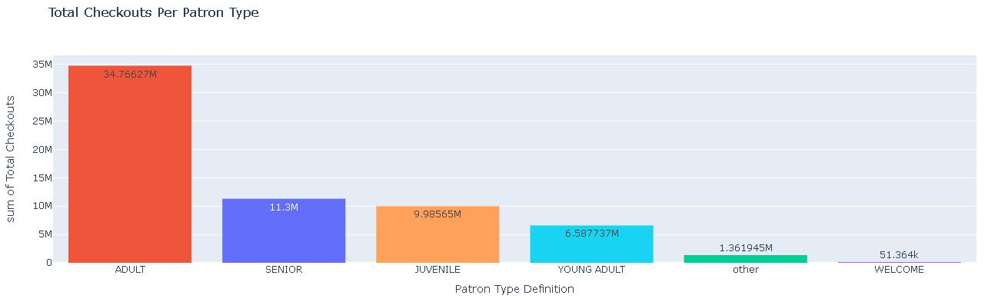
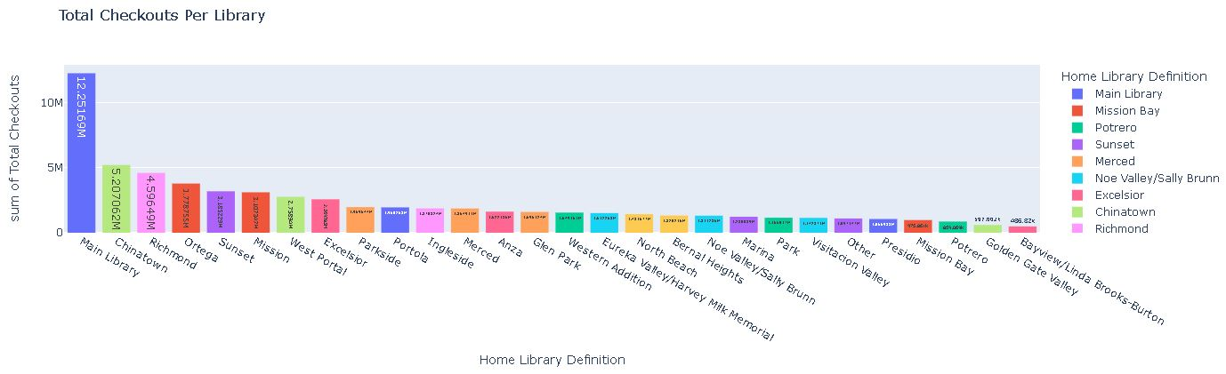
Exploratory Data Analysis (EDA)
Visualizations:
Distribution of Total Checkouts by Patron Type Definition
Key Findings:
Most frequent library users are adults
A significant number of checkouts from main libraries

Slide 7
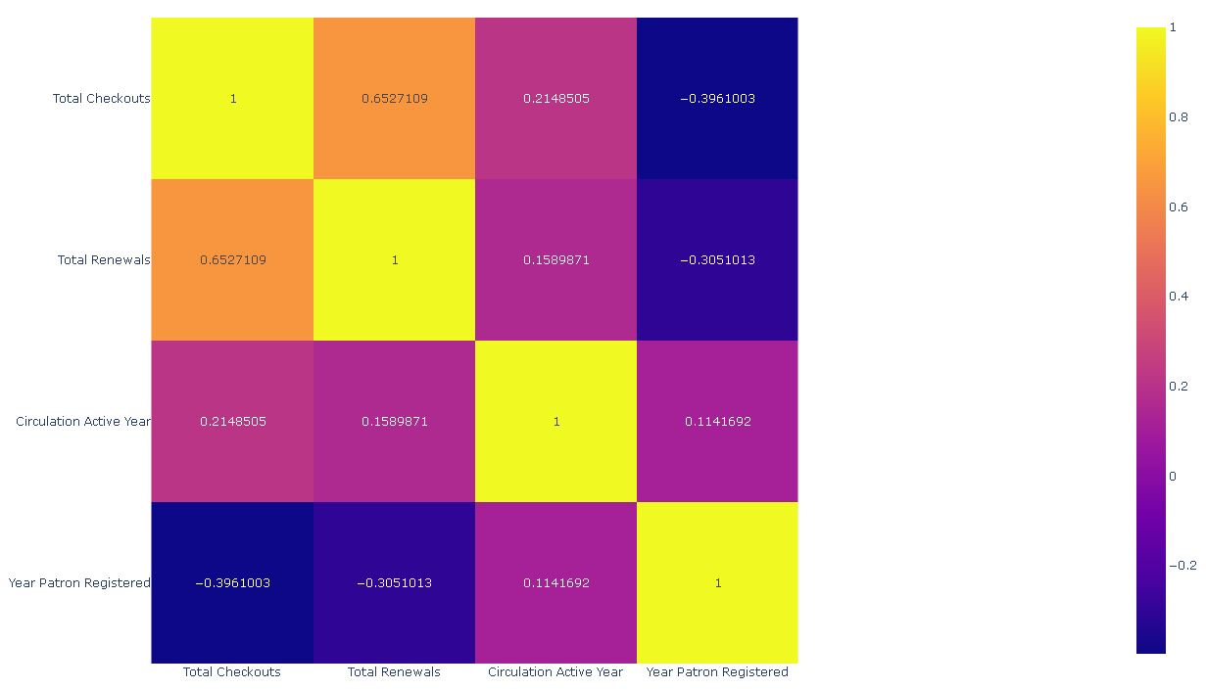
Data Analysis Methodology
Techniques Used:
Descriptive statistics for summary
Correlation analysis to identify relationships between features
Data transformations to handle skewness
Rationale:
These methods were chosen to provide a comprehensive understanding of the data and to prepare it for further predictive analysis.

Slide 8
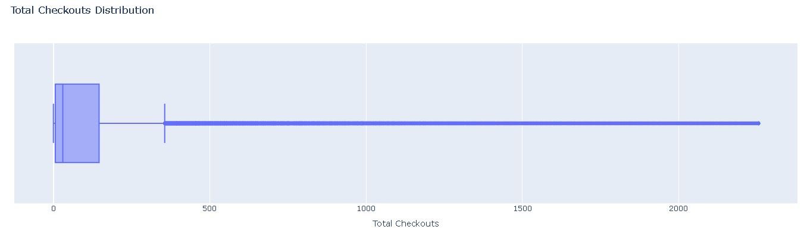
Results
Key Results:
High correlation between Total Checkouts and Total Renewals
Significant outliers in checkouts, indicating heavy users

Slide 9
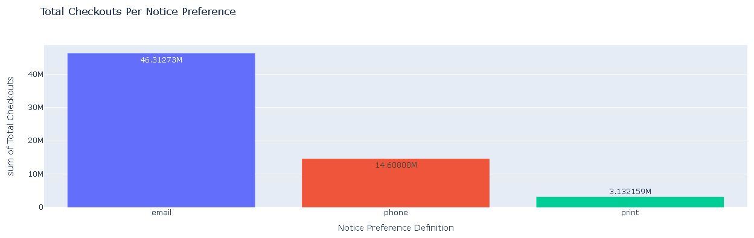
Interpretation of Results
Insights:
Heavy users drive a significant portion of library checkouts
Email is the preferred method of receiving notices
Relevance:
These insights can guide targeted marketing and resource allocation to enhance library services.

Slide 10
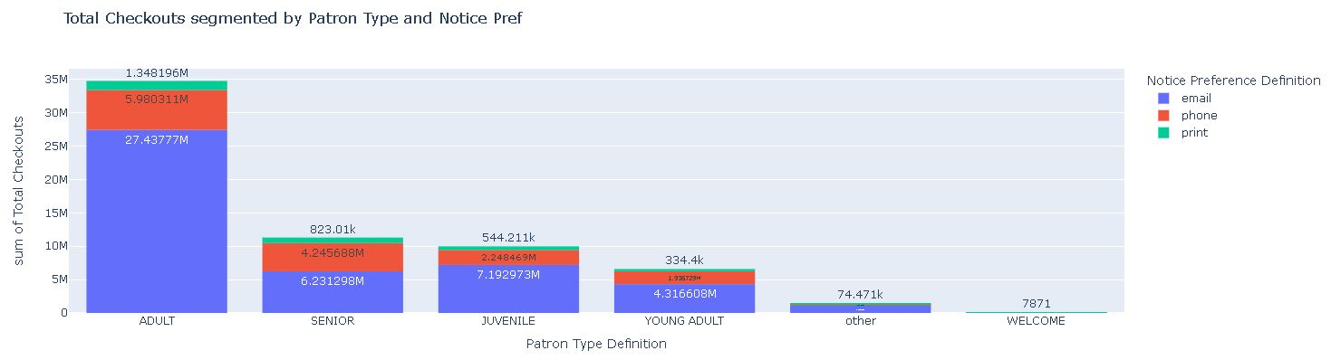
Recommendations
Actionable Steps:
Increase engagement programs for less active user groups
Optimize resources for high-demand libraries
Potential Impact:
Improved user satisfaction and more efficient library operations.

Slide 11
Challenges and Limitations
Challenges:
Handling missing values and outliers
Ensuring data consistency across different libraries
Limitations:
Data is limited to the records available, which may not capture all usage patterns
Potential biases in the data collection process

Slide 12
Future Work
Next Steps:
Implement predictive models to forecast library usage trends
Conduct a survey to complement the existing data
Improvements:
Collect more granular data on user interactions
Integrate data from additional sources for a more comprehensive analysis

Slide 13
Conclusion
Summary:
The analysis provides valuable insights into library usage patterns, highlighting the importance of targeted services and resource optimization.
Final Thoughts:
Continued data analysis and user feedback will be essential in adapting to the evolving needs of library patrons.

Slide 14
Q&A
Questions:
Feel free to ask any questions regarding the analysis and findings.
Contact Information:
m.mabrouk.data@gmail.com

Slide 15
Thank You
Closing:
Thank you for your attention.
Acknowledgments:
Special thanks to Eng. Tarek Ziad and Epsilon AI for all their efforts

