Slide 2
Statistics 101 by Mathies Brinks Sørensen (PhD candidate)
Course 26301

Slide 3
Content
Introduction
Descriptive statistics
Evaluation of uncertainties
Density functions
T-distribution and hypothesis testing
Confidence intervals

Slide 4
Introduction
What is statistics?
Common or popular definition: A collect of data showing a plot or a graph related to a specific topic (newspapers, gallop, Danmarks statistik lookup, ect.)
In science: Descriptive or exploratory statistic
Broader, more correct definition: How to learn from data to make intelligent decisions
In science: Inferential statistics
Some big fields of inferential statistics:
Chemometrics
Epidemiology
Quality control
Signal processing
Machine learning & deep learning

Slide 5
Introduction
Why is Statistics important?
Gives the ability to learn from data
Making scientific results comparable
Rules of results based on luck (if done probably)
Interesting note:
New England Journal of medicine pointed out in 2000 the 11 most influential points for the advances in health of mankind. Application of statistics to medicine was one of them compared to the likes of discovering penicillin and anesthesia.
How does this helps us?
We can evaluate the robustness of experimental results
We can compare experimental results in different setting
We can predict behavior of chemical systems given data
We can maximize the value of experiments by using statistical experimental designs

Slide 6

Introduction
The idea statistical analysis
Design experiments to match hypothesis
Design measurement strategy to minimize nuisance influence
Investigate results:
Confirm or reject hypothesis
Formulate a hypothesis
Question: where do you think most people fails when testing out a hypothesis? And why?
High precision and accuracy
low precision and high accuracy
low precision and accuracy
High precision and low accuracy

Slide 7
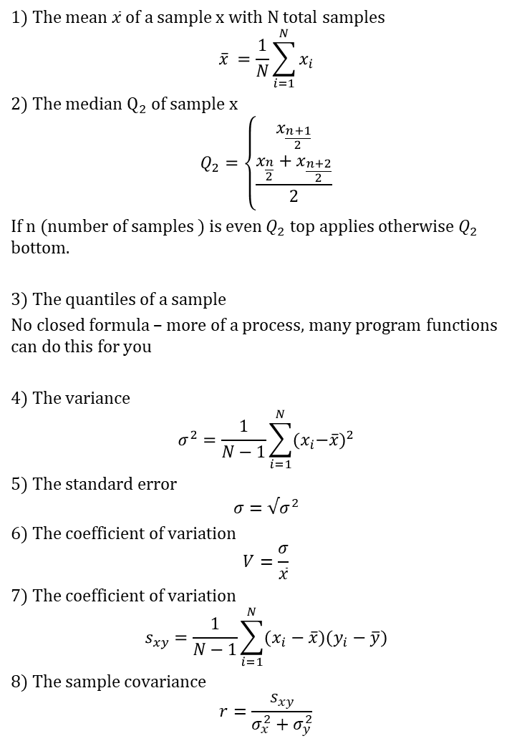
Descriptive statistics
1) The mean $\overline{x}$ of a sample x with N total samples
$$\overline{x} =\frac{1}{N}\sum_{i=1}^{N}{x_{i}}$$
2) The median $Q_{2}$ of sample x
$$Q_{2}=\left\{\begin{aligned}x_{\frac{n+1}{2}} \\ \frac{x_{\frac{n}{2}}+x_{\frac{n+2}{2}}}{2}\end{aligned}\right.$$
If n (number of samples ) is even $Q_{2}$ top applies otherwise $Q_{2}$ bottom.
3) The quantiles of a sample
No closed formula – more of a process, many program functions can do this for you
4) The variance
$$σ^{2}=\frac{1}{N−1}\sum_{i=1}^{N}{{{(x}_{i}−\overline{x})}^{2}}$$
5) The standard error
$$σ=√σ^{2}$$
6) The coefficient of variation
$$V=\frac{σ}{\overline{x}}$$
7) The coefficient of variation
$$s_{xy}=\frac{1}{N−1}\sum_{i=1}^{N}{(x_{i}−\overline{x})(y_{i}−\overline{y})}$$
8) The sample covariance
$$r=\frac{s_{xy}}{σ_{x}^{2}+σ_{y}^{2}}$$
Measures of centrality
Mean
Median
Quantiles
Measures of variability
Variance
Standard deviation
Coefficient of variation
Measures of relation
Covariance
Correlation
Important: The quality of your centrality depends on the variability!

Slide 8
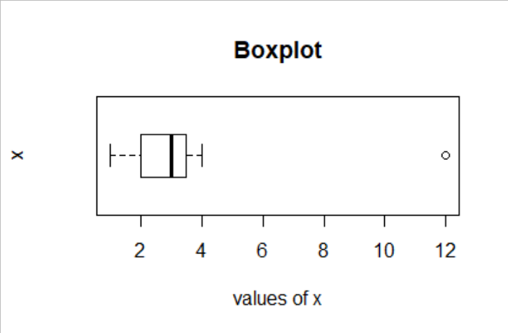
Descriptive statistics
Outliers
These are measurements that affect your data estimates by having an extreme value compare to the rest of the data
Spot the outliers via a boxplot
Mitigate outliers by using median instead of the mean
Remove outliers (careful consideration though!)

Slide 9
Evaluation of uncertainties
What is uncertainty?
A cause of data being recorded under imperfect conditions or a lack of information in data.
Solutions
The perfect solution: Get all data in the world of a specific case (impossible!)
The next best thing: Take samples to make up a dataset, downside you get is uncertainty or error.
Questions:
What types of error affects my sample estimates?
How to quantify this/these error?
How many samples should I make?
Hint what happens to your estimates if you make more samples?

Slide 10
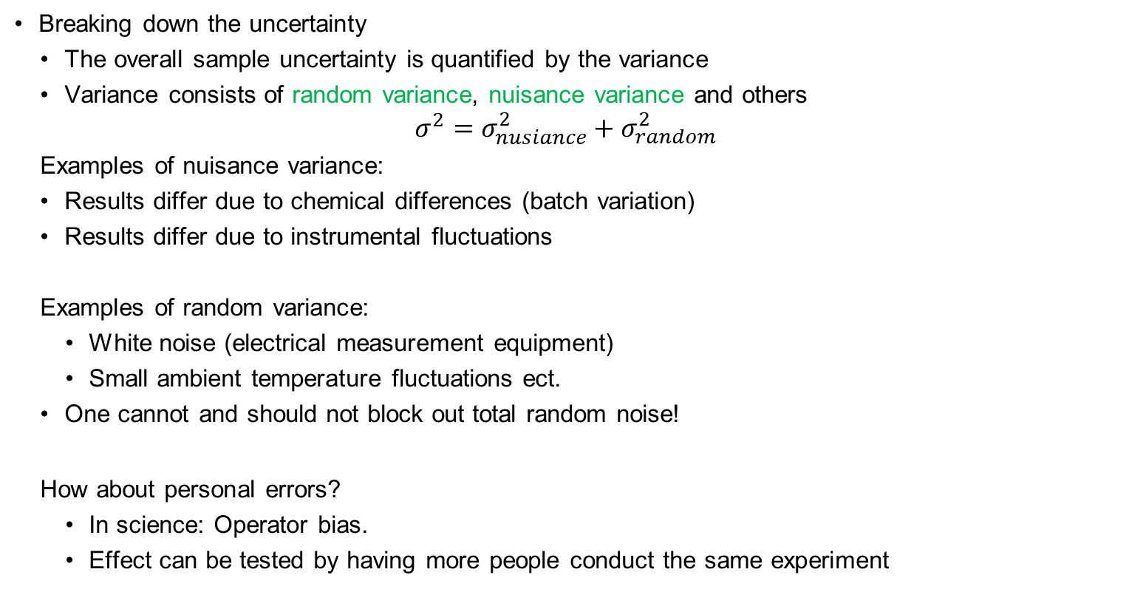
Evaluation of uncertainties
Breaking down the uncertainty
The overall sample uncertainty is quantified by the variance
Variance consists of random variance, nuisance variance and others
$$σ^{2}={σ_{nusiance}^{2}+σ}_{random}^{2}$$
Examples of nuisance variance:
Results differ due to chemical differences (batch variation)
Results differ due to instrumental fluctuations
Examples of random variance:
White noise (electrical measurement equipment)
Small ambient temperature fluctuations ect.
One cannot and should not block out total random noise!
How about personal errors?
In science: Operator bias.
Effect can be tested by having more people conduct the same experiment

Slide 11
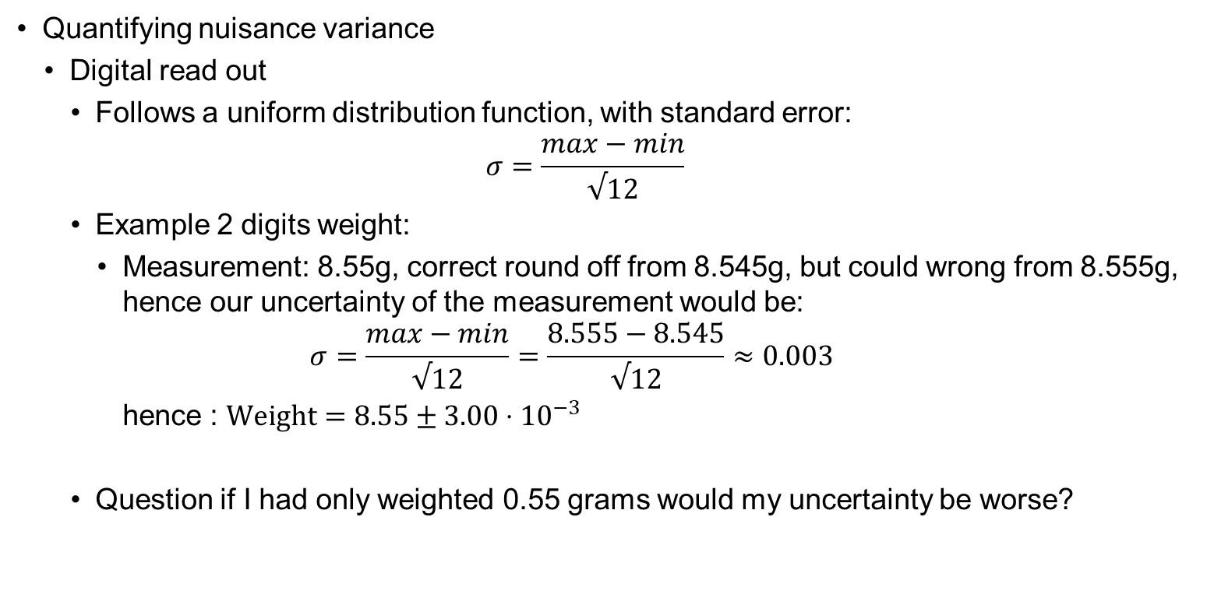
Evaluation of uncertainties
Quantifying nuisance variance
Digital read out
Follows a uniform distribution function, with standard error:
$$σ=\frac{max−min}{√12}$$
Example 2 digits weight:
Measurement: 8.55g, correct round off from 8.545g, but could wrong from 8.555g, hence our uncertainty of the measurement would be:
$$σ=\frac{max−min}{√12}=\frac{8.555−8.545}{√12}≈0.003$$
hence : $Weight=8.55±3.00⋅{10}^{−3}$
Question if I had only weighted 0.55 grams would my uncertainty be worse?

Slide 12
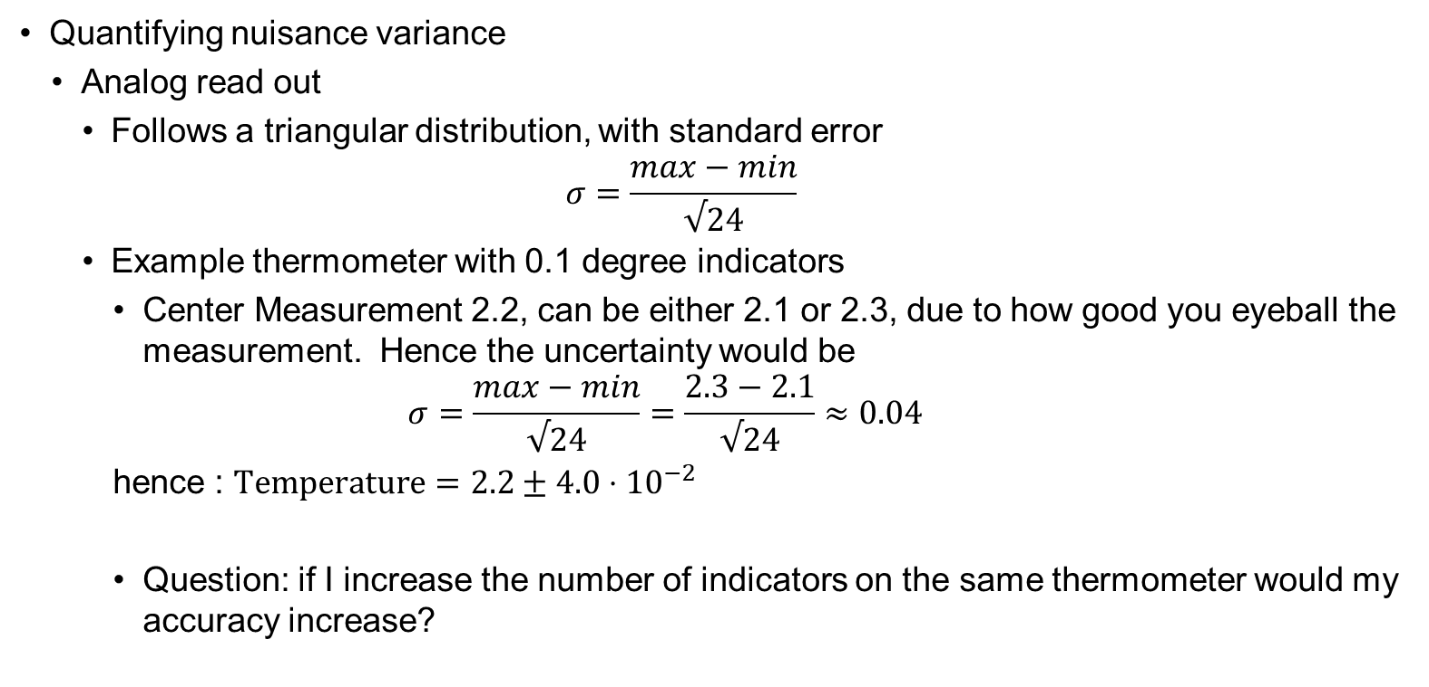
Evaluation of uncertainties
Quantifying nuisance variance
Analog read out
Follows a triangular distribution, with standard error
$$σ=\frac{max−min}{√24}$$
Example thermometer with 0.1 degree indicators
Center Measurement 2.2, can be either 2.1 or 2.3, due to how good you eyeball the measurement. Hence the uncertainty would be
$$σ=\frac{max−min}{√24}=\frac{2.3−2.1}{√24}≈0.04$$
hence : $Temperature=2.2±4.0⋅{10}^{−2}$
Question: if I increase the number of indicators on the same thermometer would my accuracy increase?

Slide 13
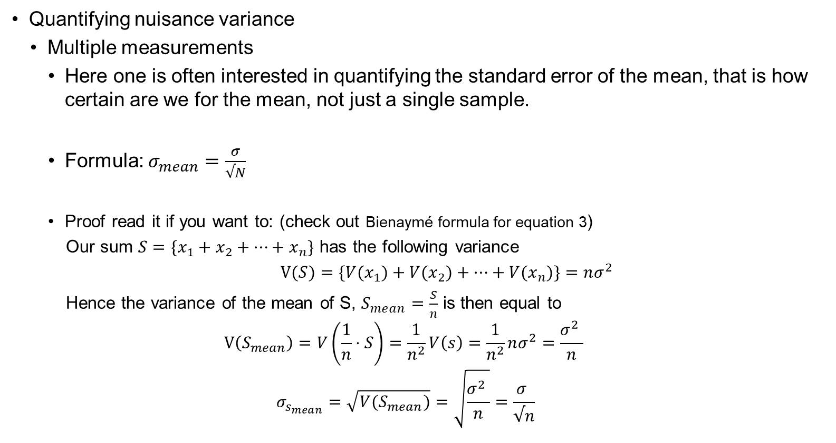
Evaluation of uncertainties
Quantifying nuisance variance
Multiple measurements
Here one is often interested in quantifying the standard error of the mean, that is how certain are we for the mean, not just a single sample.
Formula: $σ_{mean}=\frac{σ}{√N}$
Proof read it if you want to: (check out Bienaymé formula for equation 3)
Our sum $S=\{x_{1}+x_{2}+…+x_{n}\}$ has the following variance
$V(S)=\{V(x_{1})+V(x_{2})+…+{V(x}_{n})\}=nσ^{2}$
Hence the variance of the mean of S, $S_{mean}=\frac{S}{n}$ is then equal to
$$V\left(S_{mean}\right)=V\left(\frac{1}{n}⋅S\right)=\frac{1}{n^{2}}V\left(s\right)=\frac{1}{n^{2}}nσ^{2}=\frac{σ^{2} }{n}$$
$$σ_{s_{mean}}=\sqrt{V(S_{mean})}=\sqrt{\frac{σ^{2} }{n}}=\frac{σ }{√n}$$
Question: how can we increase the certainty of out mean?

Slide 14
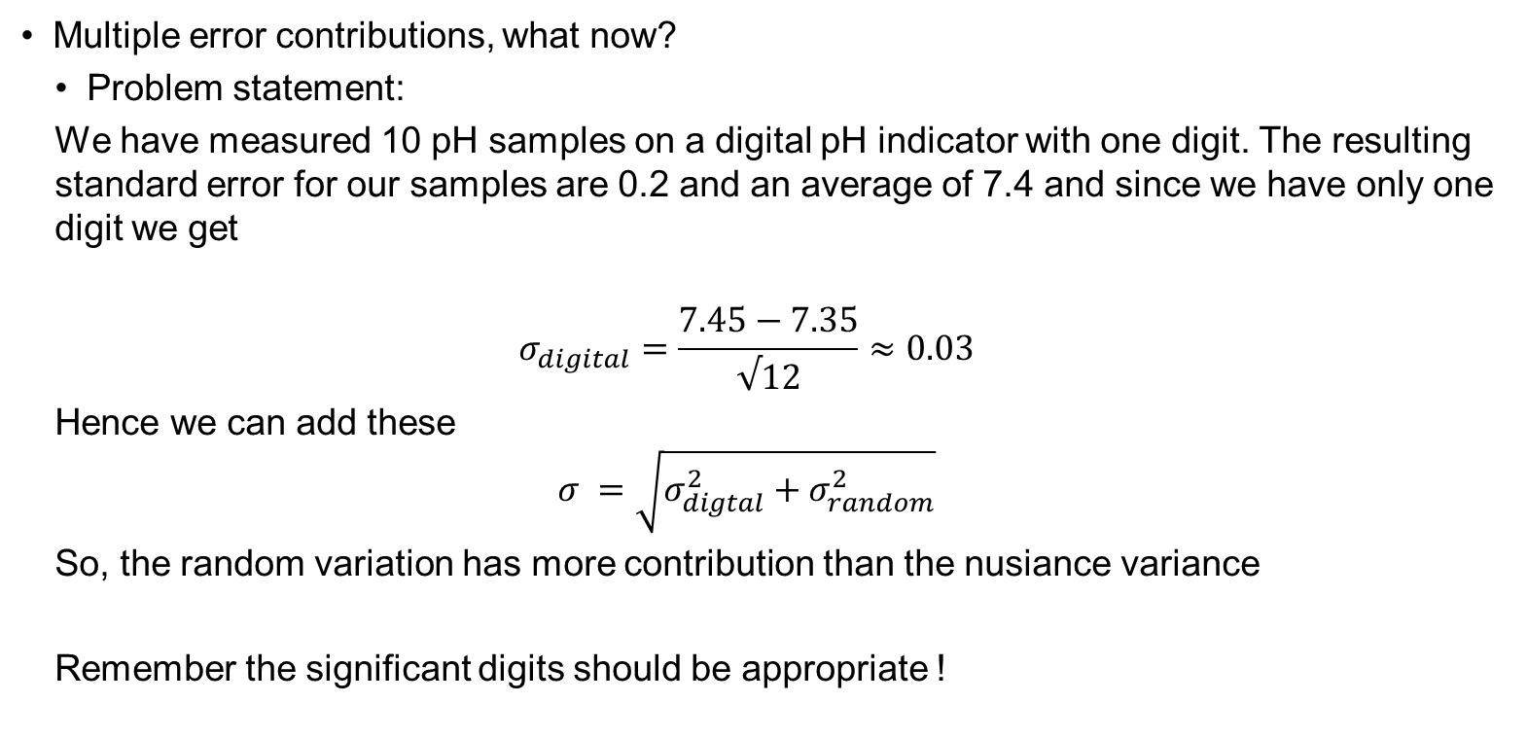
Evaluation of uncertainties
Multiple error contributions, what now?
Problem statement:
We have measured 10 pH samples on a digital pH indicator with one digit. The resulting standard error for our samples are 0.2 and an average of 7.4 and since we have only one digit we get
$$σ_{digital}=\frac{7.45−7.35}{√12}≈0.03$$
Hence we can add these
$$σ =\sqrt{{σ_{digtal}^{2}+σ}_{random}^{2}}$$
So, the random variation has more contribution than the nusiance variance
Remember the significant digits should be appropriate !

Slide 15
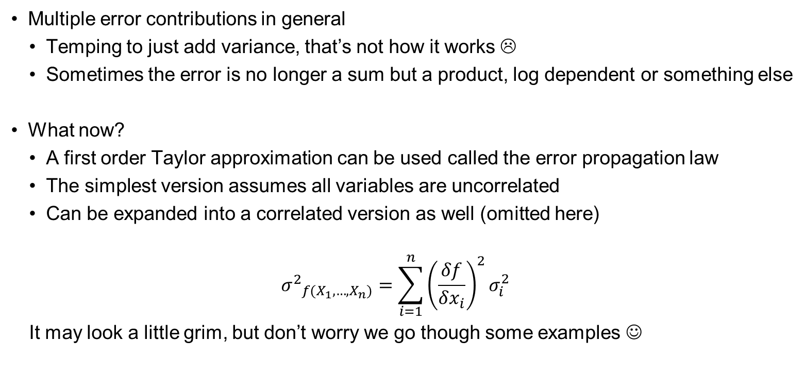
Evaluation of uncertainties
Multiple error contributions in general
Temping to just add variance, that’s not how it works ☹
Sometimes the error is no longer a sum but a product, log dependent or something else
What now?
A first order Taylor approximation can be used called the error propagation law
The simplest version assumes all variables are uncorrelated
Can be expanded into a correlated version as well (omitted here)
$${σ^{2}}_{f(X_{1},…,X_{n})}=\sum_{i=1}^{n}{{\left(\frac{δf}{δx_{i}}\right)}^{2}σ_{i}^{2}}$$
It may look a little grim, but don’t worry we go though some examples ☺

Slide 16
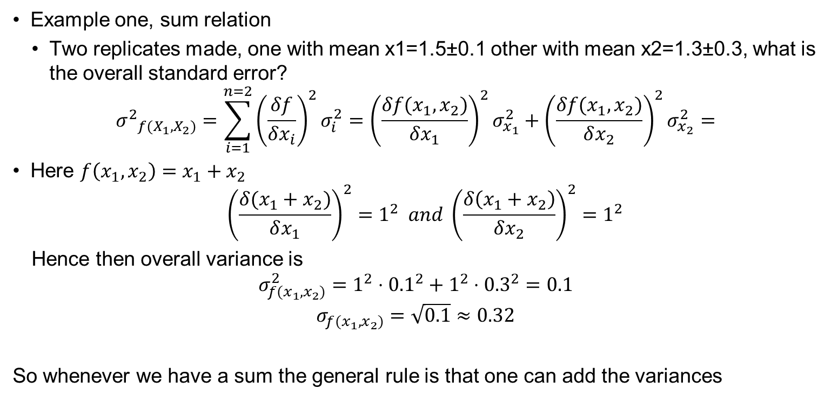
Evaluation of uncertainties
Example one, sum relation
Two replicates made, one with mean x1=1.5±0.1 other with mean x2=1.3±0.3, what is the overall standard error?
$${σ^{2}}_{f(X_{1},X_{2})}=\sum_{i=1}^{n=2}{{\left(\frac{δf}{δx_{i}}\right)}^{2}σ_{i}^{2}={\left(\frac{δf(x_{1},x_{2})}{δx_{1}}\right)}^{2}σ_{x_{1}}^{2}+{\left(\frac{δf(x_{1},x_{2})}{δx_{2}}\right)}^{2}σ_{x_{2}}^{2}=}$$
Here $f\left(x_{1},x_{2}\right)=x_{1}+x_{2}$
$${\left(\frac{δ(x_{1}+x_{2})}{δx_{1}}\right)}^{2}=1^{2} and {\left(\frac{δ\left(x_{1}+x_{2}\right)}{δx_{2}}\right)}^{2}=1^{2}$$
Hence then overall variance is
$$σ_{f(x_{1},x_{2})}^{2}=1^{2}⋅{0.1}^{2}+1^{2}⋅{0.3}^{2}=0.1$$
$$σ_{f(x_{1},x_{2})}=\sqrt{0.1}≈0.32$$
So whenever we have a sum the general rule is that one can add the variances

Slide 17
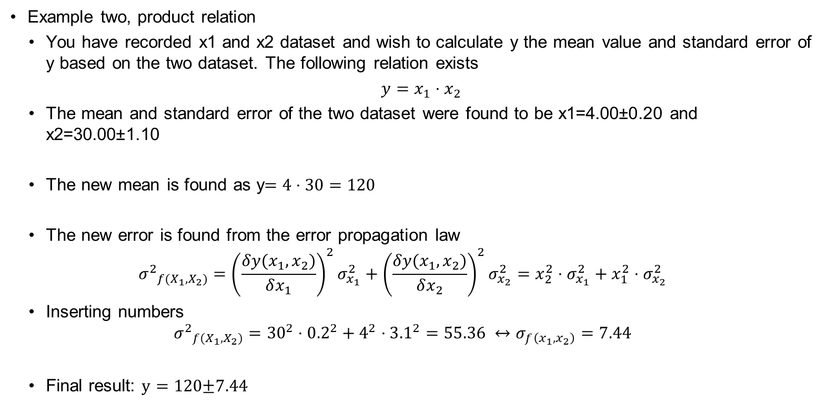
Evaluation of uncertainties
Example two, product relation
You have recorded x1 and x2 dataset and wish to calculate y the mean value and standard error of y based on the two dataset. The following relation exists
$y=x_{1}⋅x_{2}$
The mean and standard error of the two dataset were found to be x1=4.00±0.20 and x2=30.00±1.10
The new mean is found as y$=4⋅30=120$
The new error is found from the error propagation law
$${σ^{2}}_{f(X_{1},X_{2})}={\left(\frac{δy(x_{1},x_{2})}{δx_{1}}\right)}^{2}σ_{x_{1}}^{2}+{\left(\frac{δy(x_{1},x_{2})}{δx_{2}}\right)}^{2}σ_{x_{2}}^{2}=x_{2}^{2}⋅σ_{x_{1}}^{2}+x_{1}^{2}⋅σ_{x_{2}}^{2}$$
Inserting numbers
$${σ^{2}}_{f(X_{1},X_{2})}={30}^{2}⋅{0.2}^{2}+4^{2}⋅{3.1}^{2}=55.36 ↔σ_{f\left(x_{1},x_{2}\right)}=7.44$$
Final result: $y=120\text{±}\text{7.44}$

Slide 18
Evaluation of uncertainties
Calibration of measurements
Equipment:
Use a standard to calibrate the equipment before usage
Test with blanks for contaminations
Samples:
Make replicates
Use Quality control samples of replicates
Calibrate for batch to batch variations
Complete all of these steps and you have a solid measurement design. remember this for when you do your research, so many errors and or false conclusions can be avoided by doing the “boring” measurement design.

Slide 19
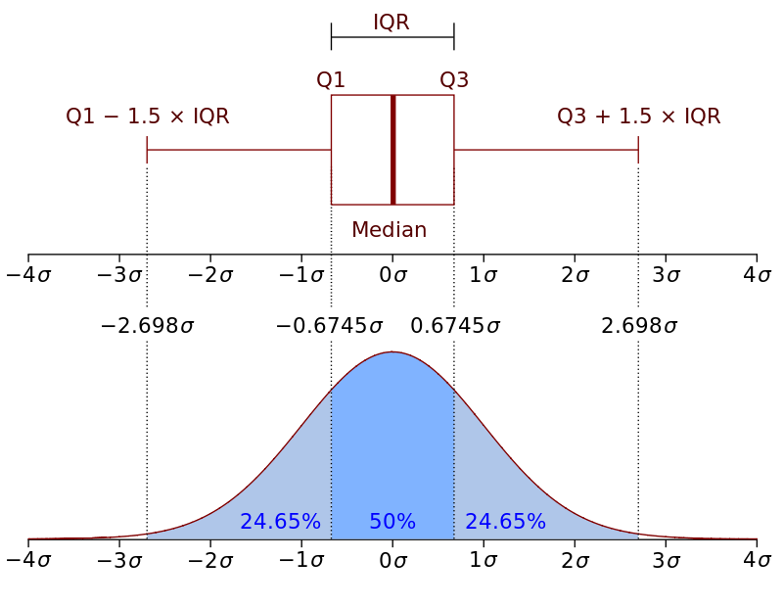
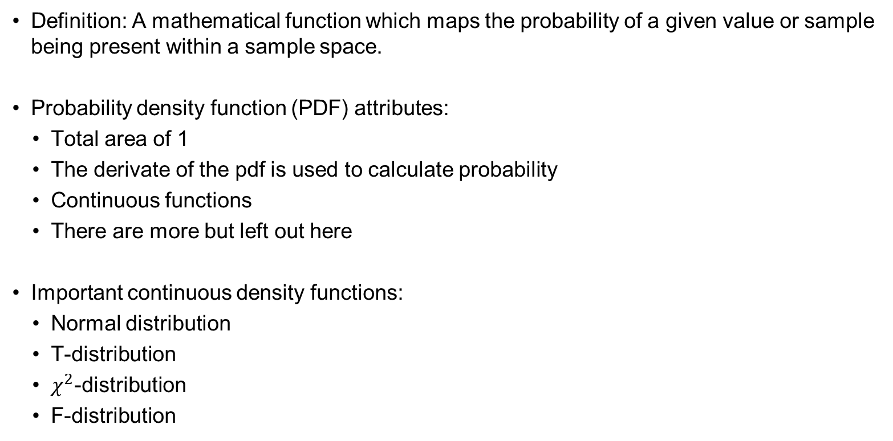
Density functions
Definition: A mathematical function which maps the probability of a given value or sample being present within a sample space.
Probability density function (PDF) attributes:
Total area of 1
The derivate of the pdf is used to calculate probability
Continuous functions
There are more but left out here
Important continuous density functions:
Normal distribution
T-distribution
$χ^{2}$-distribution
F-distribution

Slide 20
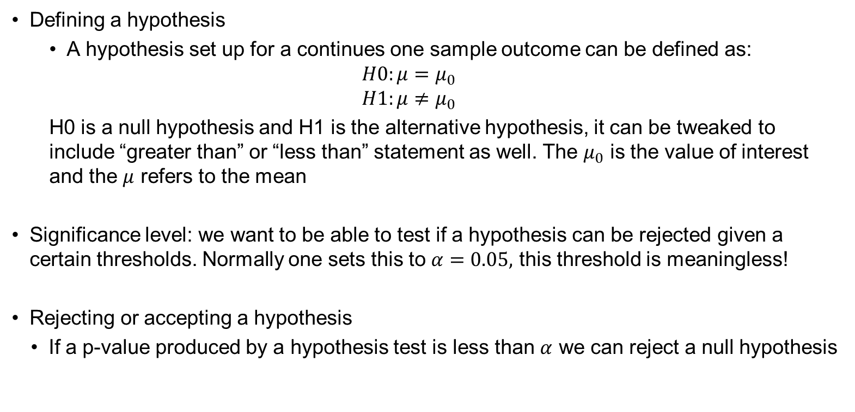
T-distribution and hypothesis testing
Defining a hypothesis
A hypothesis set up for a continues one sample outcome can be defined as:
$$H0:μ=μ_{0}$$
$$H1:μ≠μ_{0}$$
H0 is a null hypothesis and H1 is the alternative hypothesis, it can be tweaked to include “greater than” or “less than” statement as well. The $μ_{0}$ is the value of interest and the $μ$ refers to the mean
Significance level: we want to be able to test if a hypothesis can be rejected given a certain thresholds. Normally one sets this to $α=0.05,$ this threshold is meaningless!
Rejecting or accepting a hypothesis
If a p-value produced by a hypothesis test is less than $α$ we can reject a null hypothesis

Slide 21
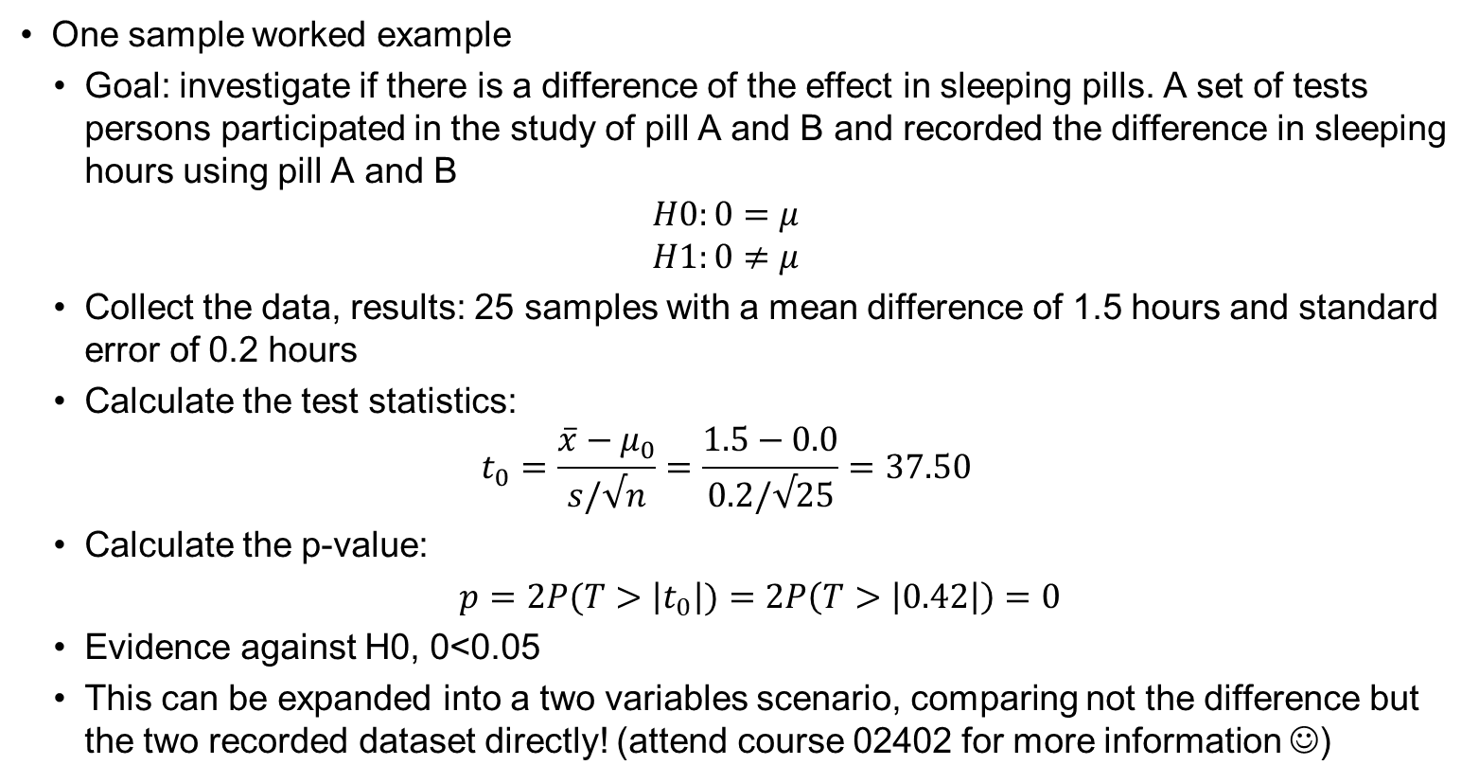
T-distribution and hypothesis testing
One sample worked example
Goal: investigate if there is a difference of the effect in sleeping pills. A set of tests persons participated in the study of pill A and B and recorded the difference in sleeping hours using pill A and B
$$H0:0=μ$$
$$H1:0≠μ$$
Collect the data, results: 25 samples with a mean difference of 1.5 hours and standard error of 0.2 hours
Calculate the test statistics:
$$t_{0}=\frac{\overline{x}−μ_{0}}{s/√n}=\frac{1.5−0.0}{0.2/√25}=37.50$$
Calculate the p-value:
$p=2P(T>\left|t_{0}\right|)=$ $2P\left(T>\left|0.42\right|\right)=0$
Evidence against H0, 0<0.05
This can be expanded into a two variables scenario, comparing not the difference but the two recorded dataset directly! (attend course 02402 for more information ☺)

Slide 22
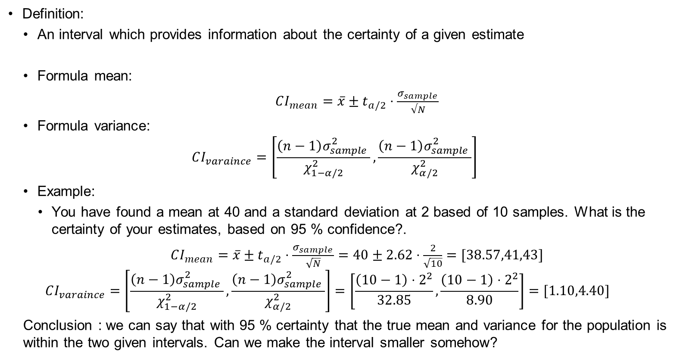
Confidence interval
Definition:
An interval which provides information about the certainty of a given estimate
Formula mean:
$CI_{mean}=\overline{x}±t_{a/2}⋅\frac{σ_{sample }}{√N}$
Formula variance:
$$CI_{varaince}=\left[\frac{\left(n−1\right)σ_{sample }^{2}}{χ_{1−α/2}^{2}},\frac{\left(n−1\right)σ_{sample }^{2}}{χ_{α/2}^{2}}\right]$$
Example:
You have found a mean at 40 and a standard deviation at 2 based of 10 samples. What is the certainty of your estimates, based on 95 % confidence?.
$CI_{mean}=\overline{x}±t_{a/2}⋅\frac{σ_{sample }}{\sqrt{N}}=40±2.62⋅\frac{2}{\sqrt{10}}=[38.57,41,43]$
$$CI_{varaince}=\left[\frac{\left(n−1\right)σ_{sample }^{2}}{χ_{1−α/2}^{2}},\frac{\left(n−1\right)σ_{sample }^{2}}{χ_{α/2}^{2}}\right]=\left[\frac{\left(10−1\right)⋅2^{2}}{32.85},\frac{\left(10−1\right)⋅2^{2}}{8.90}\right]=[1.10,4.40]$$
Conclusion : we can say that with 95 % certainty that the true mean and variance for the population is within the two given intervals. Can we make the interval smaller somehow?

Slide 23
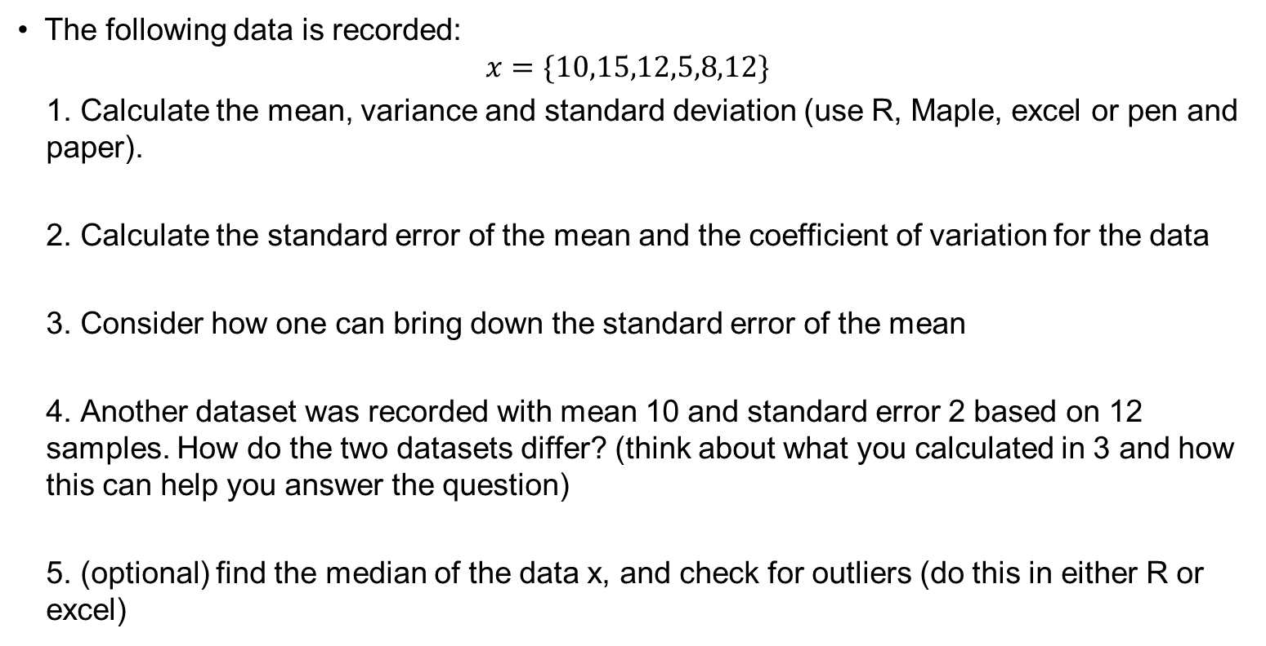
Small exercise 1
The following data is recorded:
$$x=\{10,15,12,5,8,12\}$$
1. Calculate the mean, variance and standard deviation (use R, Maple, excel or pen and paper).
2. Calculate the standard error of the mean and the coefficient of variation for the data
3. Consider how one can bring down the standard error of the mean
4. Another dataset was recorded with mean 10 and standard error 2 based on 12 samples. How do the two datasets differ? (think about what you calculated in 3 and how this can help you answer the question)
5. (optional) find the median of the data x, and check for outliers (do this in either R or excel)

Slide 24
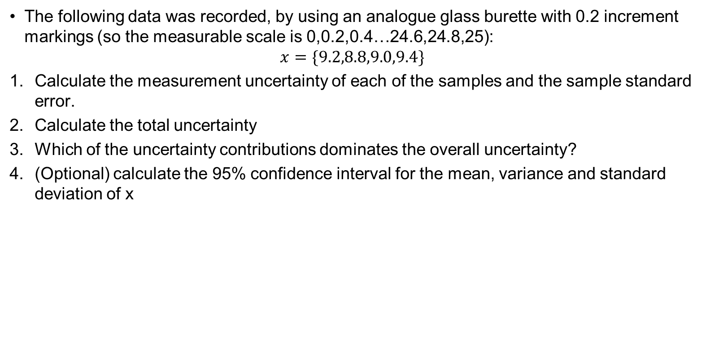
Small exercise 2
The following data was recorded, by using an analogue glass burette with 0.2 increment markings (so the measurable scale is 0,0.2,0.4…24.6,24.8,25):
$$x=\{9.2,8.8,9.0,9.4\}$$
Calculate the measurement uncertainty of each of the samples and the sample standard error.
Calculate the total uncertainty
Which of the uncertainty contributions dominates the overall uncertainty?
(Optional) calculate the 95% confidence interval for the mean, variance and standard deviation of x

Slide 25
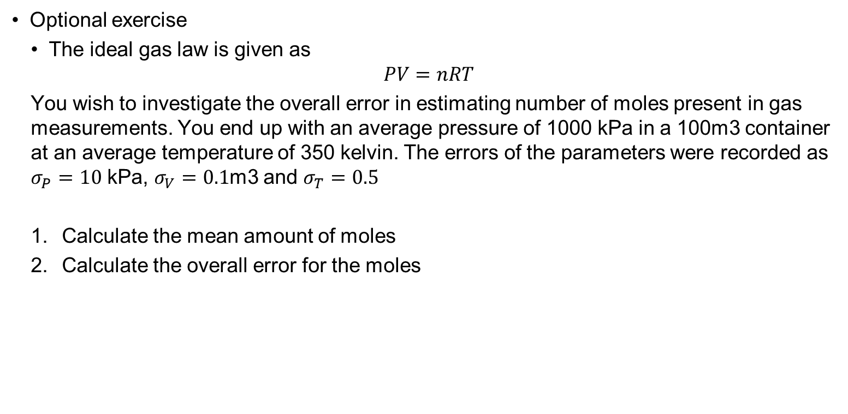
Small exercise 3
Optional exercise
The ideal gas law is given as
$$PV=nRT$$
You wish to investigate the overall error in estimating number of moles present in gas measurements. You end up with an average pressure of 1000 kPa in a 100m3 container at an average temperature of 350 kelvin. The errors of the parameters were recorded as $σ_{P}=10$ kPa, $σ_{V}=0.1$m3 and $σ_{T}=0.5$
Calculate the mean amount of moles
Calculate the overall error for the moles

