Slide 1



Microsoft
World
Mac & Fay
From the
Makers of

Slide 3
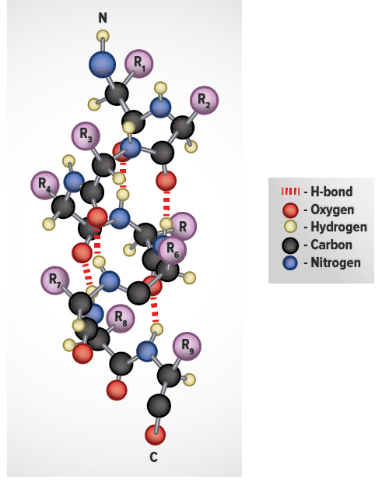
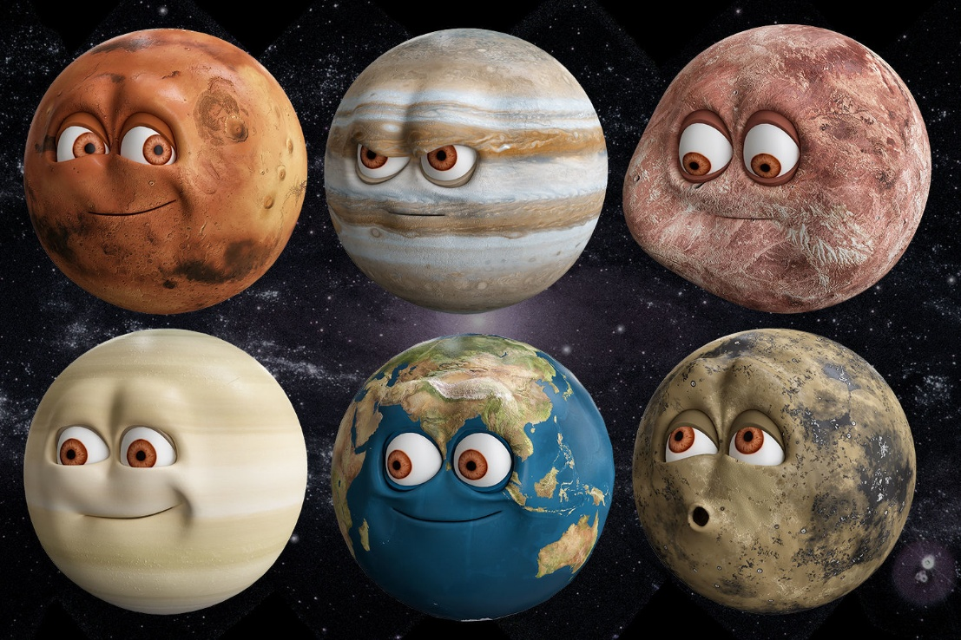
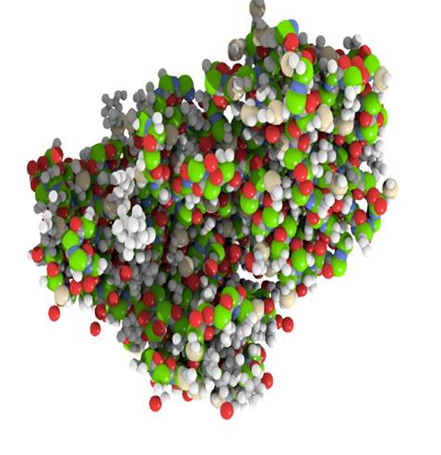
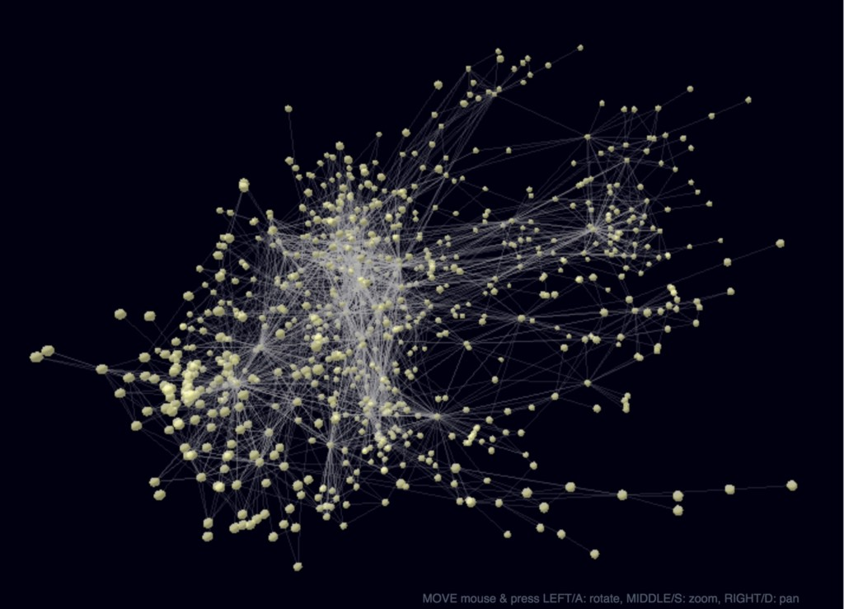
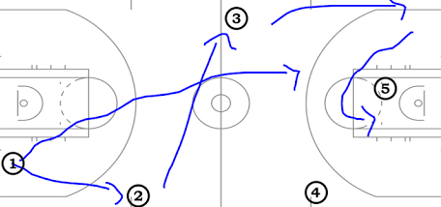
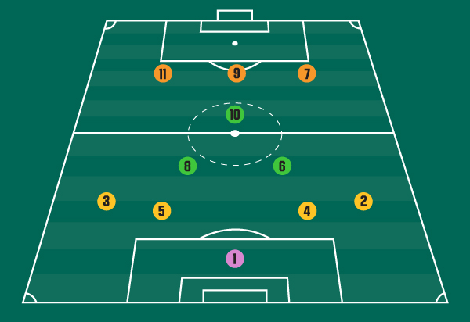


Revolutionary real-world applications...
Solar System/
Planetary Modelling
Molecule Visualizer
3D Mind Mapping
Sport Tactics

