Slide 1
IEEE NEWCAS 2026 · LECTURE · JUNE 22, 2026
Score Shaping & Pareto Optimality
in Analog IC Design Automation
Why the shape of your score function decides whether automated transistor sizing succeeds.
sigmoid score
linear baseline
Danial Noori Zadeh
MacAnalog · McMaster University — Electrical & Computer Engineering
McMaster University | Engineering

Slide 2
02 · SPEAKER & GROUP
MacAnalog — analog design automation at McMaster
Danial Noori Zadeh
1
Electrical & Computer Engineering, McMaster University. Building open tooling that puts optimization formulation — not just the solver — at the centre of analog sizing.
SpiceXplorer: YAML-driven black-box optimization over SPICE.
This talk: a controlled study of how the score-function shape changes what the optimizer finds.
One message for the next 12 minutes
Problem formulation matters as much as the solver. A bounded (sigmoid) score meets every spec where the unbounded (linear) baseline silently blows the current budget — and finds ~2× lower-power designs.

Slide 3
03 · THE PROBLEM
Sizing is a constrained, multi-objective trade-off
Analog specs live on wildly different scales — and how you normalize them decides what the optimizer chases.
The setup
The gap
Find a parameter vector x (widths, lengths, biases) that meets hard targets T, then maximizes a figure of merit.
Objectives are application-dependent: bandwidth, gain, noise, power, phase margin, settling — all at once.
Research over-fixates on the solver; the score function is under-studied.
An ill-shaped objective stalls even a strong optimizer.
A 500 MHz bandwidth error and a 100% power error live on totally different scales. Normalize them wrong and one drowns the other.

Slide 4
04 · FRAMING
Constraint satisfaction, then a single fitness
Feasibility first (drive every penalty to zero), then bank reward beyond spec — one scalar F(x).
Raw penalty per metric
Dual-mode fitness F(x)
EXCEED
p = max(0, T − m)
WHILE INFEASIBLE
F(x) = − Σ Pᵢ
(push penalties → 0)
MINIMIZE
p = max(0, m − T)
ONCE FEASIBLE
EXACT
p = | m − T |
F(x) = + reward(x)
m = measured metric, T = target. Zero penalty = spec met.
Crossing F = 0 means every constraint is met.

Slide 5
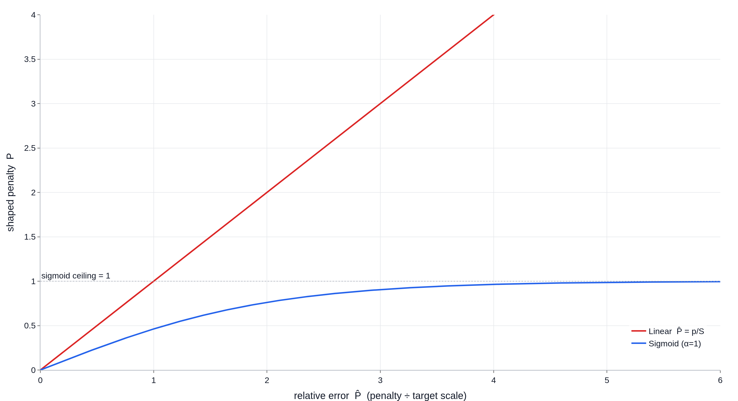
05 · METHOD
Score shaping: bound the penalty
Linear (red) P̂ = p/|T| grows without limit — one outlier dominates. Sigmoid (blue) saturates at 1 — balance beats peaks.
Linear vs. sigmoid penalty mapping · α sets the saturation rate

Slide 6
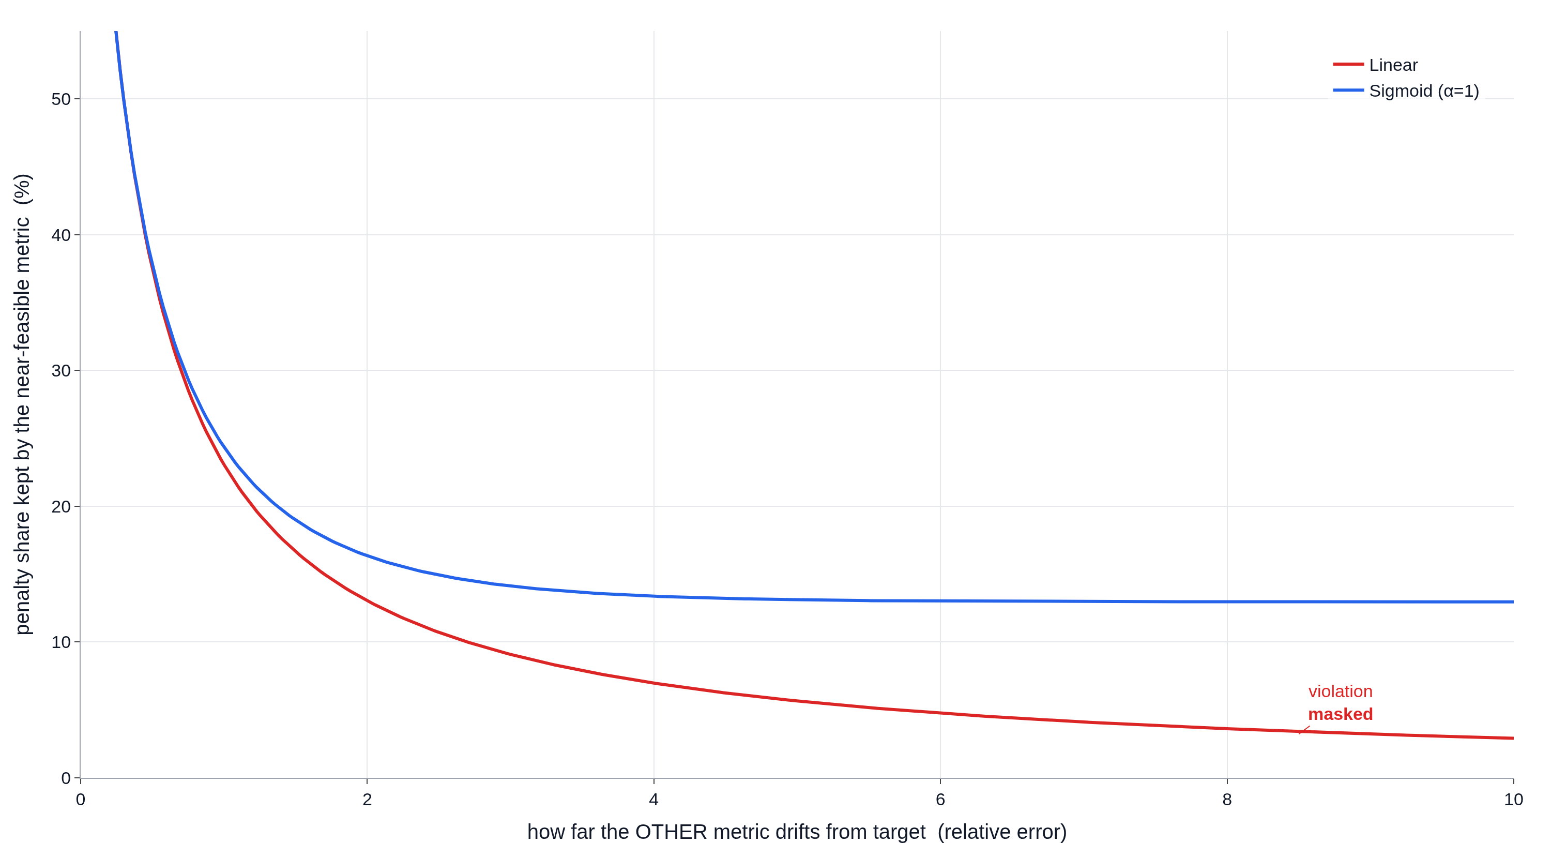
06 · WHY IT MATTERS
The masking effect
Under linear scoring, a metric just outside spec loses its share of the cost as another metric drifts — its violation is masked. The bounded sigmoid keeps it visible.
Penalty share kept by a near-feasible metric (rel. error 0.30) as another drifts

Slide 7
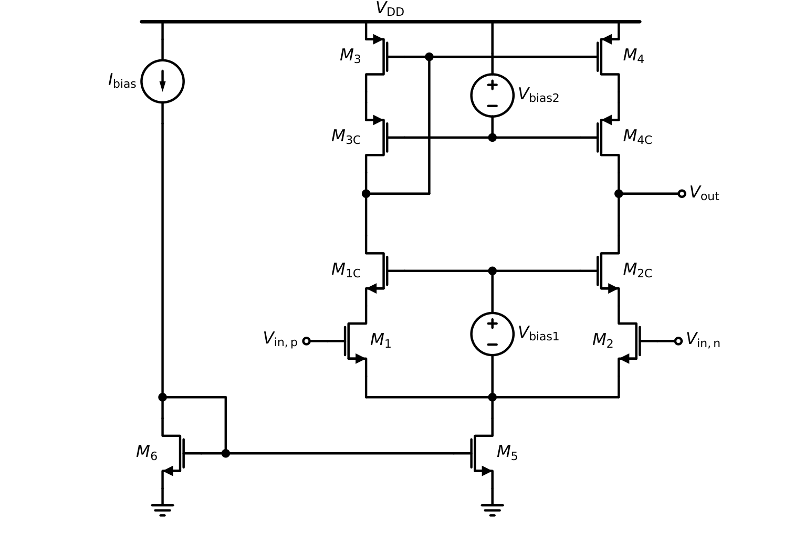
07 · CASE STUDY
Telescopic cascode OTA — IHP 130 nm
14-D design space (W/L + biases). Three engines, same targets, a resource-constrained budget.
Metric | Target | Type
Unity-gain freq. | >200 MHz | max
DC gain | >40 dB | max
Input noise | <1.2 mV | min
Supply current | <25 µA | min
Phase margin | 60 ± 10° | exact
Settling time | <15 µs | min
LHS baseline 12k sims
DE — the workhorse 2k sims
BFGS 2k sims
Improved telescopic cascode OTA, ideal bias (paper Fig. 2)
V_DD 1.5 V · C_L 50 fF · I_bias 5 µA · 14-D search space

Slide 8
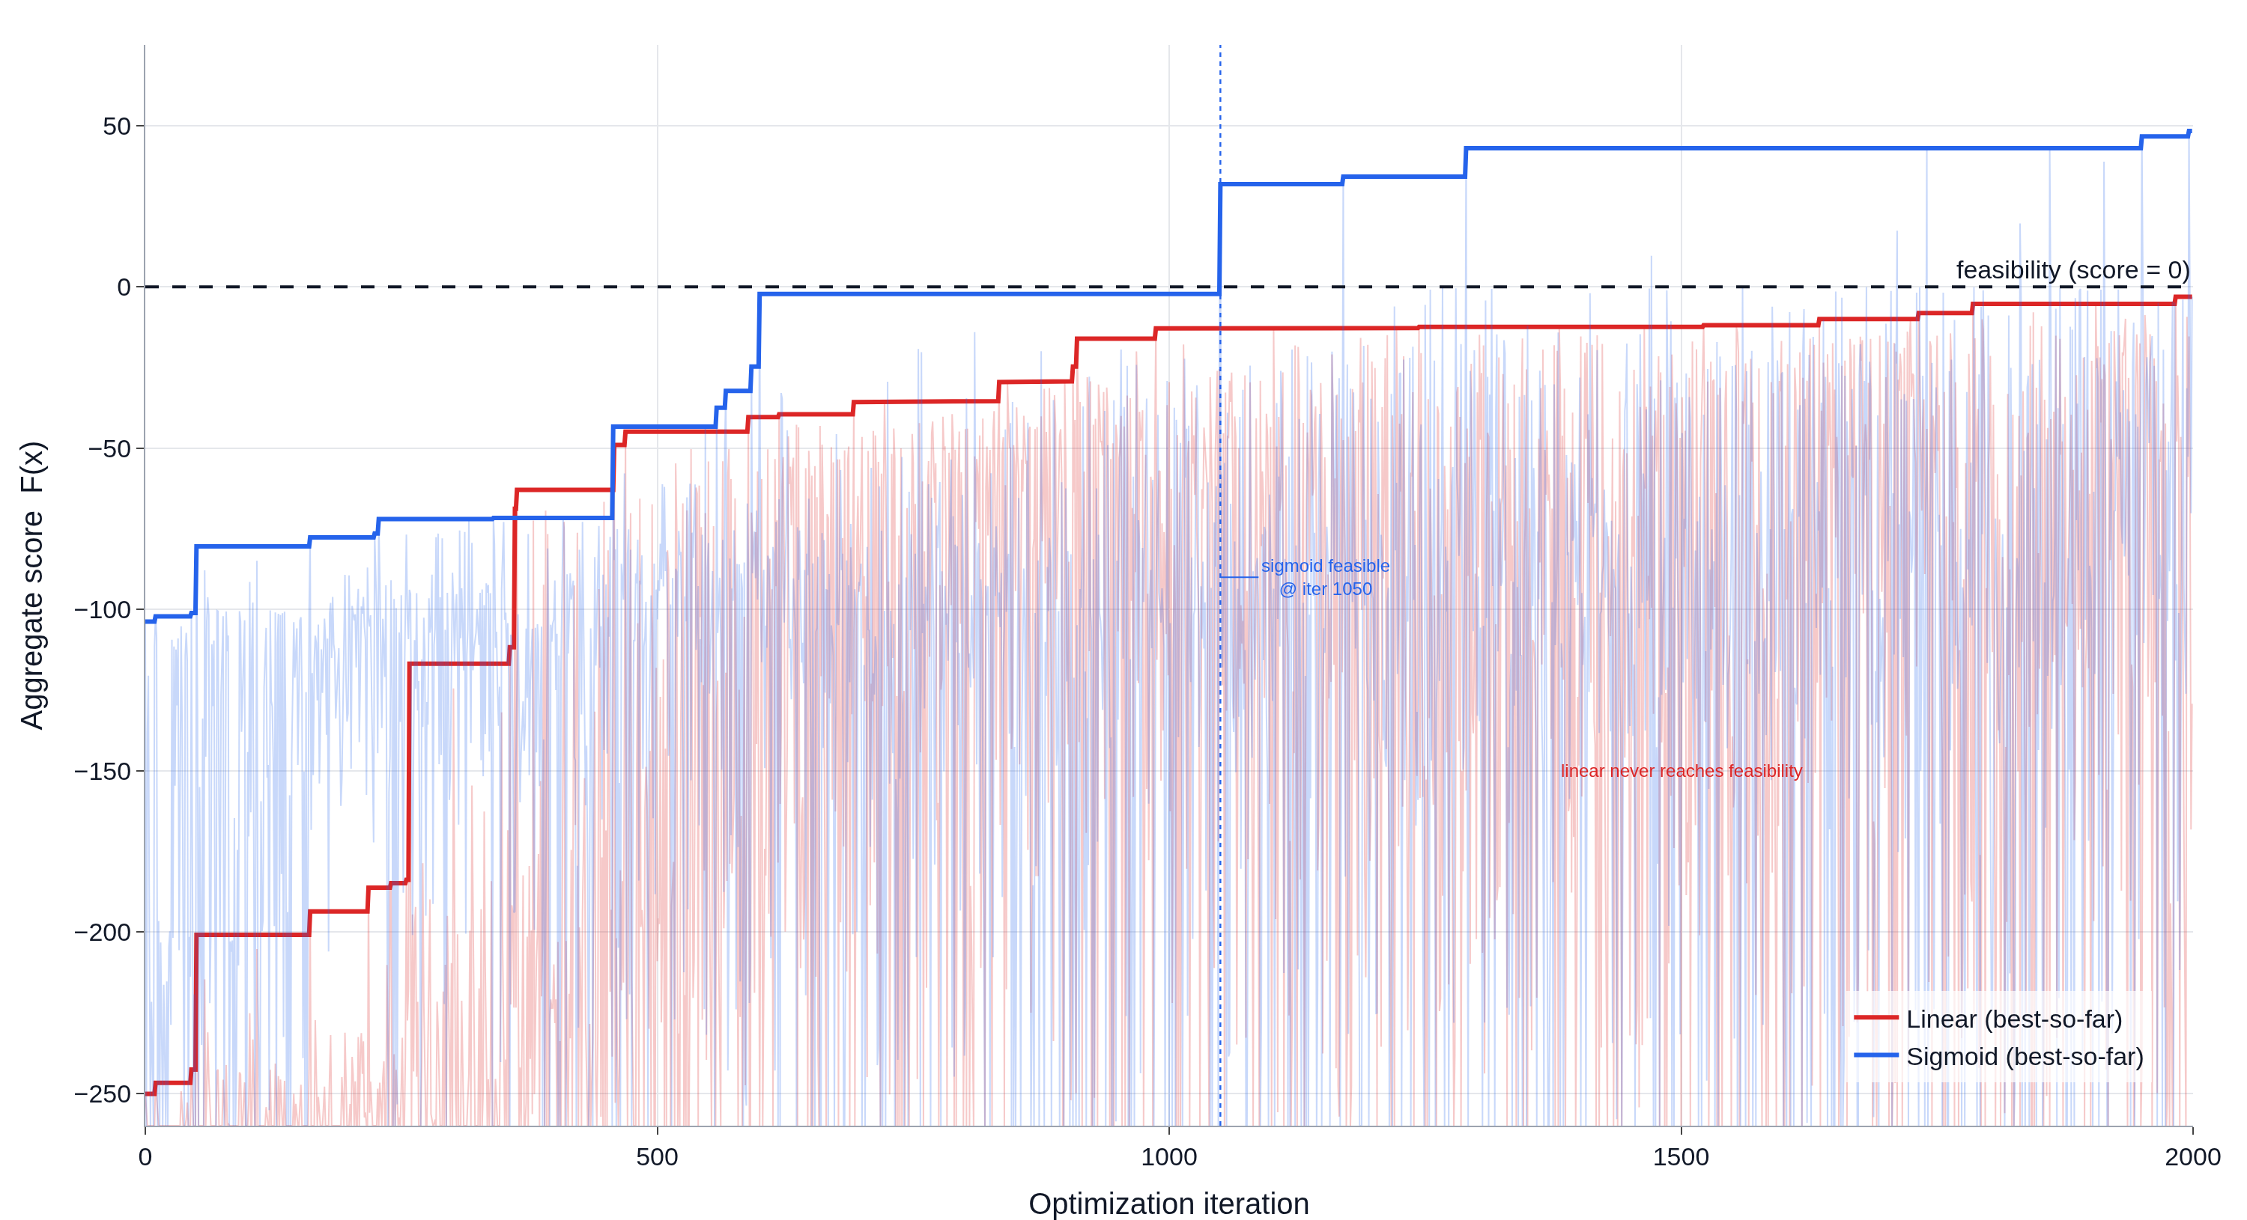
08 · RESULT 1
Same solver, same budget — only the score shape changed
Sigmoid crosses into feasibility at iteration 1050 and banks reward. Linear never reaches a feasible design in 2,000 sims.
SIGMOID
feasible @
iter 1050
LINEAR
feasible designs
0 / 2000

Slide 9
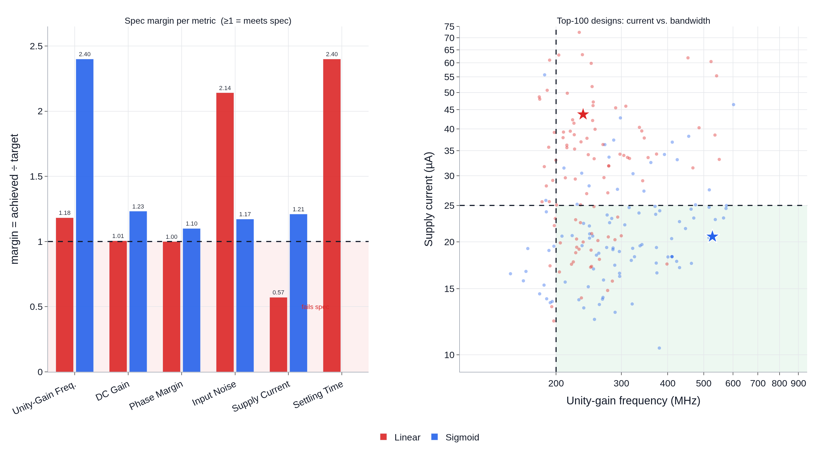
09 · RESULT 2
Sigmoid balances every spec; linear blows the current budget
Linear's best maximizes bandwidth & gain but lands at 43.7 µA — 1.75× over the 25 µA budget. Sigmoid meets all six specs at 20.6 µA. The masking effect, made real.
SIGMOID BEST
20.6 µA
meets all 6 specs
LINEAR BEST
43.7 µA
1.75× over budget

Slide 10
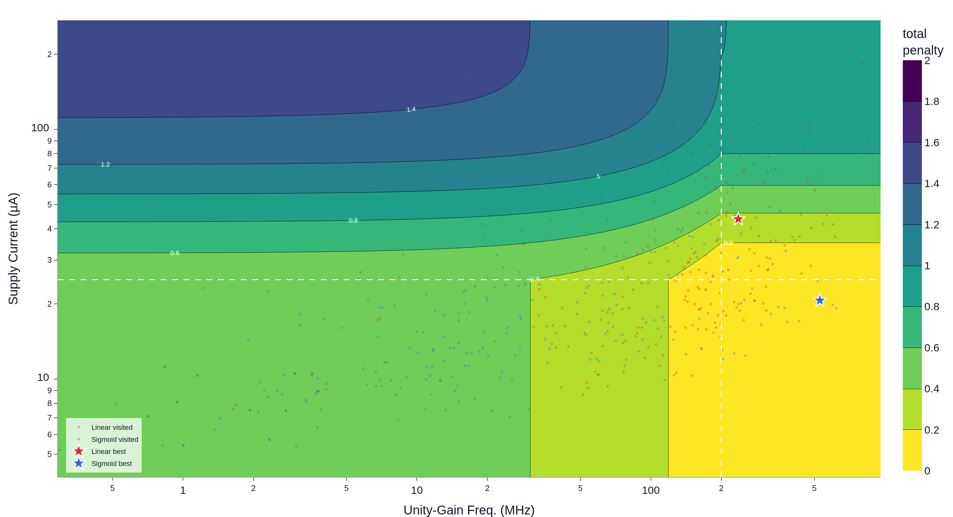
10 · RESULT 3
Why: the equi-score landscape
Linear → straight, parallel iso-lines dominated by one axis (the other is masked). Sigmoid → a bounded, concentric basin pulling toward the feasible corner.
Cost field over bandwidth × current, with real visited points overlaid

Slide 11
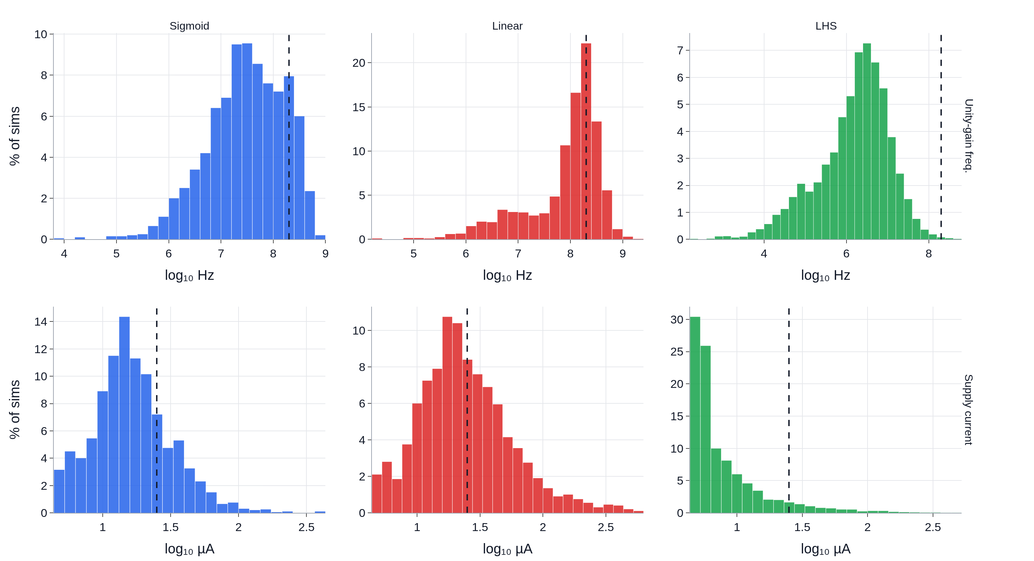
11 · RESULT 4
Where each method spends its simulations
Sigmoid keeps unity-gain-frequency diversity while pulling current below 25 µA. Linear over-concentrates at high UGF and higher power; LHS stalls at the ≈5 µA sub-threshold bias.
Dashed line = spec target

Slide 12
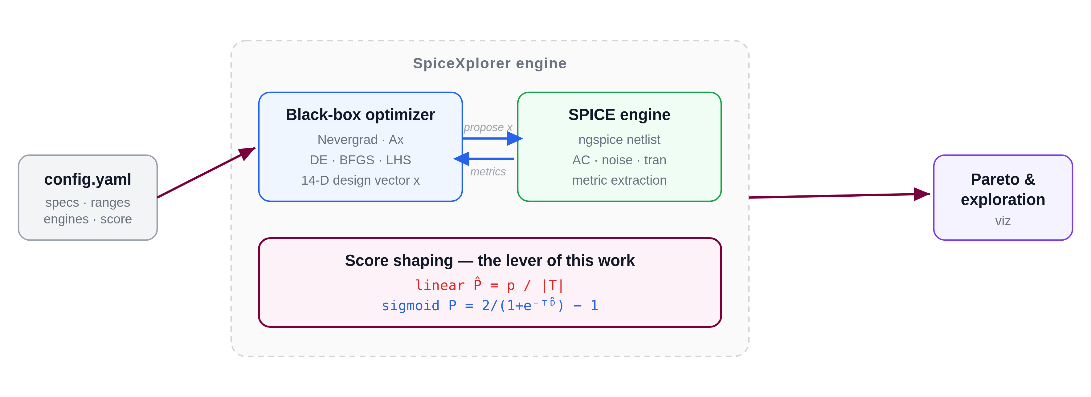
12 · THE TOOL
SpiceXplorer — the open framework behind this
Everything you just saw is one YAML config away.
A YAML config orchestrates black-box optimizers (Nevergrad / Ax) against SPICE: metric extraction → score shaping → Pareto / exploration viz. github.com/MacAnalog/SpiceXplorer · open-source

Slide 13
13 · WHERE IT'S GOING
Agentic, topology-aware sizing
01
02
03
Warm starts
Constraint synthesis
Manager agents
Initialize from circuit theory (gm/ID) instead of cold random search.
Auto-derive symmetry and biasing constraints to shrink the feasible search.
Multi-fidelity orchestration: cheap screens first, full SPICE where it counts.

Slide 14
14 · CONCLUSION
Formulation is a first-class lever
CONSTRAINT SATISFACTION
POWER
SAME SOLVER & BUDGET
Sigmoid met all 6 specs
Linear met 0 / 2000
20.6 µA vs 43.7 µA
~2× lower
Only the score shape
changed
Thank you — questions?
Danial Noori Zadeh · MacAnalog, McMaster University · github.com/MacAnalog/SpiceXplorer

