Slide 1
OPS ANALYTICS
Jobs reviewed, then a drop in weekly engagement
Two case studies. Pandas + SQLite. The job table has 8 rows;
I still ran the queries. The product tables are real size.
Practice project · May–Aug 2014 events · Nov 2020 jobs

Slide 2
What the brief asked
CASE 1 · JOB DATA
CASE 2 · PRODUCT EVENTS
• Jobs reviewed per hour per day (Nov 2020)
• Weekly user engagement
• Throughput (events / sec) and 7-day rolling
• User growth
• Language share, last 30 days
• Weekly retention of the signup cohort
• How to display duplicate rows
• Weekly engagement per device
• Email engagement
Engagement = unique users with at least one event_type = engagement that week.
Weeks start Monday. IDs came in as floats; I cast them to int.
Case 1 has no timestamp, only a date — so “per hour” is jobs / 24.
Ops analytics · not a live client
2 / 11

Slide 3
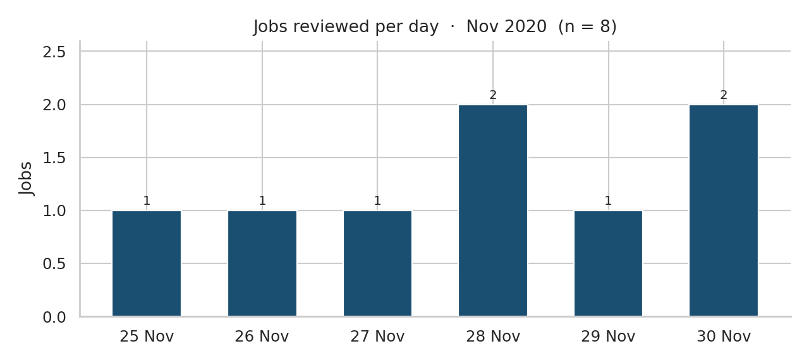
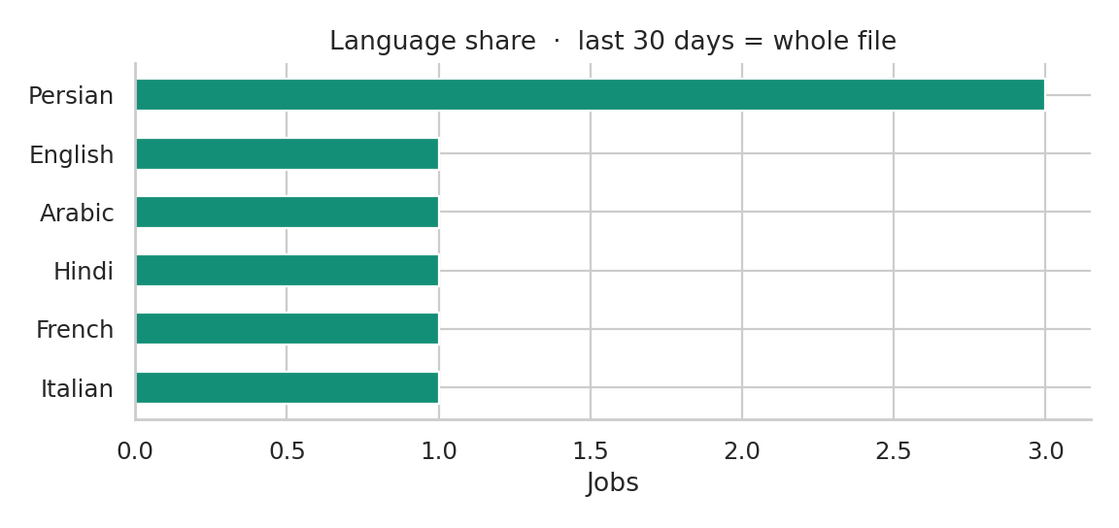
Case 1 · eight jobs, six days
Per hour: 0.0417 or 0.0833. Throughput: 0.000012–0.000023 events/sec. 7-day rolling ends at 0.0000154 — and we only have 6 days, so it is a running mean, not a full window.
Persian is 3 of 8 (37.5%). Everything else is one row.
No exact duplicate rows. job_id 23 appears three times with different actors. I would show that with GROUP BY job_id HAVING COUNT(*) > 1, not SELECT DISTINCT.
Ops analytics · not a live client
3 / 11

Slide 4
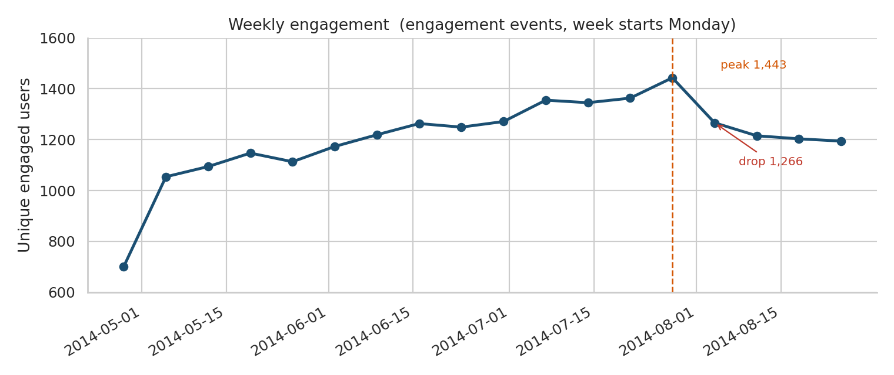
Case 2 · weekly engagement falls in the week of 4 Aug
28 JUL (PEAK)
1,443 users
4 AUG
1,266 (−12%)
25 AUG
1,194 (−17%)
340,832 events, 9,760 users in the event log, 1 May–31 Aug 2014. The week of 28 Apr is short (data starts Thursday 1 May). Events per engaged user also slip a little (14.9 → 13.5), so it is not only fewer people — they do slightly less.
Ops analytics · not a live client
4 / 11

Slide 5
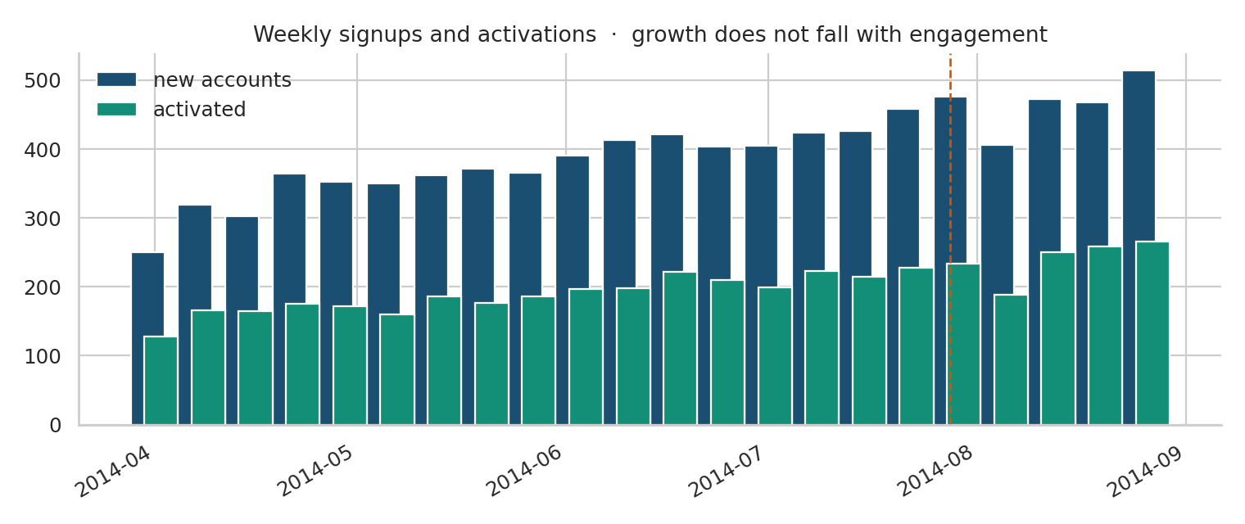
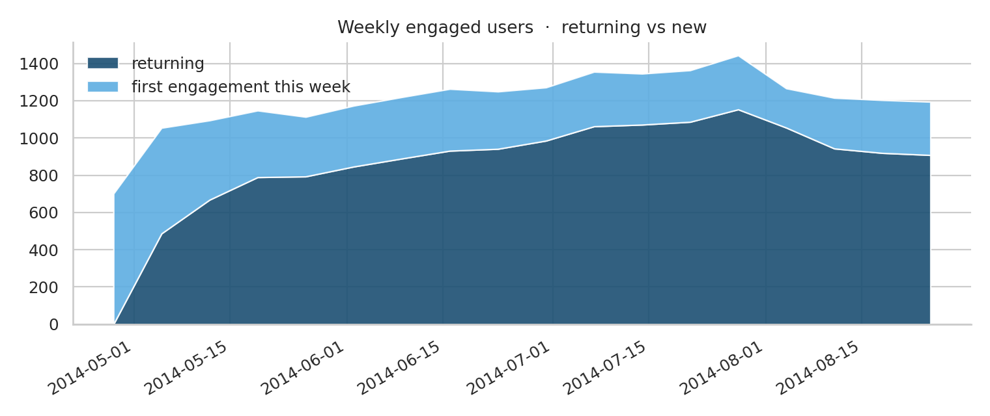
Growth is not the problem
19,066 accounts created (Jan 2013–Aug 2014). 9,381 activated (49.2%). Weekly signups in August: 476 → 406 → 473 → 468 → 514. Activations follow.
Returning engaged users: 1,153 (28 Jul) → 1,055 → 943 → 908. First-time engagers dip only in the week of 4 Aug (290 → 211) and then come back. The hole is existing users, not new ones.
Ops analytics · not a live client
5 / 11

Slide 6
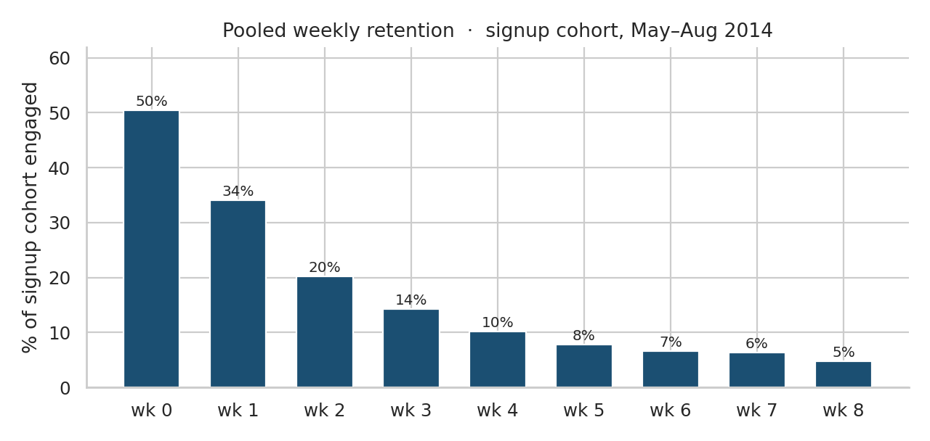
Signup-cohort retention
7,298 signups inside the event window.
Week 0 50.4%
Week 1 34.1%
Week 2 20.3%
Week 4 10.2%
Week 8 4.8%
Week 0 is ~50% because pending accounts never engage. The brief said signup cohort, so I kept pending users in the denominator.
Ops analytics · not a live client
6 / 11

Slide 7
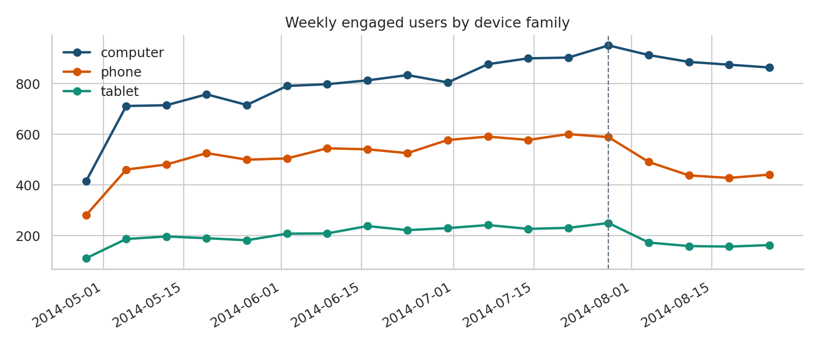
Phone and tablet fall harder than computer
Unique engaged users
28 Jul → 25 Aug
Computer 951 → 864 −9%
Phone 589 → 441 −25%
Tablet 250 → 163 −35%
Families are a hand mapping of the 26 device strings (galaxy note → phone, “samsumg” tablet kept as tablet).
Ops analytics · not a live client
7 / 11

Slide 8
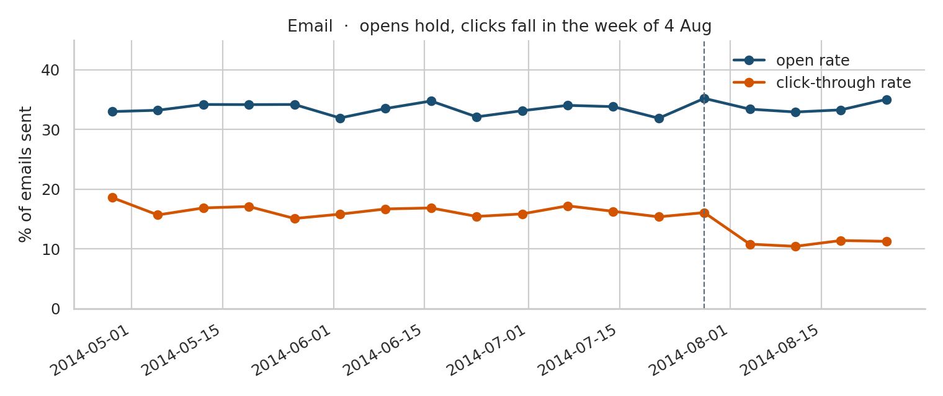
Email · opens hold, clicks do not
90,389 rows. Whole window:
open 33.6% · CTR 14.8%
28 Jul open 35.2% CTR 16.1%
4 Aug open 33.4% CTR 10.8%
25 Aug open 35.0% CTR 11.3%
People still open the digest. Fewer click through in the same week engagement drops.
Ops analytics · not a live client
8 / 11

Slide 9
What I would tell ops
Not acquisition
Signups and activations keep going up in August. New-to-engagement recovers after one week.
Existing users, mobile first
Returning users fall and stay down. Phone −25%, tablet −35%, computer −9%.
Email CTA is a live lead
Open rate is flat; CTR drops from 16.1% to 10.8% the week of 4 Aug.
I cannot name the bug from this file
Event mix did not change. Next: mobile release log, digest template, August holidays by country.
Ops analytics · not a live client
9 / 11

Slide 10
How this was run
Stack: Python (pandas) and SQLite. No extra database.
Cleaning: drop empty Excel rows; cast user_id to int; parse timestamps; strip nothing else. Language and device strings are used as they arrived (including “portugese” and “samsumg galaxy tablet”).
SQL lives in sql/01_job_ops.sql and sql/02_metric_spike.sql. The notebook loads the CSVs into an in-memory SQLite database and checks that the pandas and SQL answers match.
I would not ship Case 1 as a dashboard. Eight rows. Case 2 is the actual investigation.
Ops analytics · not a live client
10 / 11

Slide 11
1,443 → 1,266 engaged users
in one week. Growth did not follow.
Check mobile clients and the digest click target first.
Do not pause acquisition on this evidence.

