Slide 1
FORAGE · ACCENTURE VIRTUAL EXPERIENCE
What people react to on Social Buzz
Top 5 content categories by popularity score 22,534 reactions · 962 posts · Jun 2020 – Jun 2021
Maqsood Ansari · Data Analyst
Social Buzz · content popularity · Forage / Accenture VE
1 / 12

Slide 2
Agenda
01
Brief
Why Social Buzz asked for a category ranking
02
Data
What is in the sample and how I cleaned it
03
Top 5
Popularity score, not raw reaction count
04
Extras
Sentiment, format, and a quiet month pattern
05
So what
Three things a content team could try next
Social Buzz · content popularity · Forage / Accenture VE
2 / 12

Slide 3
Project recap
Social Buzz is a fast-growing social platform. This Forage brief is a three-month POC story with three workstreams. This analysis is the third one.
01
02
03
Big data audit
IPO readiness
Top 5 categories
How they handle volume. Not this deck.
Process and controls. Not this deck.
This deck. Score the sample and rank topics.
Social Buzz · content popularity · Forage / Accenture VE
3 / 12

Slide 4
The problem
The client story is 100,000+ posts a day. That is too much to steer by gut. The ask for this sample is simple: which categories actually get love?
100k+
22,534
16
sum of scores
posts / day (client context)
reactions in this sample
categories after cleaning
definition of “popular”
I do not treat reaction count as popularity. A peek (35) is not a super-love (75). Ranking uses the score table that came with the reaction types.
Social Buzz · content popularity · Forage / Accenture VE
4 / 12

Slide 5
What I used
Joined Content × Reactions × Reaction types. One row = one reaction. Window: 18 Jun 2020 – 18 Jun 2021.
22,534
16
reactions (no nulls, no duplicate rows)
categories after stripping quotes and lowercasing
962
4
distinct posts
formats: photo, video, GIF, audio
500
16
users who reacted
reaction types, scores 0 to 75
Social Buzz · content popularity · Forage / Accenture VE
5 / 12

Slide 6
Process
1
2
3
4
5
Understand
Clean
Score
Check
Tell
Read the six-table model. Only Content, Reactions, and scores are needed for the ranking.
Drop unused User/Profile tables. Fix "animals" vs Animals. Parse dates day-first.
Popularity = sum(Reaction_Score) by category.
Compare count vs score, sentiment, format, month.
Five headlines + a short recommendation.
Social Buzz · content popularity · Forage / Accenture VE
6 / 12

Slide 7
Four numbers worth keeping
16
1,738
68,624
May 2021
categories (quoted labels merged)
Animals reactions — count, not score
Animals popularity score
busiest month (1,954 reactions)
The old “1,738 popularity score” figure was the reaction count. Score is ~40× larger.
Also true in this sample
• Top 5 share of all score: 36.0%. The tail is long — travel, cooking, culture sit just under Food.
• 2020 has 12,195 reactions vs 10,339 in 2021. The file is mid-year to mid-year, so this is not a “lockdown year” claim.
• May is the peak month, but January is 5 reactions behind. Do not overfit a season story.
• 56.2% of reactions are positive. That mix is similar inside every top-5 category.
Social Buzz · content popularity · Forage / Accenture VE
7 / 12

Slide 8
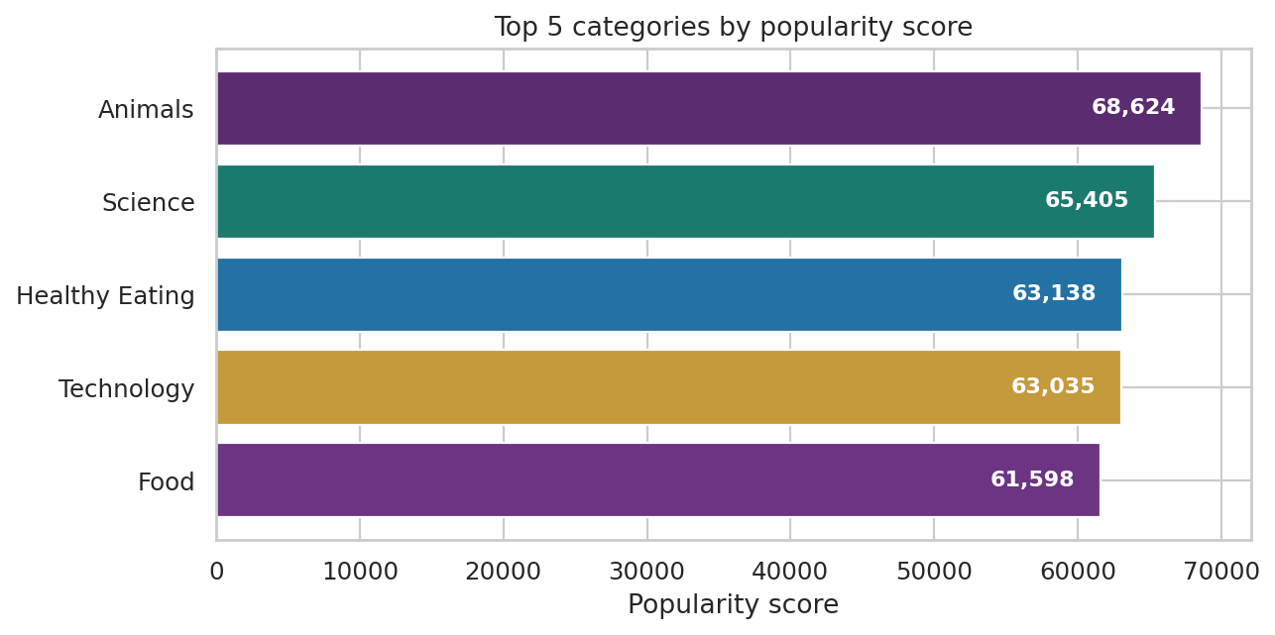
Top 5 categories by popularity score
Rank
1 Animals 68,624
2 Science 65,405
3 Healthy eating 63,138
4 Technology 63,035
5 Food 61,598
Healthy eating sits above Food. Science sits above Technology. Gaps inside the top 5 are small.
Social Buzz · content popularity · Forage / Accenture VE
8 / 12

Slide 9
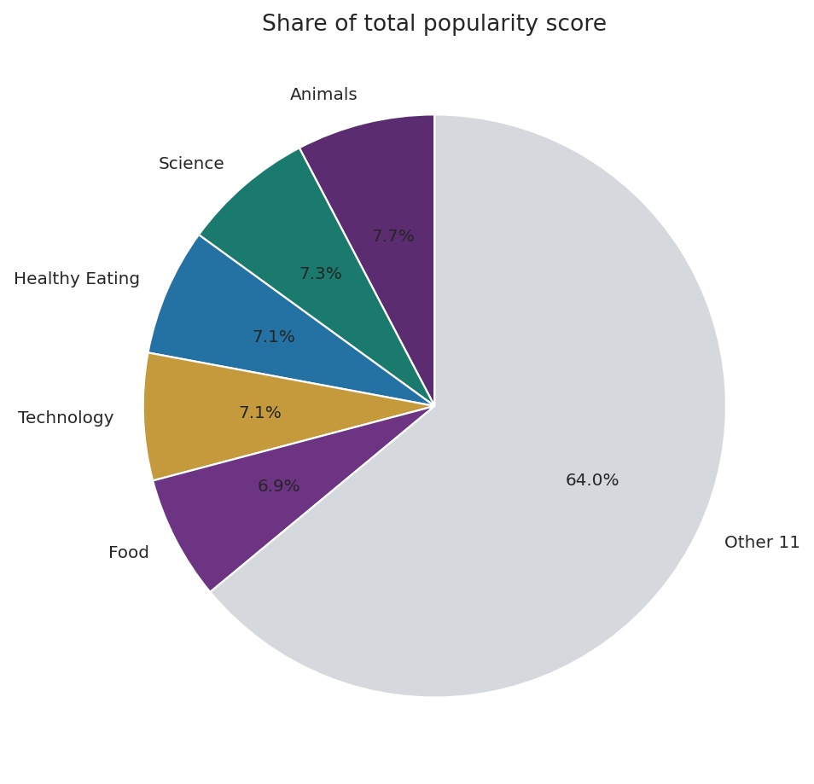
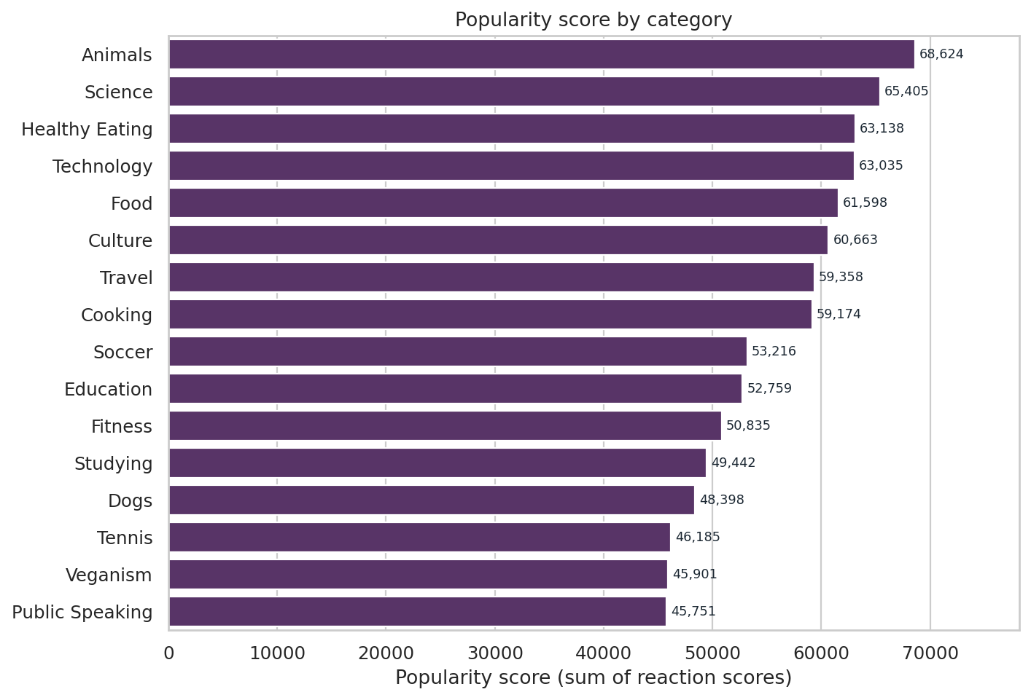
The top 5 are close. The tail is not empty.
Social Buzz · content popularity · Forage / Accenture VE
9 / 12

Slide 10
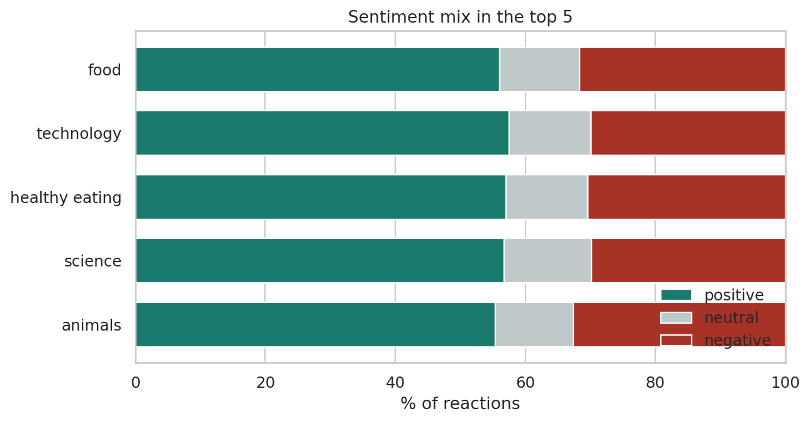
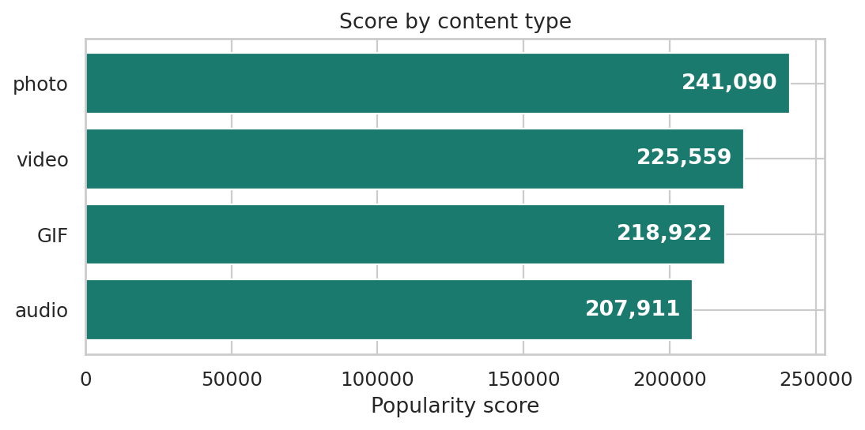
Two extra cuts
Sentiment does not explain the ranking — every top category is ~56–58% positive. Format does: photos hold the most total score (241,090). Animals is unusually photo-heavy (35% of its reactions). Technology is more GIF/audio than video.
Social Buzz · content popularity · Forage / Accenture VE
10 / 12

Slide 11
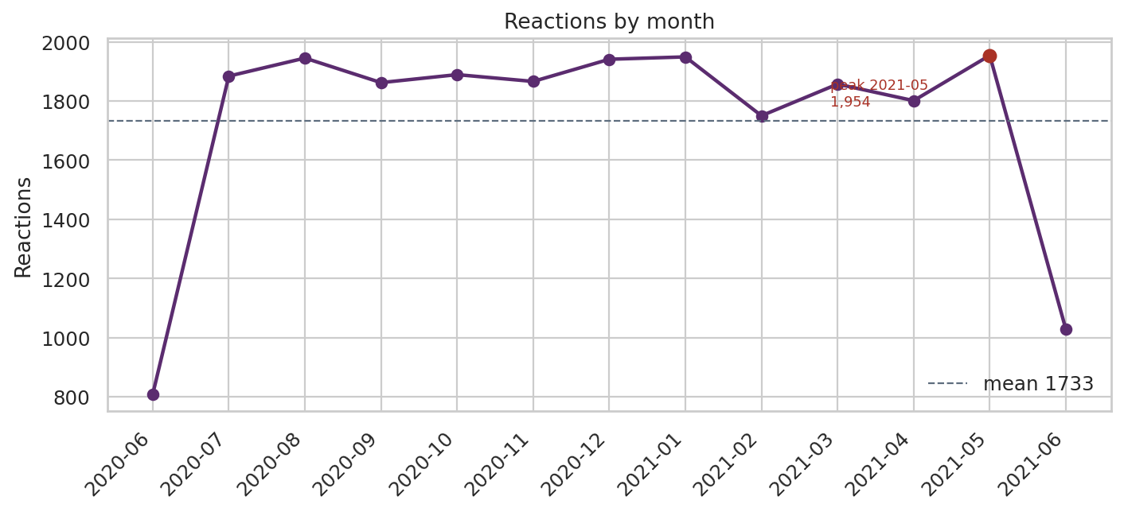
Reactions by month
Peak is May 2021 (1,954). The line is fairly flat — no month is a collapse. I would not sell a “holiday season” campaign off this sample alone.
Social Buzz · content popularity · Forage / Accenture VE
11 / 12

Slide 12
What I would do with this
Animals first
Food is two buckets
Science + tech
Highest score and most reactions. Nature / pet creators are the obvious partnership list.
Healthy eating beats Food. A wellness brand fit is closer than a generic restaurant campaign.
Together they almost match Animals. How-to and explainers are not a niche here.
Watch volume, not vibe
Do not stop at five
Next measurement
Mean score is ~40 everywhere. To move the ranking you need more posts (or more reactions), not “better” emojis.
Travel, cooking and culture are within ~8k points of Food. A six-month refresh should include them.
This is a static sample. Production would score categories weekly and split by format.
Social Buzz · content popularity · Forage / Accenture VE
12 / 12

