Slide 1
MEDTOUREASY · 1,472 SEPHORA SKUs
Similar ingredients, cheaper jar
One-hot the formula list. t-SNE to look at it.
Cosine to pick a neighbor.

Slide 2
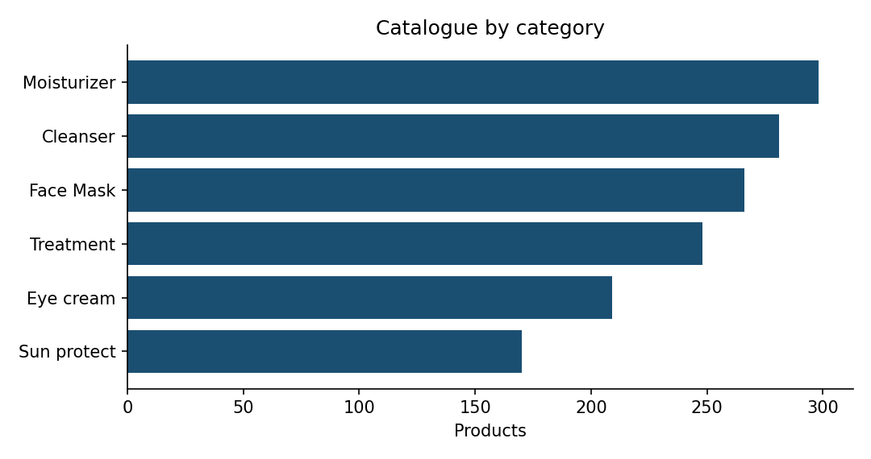
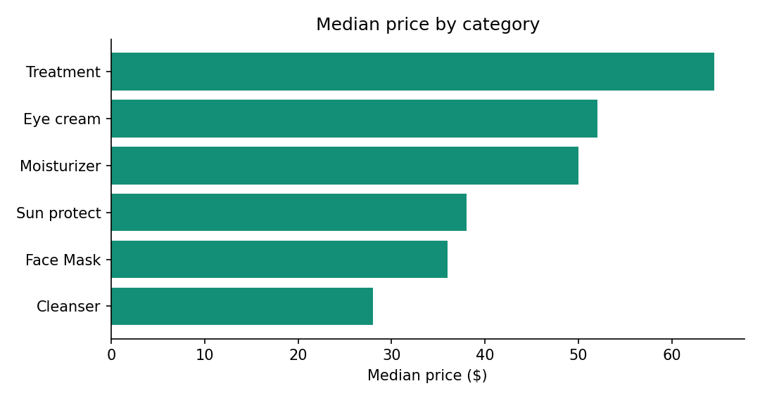
Catalogue
Treatments are the expensive aisle (median $64.50). Cleansers are $28.
Eye cream has the weakest mean rank (3.81). 116 brands; CLINIQUE leads SKU count (79).
471 products have no skin-type flag — the 0/1 columns are incomplete.
Chemical components · MedTourEasy practice project
2 / 8

Slide 3
The matrix
Filter: Label = Moisturizer AND Dry = 1 → 190 products.
Split Ingredients on “, ”, lowercase, unique token → index. 2,233 tokens.
decyl oleate sits at index 25 (the DataCamp check).
Binary document-term matrix 190 × 2,233. Mean 35.1 ingredients / product. 98.4% zeros.
t-SNE (2-D, learning_rate=200, random_state=42) for the map.
Cosine on the raw binary rows for neighbors — that number is stable; t-SNE is not a metric.
Chemical components · MedTourEasy practice project
3 / 8

Slide 4
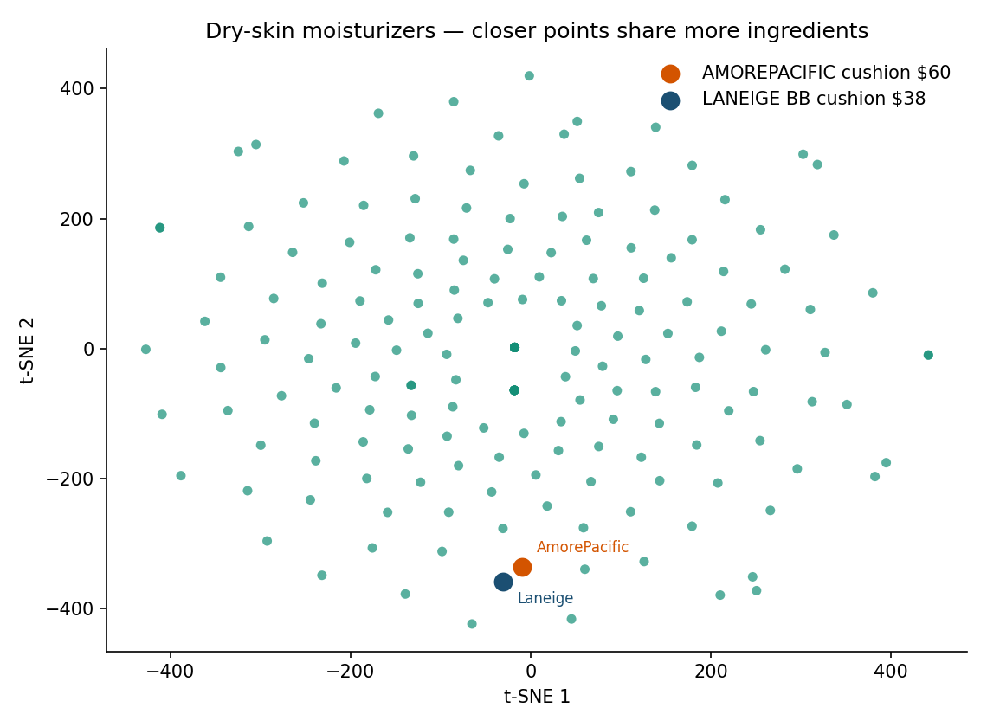
t-SNE map of dry moisturizers
Axes are not ingredients.
Distance ≈ shared formula.
Orange: AmorePacific cushion $60 / 4.0
Navy: Laneige BB cushion $38 / 4.3
They sit next to each other.
Cosine 0.535 · 23 shared tokens.
Chemical components · MedTourEasy practice project
4 / 8

Slide 5
The $22 swap
AmorePacific Color Control Cushion SPF 50+ $60 rank 4.0
Laneige BB Cushion Hydra Radiance SPF 50 $38 rank 4.3
Nearest product in the 190-row set (cosine 0.535).
Next neighbor is only 0.333 — so this is not a crowded blob.
Same job (tinted cushion + SPF), $22 less, slightly better rating.
That is the whole point of the brief: read the back of the bottle without being a chemist.
Chemical components · MedTourEasy practice project
5 / 8

Slide 6
What this is not
• Not a safety ranking. Shared silicones ≠ shared irritation profile.
• Not “word embeddings.” It is one-hot presence. Order on the INCI list is ignored.
• 120 rows say “Visit the boutique” instead of a formula. They contribute almost nothing.
• t-SNE will jitter if you drop random_state. Use cosine for the actual recommendation.
Chemical components · MedTourEasy practice project
6 / 8

Slide 7
How it was run
pandas + numpy one-hot, sklearn TSNE / cosine_similarity, SQLite for the catalogue, Excel for the tables.
No Bokeh app. Static map in reports/figures/tsne_map.png.
Notebook: notebooks/cosmetics_analysis.ipynb
Chemical components · MedTourEasy practice project
7 / 8

Slide 8
Same silicones. Twenty-two dollars less.

