Slide 1
IMDb · 4,916 unique titles · 1916–2016
What actually moves the score?
Genre, runtime, and director beat budget for IMDb.
Budget beats score for gross.

Slide 2
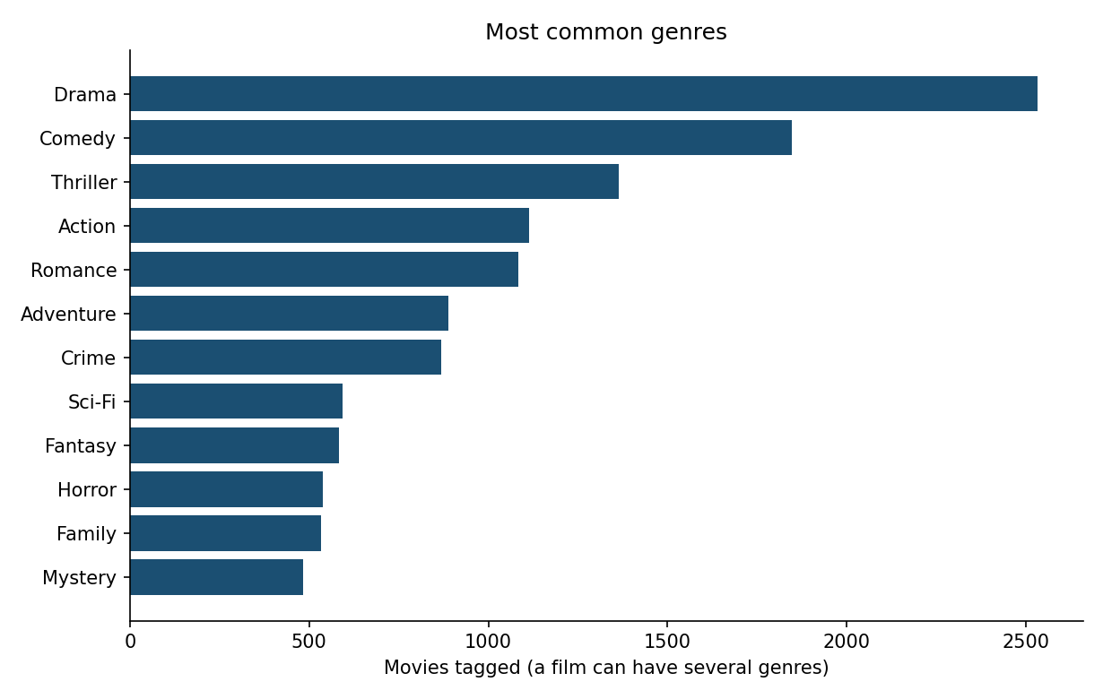
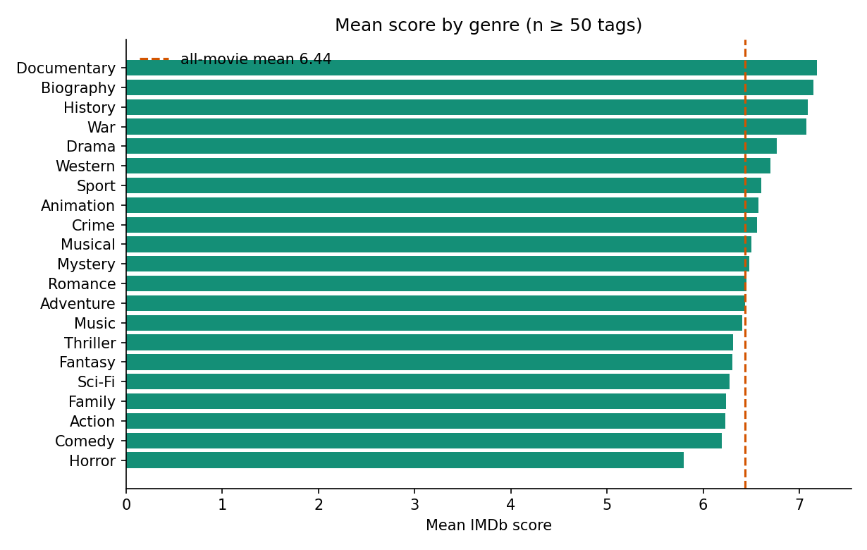
A · Genre
Drama is the most common tag (2,532). Documentary / biography / history / war sit ~7.1.
Horror is 5.80. Comedy is everywhere (1,847) and still below the 6.44 all-movie mean.
IMDb movies · practice project
2 / 9

Slide 3
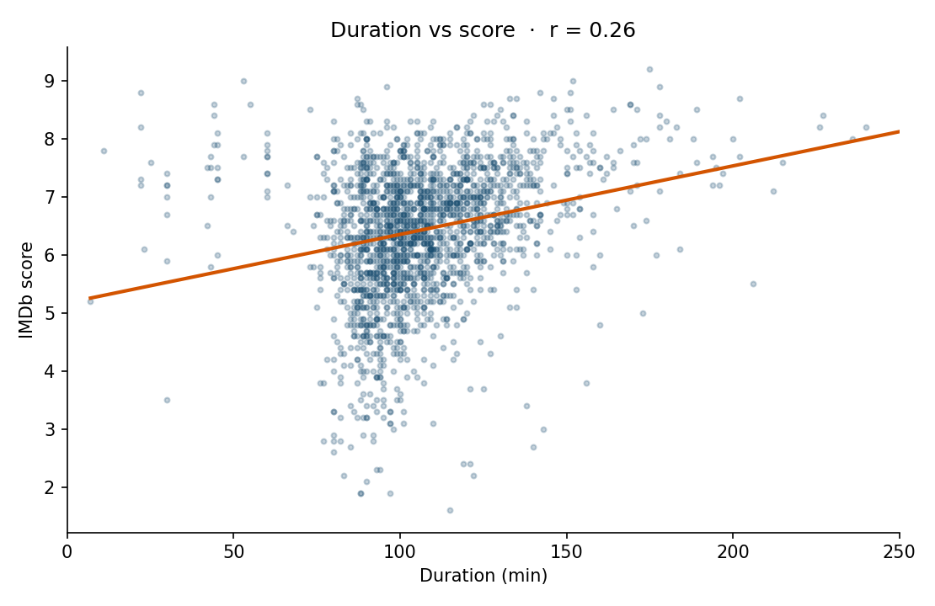
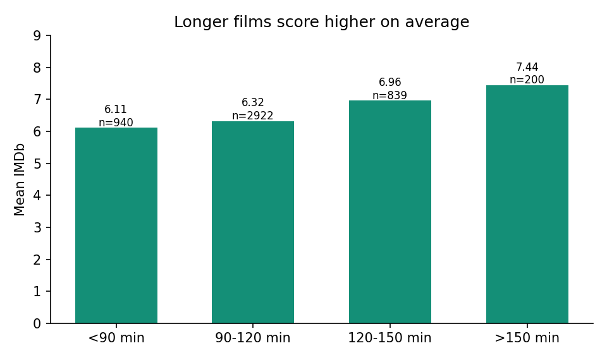
B · Duration
r = 0.26. Under 90 min → 6.11 mean. Over 150 min → 7.44. Mode is 90 minutes.
That is a mix/prestige effect, not a reason to pad the cut.
IMDb movies · practice project
3 / 9

Slide 4
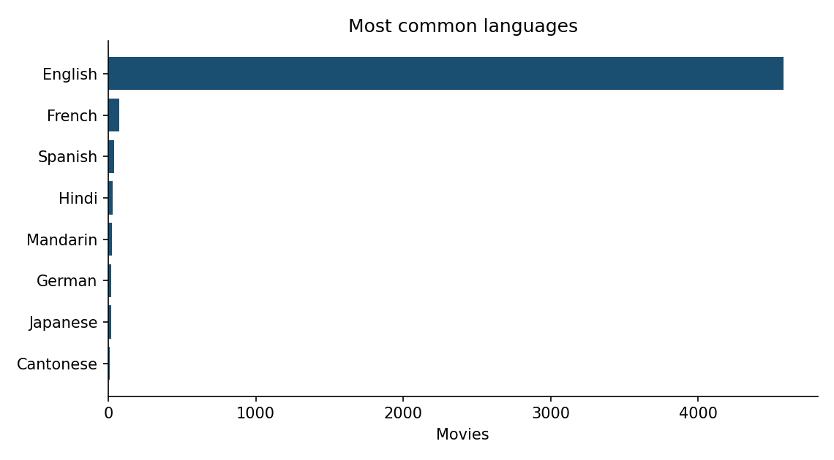
C · Language
English: 4,582 films, mean 6.39 (93% of the file).
Japanese 7.35 (n=17)
German 7.34 (n=19)
French 7.04 (n=73)
Small-n languages look better because this dump keeps the famous ones.
IMDb movies · practice project
4 / 9

Slide 5
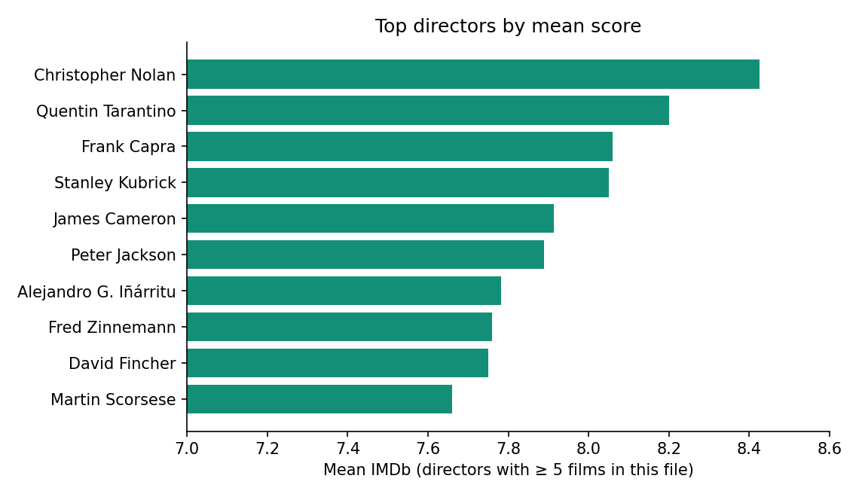
D · Directors (≥ 5 films)
214 directors with 5+ films here.
Nolan 8.425 (8 films) — 100th percentile of that set.
Tarantino 8.20 · Capra 8.06 · Kubrick 8.05
90th percentile of means: 7.41
One-film 9.5 TV rows are not this chart.
IMDb movies · practice project
5 / 9

Slide 6
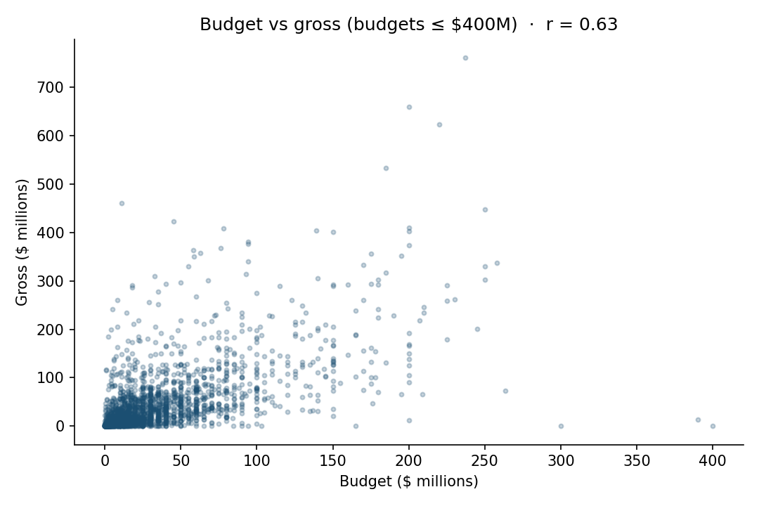
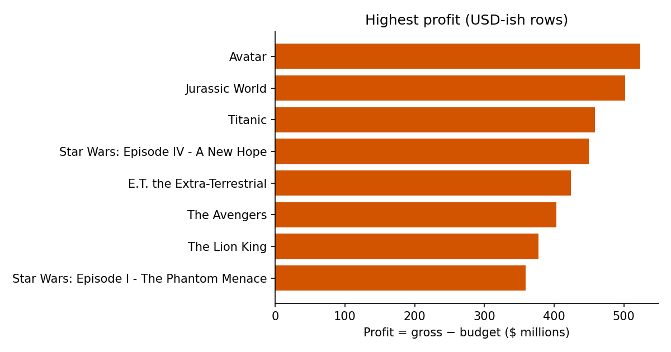
E · Budget, gross, profit
After dropping 10 local-currency budgets: r(budget, gross) = 0.63. r(budget, IMDb) ≈ 0.04.
Avatar +$523.5M, Jurassic World +$502.2M, Titanic +$458.7M. Excel sheet E_correl has =CORREL().
IMDb movies · practice project
6 / 9

Slide 7
Five whys · the duration pattern
1. Why do longer films score higher? They sit with drama / biography / war, not 90-minute horror.
2. Why those genres run long? Awards-circuit habit and editors keeping footage that works.
3. Why the average moves: voters who finish 160 minutes are already bought in; short bins are padded with 5.x horror.
4. Why this is not a lever: stretching a weak script does not mint Shawshank.
5. Why it still matters: runtime is a proxy for intent. Budget tracks gross. IMDb tracks something else.
IMDb movies · practice project
7 / 9

Slide 8
What I would not tell a producer
• Do not rank directors on a single 9.x.
• Do not read Lady Vengeance as a $4.2B flop — that budget is not USD.
• Do not treat English’s 6.39 as 'English films are worse.'
• Do not use IMDb as a stand-in for profit. Avatar is both; plenty of 8.x films are not.
IMDb movies · practice project
8 / 9

Slide 9
Spend money to chase gross.
Runtime and genre describe the score.
They are not the same job.

