Slide 1


Data Analysis
Notes:
Hello and welcome, my name is Maqsood Ansari and today I will be presenting to you the results of the Data Analytics task.

Slide 2


Today's agenda
Project recap
Problem
The Analytics team
Process
Insights
Summary
Notes:
The following items will be on today's agenda:
We will summarize the whole project to provide a high-level knowledge of the business challenge and the detailed needs.
We will go through the exact problem that we, the Data Analytics team, have been working on and explain why it is such a major deal.
After outlining the situation, I will go through the team accountable for completing this assignment from our end.
I will then go over the high-level procedure that we used to execute this assignment, so that you understand exactly how we approach these types of tasks.
Finally, I will go over the key findings and offer them as a series of insights and visualizations based on our investigation.

Slide 3

S
Social Buzz is a fast growing technology unicorn that need to adapt quickly to it’s global scale.
Accenture has begun a 3 month POC focusing on these tasks:
An audit of Social Buzz’s big data practice
Recommendations for a successful IPO
Analysis to find Social Buzz’s top 5 most popular categories of content
Project Recap
Notes:
Let me begin by recapping this engagement.
Accenture has begun a three-month trial with Social Buzz to focus on three primary activities that are linked with some of the most pressing difficulties you are now facing.
In recent years, Social Buzz has grown to become known as a worldwide unicorn firm. We are here to assist you in navigating this scale and pointing you in the proper route.
To begin, we will assess your big data approach and provide best practices and industry knowledge. Second, we will guide you through a successful IPO, in which we have extensive expertise and understanding.
Last but not least, we have conducted an analysis of your data to find insights regarding your top 5 most popular categories of content

Slide 4

Problem
Over 100000 posts per day
36,500,000 pieces of content per year!
But how to Capitalize on it when there is so much?
Analysis to find Social Buzz’s top 5 most popular categories of content
Notes:
Focusing on the last point that I mentioned there, this is where the Data Analytics team has concentrated their efforts.
Clearly with such grand scale, this comes with a lot of data and with such vast amounts of data comes challenges.
To give a background on how much data you've been creating:
- You told us that your platform receives over 1,00,000 posts per day which amounts to 36 500 000 posts every year, of which, this is all unstructured data making it very hard to make sense of.
In this day and age, content is king. Just look at some of the biggest platforms in the world, for example YouTube, Facebook and Instagram... they are all content businesses...
But how to capitalize on it when there is so much?
It's not just all about harvesting as much content as possible... The real value is in understanding and crunching this content to gain a deeper understanding of your audience and to therefore provide a more personalized and enjoyable experience.
And this is where out data analytics expertise comes in, with the insights that we've uncovered from this task, we can show you exactly how to take analytics to production at scale.

Slide 5



ANDREW FLEMING
Chief Technology Architect
The Analytics team
MARCUS ROMPTON
Senior Principal
Maqsood Ansari
Data Analyst
Notes:
Talking about experience, we have a large data analytics practice at Accenture but we had a team of 3 people primarily focusing on this task. Andrew Fleming is our Chief Technical Architect and his expertise really helped to guide the team to produce high quality analysis.
Marcus Rompton, a senior data expert has worked with the worlds biggest clients on solving their data problems and was heavily involved in the data engineering side of this project.
And finally myself, Maqsood , who was solely responsible for taking leadership guidance and delivering high quality insights from the raw datasets and turning these into business decisions.

Slide 6
Process
1
Data Understanding
2
Data Cleaning
3
Data Modelling
4
Data Analysis
5
Uncover Insights
Notes:
So, how did we tackle this problem?
Well, we approached it in 5 steps:
1. Data understanding - the key to success on any data project is to understand the data in detail. So we took the time to understand the data model and domain of your business.
2. Data extraction - after understanding your business, we then architected what an ideal dataset should look like for this problem and extracted it from the relevant data sources.
3. After extracting the raw data, we needed to process and model this data into a dataset that can precisely answer the business questions and produce analytics.
4. With our new dataset, we used our analytical expertise to uncover insights from this dataset and to produce visualizations to describe the insights.
5. And finally we used these insights to unlock business decisions and to make recommendations on next steps.

Slide 7

Insights
17
Unique Categories
1738
Reactions to “Animals” posts
May
Month with
most posts
2021
Year with
most posts
Notes:
From your data we found that you had a total of 17 unique categories of posts across your sample dataset. This includes things such as Food, Culture and Sport.
As well as this, there was 1738 posts from just the Animals category alone! People obviously really like Animals !. People made use of year 2021 to make more posts as it was the year of lockdowns.
And also the most common month for users to post within was May, since this is such a seasonal month with so many holidays and events, this is interesting to know that people are most active during this month!
But now, onto the main question... which is... what were the top 5 most popular categories of posts?

Slide 8
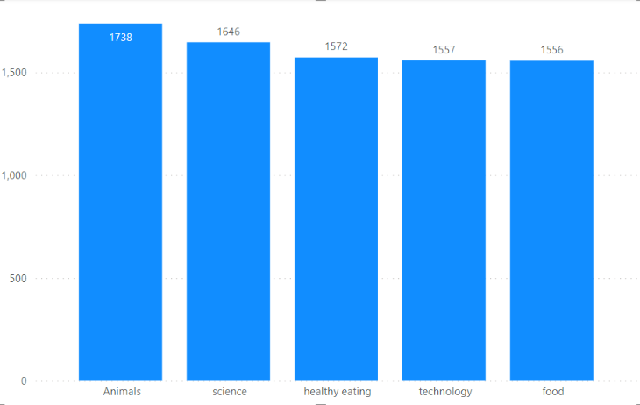
Notes:
From our analysis you can see that the top 5 most popular categories of posts were Animals, Science, Healthy Eating, Technology and Food in descending order.
Animals had an aggregate popularity score of almost 1738. It is very interesting to see both Food and Healthy Eating within the top 5, it really shows what people enjoy consuming such content. But also interesting to see Science and Technology too. Clearly users favor "real-life" content on this platform.

Slide 9
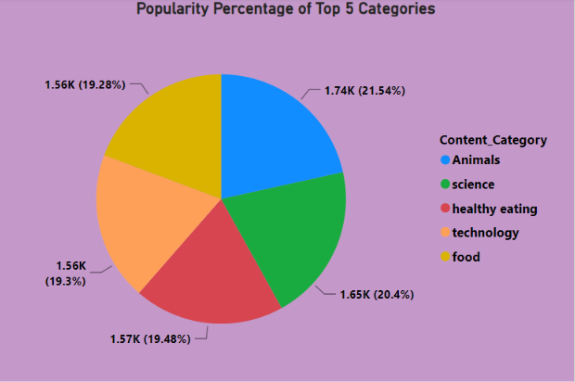
Notes:
Additionally, you can see from this chart the % split of popularity between the top 5 categories. There is not much difference between each of them, Healthy eating outperforms Food by 0.20% within the top 5. Science outperforms Technology by 1.1%.
However the difference between the 5th most popular, Food, and the 1st most popular, Animals, is much larger at 2.26%
This tells me that the categories sorted by popularity is weighted towards categories at the top. This means that it exhibits a "greedy" effect, the most popular categories get more popular whilst as you drop down the popularity rankings, you may see that they fall away drastically.

Slide 10

ANALYSIS
Animals category is the most popular category of content showing that people enjoy “real-life” and “Natural” content the most.
INSIGHT
Food is a common theme with the top 5 Categories with “Healthy Eating” ranking the higher than Food. This may give an indication to the audience within your user base. You could use the insight to create a campaign and work with healthy eating brands to boots user engagement.
Summary
NEXT STEPS
This ad-hoc analysis is insightful, but it’s time to take this analysis into large scale production for real-time understanding of your business. We can show you how to do this.
Notes:
So to summarize:
We tackled this task and found the top 5 most popular categories as asked, but we also went one step further.
We found that Food and Healthy Eating are among the popular categories, suggesting that users like healthy food content
We also found that Science and Technology are among the popular categories, suggesting that users like sci-fi content
We also found that Animals was the most popular suggesting people love to see real-life, nature a lot.
- As much as this analysis was insightful, we are ready to take it to the next stage and we have the expertise within Accenture to help you realize these kinds of insights in production across your organization and in real time. We would love to help you with this.

Slide 11
Thank you!
ANY QUESTIONS?
Notes:
Thank you very much for listening, please feel free to ask any questions that you may have!

