Slide 1
CSI Final Project
Shopaholic
Shop now!

Slide 2

Introduction
Do you or a loved one struggle with a shopping addiction?
Shopaholic is designed to replicate the feel of common shopping websites and apps.
It allows the user to go through the motions of shopping for items and replicate the act of buying the items online from within a shopping cart.

Slide 3

Inspiration
01
03
This project was inspired by a personal contact who has trouble with a shopping addiction, but people all around the world share this struggle.
This app is designed to be used by those with a shopping addiction, to reduce the amount of time these users will spend on real shopping websites.
02
04
Though it may not seem detrimental, this addiction can end up costing people thousands of dollars and can disrupt their lives.
Shopaholic will benefit those all around the world by creating a safe app that they can go through the motion of purchasing items without the risk of overspending.

Slide 4
What Our System Can Do
A
C
Allows users to view a variety of items as well as different options to add to a cart.
Users can choose the size, quantity, and color of said item and add to the cart or remove if they change their mind
B
D
Users can view a description of each item along with an image to get information regarding the product
The user can view their cart which displays all of the selected items, the total quantity of the cart, as well as the total price.

Slide 5
Special Features
Live updates within Cart
Random Discounts
Every time a user adds or removes an item, the quantity and total price of the items will be updated within the cart.
The app will choose a random item to discount and display this to the user with a Buy Now option

Slide 6
How We Worked Together
Kailey
Christina
Created the Item Class
Created the Shoe class, Jewelry class, as well as the subclasses containing each item and its methods
GUI for the shopping App main window, such as displaying the items, selecting the size, quantity, image, etc
Created the Shopping Cart Class
Created the Clothing item class as well the subclasses containing each item and its methods
GUI for viewing the user’s cart, confirming the purchase, removing the items, etc.

Slide 7
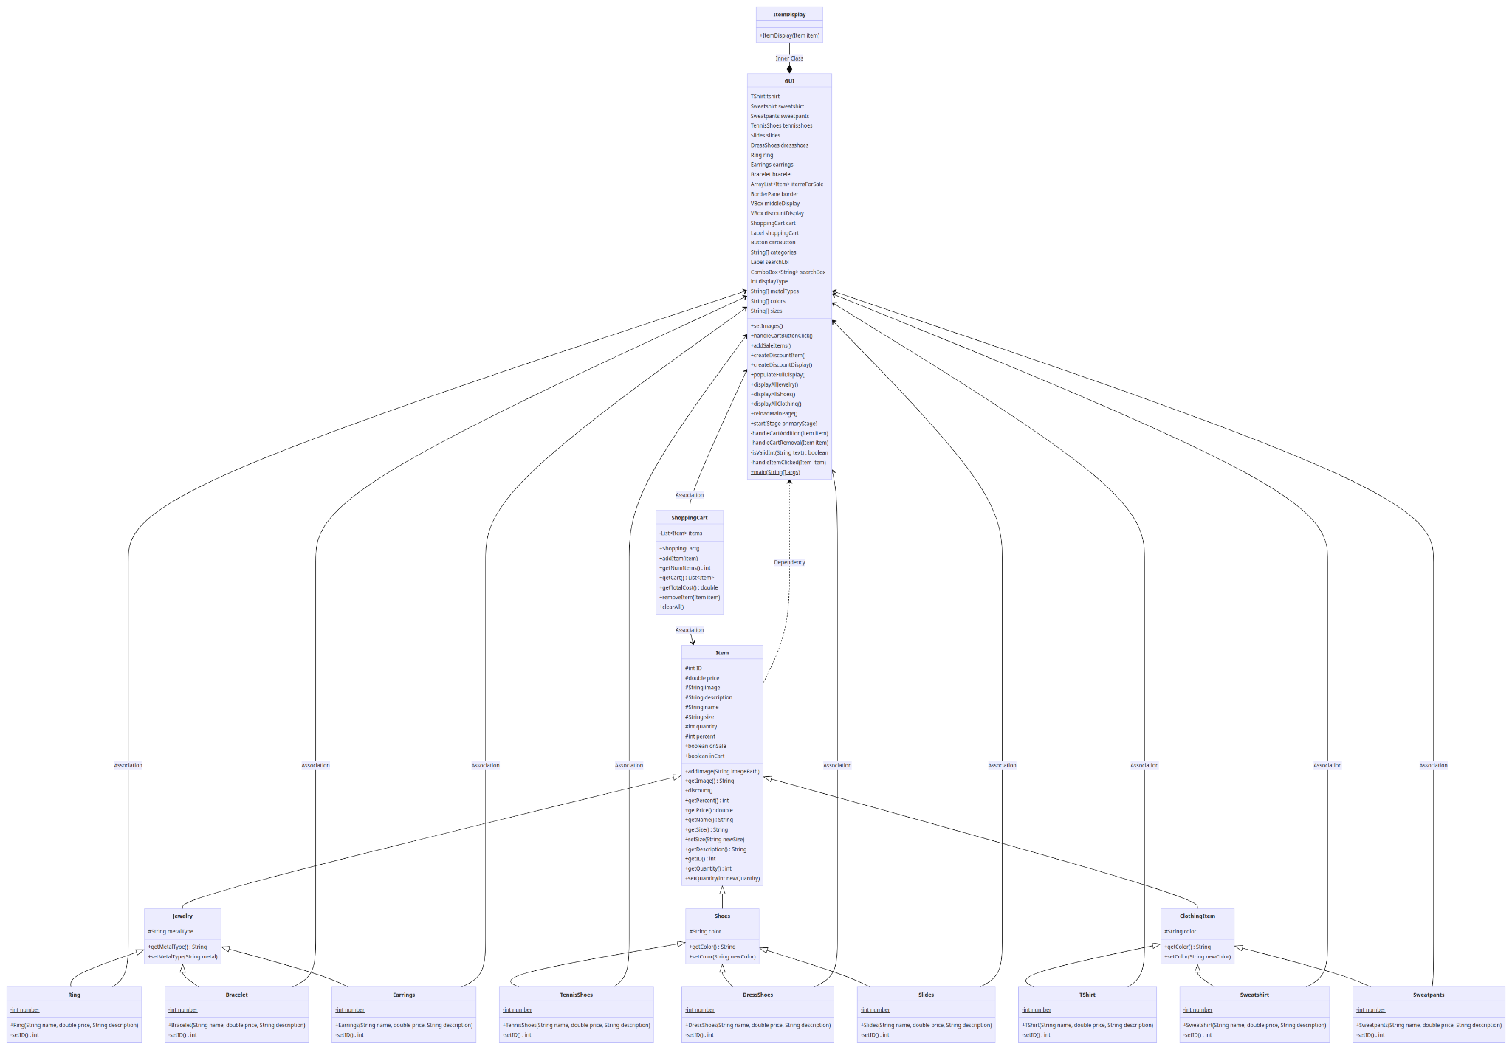
UML Diagram

Slide 8
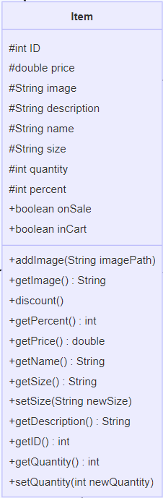
Abstract class for all the items available in the Shopaholic app
Item ID
Item Price
Image Path
Item description
Item name
Item size
Item quantity
Percent discounted
Whether item is on sale
Whether item is in a cart
The item class also includes methods available for use for all item objects
addImage(String imagePath): adds the inputted string as the image path for the item object
getImage(): returns the image path of the item as a string
discount(): generates a random discount on the item between 5% and 50% & indicates that the item is now on sale
getPercent(): returns the percent discount on the item
getPrice(): returns the price of the item as a double value
getName(): returns the name of the item
getSize(): returns the size of the item (S, M, L, XL)
setSize(String newSize): sets the size of the item to the inputted string value
getDescription(): gets the string description of the item
getID(): gets the integer ID of the item
getQuantity(): gets the integer quantity of the item
setQuantity(int newQuantity): sets the quantity of the item to the inputted integer value

Slide 9
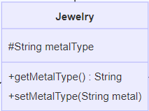
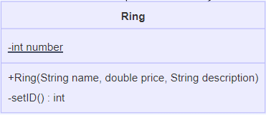
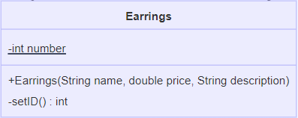
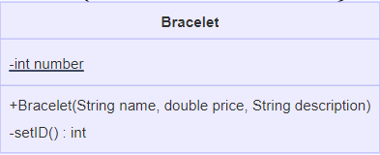
getMetalType(): returns the string value for the metal type assigned to the jewelry item
setMetalType(String metal): sets the type of metal of the jewelry to the passed parameter value
Jewelry class: an abstract subclass of the Item class for Jewelry type items
**Constructor sets the name, price, and description of the item type, & generates an ID for that instance
**The method setID() will return a 3 digit ID for each item instance using the number as the lowest value
*Ring items have IDs in the 100s
*Bracelet items have IDs in the 200s
*Earrings items have IDs in the 300s

Slide 10
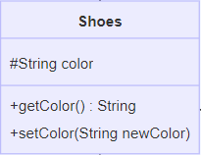
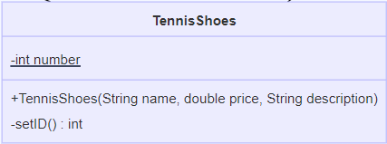
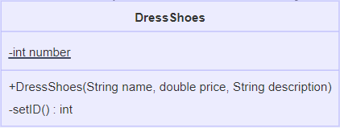
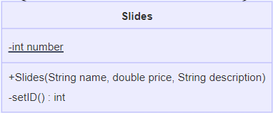
getColor(): returns the color string of the shoe item
setColor(String newColor): sets the color value to the value of the new color parameter
The abstract class Shoes is a subclass of the Item class for Shoe type items
ID Numbers: 400s
ID Numbers: 500s
ID Numbers: 600s

Slide 11
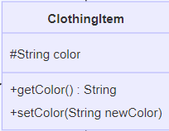
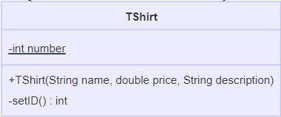
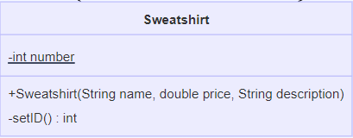
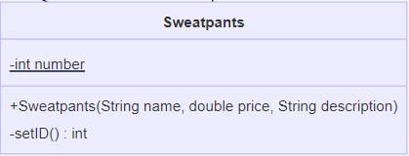
Clothing Item class is an abstract subclass of the Item class
ID Numbers: 700s
ID Numbers: 800s
ID Numbers: 900s

Slide 12
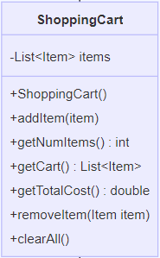
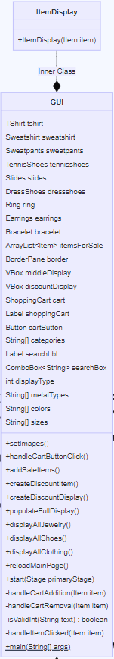
The class GUI contains all necessary functions and objects that allow for the user interface to be created and extends the JavaFX class Application
**contains all methods related to a shopping cart
**contains a list of Items which hold each item within the shopping cart
**creates an empty ArrayList assigned to the items field

Slide 13
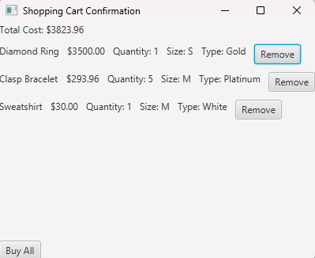

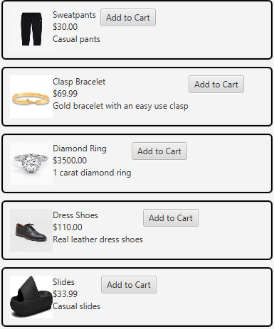
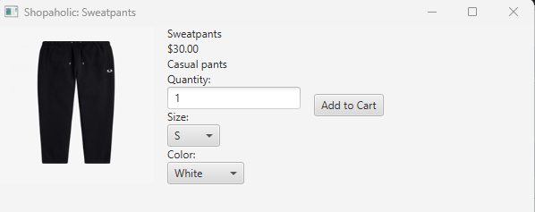
GUI Output

Slide 14
What We Learned
01
Within the coding process you have to anticipate every potential action/possibility
03
How to problem solve and collaborate effectively to overcome obstacles.
The smallest error in coding can cause system malfunctions
How to use different features of JavaFX to create a working interface
02
04

Slide 15
Systems’ Features
Youtube Link:
https://youtu.be/B7TGePpM-L0

Slide 16
So Who Wants to Try?
Live demo of application

Slide 17
THANKS!
Do you have any questions?
Follow the project updates
https://github.com/MacFadyenK/Shopaholic.git

