Slide 1
Fine-Tuning Musical Descriptions using a Large Audio-Language Model (LALM)
Kailey MacFadyen

Slide 2
Problem Statement
Approximately 15% of American adults report having some degree of hearing loss
In movies and other stories, music is used to enhance the experience and understanding
Those hard-of-hearing or otherwise unable to listen to music can be at a disadvantage in these situations

Slide 3
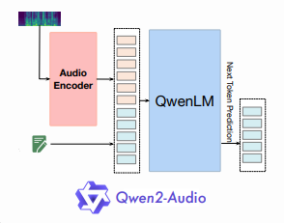
Solution
Fine-tune Qwen2-Audio-7B Large Audio-Language Model (LALM) to produce quality textual descriptions of music
LALMs work through integrating an audio processor/encoder in collaboration with an LLM architecture
Qwen2-Audio-7B is pre-trained on a variety of audio-related tasks
From [2]

Slide 4
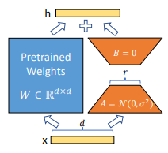
Low-Rank Adaptation (LoRA)
Reduces memory usage and storage for fine-tuning large models by freezing pretrained weights W and tuning matrices A and B. Weights are adapted using W + BA
Apply LoRA to Wq and Wv attention projections only to make fine-tuning possible in my limited memory environment: Trains only 0.0655% of the model parameters
From [3]

Slide 5
MusicCaps Dataset
Originally contains 5521 ten second music audio to human description pairs
When downloaded, a total of 4204 audio files were downloadable from YouTube while the rest were unavailable due to copyright, private videos, etc.
Data was split 70/15/15 into Training, validation, and testing set with end sizes of 2942, 631, and 631, respectively
A prompt was added to the beginning of the descriptions: “<|audio_bos|><|AUDIO|><|audio_eos|>Describe the music thoroughly:” to guide the task for generation

Slide 6
Metrics for Text Output
BLEU – modified n-gram precision
METEOR – improvement of BLEU using alignment of unigrams and synonym/paraphrase tables, combines precision and recall
ROUGE – Recall-Oriented Understudy of Gisting Evaluation
ROUGE-1: unigram recall
ROUGE-2: bigram recall
ROUGE-L: Longest Common Subsequence
BERT-Score – token similarity scores from BERT model embeddings, Includes Precision, Recall, and F1 scores

Slide 7
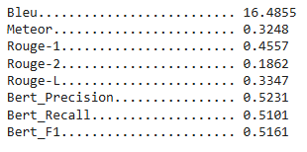
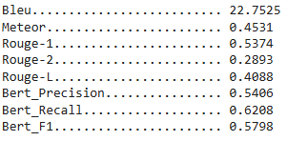
Results
REF : The low quality recording features an electro song that consists of a typical punchy "4 on the floor" kick pattern, wide and mellow synth pad chords and synth lead melody with wide echoing effects on. It sounds energetic and like a song from the early 00s.
Before Fine Tuning:
After Fine Tuning:
PRED: This is an electronic dance track. There are synth drums playing a four on the floor pattern with a high tempo. The bass line is very prominent and there is a melodic lead that sounds like it could be played in a trance song. This song can be played at nightclubs.
PRED: The low quality recording features a techno song that consists of wide synth lead melody, groovy synth bass and "4 on the floor" kick pattern. It sounds energetic and like something you would hear in nightclubs. The recording is noisy and in mono.
Notes:
Qualitative – more similar phrasing to original after fine-tuning, like the ‘low quality’ or ‘4 on the floor’ in quotations, but can repeat phrases and cut off suddenly.
Quantitative – after fine tuning, all metrics increased, but larger increases seemed to occur in the recall based metrics more than for precision, indicating that the model widened its range of topics to be more inclusive, but may still contain irrelevant information.

Slide 8
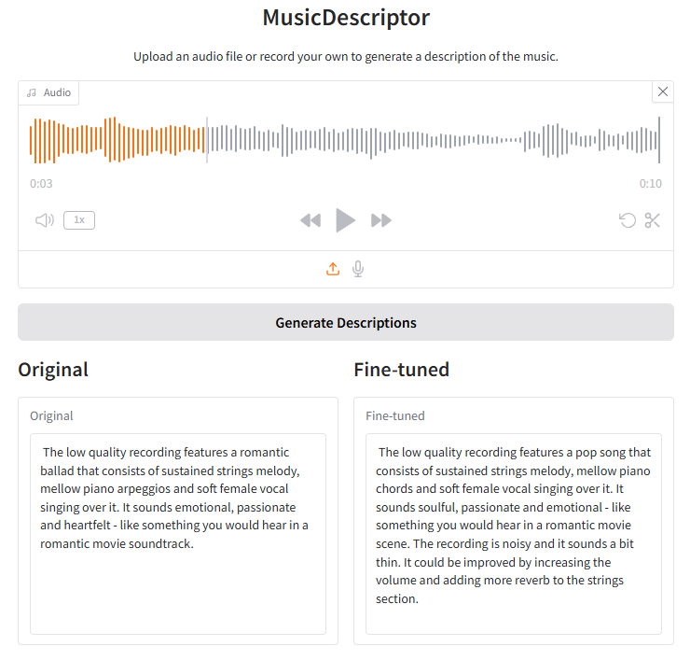
Demonstration and Comparison
Compared to other music description models, our model had similar scores for n-gram metrics (BLEU, ROUGE, METEOR) but lower scores for semantic similarity (BERT-Score)
Notes:
Other Models: LP-MusicCaps, MusiLingo, BLAP

Slide 9
What I Learned
How LALMs process both audio and text to formulate responses
How to fine-tune large models using limited memory and computation resources using LoRA
How to evaluate the quality of text responses of a description, summarization, or translation task using different metrics
How to create a custom data collator to pad batches to the same size
How to upload tuned models to HuggingFace so they can be loaded by others

Slide 10
Limitations and Future Work
Limited by computation power, memory, and time: Unable to explore a larger dataset or more intensive fine-tuning
All evaluations were done on the same dataset. Using a separate dataset for additional testing can be more robust testing of quality
The interactable interface is base-level and memory intensive – to make direct comparisons, both the base and tuned model must be loaded. A more developed app that uses API calls to a server to reduce local memory usage would be more accessible
Expand to have different categories of descriptions to chose from like emotional(explain how it makes you feel) or technical (explain chord progression, instrumentation, etc.)

Slide 11
Thank You! Questions?

Slide 12
References
[1] National Institute on Deafness and Other Communication Disorders (NIDCD), “Quick Statistics About Hearing, Balance, & Dizziness | NIDCD.” Accessed: Apr. 11, 2026. [Online]. Available: https://www.nidcd.nih.gov/health/statistics/quick-statistics-hearing
[2] Y. Chu et al., “Qwen2-Audio Technical Report,” Jul. 15, 2024, arXiv: arXiv:2407.10759. doi: 10.48550/arXiv.2407.10759.
[3] E. J. Hu et al., “LoRA: Low-Rank Adaptation of Large Language Models,” Oct. 16, 2021, arXiv: arXiv:2106.09685. doi: 10.48550/arXiv.2106.09685.
[4] K. Papineni, S. Roukos, T. Ward, and W.-J. Zhu, “Bleu: a Method for Automatic Evaluation of Machine Translation,” in Proceedings of the 40th Annual Meeting of the Association for Computational Linguistics, P. Isabelle, E. Charniak, and D. Lin, Eds., Philadelphia, Pennsylvania, USA: Association for Computational Linguistics, Jul. 2002, pp. 311–318. doi: 10.3115/1073083.1073135.
[5] S. Banerjee and A. Lavie, “METEOR: An Automatic Metric for MT Evaluation with Improved Correlation with Human Judgments,” in Proceedings of the ACL Workshop on Intrinsic and Extrinsic Evaluation Measures for Machine Translation and/or Summarization, J. Goldstein, A. Lavie, C.-Y. Lin, and C. Voss, Eds., Ann Arbor, Michigan: Association for Computational Linguistics, Jun. 2005, pp. 65–72. https://aclanthology.org/W05-0909/
[6] C.-Y. Lin, “ROUGE: A Package for Automatic Evaluation of Summaries,” in Text Summarization Branches Out, Barcelona, Spain: Association for Computational Linguistics, Jul. 2004, pp. 74–81. https://aclanthology.org/W04-1013/
[7] T. Zhang, V. Kishore, F. Wu, K. Q. Weinberger, and Y. Artzi, “BERTScore: Evaluating Text Generation with BERT,” in International Conference on Learning Representations (ICLR) 2020, Addis Ababa, Ethiopia: International Conference on Learning Representations, Feb. 2020. doi: 10.48550/arXiv.1904.09675.

