Slide 1
EEG-Driven Spiking Neural Network Virtual Keyboard
with CPU & FPGA Implementation
BE 4999 Winter 2026
Chloe Orlandi, Madalyn Fox, Kailey MacFadyen, Michael Josh Pasamba,
Ava Waligora, Mary Fayad, & Nicklas Hanson

Slide 2

Meet Our Design Team

Slide 3
Introduction

Slide 4
Introduction
Virtual Brain Computer Interface (BCI)
Project focuses on EEG driven virtual keyboard
Original scope was positive selection of eight letters - expansion to thirty-six alphanumeric characters.
Applications to improve communication with disabled or impaired.
Applications for industry + technology (faster/quicker communication)
Also opportunity for mapping and understanding of overall brain function.
Project Goal
Convert raw EEG data with stimuli into expected alphanumeric character display
High accuracy (above random success rate)
Low latency (fast selection for each character)
Low power consumption (efficiency)
Low cost (project budget $600)
Notes:
Mary

Slide 5

Introduction
EEG
Safe and non-invasive
Easy to measure/capture output of electrical signals
Analyze/classify through specific commands or regional brain activities
Classification
Process achieved through pipeline function.
Software and hardware requirements to complete character selection
Preprocessing and filtering of raw data
Feature extraction to identify correct positive response (P300)
Spike Neural Network (SNN) training and hyperparameters
Character selection probability matrix
Notes:
Mary

Slide 6
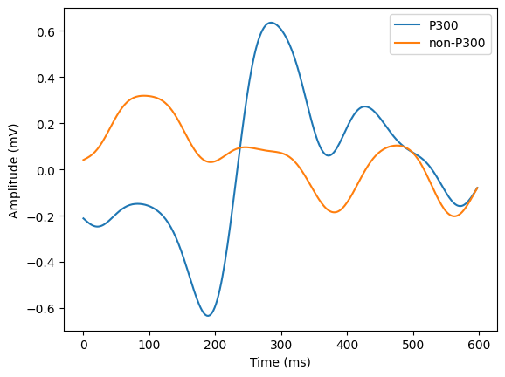
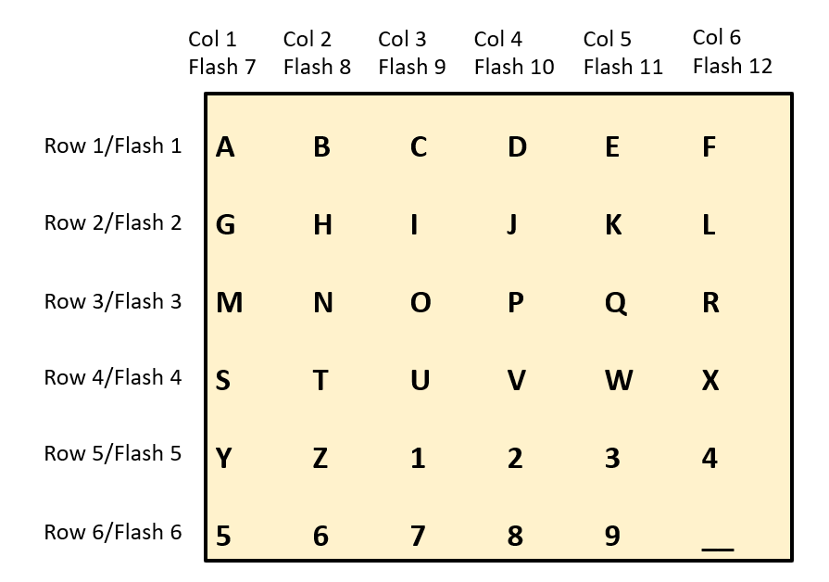
Introduction - P300 Signal
What is P300 Response?
Event-Related Potential (ERP)
Neural response to “oddball” stimulus
Positive peak occurs around 300ms from trigger
Use in Virtual Keyboard
1988 - Farwell and Donchin introduced P300 virtual keyboard [1]
Randomly flashing matrix of characters
Focus on character produces P300 signal when its row/column is flashed
Midline averaged P300 response
6x6 matrix of characters
Notes:
Mary

Slide 7
Introduction - Keyboard Selection
Alpha-numeric thirty-six character matrix
Project uses existing raw EEG data from other research sources
Background logic or understanding is required to explain character selection process
Thirty-six characters (entire English alphabet plus nine numbers and space bar) allow expanded communication capability.
Word or string can be created, but one character at a time.
Matrix
Simplest, but longest method - flash each character individually.
Row/Column probability calculation and intersection reduces number of flashes from thirty-six to only twelve.
Achieved through 6x6 flash matrix.
Notes:
Mary

Slide 8
Materials

Slide 9
Materials
System Components & Uses
FPGA Board & USB/Micro B Cable
Hardware implementation of SNN system
Power/communication between FPGA & computer
Computer
Development, training, and testing of full pipeline
MATLAB
Coding/testing for initial preprocessing
Python
Coding for full pipeline
Xilinx Vivado Design Suite
Design and synthesis of FPGA
VS Code & Google Colab
Development and debugging
Item Name | Quantity | Cost | Taxes | Total
Nexys A7 AMD Artix™ 7 | 1 | $290.00 | $17.40 | $307.40
USB/Micro B Cable | 1 | $2.99 | $0.18 | $3.17
Computer* | 1 | $0.00 | $0.00 | $0.00
Software Tools** | N/A | $0.00 | $0.00 | $0.00
EEG Database*** | N/A | $0.00 | $0.00 | $0.00
Project Total Cost: |  |  |  | $310.57
*Used personal laptops **Freely available software tools, with exception of MATLAB, which was accessed through Oakland University ***Used public database
Notes:
Chloe

Slide 10
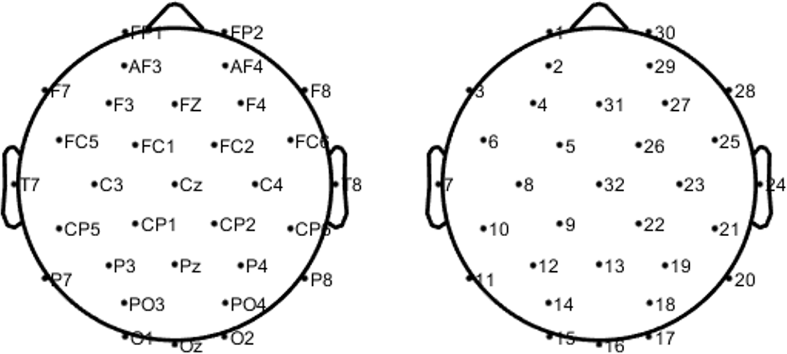
Materials – EEG Dataset
Dataset collected by Won et al. [2]
Collection Details
55 healthy subjects
32 electrodes
Sampling Rate: 512 Hz
Training Data
2 words: BRAIN & POWER
99000 total P300/non-P300 responses
Testing Data
Validation: word SUBJECT (385 chars), Final Testing: words NEURONS, IMAGINE, QUALITY (1155 chars)
EEG Electrodes in international 10-20 config [2]
Notes:
Kailey

Slide 11
Methods & Results

Slide 12
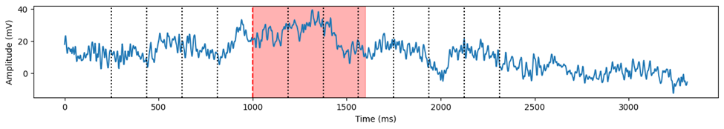
Preprocessing
Raw EEG Input [2]
Multi-channel EEG recorded during P300 speller task
Flash stimuli indicated by dotted lines
Epoch Extraction
Extract 600 ms window after each flash
Focuses on time region where P300 occurs [2]
Raw EEG data of one channel for one flash sequence, with 600 ms time window highlighted
Channel Selection
Selected 8 key EEG channels
Focuses on the most relevant neural activity [3]
Channel Number | 31 | 32 | 12 | 13 | 19 | 14 | 18 | 16
Electrode Name | Fz | Cz | P3 | Pz | P4 | PO3 | PO4 | Oz
Electrode channel mapping [2], with selected channels highlighted
Notes:
Michael

Slide 13
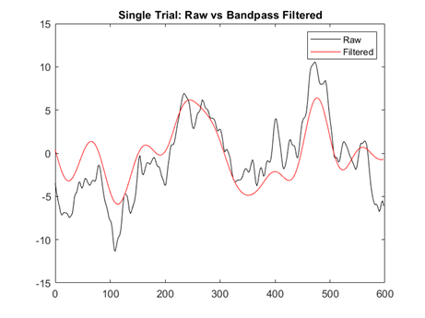
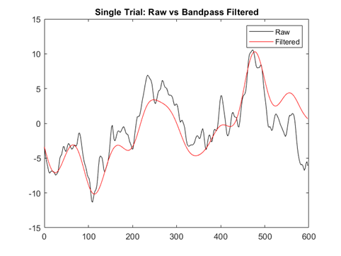
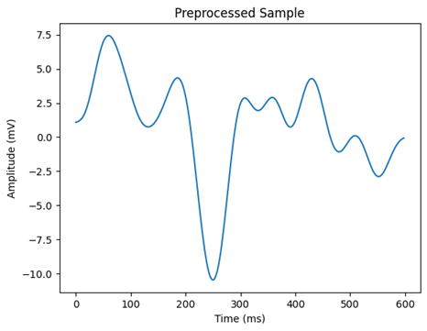
Preprocessing
Linear Detrending
Removes linear drift within each epoch
Baseline Correction
Subtract mean of 200 ms pre-stimulus window
Removes DC offset and signal drift
Bandpass Filtering
4th-order Butterworth filter applied
Tested for best cutoff frequency
Tested: 0.5-10 Hz vs 0.5-15 Hz
Compared raw vs filtered signals
Evaluated smoothing vs feature preservation
Selected: 0.5-15 Hz
Better balance of noise reduction and signal detail
Cutoff Frequency of Filter: 0.5-10 Hz
Cutoff Frequency of Filter: 0.5-15 Hz
Preprocessed 600 ms Epoch
Notes:
Michael

Slide 14
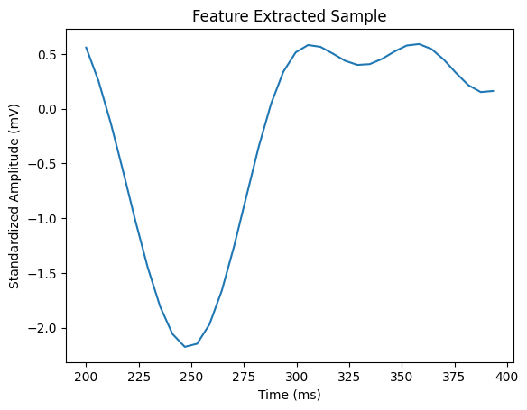
Feature Extraction
Purpose
Further reduce noise for classification
Time downsampling
Decimation by average (f=3): 512Hz -> 171Hz
Time Window
Narrow in on P300 signal (~300ms)
200-400 ms window accounts for subject and trial variation
Standardization
Standard scaler applied per channel
Example of a feature extracted sample waveform
Notes:
Maddie

Slide 15
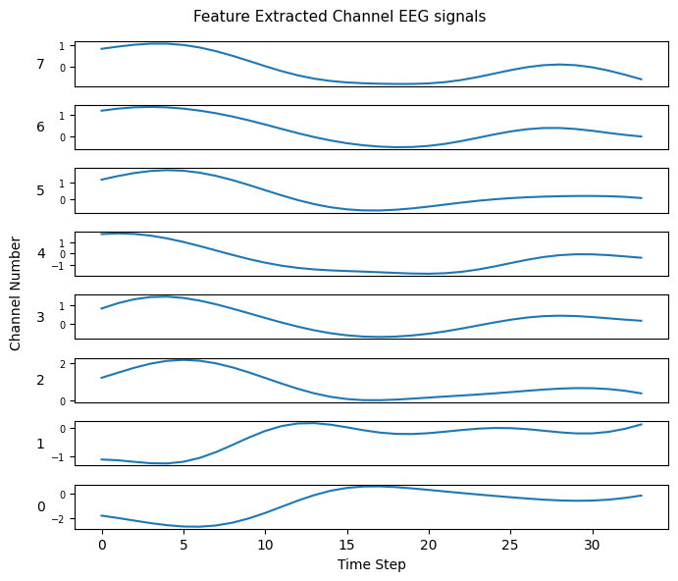
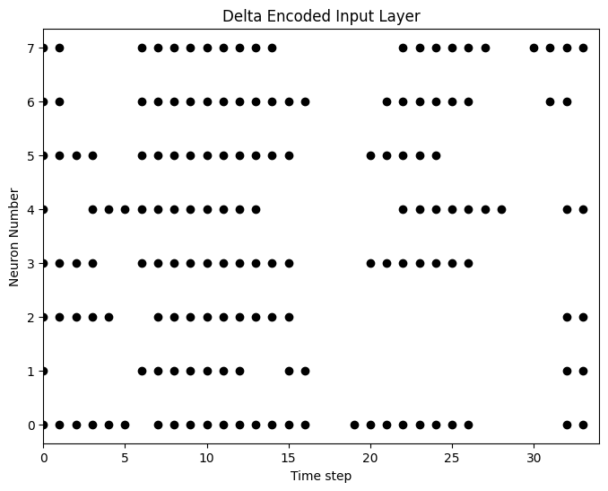
Spike Encoding
Purpose
Convert EEG signals into spike trains for SNN processing
Preserve temporal information while reducing unnecessary data
Method: Delta Encoding
Computes difference between consecutive time steps (Δ signal)
Spike generated if change exceeds threshold of 0.09
+1 → significant increase
–1 → significant decrease
Why Delta Encoding?
Lower spike density → reduced computational load
Captures dynamic signal changes
Improves temporal representation of EEG features
Notes:
Chloe

Slide 16
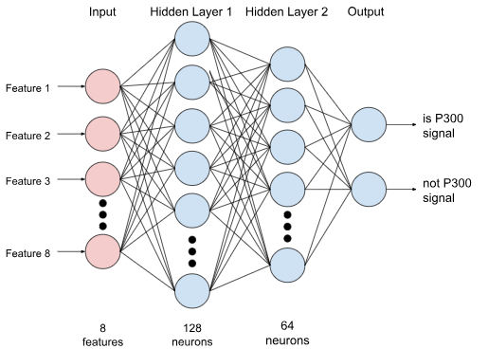
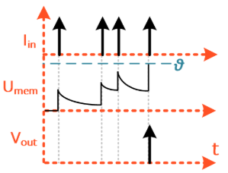
SNN Architecture
Purpose
Classify signal as P300 or non-P300
Structure
Fully Connected layers [8->128->64->2]
LIF neurons: Integrate incoming spikes, Membrane leak over time, Fire when threshold is reached
Leak constant (ꞵ): 0.95
Threshold: 1 mV
Justification
LIF neurons are simple but accurate
Simple implementation for FPGA transfer
Layer sizes allow for parallel computation on FPGA
Fully connected SNN. Pink: input features, Blue: LIF neurons
LIF neuron graphical representation [4]
Notes:
Kailey

Slide 17
SNN Training & Hyperparameters
 | Final Design Selection
Preprocessing | Filter Range | 0.5-15Hz
Feature Extraction | Downsample Factor | 3
 | Time Window | 200-400ms
Delta Encoding | Threshold | 0.09
LIF Neurons | Decay Constant (ꞵ) | 0.95
 | Threshold | 1
SNN Architecture | Hidden Layer Sizes | [128, 64]
 | Dropout | 0.1
Training | Surrogate Gradient Constant (k) | 10
 | Batch Size | 256
 | Epochs | 100
Training Structure
Surrogate Gradient Descent (SGD) and Backpropagation through time (BPTT)
Surrogate Gradient: Fast Sigmoid
Loss: Weighted Cross Entropy Loss on output Spike Rate
Dropout rate of 0.1
Adam optimizer
Learning rate: 5e-4 + scheduler monitoring validation loss plateau
Notes:
Kailey

Slide 18
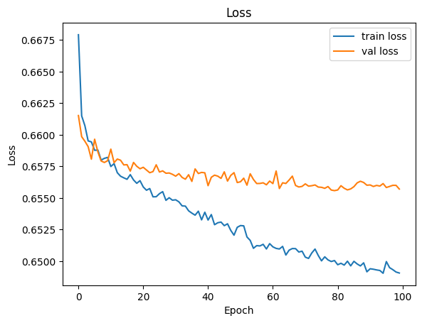
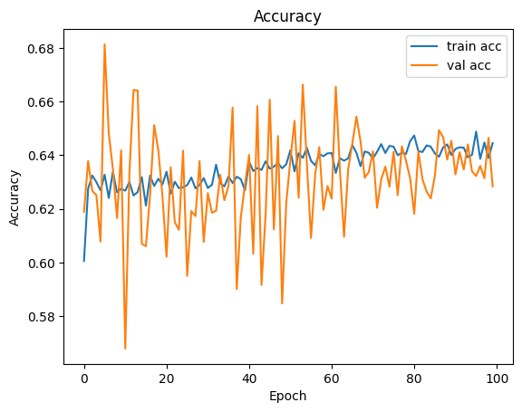
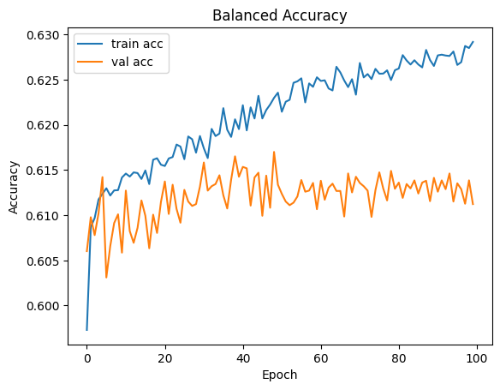
Training Validation
Avg output spike rate: 0.4078
Avg membrane max: 29.6930
 | Loss | Accuracy | Balanced Accuracy
Training | 0.6491 | 64.45% | 62.92%
Validation | 0.6557 | 62.84% | 61.12%
Testing | 0.6629 | 62.50% | 59.90%
Notes:
Kailey

Slide 19
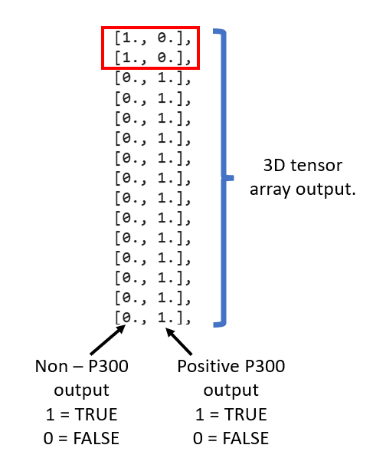
Character Selection
Probability Calculation
Each individual flash is pre-processed and completes SNN P300 identification.
Output is 3D tensor array for either positive or negative P300 signal.
Due to outside noise, output can have four options:
(0,0): Response is NOT non-P300 and NOT P300 positive
(1,0): Response is non-P300 but NOT P300 positive
(0,1): Response is NOT non- P300 BUT P300 positive
(1,1): Response is both non-P300 and P300 positive
Calculate the mean spike rate of positive P300 hits across timesteps to find probability percent value.
This probability percent calculation is only for the first flash.
Notes:
Ava

Slide 20
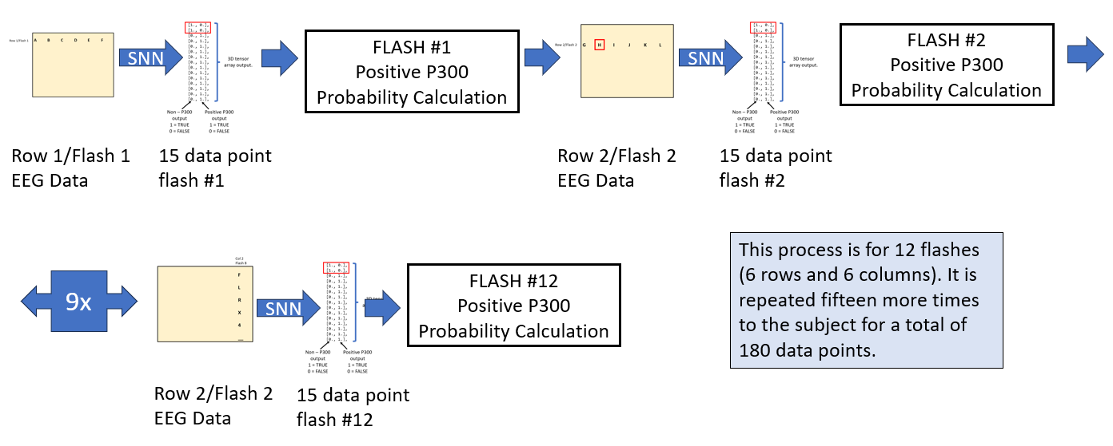
Character Selection
Probability Calculation
The probability calculation is completed for the twelve flashes of the 6 by 6 matrix (six individual row flashes and six individual column flashes).
In theory, there should only be one positive P300 row and one positive P300 column.
The 12 flashes required are then repeated a total of 15 times to help improve accuracy and eliminate noise factor influence (total of 180 flashes).
Notes:
Ava

Slide 21
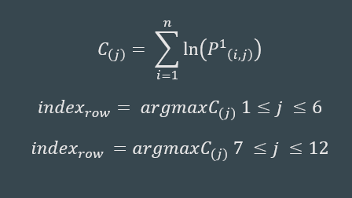
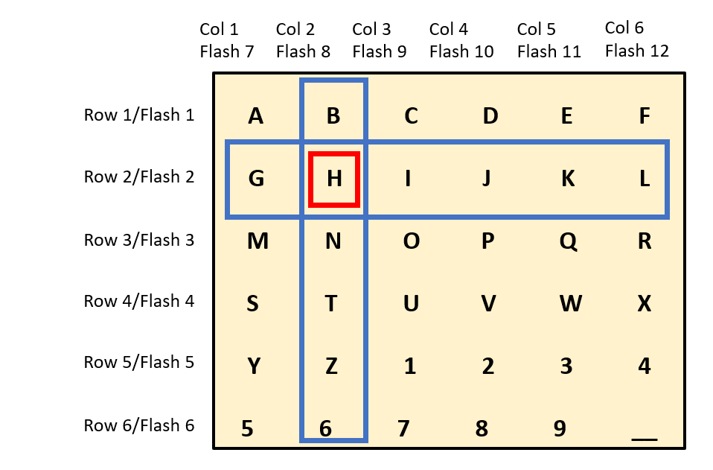
Character Selection
Probability Calculation
Each individual row and column flashed 15 times separately. The P300 positive probability is summed for each flash.
The character selection is the intersection of the highest probability summation row with the highest probability summation column.
The main improvement is only requiring twelve flashes with column/row intersection instead of thirty-six individual flashes [1].
Notes:
Ava

Slide 22
Field Programmable Gate Array (FPGA) Implementation Overview
Three Layer Connection
Input spike vectors are stored in read-only memory (ROM)
Weights are initialized using .coe files
Clock driven, synchronous architecture
Output spikes verified in simulation
Spikes loaded via .coe
Layer 1
(hidden layer 1)
Layer 2
(hidden layer 2)
Layer 3
(output layer)
Spikes Outputted [#,#]
Notes:
Maddie

Slide 23

FPGA Timing Diagram
Bias: Layer 1 - 5, Layer 2 - 14, Layer 3 - 11
Displayed neuron/ membrane potential evolution over a single timestep
Simulation run continuously to visualize layer-by-layer
Notes:
Maddie

Slide 24
FPGA Implementation - Execution and Validation
FPGA Architecture
Input spike samples are streamed from ROM, with one timestep (TS) processed per clock cycle
Internal logic control tracks the TS index and manage layer synchronization
Neurons perform parallel multiply-accumulate (MAC) operations using fixed point arithmetic
Validation Approach
Step by step neuron behavior validated with Excel reference model (membrane potentials, currents, accumulation)
Layer and timestep-specific outputs compared with CPU
Correct spike alignment observed in 16/34 timesteps, discrepancies likely from latency and scaling
*1 Subject Character Selection Accuracy: 4.8%
Output Comparison
Timestep | Expected (CPU) | Actual (FPGA)
1 ✓ | [0, 0] | [0, 0]
2 ✓ | [0, 1] | [0, 1]
3 ✓ | [0, 0] | [0, 0]
4 ✓ | [0, 0] | [0, 0]
5 ✓ | [0, 0] | [0, 0]
6 ✗ | [0, 0] | [0, 1]
Decent accuracy established through 34 time steps, first six shown in table.
Notes:
Michael

Slide 25
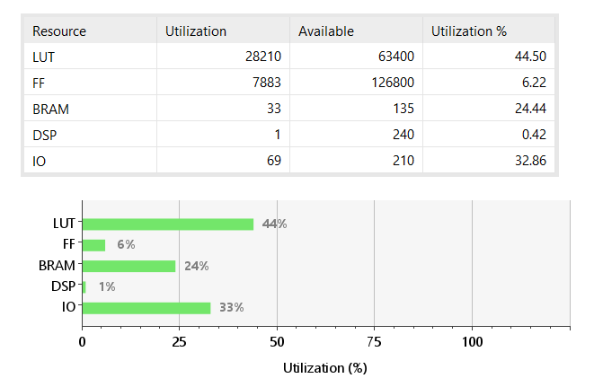
FPGA Implementation - Utilization
FPGA Utilization & Resources
Majority of usage in look-up tables due to parallel neuron computation
Minimal digital signal processing utilization (<1%) due to coding method selected
Available resources indicate remaining capacity to expand network size in future
Notes:
Michael

Slide 26
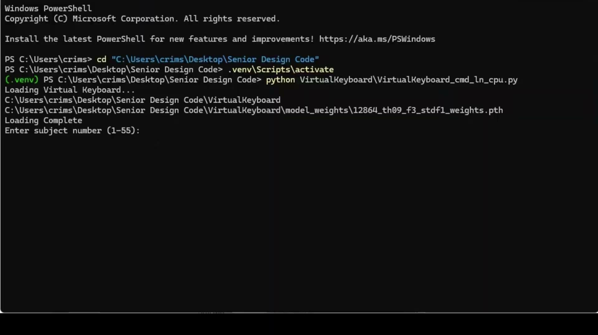
Pipeline Implementation
Command line demo
Loads desired character EEG data and outputs selected character from our system
Notes:
Kailey

Slide 27
Performance Evaluation

Slide 28
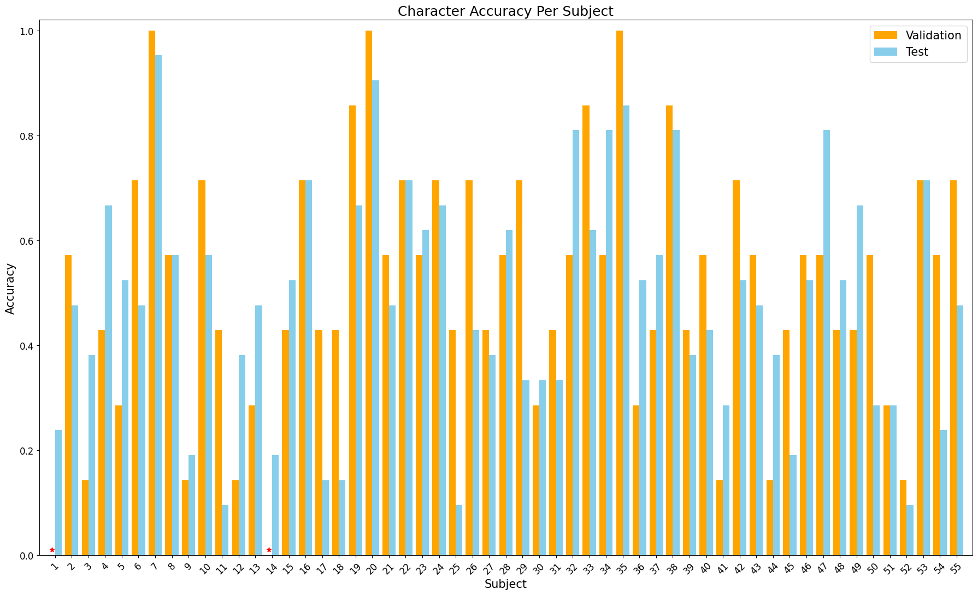
Character Selection Accuracy
Final CPU Accuracy:
48.31 ± 22.15%
Random weight Classifier:
9.35 ± 8.69%
Significance
Paired t-test:
p=8.85e-20 <<< 0.05
Accuracy is significantly above random baseline
Notes:
Ava

Slide 29
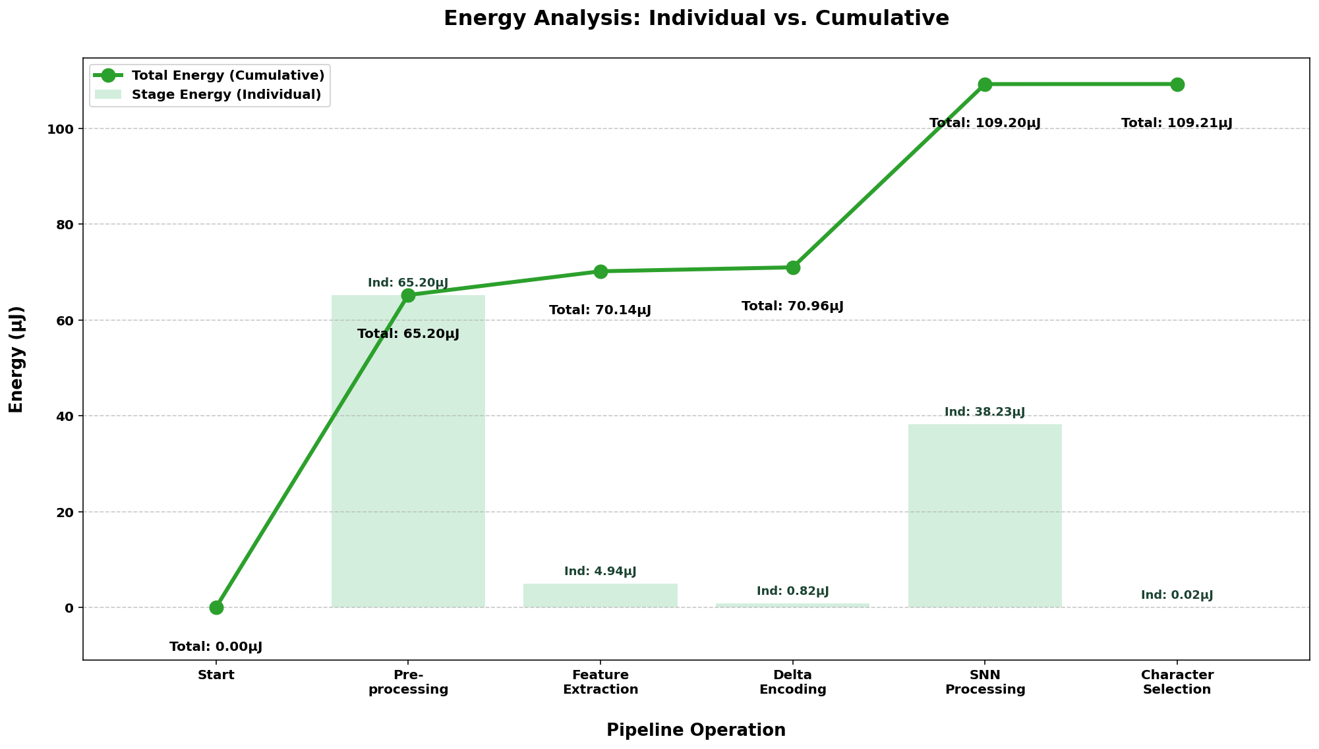
Energy
Purpose
Calculating the energy of each process quantifies the real cost of each stage of the pipeline
Method
Floating Point Operations FLOPs include addition, subtraction, multiplication or division
Multiplying the number of FLOPs and the energy of each FLOP in Joules
Observations
Preprocessing and SNN development consume the largest amount of computational energy
Notes:
Nick

Slide 30
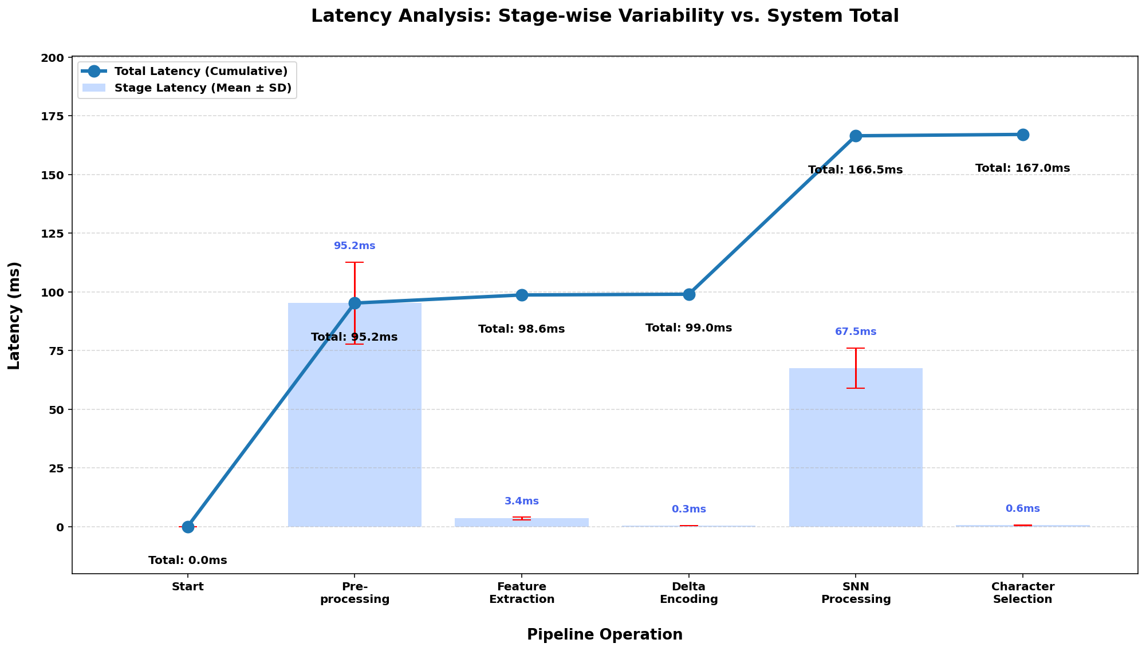
Latency
Purpose
Understand how quickly the virtual keyboard will output a character upon EEG input
To meet requirements, the total latency must be below 300ms
Method
The latency is determined by simply recording the time it takes to perform each operation by means of the CPU
Observations
Total CPU latency: 167 ms
Like with energy, preprocessing the data and developing the SNN contribute to the majority of the latency
Notes:
Nick

Slide 31
ANN Architecture & Training
Purpose
Used for performance comparison with SNN
Final Model Setup
Trained on same dataset, preprocessing, and feature extraction as SNN
Multilayer Perceptron (MLP) with ReLU Activations
Final Hyperparameters:
Dropout = 0.1
Batch Size = 256
Hidden Layers = [128, 64]
Epochs = 100
Learning Rate = 1×10-3
Weight Decay = 5×10-4
Training
Hyperparameters tuned to achieve performance comparable to SNN
Monitored:
Accuracy
Balanced Accuracy
Loss (training and validation)
 | Accuracy | Balanced Accuracy | Loss
Final Epoch (100) | 73.84% | 74.56% | 0.5106
Validation Set | 69.64% | 65.20% | 0.6574
Test Set | 69.26% | 64.32% | 0.6724
Notes:
Chloe

Slide 32
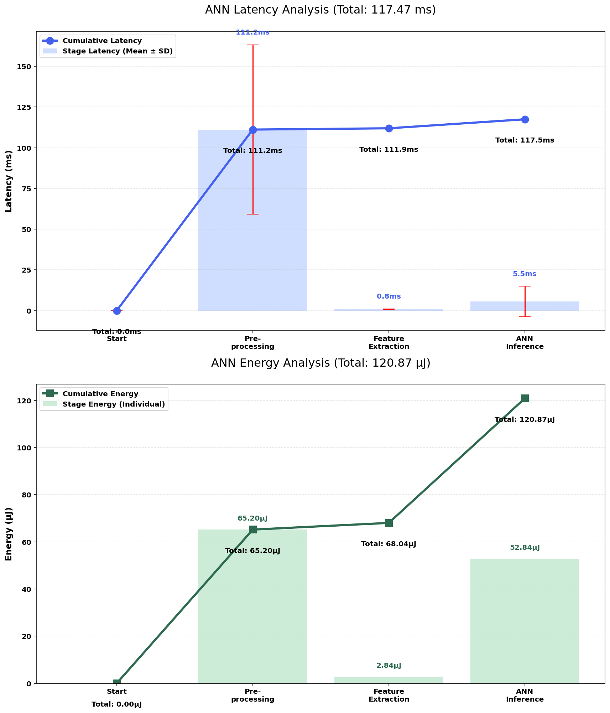
SNN vs. ANN - Energy
Comparison
SNN uses less energy than ANN, making it computational less expensive
Notes:
Nick

Slide 33
SNN vs. ANN - Latency
Comparison
Here the ANN occurs much faster, however, the code was ran on a CPU not built to handle spikes in parallel. If running the same SNN code on a device which uses parallel computation like the FPGA, the latency is much lower
Notes:
Nick

Slide 34
SNN vs. ANN vs FPGA
Latency (ms) | SNN | ANN | FPGA
Preprocessing | 95.2 | 111.2 | 95.2
Feature Extraction | 3.4 | 0.8 | 3.4
Delta Encoding | 0.3 | - | 0.3
SNN/ANN/FPGA | 67.5 | 5.5 | 13.7
Character Selection | 0.6 | - | 0.6
TOTAL | 167.0 | 117.5 | 113.2
Energy (uJ) | SNN/FPGA | ANN
Preprocessing | 65.2 | 65.2
Feature Extraction | 4.94 | 2.84
Delta Encoding | 0.82 | -
SNN/ANN/FPGA | 38.2/ 3.75E-5 | 52.8
Character Selection | 0.02 | -
TOTAL | 109.21/69.98 | 120.87
Notes:
Nick

Slide 35
Discussion

Slide 36
Project Successes & Key Achievements
Design Requirements | Final Outcome | Notes
Real-Time Operation | 167 ms latency (CPU) | Meets ≤ 300 ms requirement
Keyboard Functionality | 36-character alphanumeric layout | Exceeds 4-8 key requirement
Spike-Based Computation | SNN implemented | Used for final decision-making stage
Character Selection | Full working pipeline demo | End-to-end system completed
Classification Performance | Above random chance | Shows some meaningful learning of P300 signals
Cost Constraint | $310.57 total cost | Well below $600 limit
Reproducibility | Consistent evaluation methods | Consistent training/validation/testing
Notes:
Chloe

Slide 37
Problem Solving & Design Implementation
Preprocessing
Developed Three Preprocessing Functions:
Full Dataset with P300 vs non-P300 indicators
Full Dataset with Flash IDs
Simulated Real-Time Processing of a Single Character
Feature Extraction
Started with Static Feature Extraction
Issue: Lost Temporal Information from Waveforms
Switched to Time-Based Feature Extraction
Used downsampling and windowing
Better use of SNN temporal dynamics
Spike Encoding
Started with Deterministic Rate Encoding
Issue: Lost Temporal Information
Switched to Delta Encoding
Captures increases/decreases in signal
Fewer unnecessary spikes, and improved model performance
Notes:
Michael, Maddie, Chloe

Slide 38
Problem Solving & Design Implementation (cont.)
SNN Architecture & Training
Designed with FPGA memory + LUT usage in mind
Hidden layers from 256 → 128 to 128 → 64
Hyperparameters tuned through iterative testing
Training Challenges:
Sparse spikes
Non-differentiable gradients
Temporal behavior
Character Selection
Challenge: Epoch ordering, & tracking with additional variables
Computed row/column probabilities from flash matrix
Converted data handling from 2D → 1D
Final method uses log-based probability summation
More accurate and stable output
FPGA Implementation
Challenges: Designing, Implementing Three-Layer SNN, & Sequential Timing
Required designing a universal neuron with designated LIF-based formulas
Developed a generation method to upscale 128 neurons → 64 neurons → 2 neurons
Three Layer Connection between layers to declare specific state when each layer will run and ensure continuous membrane accumulation for individual samples
Notes:
Kailey, Ava, Maddie

Slide 39
Challenges & Limitations
Final accuracy ~50%: many typos could happen and hinder communication
Potential cause: inter-subject variability or architecture limitations
Managing timestep control and synchronization across layers added design complexity including incorporation of UART
Fixed-point arithmetic introduced precision loss vs. CPU floating point model
Drastic FPGA development learning curve within several weeks
Improving accuracy of FPGA board outputs
Notes:
Nick

Slide 40
Future Work & Potential Improvements
UART communication to and from FPGA to simulate real-time character selection using FPGA SNN.
Full pipeline FPGA implementation (Preprocessing -> Character Selection on FPGA)
Instantaneous use of neurons within neural network on FPGA vs. Sequential
Subject-specific SNN tuning
Confidence cut-offs for repetition number each character
Full Virtual Keyboard integration with real-time gathered EEG data
Notes:
Nick

Slide 41
Conclusion

Slide 42
Conclusion
Objective
Develop an EEG-based system for non-invasive assistive communication using a SNN
Methods
Data | P300 dataset (55 subjects), 8 selected EEG channels
Preprocessing | 600 ms epochs, baseline correction, bandpass filter, detrending, downsampling
Feature Extraction | Time windowing (200-400 ms), standard normalization
Spike Encoding | Delta encoding (threshold = 0.09) capturing signal changes with on/off spikes
SNN Classification | LIF neurons (β = 0.95, threshold = 1), architecture 8 → 128 → 64 → 2, trained with BPTT + surrogate gradients, weighted cross-entropy, Adam optimizer
Character Selection | Log-probability summation across rows/columns to select final character
FPGA Implementation | Deployment of SNN on FPGA with timestep-based processing and hardware validation
Notes:
Nick

Slide 43
Conclusion
Results
Successfully implemented in both software and FPGA (pseudo-real-time operation)
 | CPU | FPGA
Accuracy | 48.31 ± 22.15% | 4.76’%* | CPU above random baseline, but high subject variability *Single Subject - not above baseline
Latency | 167 ms | 113 ms | Within ≤300 ms total system
Energy | 109.21 μJ | 3.75*10^-5μJ | Energy was reduced after FPGA implementation
Impact
Highlights the impact in biomedical engineering of turning neural signal processing and computation into accessible and efficient assistive communication technology.
Notes:
Nick

Slide 44
References

Slide 45
References
[1] L. A. Farwell and E. Donchin, “Talking off the top of your head: toward a mental prosthesis utilizing event-related brain potentials,” Electroencephalography and Clinical Neurophysiology, vol. 70, no. 6, pp. 510–523, Dec. 1988, doi: 10.1016/0013-4694(88)90149-6.
[2] K. Won, M. Kwon, M. Ahn, and S. C. Jun, "EEG Dataset for RSVP and P300 Speller Brain-Computer Interfaces," Sci Data, vol. 9, no. 1, p. 388, Jul. 2022, doi: https://doi.org/10.1038/s41597-022-01509-w.
[3] D. J. Krusienski, E. W. Sellers, D. J. McFarland, T. M. Vaughan, and J. R. Wolpaw, “Toward Enhanced P300 Speller Performance,” Journal of Neuroscience Methods, vol. 167, no. 1, pp. 15–21, Jan. 2008, doi: https://doi.org/10.1016/j.jneumeth.2007.07.017.
[4] J. K. Eshraghian et al., “Training Spiking Neural Networks Using Lessons From Deep Learning,” Proceedings of the IEEE, vol. 111, no. 9, pp. 1016–1054, Sep. 2023, doi: 10.1109/JPROC.2023.3308088.

Slide 46
Acknowledgements
We would like to thank Professor Li for her guidance, support, and encouragement throughout this project.
We also would like to express our gratitude to Dr. Llammoca, for assisting us and providing valuable guidance on FPGA implementation.
Thank you to the Bioengineering Department for funding.
This project wouldn’t have been possible without the help, dedication, and guidance from our professors and faculty at OU, supporting our team every step of the way this semester!

Slide 47

Questions?
Check us out on GitHub:
https://github.com/MacFadyenK/VirtualKeyboard

