Slide 1
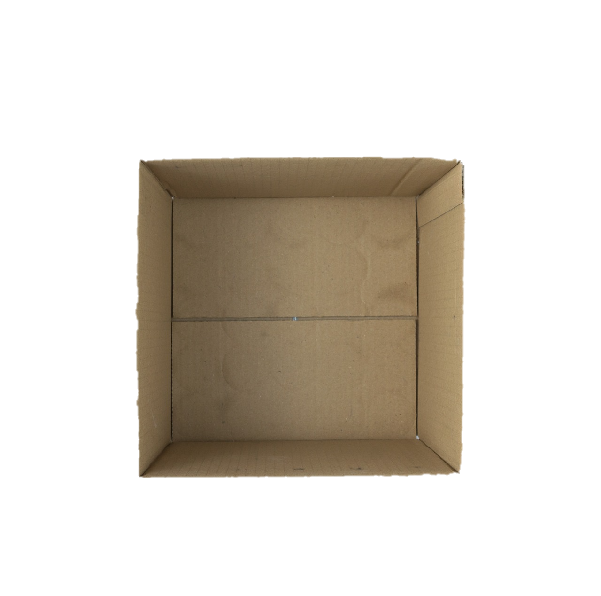
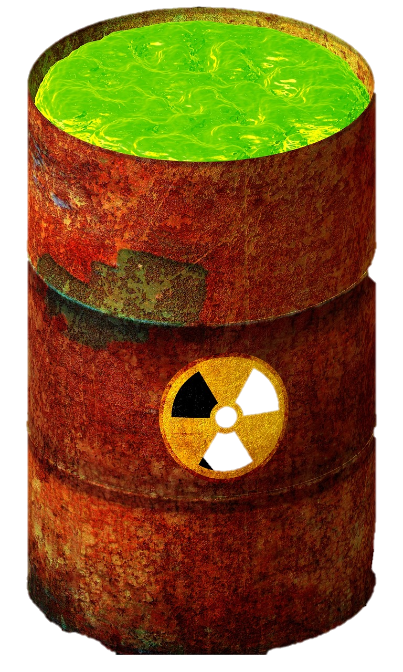
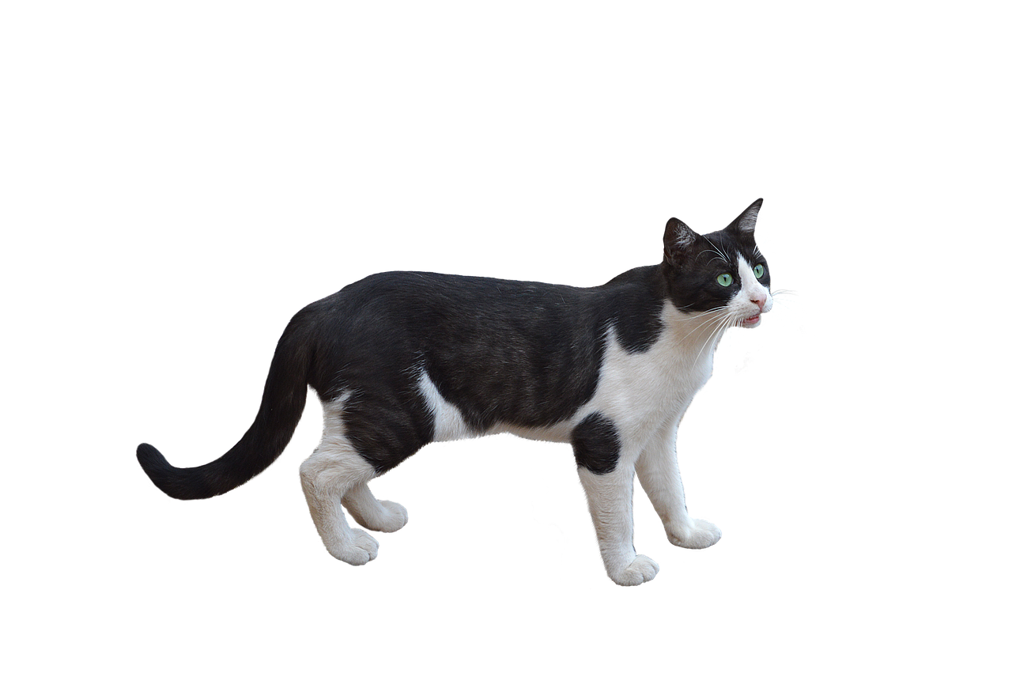
No real cats were harmed in the making of this gif
PLAD5
When unobserved, the cat is considered simultaneously alive and dead
Pretend this is a radioactive atom

