Slide 1
Introduction to R
EPID 799B
Xiaojuan Li
Victor Ritter
Fall 2016

Slide 2
Example data
N <- 500
var4 <- rnorm(n=N, mean=0, sd=1)
var5 <- rnorm(N, 1.2*var4+1, 2)
var6 <- 10 + var5
var1 <- rbinom(N, 1, 0.4 + 0.1*var4)
var3 <- rbinom(N, 1, 0.4 + 0.1*var5)
var2 <- ifelse(var1==1,"female","male")
exdat <- data.frame(var1, var2, var3, var4, var5, var6)

Slide 3
Overlay plots
# a. example from Wednesday
qplot(var4,var5, geom=c("point", "abline"))
# b. equivalent ggplot code
ggplot(exdat, aes(var4,var5)) + geom_point() + geom_abline()
# c. to pretty up
ggplot(exdat, aes(var4,var5)) + geom_point(aes(color=var2)) + geom_abline(linetype="dashed", size=1, colour="blue")

Slide 4
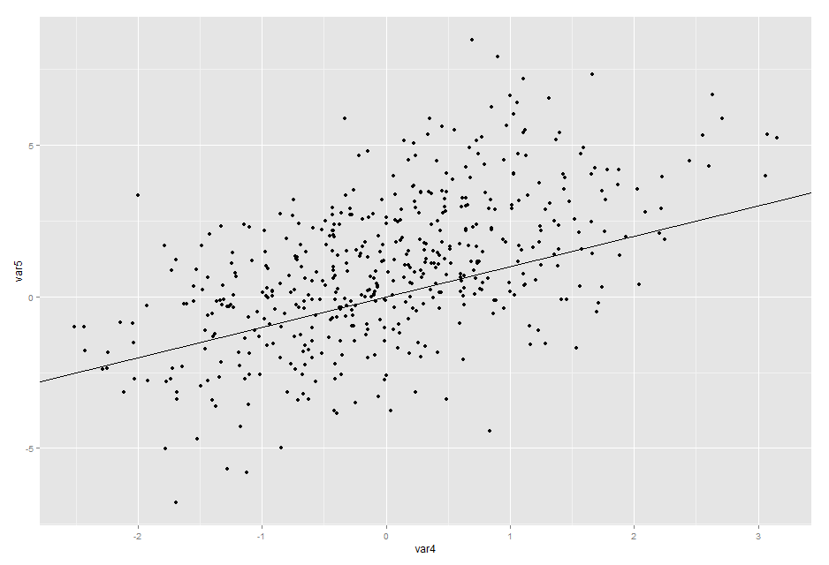
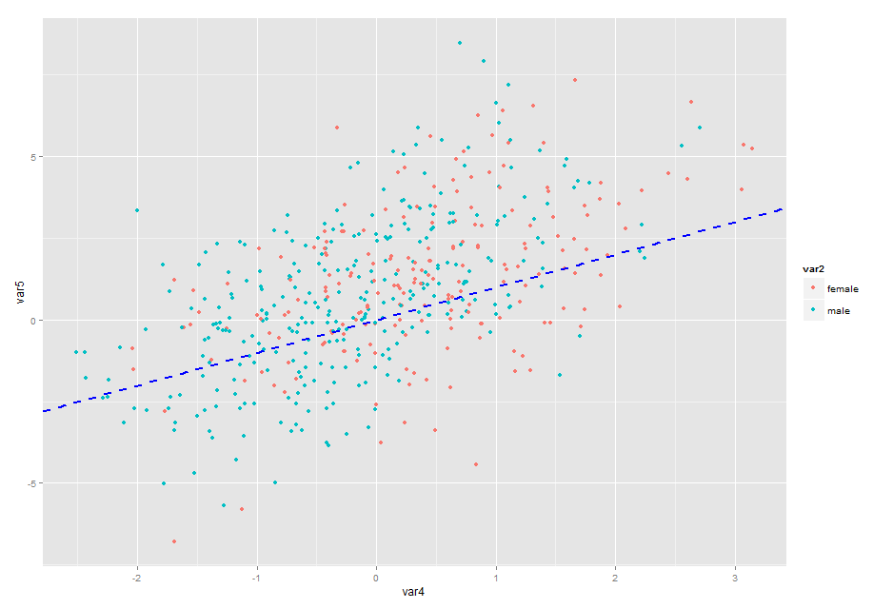
a & b
c

Slide 5
Add another layer
# scatter plot, a natural spline to the plot, grouped by var2, paneled by var4cat
ggplot(data=exdat, aes(x=var4,y=var5, shape=var2)) +
geom_point(size=2.5, alpha=0.5, na.rm=TRUE) +
scale_shape_manual(values=c(1,4)) +
geom_smooth(aes(color=var2, linetype=var2), method = "lm", formula = y ~ ns(x, 4), na.rm=TRUE) +
scale_colour_brewer(palette="Set1") +
theme_bw()+
facet_wrap(~var4cat)

Slide 6
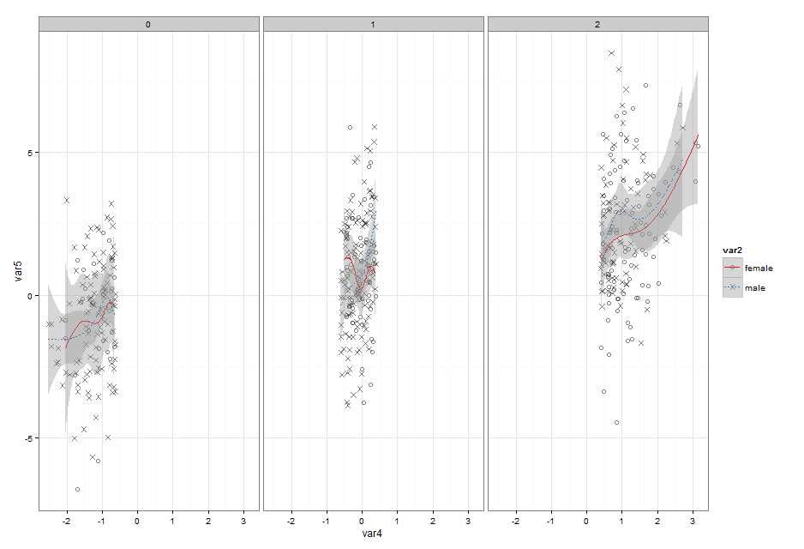

Slide 7
Multiple plots on a single page
# First plot
p1 <- ggplot(data=exdat, aes(x=var5)) + geom_density(na.rm=TRUE) + ggtitle("Density for var5")
# Second plot
p2 <- ggplot(exdat, aes(var4,var5)) + geom_point(aes(color=var2)) +
geom_abline(linetype="dashed", size=1, colour="blue") + ggtitle("var4 by var5")
# Third plot
p3 <- ggplot(data=exdat, aes(x=var4,y=var5, shape=var2)) +
geom_point(aes(size=1/var6, alpha=0.5), na.rm=TRUE) +
geom_smooth(aes(color=var2, linetype=var2), method = "lm",
formula = y ~ ns(x, 4), na.rm=TRUE) + ggtitle("natural splines")
# Fourth plot
p4 <- ggplot(data=exdat, aes(x=var5)) +
geom_histogram(fill="blue", alpha=0.3, binwidth=0.2, na.rm=TRUE) +
ggtitle("Histogram for var5") + facet_grid(var2 ~ .) +
theme(legend.position="none") # No legend (redundant in this graph)
library(gridExtra)
grid.arrange(p1, p2, p3, p4, cols=2)

Slide 8
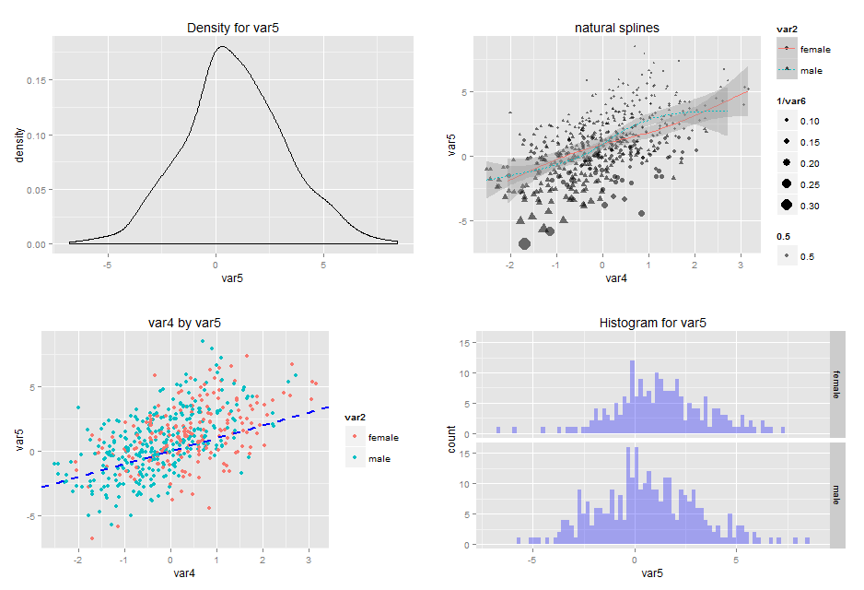

Slide 9
Multiple plots on a single page (Adv.)
p1 <- ggplot(iris, aes(x=Sepal.Length, y = Petal.Length, col=Species))+geom_point()
p2 <- ggplot(iris, aes(x=Sepal.Width, y = Petal.Length, col=Species))+geom_point()
p3 <- ggplot(iris, aes(x=Sepal.Width, y = Petal.Width, col=Species))+geom_point()
p4 <- ggplot(iris, aes(x=Sepal.Length, y = Petal.Width, col=Species))+geom_point()
grid.arrange(p1, p2, p3, p4, nrow=2)

Slide 10
Multiple plots on a single page (Adv.)

Slide 11
Multiple plots on a single page (Adv.)
# Function to save legend object
g_legend<-function(a.gplot){
tmp <- ggplot_gtable(ggplot_build(a.gplot))
leg <- which(sapply(tmp$grobs, function(x) x$name) == "guide-box")
legend <- tmp$grobs[[leg]]
return(legend)}
plotLegend = g_legend(p1)
p1 <- p1+theme(legend.position = "none")
p2 <- p2+theme(legend.position = "none")
p3 <- p3+theme(legend.position = "none")
p4 <- p4+theme(legend.position = "none")
lwidth = sum(plotLegend$width)
combinedPlots <- arrangeGrob(p1, p2, p3, p4, nrow=2)
grid.arrange(combinedPlots, plotLegend, widths=unit.c(unit(1, "npc") - lwidth, lwidth), nrow=1)
# http://people.duke.edu/~csm29/ggplot2/ggplot2.html#sec-10

Slide 12
Multiple plots on a single page (Adv.)

Slide 13
Multiple plots on a single page (Adv.)
xy <- ggplot(iris, aes(x=Petal.Width, y=Sepal.Length, col = Species))+
geom_point() + geom_density2d() + theme_classic()
xDen <- ggplot(iris, aes(x=Petal.Width, fill = Species, col=Species))+
geom_density(alpha=0.1) + theme_classic() + xlab("")
yDen <- ggplot(iris, aes(x=Sepal.Length, fill = Species, col=Species))+
geom_density(alpha=0.1) + coord_flip() + theme_classic() + xlab("")
leg <- g_legend( xDen )
grid.arrange(xDen+theme(legend.position = "none"), leg,
xy + theme(legend.position = "none"),
yDen + theme(legend.position = "none"),
nrow = 2, ncol = 2,
widths = unit(c(2,1), c("null", "null")),
heights = unit(c(1,2), c("null", "null")))
# http://people.duke.edu/~csm29/ggplot2/ggplot2.html#sec-10

Slide 14
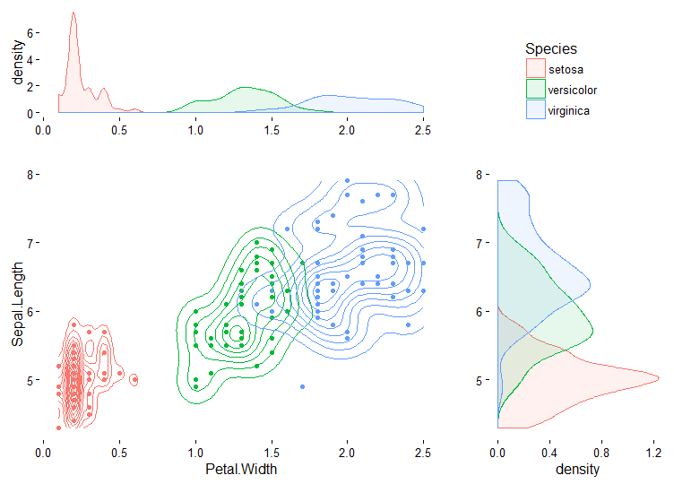
Multiple plots on a single page (Adv.)

Slide 15
Flip the axes
# flip the axes
ggplot(data=exdat, aes(x=var4,y=var5, shape=var2)) +
geom_point(aes(size=1/var6, alpha=0.5), na.rm=TRUE) +
geom_smooth(aes(color=var2)) +
xlab("Variable 4") + ylab("Variable 5") +
ggtitle("I am a meaningful title") +
theme(plot.title = element_text(lineheight=.8, face="bold")) +
coord_flip()

Slide 16
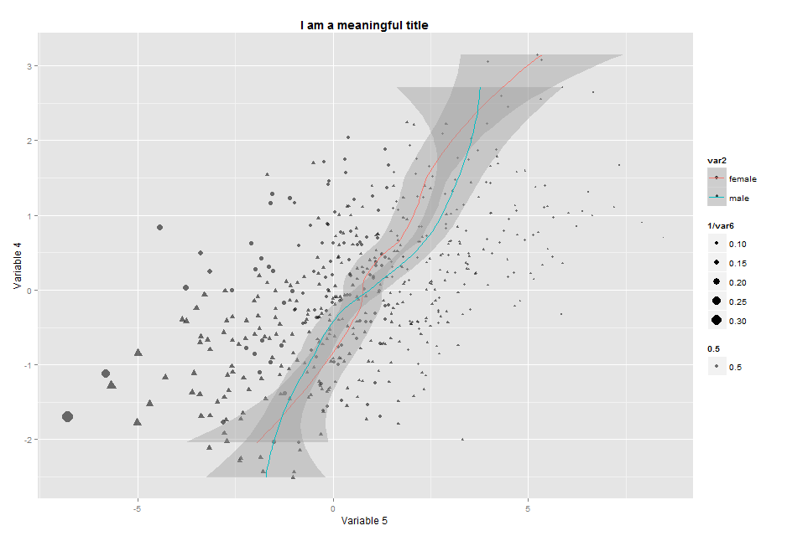

Slide 17

Output
One way – use the export option and then choose to save the figure as image or PDF
Another way – create a PDF file by running commands, this method works for most graphics in R
pdf("C:/Users/…/Documents/plot1.pdf", family="Times", width = 6, height = 6) # wd and ht are in inches for pdf, in pixels for png
print(ggplot(exdat, aes(var4,var5)) + geom_point() + geom_abline()) print(ggplot(exdat) + geom_histogram(aes(x=var4)))
dev.off() # turn off the graphic device

Slide 18
Output
Another simpler way – ggsave(), no need to print the ggplot objet then no need to turn off the graphic device
ggplot(exdat, aes(var4,var5)) + geom_point() + geom_abline()
ggsave("C:/Users/…/Documents/plot1a.pdf")

Slide 19
Output – Saving Multiple Plots
library(tidyr)
pdf('./ggplot/batch_mode.pdf')
iris %>%
gather(Attr, Measurement, -Species) %>%
group_by(Species) %>%
do({
gr <- ggplot(.) +
geom_boxplot(aes(x=Attr, y = Measurement)) +
labs(title = paste0(unique(.$Species)))
ggsave(paste0('./ggplot/', unique(.$Species), '_batch_mode.pdf'), gr)
print(gr)
data.frame()
})
dev.off()

Slide 20


Output – Saving Multiple Plots

Slide 21
Advanced Topics Working with Multiple Datasets
# 1. Usually all variables used are in the main data.frame
ggplot(data = iris) + geom_boxplot(aes(x = Species, y = Sepal.Length))
# 2. If not, option 1: create dedicated data.frame for the plot
# 3.1 Use multiple data.frames
df_bp <- boxplot(Sepal.Length ~ Species, data = iris, plot = F) %>%
with(data.frame(out, group))
ggplot(data = iris) +
geom_boxplot(aes(x = Species, y = Sepal.Length)) +
geom_text(data = df_bp, aes(x = group, y = out, label = out), hjust = -1)

Slide 22
Advanced Topics Working with Multiple Datasets
# 3.1 Using dplyr
find_out <- function(x) {
out <- x < quantile(x, 0.25) - 1.5 * IQR(x) | x > quantile(x, 0.75) + 1.5 * IQR(x)
return(ifelse(out, paste0(x, ' !!!'), NA))
}
iris %>%
group_by(Species) %>%
mutate(out = find_out(Sepal.Length)) %>%
ggplot(., aes(x = Species, y = Sepal.Length)) +
geom_boxplot() +
geom_text(aes(label = out), na.rm = T, hjust = -.5)

Slide 23
Advanced Topics Working with Multiple Datasets

Slide 24
Advanced Topics Working with Multiple Datasets

Slide 25
Advanced Topics Working with Multiple Datasets

Slide 26
Advanced Topics Working with Multiple Datasets
ggplot(iris, aes(Species, Sepal.Length, color = Species)) +
geom_boxplot(outlier.colour = NA) +
geom_jitter(position=position_jitter(width=0.1))

Slide 27
Advanced Topics Advanced Layering
library(gridExtra)
grid.arrange(
ggplot(mpg, aes(cty, hwy)) +
geom_point(colour = "darkblue"),
ggplot(mpg, aes(cty, hwy)) +
geom_point(aes(colour = "darkblue")) +
theme(legend.position = "bottom"),
ggplot(mpg, aes(cty, hwy)) +
geom_point(aes(colour = "darkblue")) +
scale_colour_identity(),
ncol = 3)

Slide 28
Advanced Topics Advanced Layering

Slide 29
Advanced Topics Advanced Layering
grid.arrange(
ggplot(mpg, aes(displ, hwy, colour = class)) +
geom_point() +
geom_smooth(se = FALSE) +
theme(legend.position = "bottom"),
ggplot(mpg, aes(displ, hwy)) +
geom_point(aes(colour = class)) +
geom_smooth(se = FALSE) +
theme(legend.position = "bottom"),
ncol = 2)

Slide 30
Advanced Topics Advanced Layering

Slide 31
Advanced Topics Advanced Layering
grid.arrange(
# here there is no legend automatically
df %>%
ggplot(aes(x=time, y=noise)) +
geom_line(color = "grey") +
geom_point(color = "red"),
# now with legend
df %>%
ggplot(aes(x=time, y=noise)) +
geom_line(aes(color = "Line")) +
geom_point(aes(color = "Points")),

Slide 32
Advanced Topics Advanced Customization
# Not there yet
df %>%
ggplot(aes(x=time, y=noise)) +
geom_line(aes(color = "Line")) +
geom_point(aes(color = "Points")) +
scale_colour_manual(name = '', values = c('Line' = 'grey', 'Points' = 'red')),
# Perfect!
df %>%
ggplot(aes(x=time, y=noise)) +
geom_line(aes(color = "Line")) +
geom_point(aes(color = "Points")) +
scale_colour_manual(name = '', values = c('Line' = 'grey', 'Points' = 'red')) +
guides(colour = guide_legend(override.aes = list(linetype=c(1,0), shape=c(NA, 16)))),
ncol = 2)

Slide 33
Advanced Topics Advanced Customization

Slide 34
Advanced Topics Advanced Customization
gg <- iris %>%
group_by(Species) %>%
mutate(out = find_out(Sepal.Length)) %>%
ggplot(., aes(x = Species, y = Sepal.Length)) +
geom_boxplot() +
geom_text(aes(label = out), na.rm = T, hjust = -.5)
library(extrafont)
grid.arrange(
gg + labs(title = 'Fancy title\nIn case you need more space') +
theme(plot.title = element_text(family = 'Trattatello', size = 20, lineheight = .6)),
gg + scale_y_continuous(labels = function(x) paste('SL =', x)),
gg + theme(axis.text.x = element_text(angle = 45, size = 15, vjust = .5)),
ncol = 2)

Slide 35
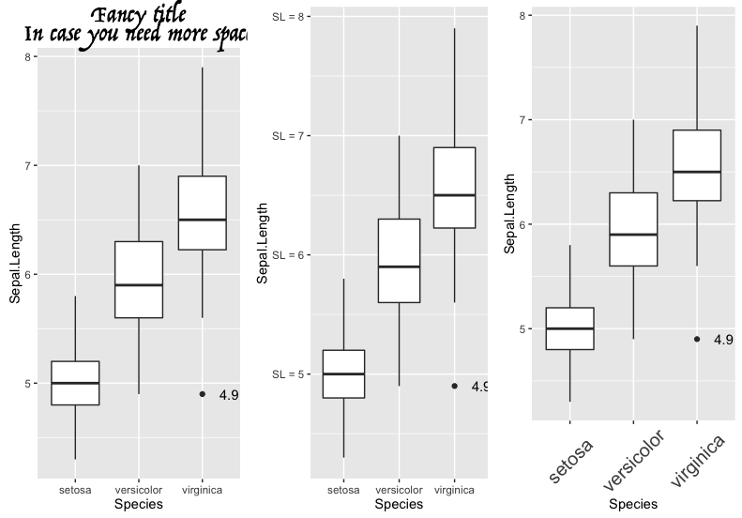
Advanced Topics Advanced Customization

