Slide 1
Multi-Level Modeling
Nathaniel MacNell
EPID 799B
Fall 2016

Slide 2
Overview
What is multi-level modeling? Why use it?
What are the types of multi-level models?
How do I put them into R?
Other considerations

Slide 3
A Note on Terminology
Lots of different classification systems
Some example terms for what we are talking about:
Multilevel models
Heirarchical models
Fixed, mixed, random effects models
Nested models
GEE

Slide 4
Why Multi-Level?
Useful when you have clustered data:
GLM assumes independent observations
Benefits:
Can be used to control for unmeasured confounders or remove nuisance parameters
Can improve precision of estimates
Can estimate effects at multiple scales

Slide 5
Multi-level Data
Data for multi-level modeling includes:
Individual covariates
Group-level covariates
Group identifiers

Slide 6
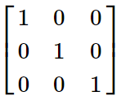
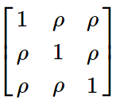
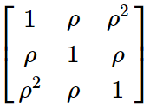
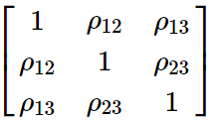
Generalized Estimating Equations
Handles clustering in the outcome covariance matrix. (No confounding control; more popular in biostatistics than as an epidemiology method)

Slide 7
Random vs. Fixed Effects
Imagine that each cluster (person) has their own individual intercept (instead of an overall intercept). We could model this intercept in two ways:
Consider it like another “error” term, but at the level of the cluster (each observation has two intercepts that are added together). [RANDOM]
Consider it like another parameter of the model to estimate (make a categorical variable ID variable). [FIXED]

Slide 8
Mixing random and fixed effects
Coefficients can have fixed and random effects too! This bring us to the idea of mixed models:
Add an “error” term to individual-level beta coefficient (allowing the effect to differ between groups around some mean effect). [RANDOM]
Estimate beta coefficients separately for each group (i.e. add an interaction term between individual-level beta and group ID). [FIXED]

