Slide 1
L21 GIS
EPID 799B
Mike Dolan Fliss
Fall 2016
11.06.2016
If you’re reading this and want to follow along today…
(1) Install QGIS. (2) Install the following R packages if you don’t have them : sp, maptools, rgeos, ggthemes, broom, rgdal,
Notes:
This is going to be less “how to” and more “this can be done.”

Slide 2
GIS
Geospatial Information Systems
ArcGIS
QGIS (free!)
R (free!)
Some generic language
Some examples
CAFOs
Crime rasters
Zip/counties
births!
Last notes:
Geocoding, APIs, etc.

Slide 3
What is a GIS?
Makes working with spatial objects easier
Polygons, lines, points, raster surfaces
Makes spatial math easier
Spatial relational operations, like join, intersect, etc.
Spatial over!
Spatial regression (lag vs. error)
Epidemiology Relevance: Person, Place, Time
Are there epi questions not related to space?

Slide 4
What is a GIS?
Polygons
Administrative boundaries
Activity spaces
Buffers
?
Points
People
Point sources of exposure
Incidents (e.g. injuries, )
Objects (e.g. wells, etc.)
?

Slide 5
What is a GIS?
Lines
Travel networks
Networks / proximities (contagion related)
Raw (crow) or travel distances
Rasters
Continuous exposures (e.g. environmental)
Continuous populations

Slide 6
Traditional GIS: ArcGIS v. QGIS
ArcGIS
you’ve got it for now! $$$
The SAS of the GIS world.
QGIS
Free forever
The R of the GIS world
Download it now!
Benefits: WYSIWYG (“Wizzy-wig”)
Downsides: You have to see/do it (by “hand”).*
Notes:
Technically there are some ways to automate Arc and QGIS, but it’s tougher. Nice thing about R is you can weave the recoding and vis all together. Still

Slide 7
Why R for a GIS?
Cons
Not WYSIWYG
Takes more start-up learning
Probably still will make production graphs in a GIS (or inkscape)
Pros
Not WYSIWYG!
Quick plots can be Great.
Integrate coding, analysis, graphs and visuals

Slide 8
R for a GIS: Packages
sp: for the objects and some viz.
maptools:
broom: for tidy().
ggplot2: for viz!
raster: for rasters (good guess)
…and others.

Slide 9
R for a GIS: Objects
Spatial objects are just aggregations of other objects we know. But now they are truly objects with “slots.” Use @ to reference a slot.
E.g. spdf = SpatialPolygonDataFrame object
spdf@data is the dataframe, linked to the shapes. So you can do stuff like spdf@data$column_name. Or, for short, spdf$column_name.
Let’s take a look in R!

Slide 10
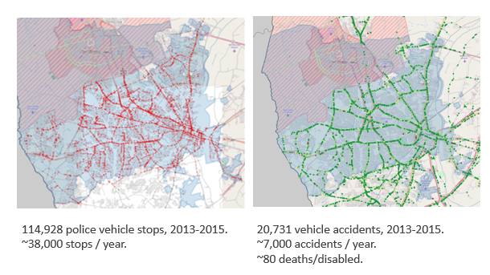
Examples: “Crime” rasters
Let’s think through this…

Slide 11
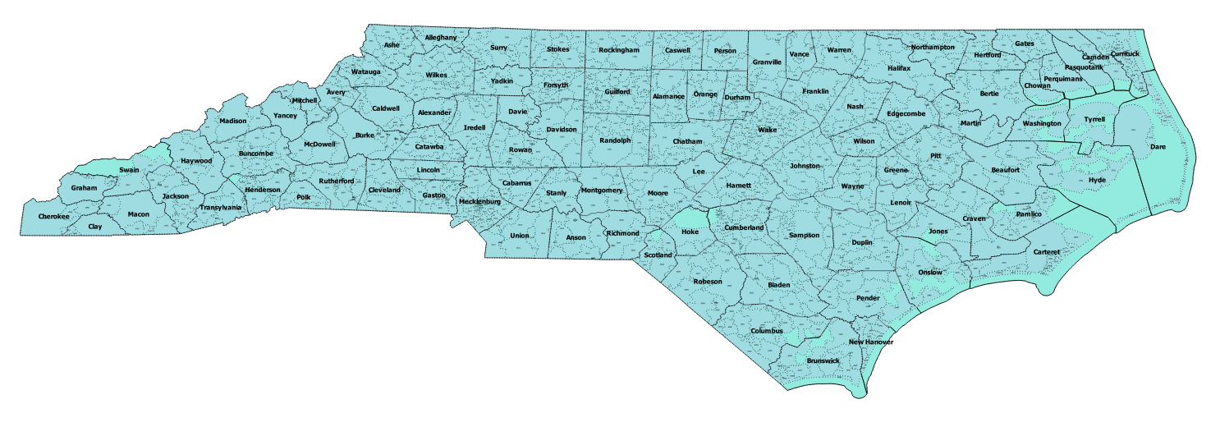
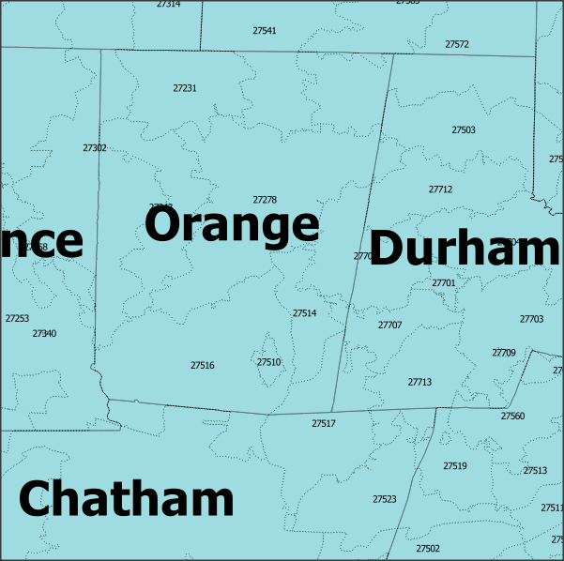
Examples: NC DETECT
Let’s think through this…

Slide 12
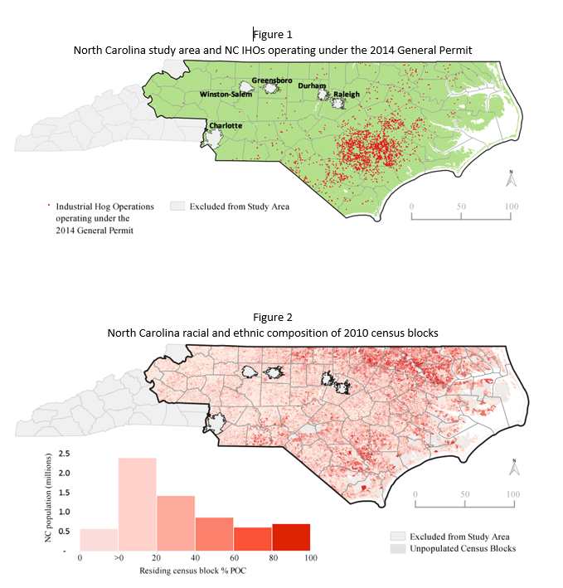
Examples: CAFOs
Let’s think
through this…

Slide 13
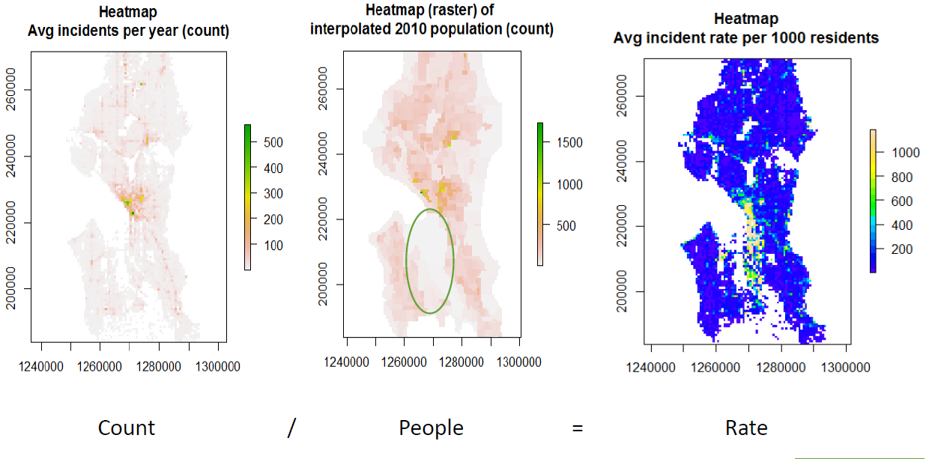
Examples: rate rasters (surfaces)

Slide 14
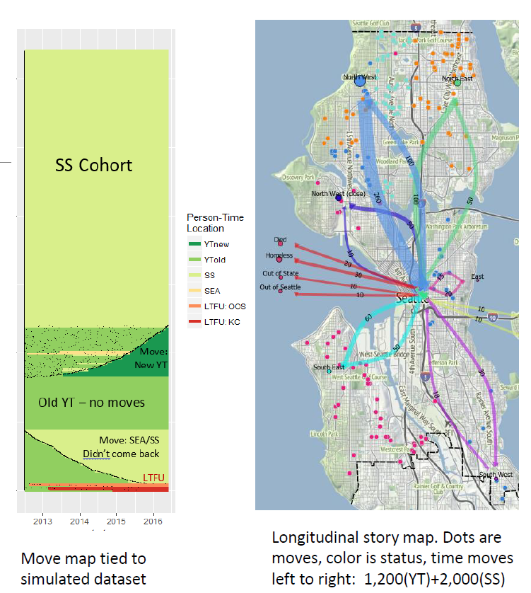
Examples: Mapping moves

Slide 15
Thinking Spatially
What about you?
Quick small groups work – 5 minutes. Report out!

Slide 16
Random Notes
Projections
Alternative geometries: Maps are not always best.
Cartograms
Pop bins
Etc.

Slide 17
Questions?

