Slide 1




X

Slide 2
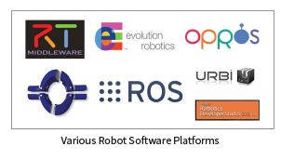
Robot Software Platform
Need for a platform that helps us
Make reusable program
Handles the communication
Support for development tools

Slide 3
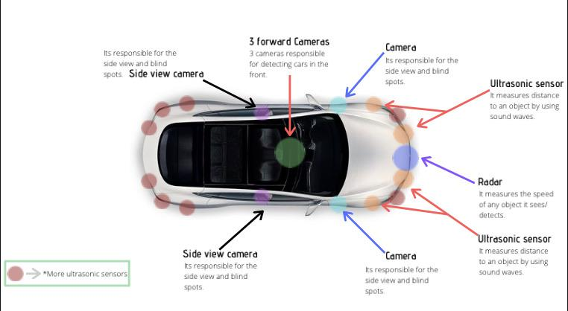
Think of car like Tesla

Slide 4
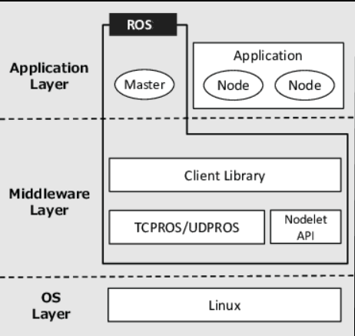
Robot Operating System
ROS is an open-source meta operating system
It provides the services you would expect from an operating system, including hardware abstraction, low-level device control, message-passing, ……………….

Slide 5

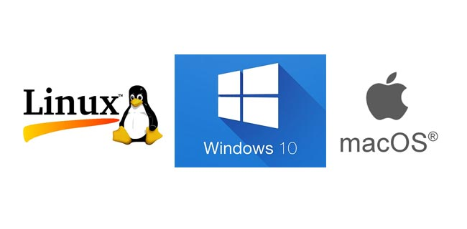
Why ROS
Community
Proven in Use
Multi-domain & Multi-platform
Functionality
Notes:
ROS is relied upon throughout the robotics industry. It’s the norm for teaching robotics. It’s the basis for most robotics research, from single-student projects to multi-institution collaborations and large-scale competitions. And it’s inside robots that are running in production all around the world today. In the autonomous mobile robot (AMR) alone, ROS has helped to create billions of dollars in value.
Linux, Windows, and macOS

Slide 6
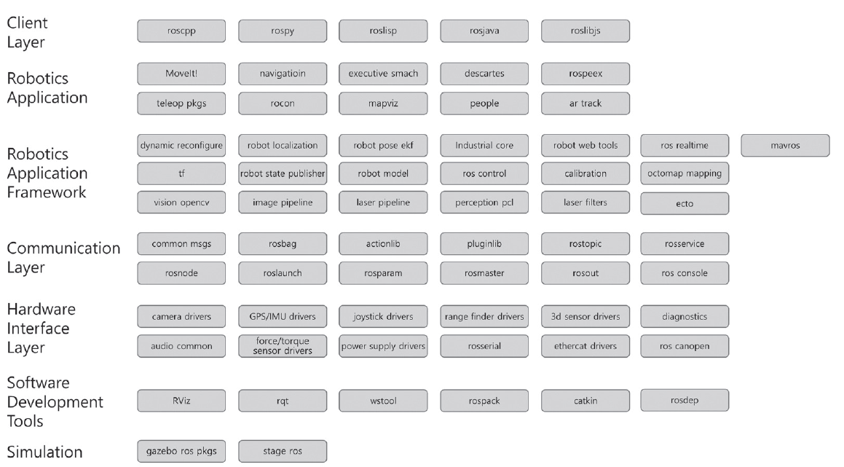
Components of ROS
Notes:
As shown in Figure 2-3, ROS consists of a client library to support various programming
languages, a hardware interface for hardware control, communication for data transmission
and reception, the Robotics Application Framework to help create various Robotics Applications,
the Robotics Application which is a service application based on the Robotics Application
Framework, Simulation tools which can control the robot in a virtual space, and Software
Development Tools.
Need changes

Slide 7
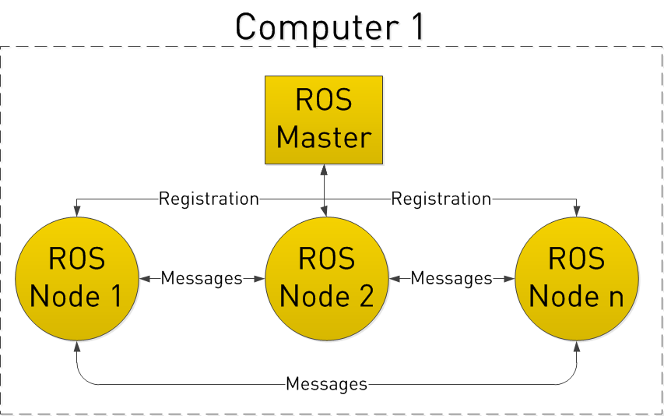
Some ROS terminology and demos
ROS Master & ‘roscore’
The ROS master acts as a name server for node-to-node connections and message communication.
Notes:
DNS name server, I make a website …

Slide 8
ROS Node & ‘rosrun’
A node refers to the smallest unit of processor running in ROS
Think of it as one executable program
Specialized function
rosrun package_name node_name
roslaunch package_name launch_file_name
Notes:
Examples from our mars rover

Slide 9
Messages & Topic
- A node sends or receives data between nodes via a message.
Messages are variables such as :
integer, floating point, boolean
- The topic is literally like a topic in a conversation.
- Nodes can get information from topics they are interested in

Slide 10
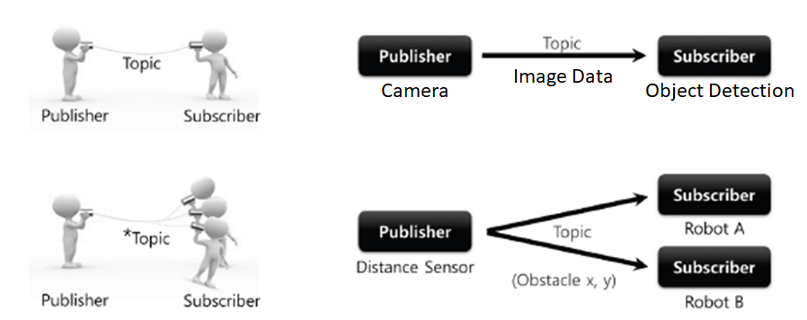
Publisher & Subscriber
The publisher node registers its own information and topic with the master, and sends a message to connected subscriber nodes
Likewise, the subscriber node receives data from related publishers
Notes:
Add images

Slide 11
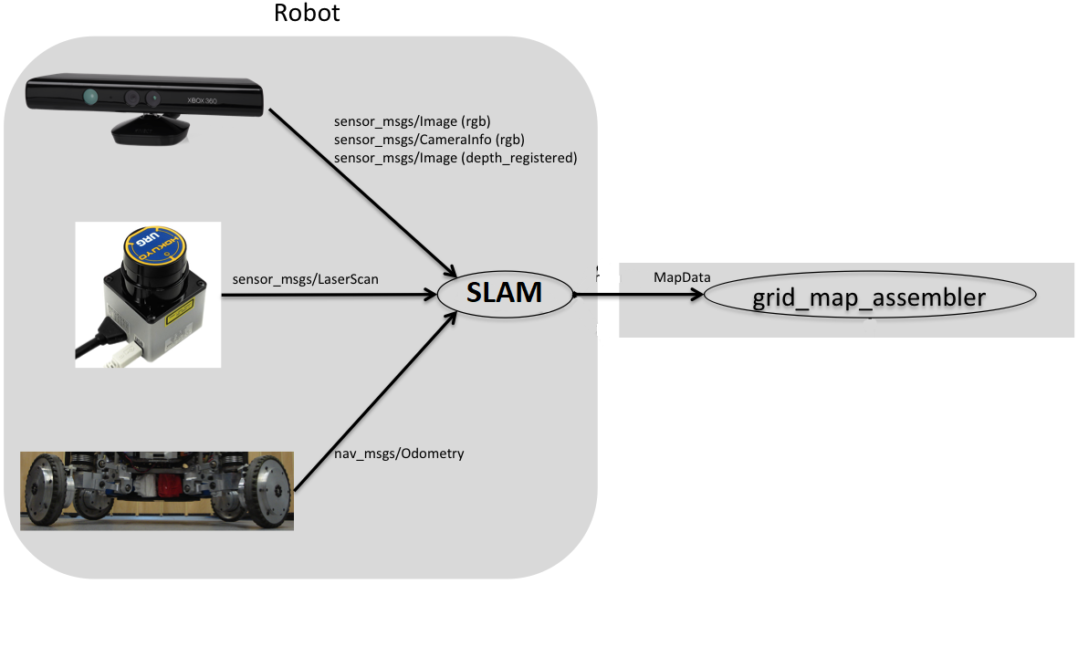
SLAM
Simultaneous Localization and Mapping

