Slide 1
Radial basis functions
Ian McFarlane,
Kellen Nankervis,
Jun Hanvey

Slide 2
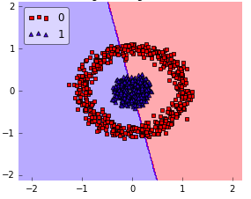
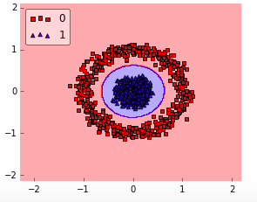

RBF Basics
The RBF kernel is a function that “transforms” data that would is not linearly separable so we can use the SVM algorithm to classify it.
The kernel trick is a powerful way to get around the limitations of linear SVM

Slide 3
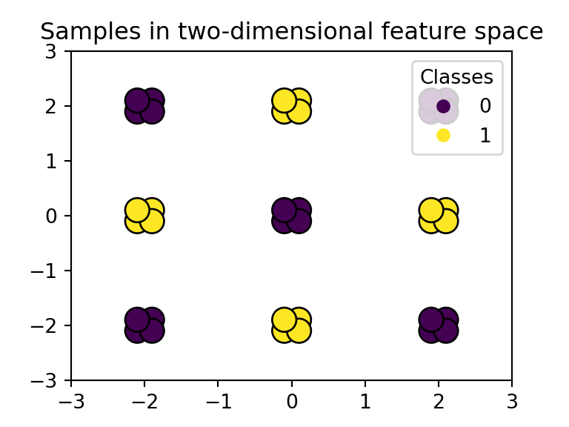
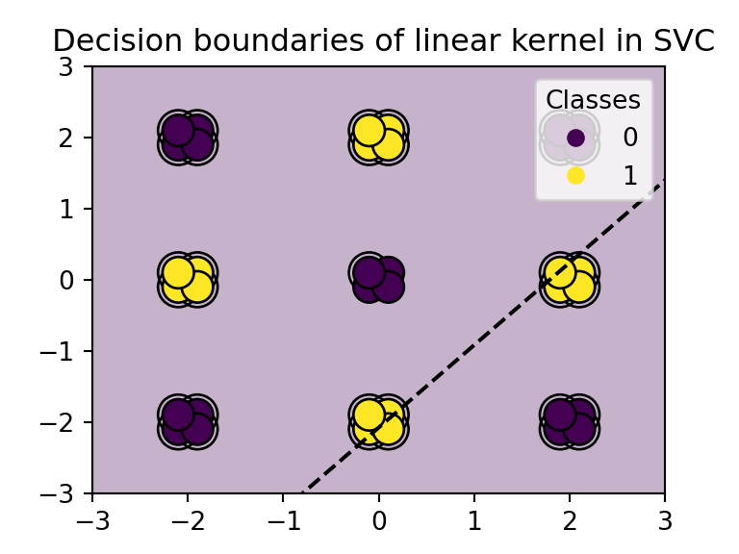
SVM Limitations

Slide 4

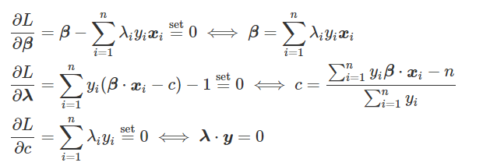
Dual problem
Optimization Goal:
Lagrangian Transformation:
Partial Derivative Results:

Slide 5



Dual Problem
Dual Result
After Feature Engineering:

Slide 6
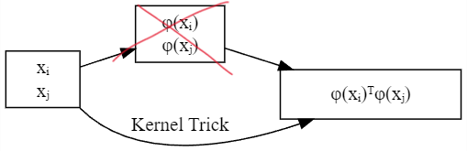
Kernel trick

Slide 7
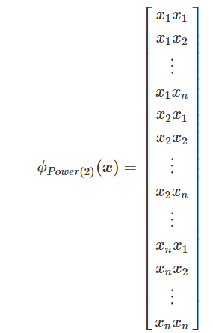


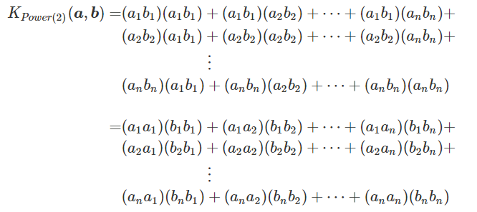
Kernel Trick

Slide 8
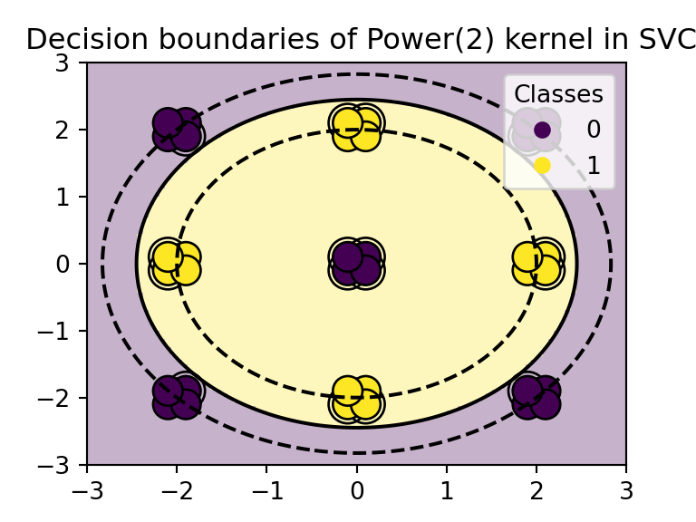
Example of Boundaries for Polynomial (power 2) kernel

Slide 9
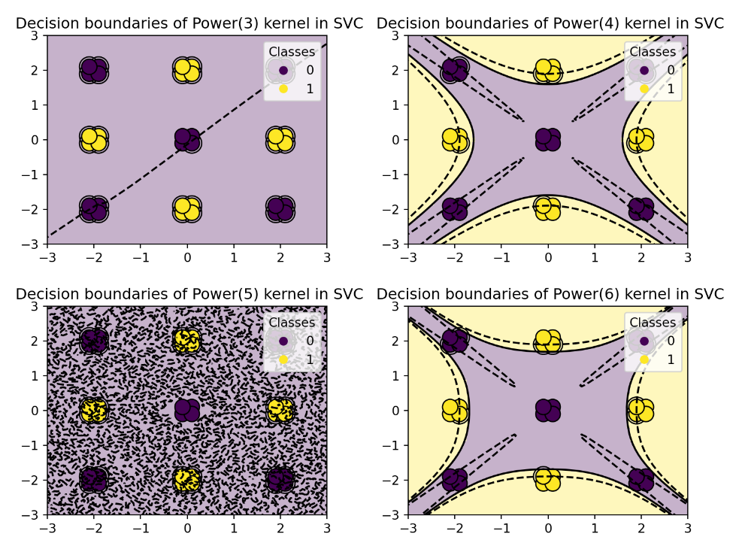

Slide 10

Including lower order terms
gives us all n-way interaction terms and below..
10

Slide 11
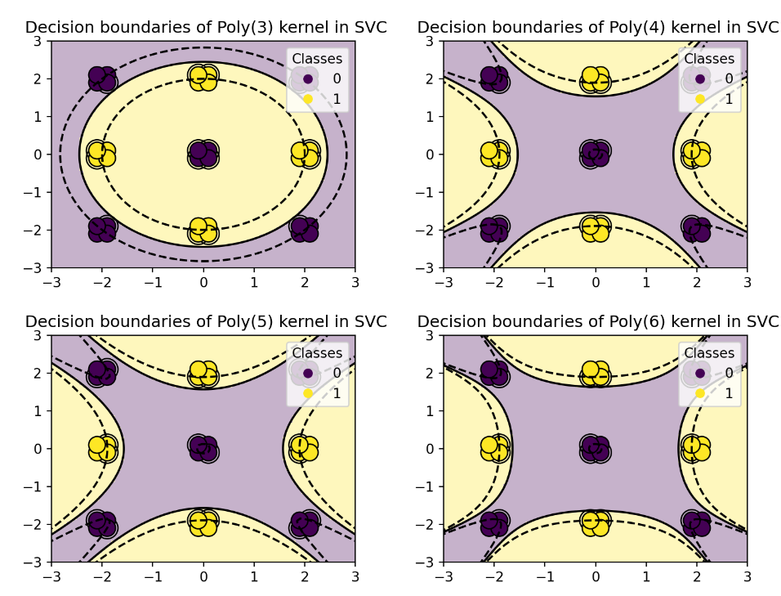

Slide 12
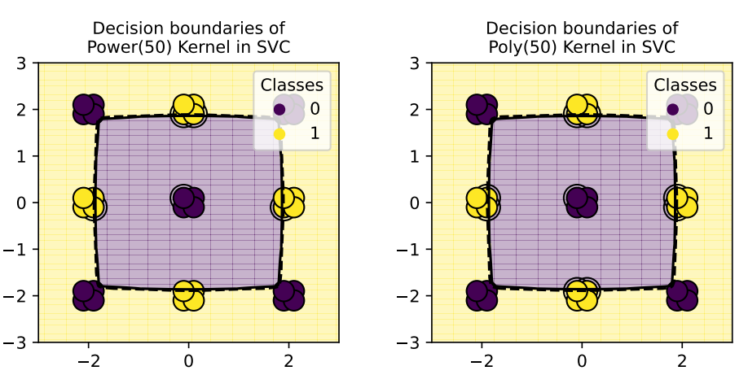

Slide 13
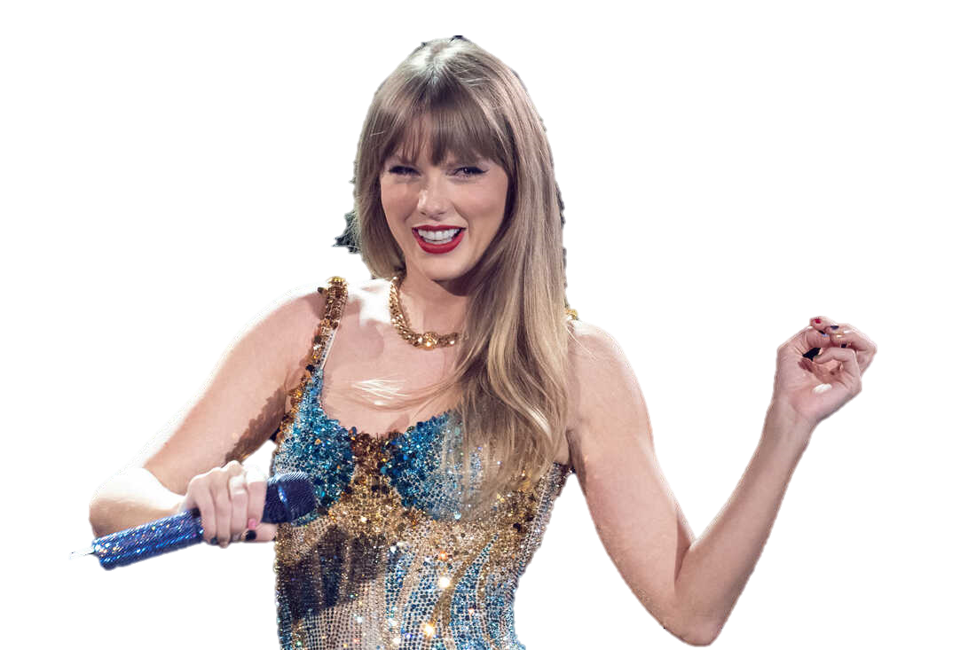
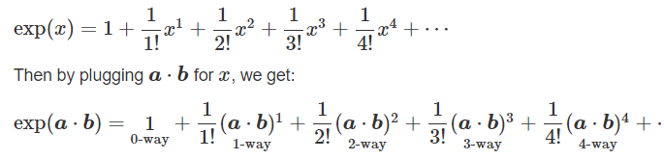
What if…we do everything?

Slide 14
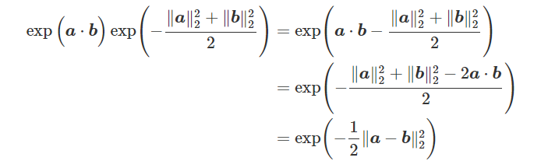


Some tweaks
Outlier mitigation
Control parameter

Slide 15
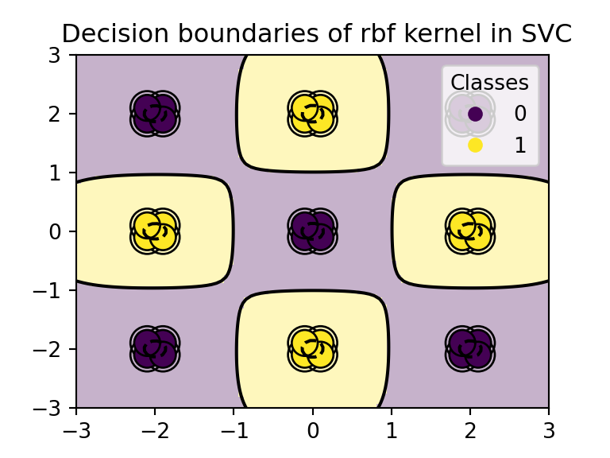

Slide 16
Radial basis function Considerations

Slide 17
Assumptions for custom-Kernel SVM
There are two classes to classify
K, the matrix composed of all pairwise kernels (k_{ij} = K(x_{i} , x_{j} )), is positive semi-definite. This is satisfied by the Radial Basis Kernel.

Slide 18
Model parameters
The cost parameter (C_{ξ}) is the cost of missclassifying a data point (Soft Margin case only). A higher C_{ξ} will lead to a more complex model that will try to classify all data points correctly. C_{ξ} behaves as a regularization parameter.
The gamma (γ) parameter controls how far the influence of a single training example reaches. A low γ will consider points far away from the decision boundary in calculations, while a high γ will consider only points close to the decision boundary.

Slide 19
Strengths and weaknesses

Slide 20
strengths
RBFs are able to perform optimization over an infinite-dimensional space, using a relatively simple formula.
There are no pre-assumptions that need to be made about the data.
RBF decisions are local, making it a more robust algorithm that is not sensitive to outliers.
Hyperparameters allow us to be more flexible about specificity.

Slide 21
weaknesses
RBFs are non probabilistic unless forced to be.
Like SVMs, we do not get easily interpretable coefficients.
The RBF kernel is non--parametric, making traditional inference more difficult.
RBFs are more complex and thus inherently easier to overfit.

Slide 22
Parameters
The cost parameter is the cost of misclassifying a data point. A higher cost will lead to a more complex model that will try to classify all data points correctly. The gamma parameter controls how far the influence of a single training example reaches.
In summary high cost and gamma values result in over fitting, while low values result in underfitting

Slide 23
Example 1

Slide 24
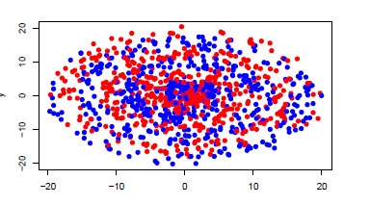
Generated data

Slide 25
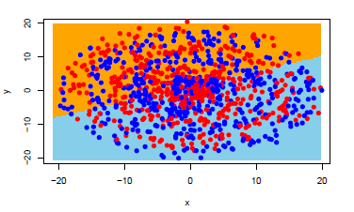
Linear Kernel
Confusion matrix
Classification plot
 | Reference
Prediction | 0 | 1
0 | 296 | 268
1 | 217 | 219
Accuracy: | 0.515
Kappa: | 0.268

Slide 26
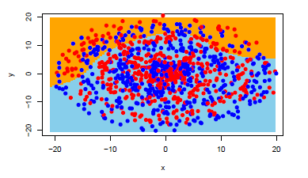
Polynomial kernel
Confusion matrix
Classification plot
 | Reference
Prediction | 0 | 1
0 | 436 | 412
1 | 77 | 75
Accuracy: | 0.511 | Degree = 5
Kappa: | 0.004 | Cost = 10 Gamma = 0.1

Slide 27
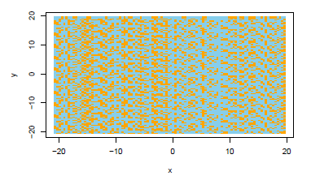
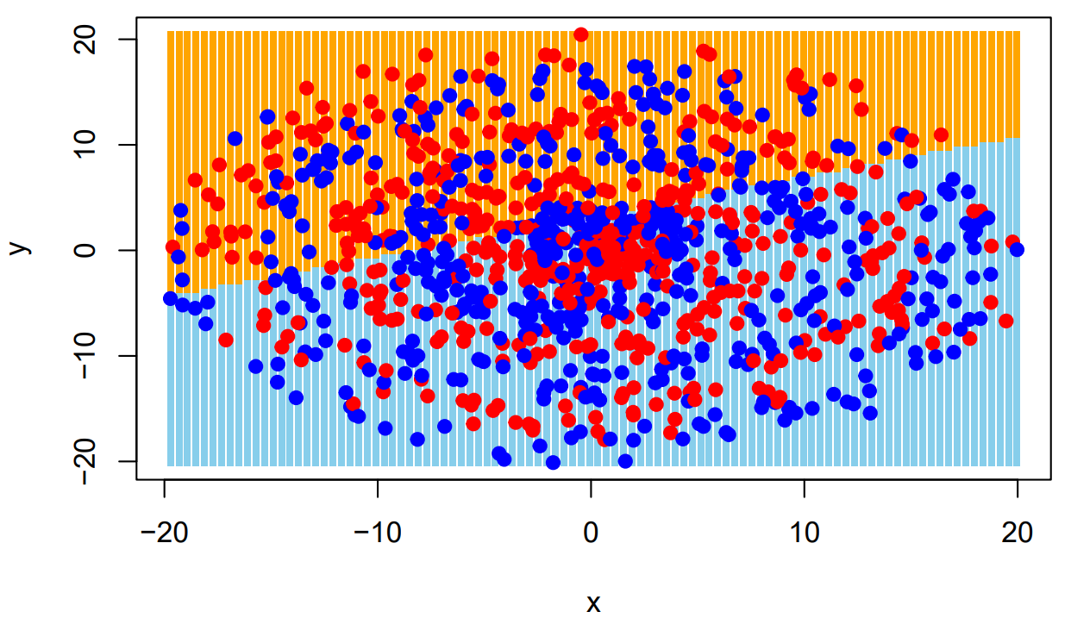
Logistic regression
Confusion Matrix
Decision boundary
 | Reference
Prediction | 0 | 1
0 | 352 | 295
1 | 161 | 192
Accuracy: | 0.544
Kappa: | 0.081

Slide 28
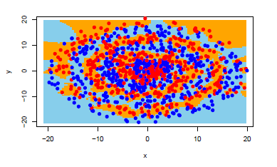
K = 3 knn model
Confusion Matrix
Classification plot
 | Reference
Prediction | 0 | 1
0 | 445 | 75
1 | 68 | 412
Accuracy: | 0.857
Kappa: | 0.714
Notes:
Test data has 72.6% accuracy

Slide 29
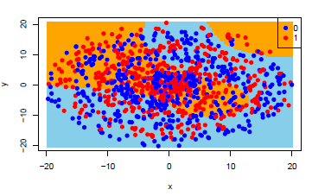
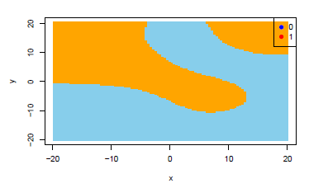
Rbf kernel output
Confusion Matrix
Classification plot
Decision boundary
 | Reference
Prediction | 0 | 1
0 | 275 | 211
1 | 238 | 276
Accuracy: | 0.551 | Cost: 1
Kappa: | 0.1027 | Gamma: 1

Slide 30
Cross validation
Using 5-Fold cross validation, we determine that the best values for cost and gamma are:
Cost | Gamma | Accuracy
1 | 10 | 74.3%
10 | 10 | 72%
1 | 100 | 70.6%
100 | 10 | 70.3%
1000 | 10 | 67.6%

Slide 31
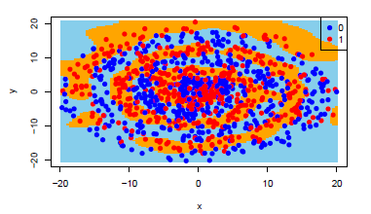
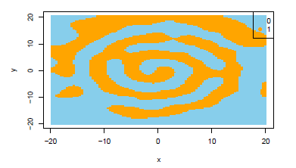
Rbf with 5-fold cross validation Results
Confusion Matrix
Classification plot
Decision Boundary
 | Reference
Prediction | 0 | 1
0 | 428 | 94
1 | 85 | 393
Accuracy: | 0.821 | Cost: 1
Kappa: | 0.642 | Gamma: 10

Slide 32
RBF vs KNN ON TEST DATA
RBF MODEL
KNN MODEL
 | Reference
Prediction | 0 | 1
0 | 375 | 128
1 | 116 | 381
Accuracy: | 0.756
Kappa: | 0.512
 | Reference
Prediction | 0 | 1
0 | 359 | 142
1 | 132 | 367
Accuracy: | 0.726
Kappa: | 0.452
Notes:
Test data has 72.6% accuracy

Slide 33
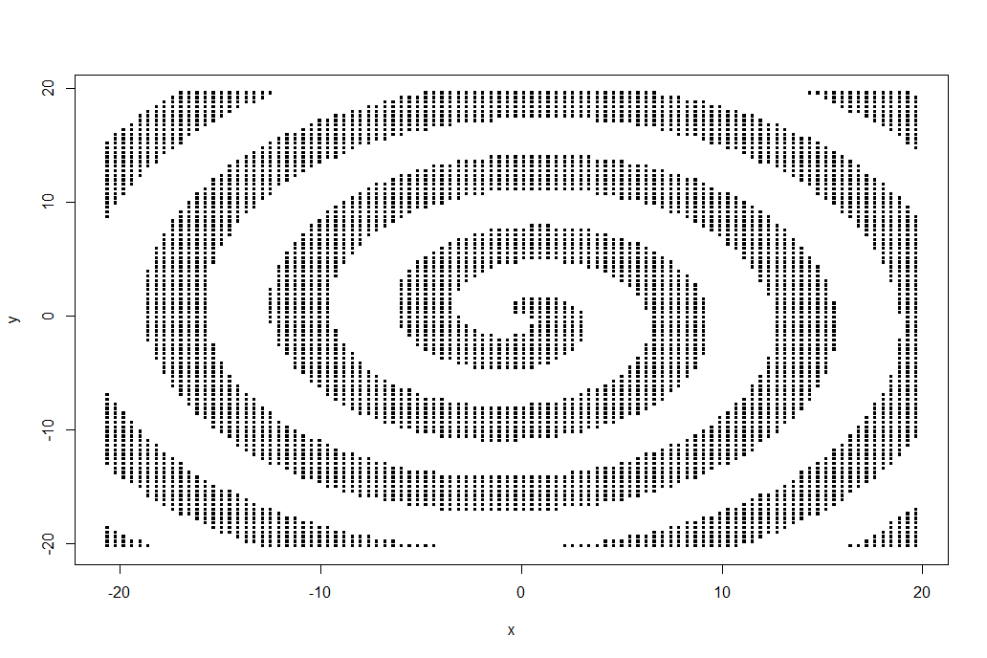
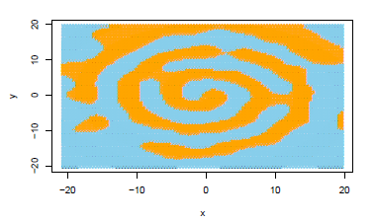
TRUE BOUNDARY RESULTS
Confusion Matrix OF TRUE BOUNDARY
True Decision Boundary
 | Reference
Prediction | 0 | 1
0 | 410 | 112
1 | 81 | 397
Accuracy: | 0.807 | Cost: 1
Kappa: | 0.614 | Gamma: 10

Slide 34
Example 2

Slide 35
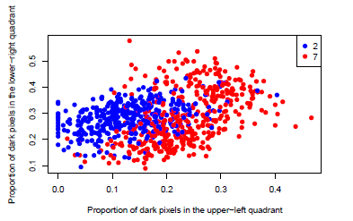
MNIST 27 Data Set
Classifies images as either a 2 or a 7 based on proportion of pixels in upper-left quadrant and pixels in lower-right quadrant.

Slide 36
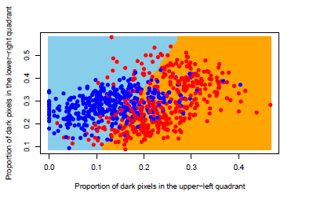
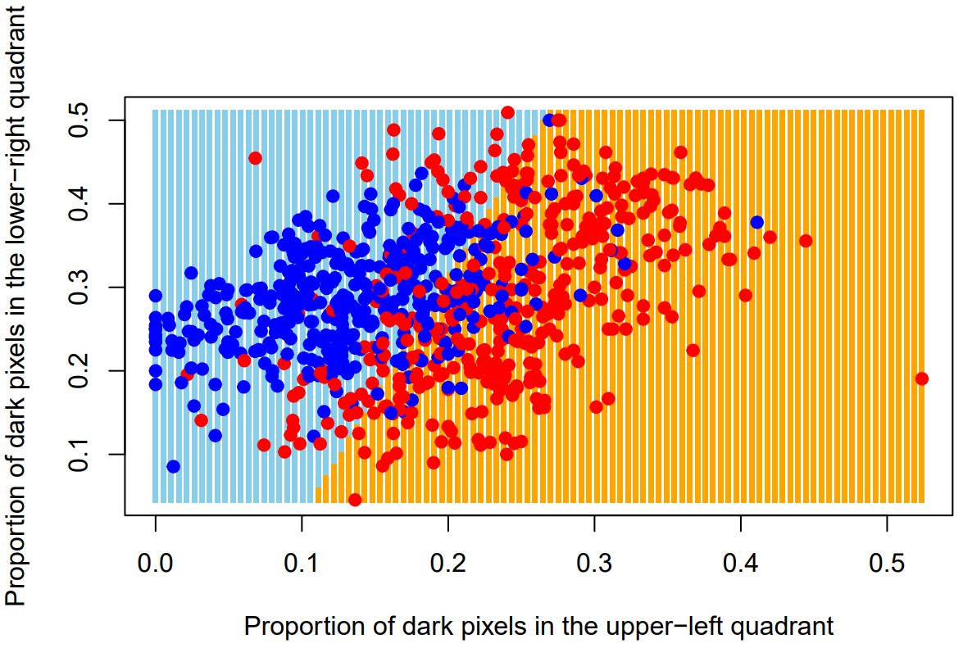
Linear kernel
Confusion Matrix
Classification plot
 | Reference
Prediction | 2 | 7
2 | 321 | 89
7 | 80 | 310
Accuracy: | 0.7888
Kappa: | 0.577

Slide 37
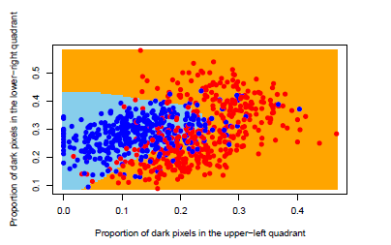
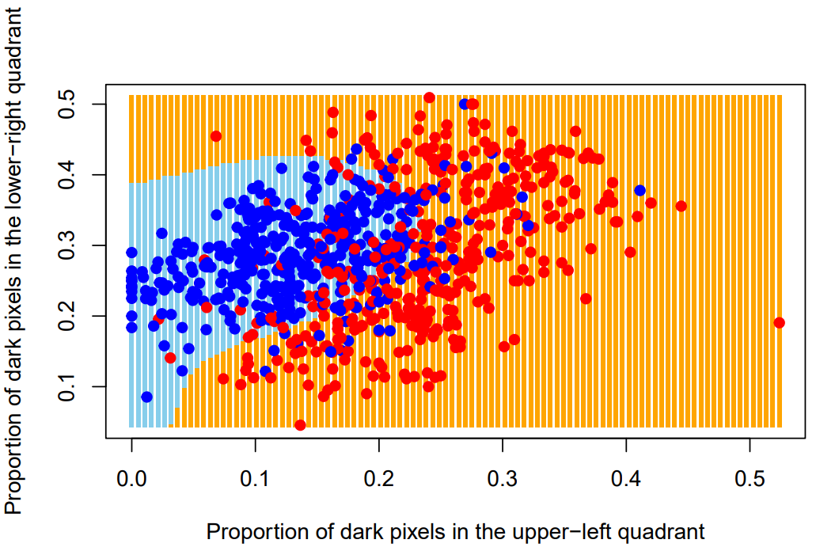
Rbf kernel
Confusion matrix
Classification plot
 | Reference
Prediction | 2 | 7
2 | 342 | 74
7 | 59 | 325
Accuracy: | 0.8338
Kappa: | 0.667

Slide 38
Cross validation
Using 5-Fold cross validation, we determine that the best values for cost and gamma are:
Cost | Gamma | Accuracy
0.1 | 1 | 83.4%
10 | 0.1 | 83.25%
1000 | 0.01 | 83.25%
10 | 1 | 83.125%
100 | 0.1 | 83.125%

Slide 39
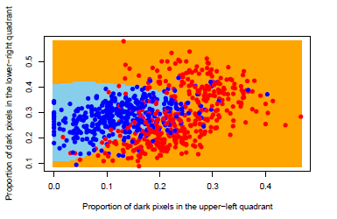
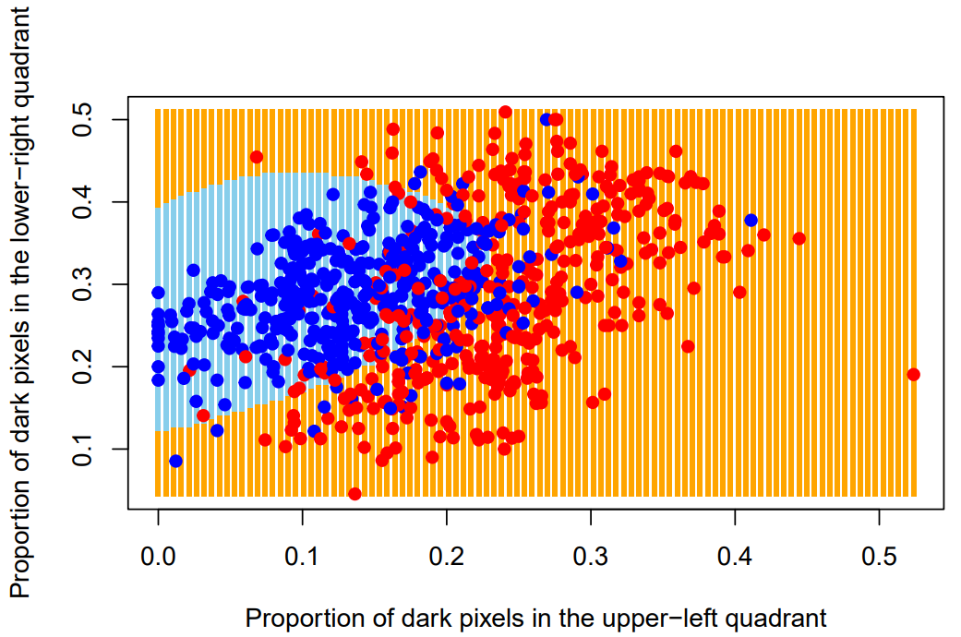
Cross validated rbf
Confusion Matrix
Classification Plot
 | Reference
Prediction | 2 | 7
2 | 335 | 63
7 | 66 | 336
Accuracy: | 0.8388 | Cost: 0.1
Kappa: | 0.678 | Gamma: 1

Slide 40
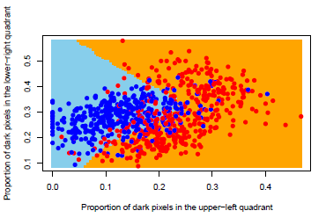
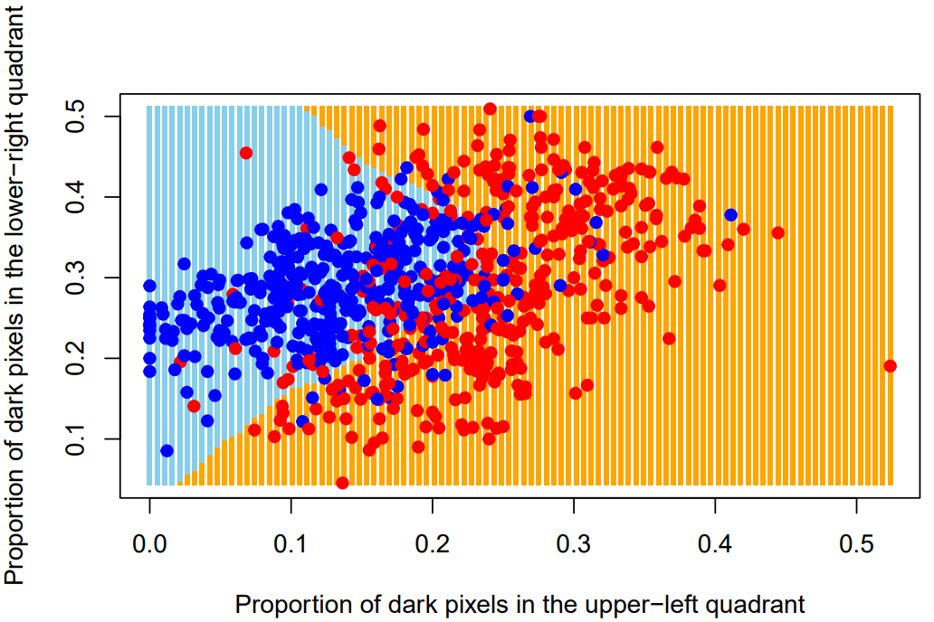

K = 83 knn
Confusion matrix
Classification plot
 | Reference
Prediction | 2 | 7
2 | 343 | 75
7 | 58 | 324
Accuracy: | 0.8338
Kappa: | 0.667

Slide 41
RBF vs KNN ON TEST DATA
RBF MODEL
KNN MODEL
 | Reference
Prediction | 0 | 1
0 | 82 | 19
1 | 14 | 85
Accuracy: | 0.835
Kappa: | 0.670
 | Reference
Prediction | 0 | 1
0 | 83 | 23
1 | 13 | 81
Accuracy: | 0.820
Kappa: | 0.641
Notes:
Test data has 72.6% accuracy

Slide 42
conclusion
From both the example data set and the MNIST data set, we can see that the RBF kernel is a powerful tool to classify non--linear data.
The kernel far outperformed the linear & polynomial kernels as well as the logistic model and the KNN model on the spiral data.
The kernel also performed very well on the MNIST data, with the KNN being a close second.
The RBF kernel is a great tool that every data scientist should have in their toolbox.

