Slide 1
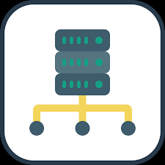





Slide 2
Frontend Proxy & APP
Backend APP & DB
Monitoring_Back: App & Promethus & DB exporter
Montoring_Front Grafana Promethus

