Slide 1



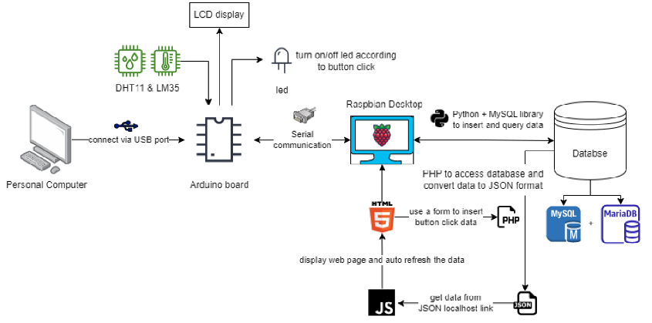












Buzzer
Takes the email stored in the database and sends the alert email to them
MQ-2 & IR Flame Sensor
Python + MySQL to insert and query data and apply the script to launch the php file
Display Web Page
PHP to access database and retrieve data from the gas_value table
Inputs Data into a table in the HTML Web Pge

