Slide 1
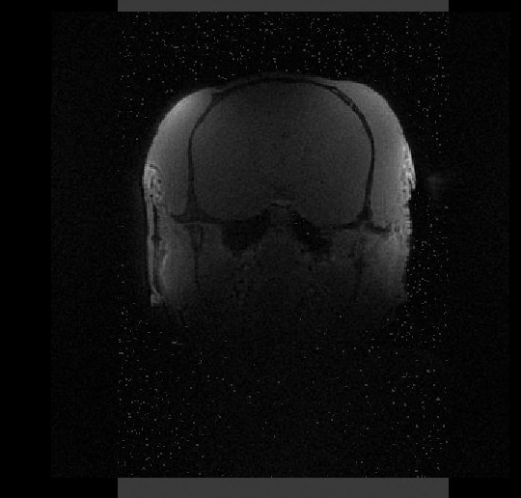
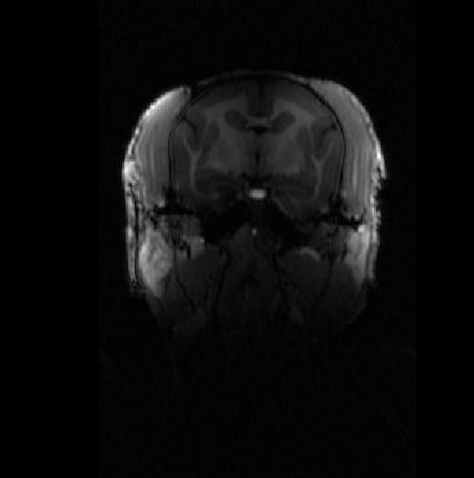
Bias correction of highly heterogeneous MRI images
In non-human Primate (NHP) MRI, extreme bias present
→ high multidimensional array whose elements are small
→ and in close proximity of the anatomy to be imaged.
Petra (Pdw) on marmoset
T1w on marmoset
(with same array)

Slide 2
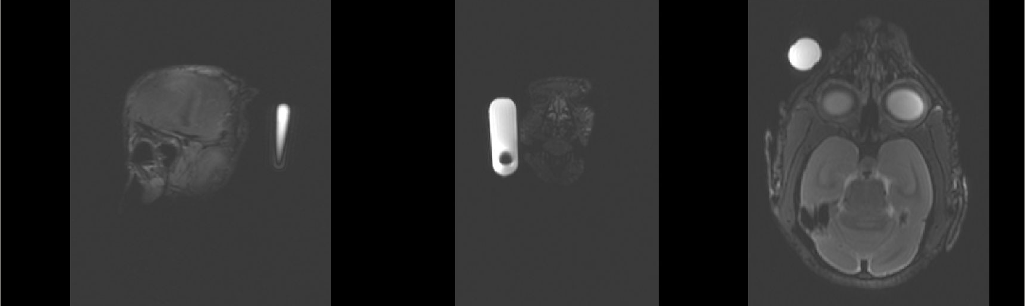
Bias correction of highly heterogeneous MRI images
IF the vitamin pastille is close to the antenna, → hyper intense
Registration to the template fail
T2w on marmoset

Slide 3
Project intensebias @brainhack
Test and develop new strategies to register this kind of images
Skills :
  some knowledge on registration / bias correction (ANTS, NiftyReg)
  OR Knowledge on MRI acquisition
mattermost = bhg24-marseille_intensebias
Project leader: Julien Sein (IR Centre IRMf ), David Meunier (IR INT)
Meeting points = Thursday noon, Friday pm
You are welcome to join us
→ Feel free to contact us, come by if you have any questions ;)

