Slide 1
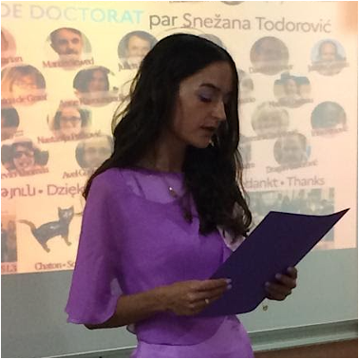
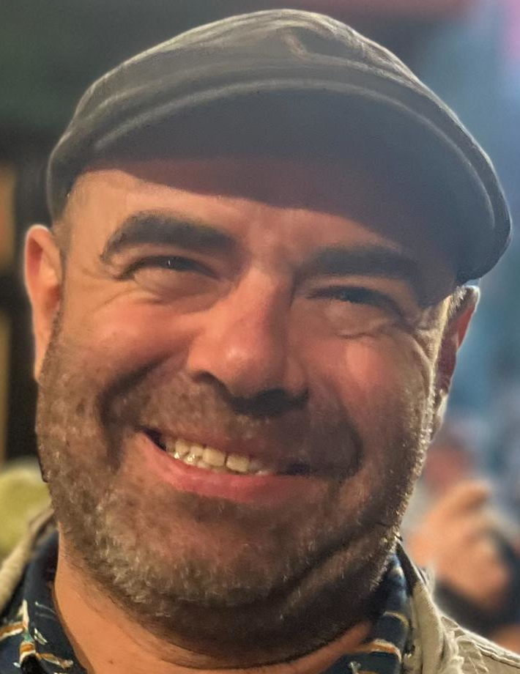
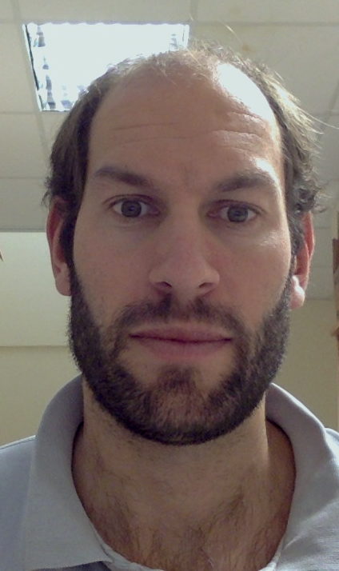
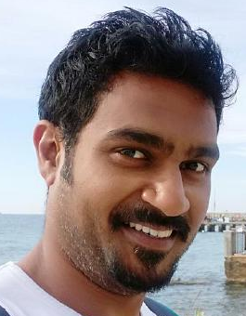
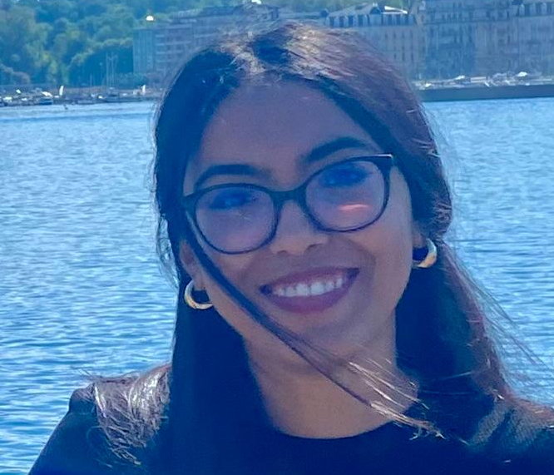
Project « intense_bias »
Who did it : An amazing team of 5 people :
David Meunier (INT, AMU)
Julien Sein (Centre IRMf, INT, AMU)
Sneža Todorović (Jagiellonian University, Kraków)
Shailesh Appukuttan (CRMBM & INT, AMU)
Khouloud Benzzaouia (CRMBM)
Ponctual contributions :Guillaume Auzias, Steven Jia, Arnaud Le Trotter, Katherine Bryant
Where it is :
bhg24-marseille_intensebias on mattermost

Slide 2
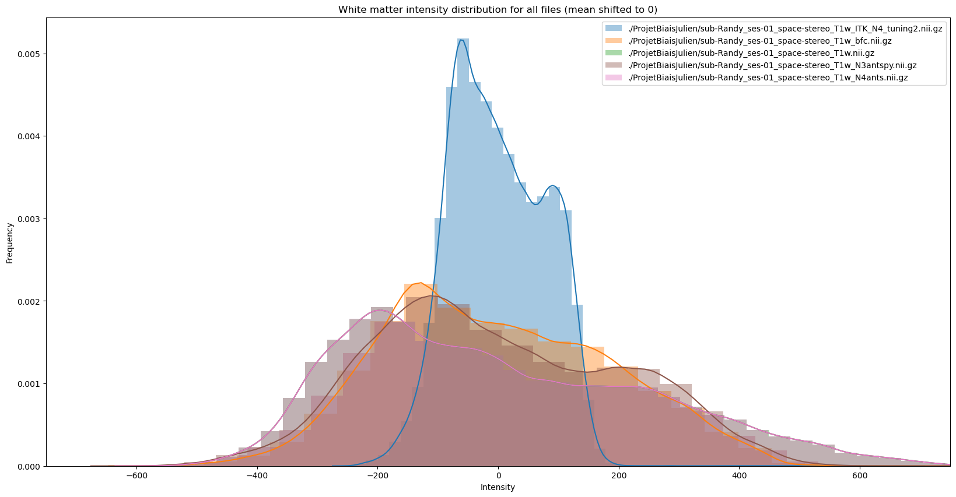
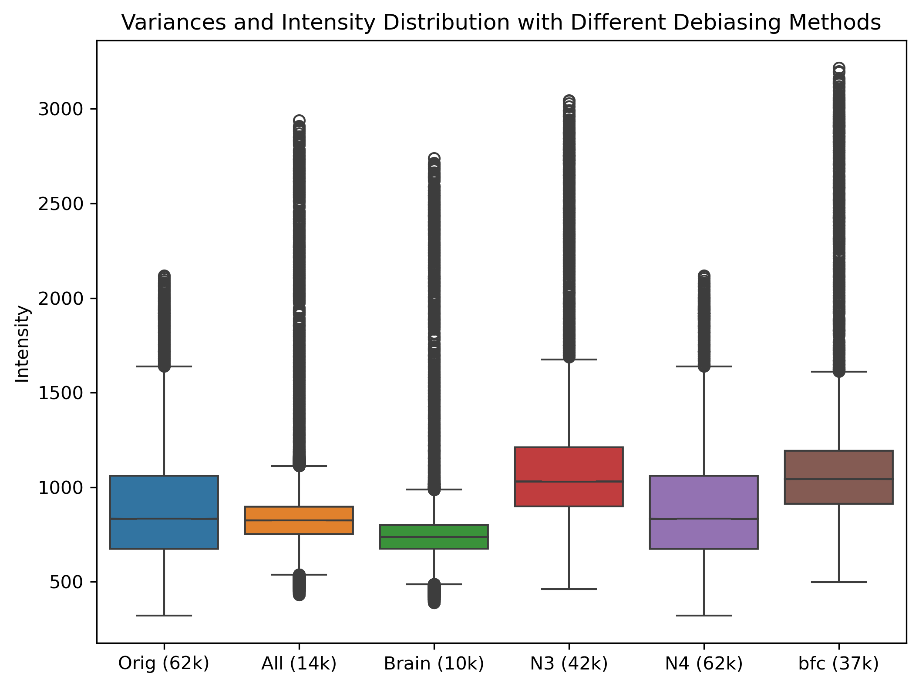
Project « intense_bias »
What we did :
1a)Testing several bias field corrections
on « easy images » (brain image after manual crop)
(David, Shailesh)
-ANTS : N4BiasFieldCorrection
-ANTSpy : n3_bias_field_correction
-BrainSuite bfc
-FSL fast
-SimpleITK – N4BiasFieldCorrectionImageFilters
1b) Scripts to assess variance in white matter
in python (Sneža, Shailesh), matlab (Khouloud)

Slide 3
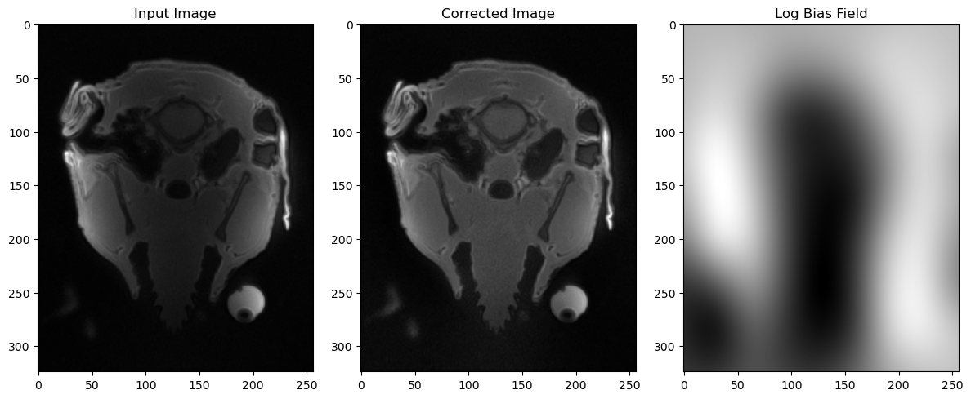
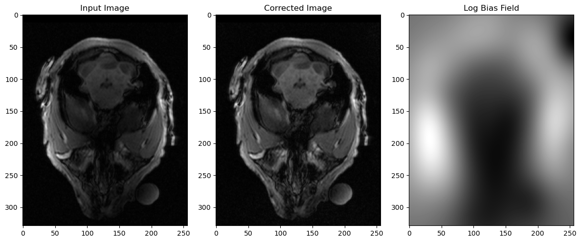
Project « intense_bias »
What we did :
2)Testing bias field corrections (Shailesh)
on «full images » (original image)

Slide 4
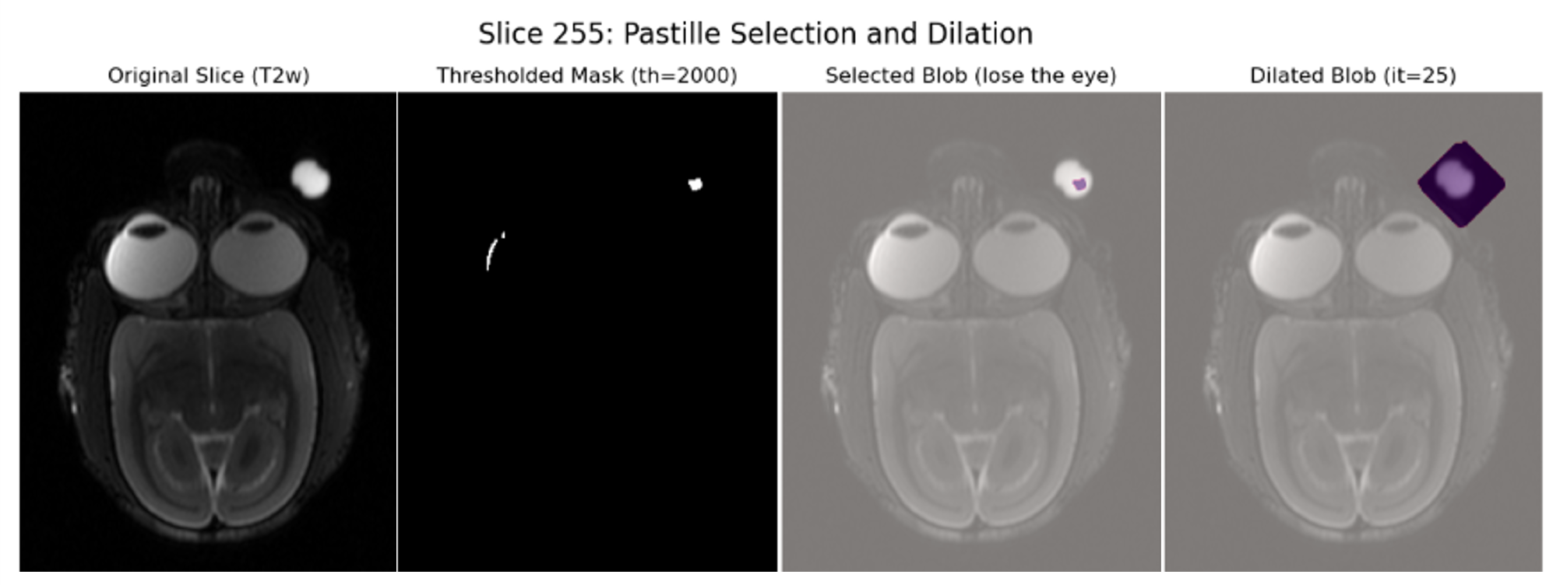
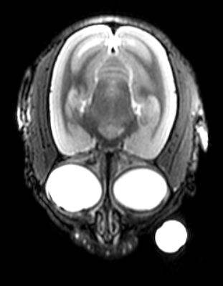
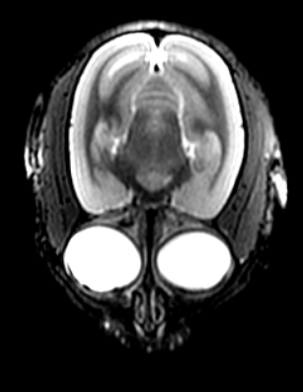
Project « intense_bias »
What we did :
3) « Automated » method to remove laterality pastille :
- low threshold and giant component mask (Khouloud) // upper threshold to keep only the pastille (Sneža)

