Slide 1

CISC7204 · Data Science and Data Visualization
US Domestic FlightDelay Drivers
Attribution · within-day cascade · airport archetypes · an interactive dashboard
Class K — Team 01
2026/2027 Semester 1
5 November 2026
Notes:
开场：CISC7204 数据科学与可视化，Class K 第一组。项目是"美国国内航班延误驱动因素"——归因、日内级联、机场画像、交互式看板。

Slide 2

The Team
Six members · eight roles · one project
1
LI TIAN HAO
2
LI YING FANG
3
WU PEI YE
4
HO MAN HOU
5
AO KIT I
6
SAVIDI AVRAM
MC663312
MC661599
MC661846
MC661647
MC660004
MC664364
CISC7204 Data Science and Data Visualization · Class K — Team 01 · 2026/2027 Semester 1
02 / 16
Notes:
合规页：合照（顶部金色序号对准六人）+ 六人姓名学号 + 课程信息。旁白逐字读六个学号。

Slide 3

Abstract
Delay is predictable in structure,not in individual flights.
01
02
03
73.3% airline-controlled
A few flights carry the tail
Rank risk, not promise
most delay is carrier-controlled
Gini 0.876 hides a heavy tail
five factors rank risk · R² 0.022
Elevator statement · one line + three numbers
03 / 16
Notes:
结论先行：结构可预测，单班航班不可预测。三个支撑点带数字。

Slide 4
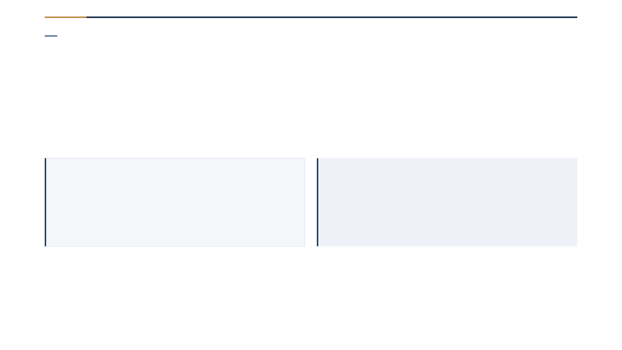
The Problem
One average hides two very different stories
−6min
+7min
median arrival
mean arrival
half of flights arrive early
a heavy tail pulls the average up
Scope: 61,689,698 completed flights · 2015–2024 · mean vs median
04 / 16
Notes:
中位数提前 6 分钟，均值延误 7 分钟——重尾把均值往上拉。旅客与航空公司需要两个不同答案。

Slide 5
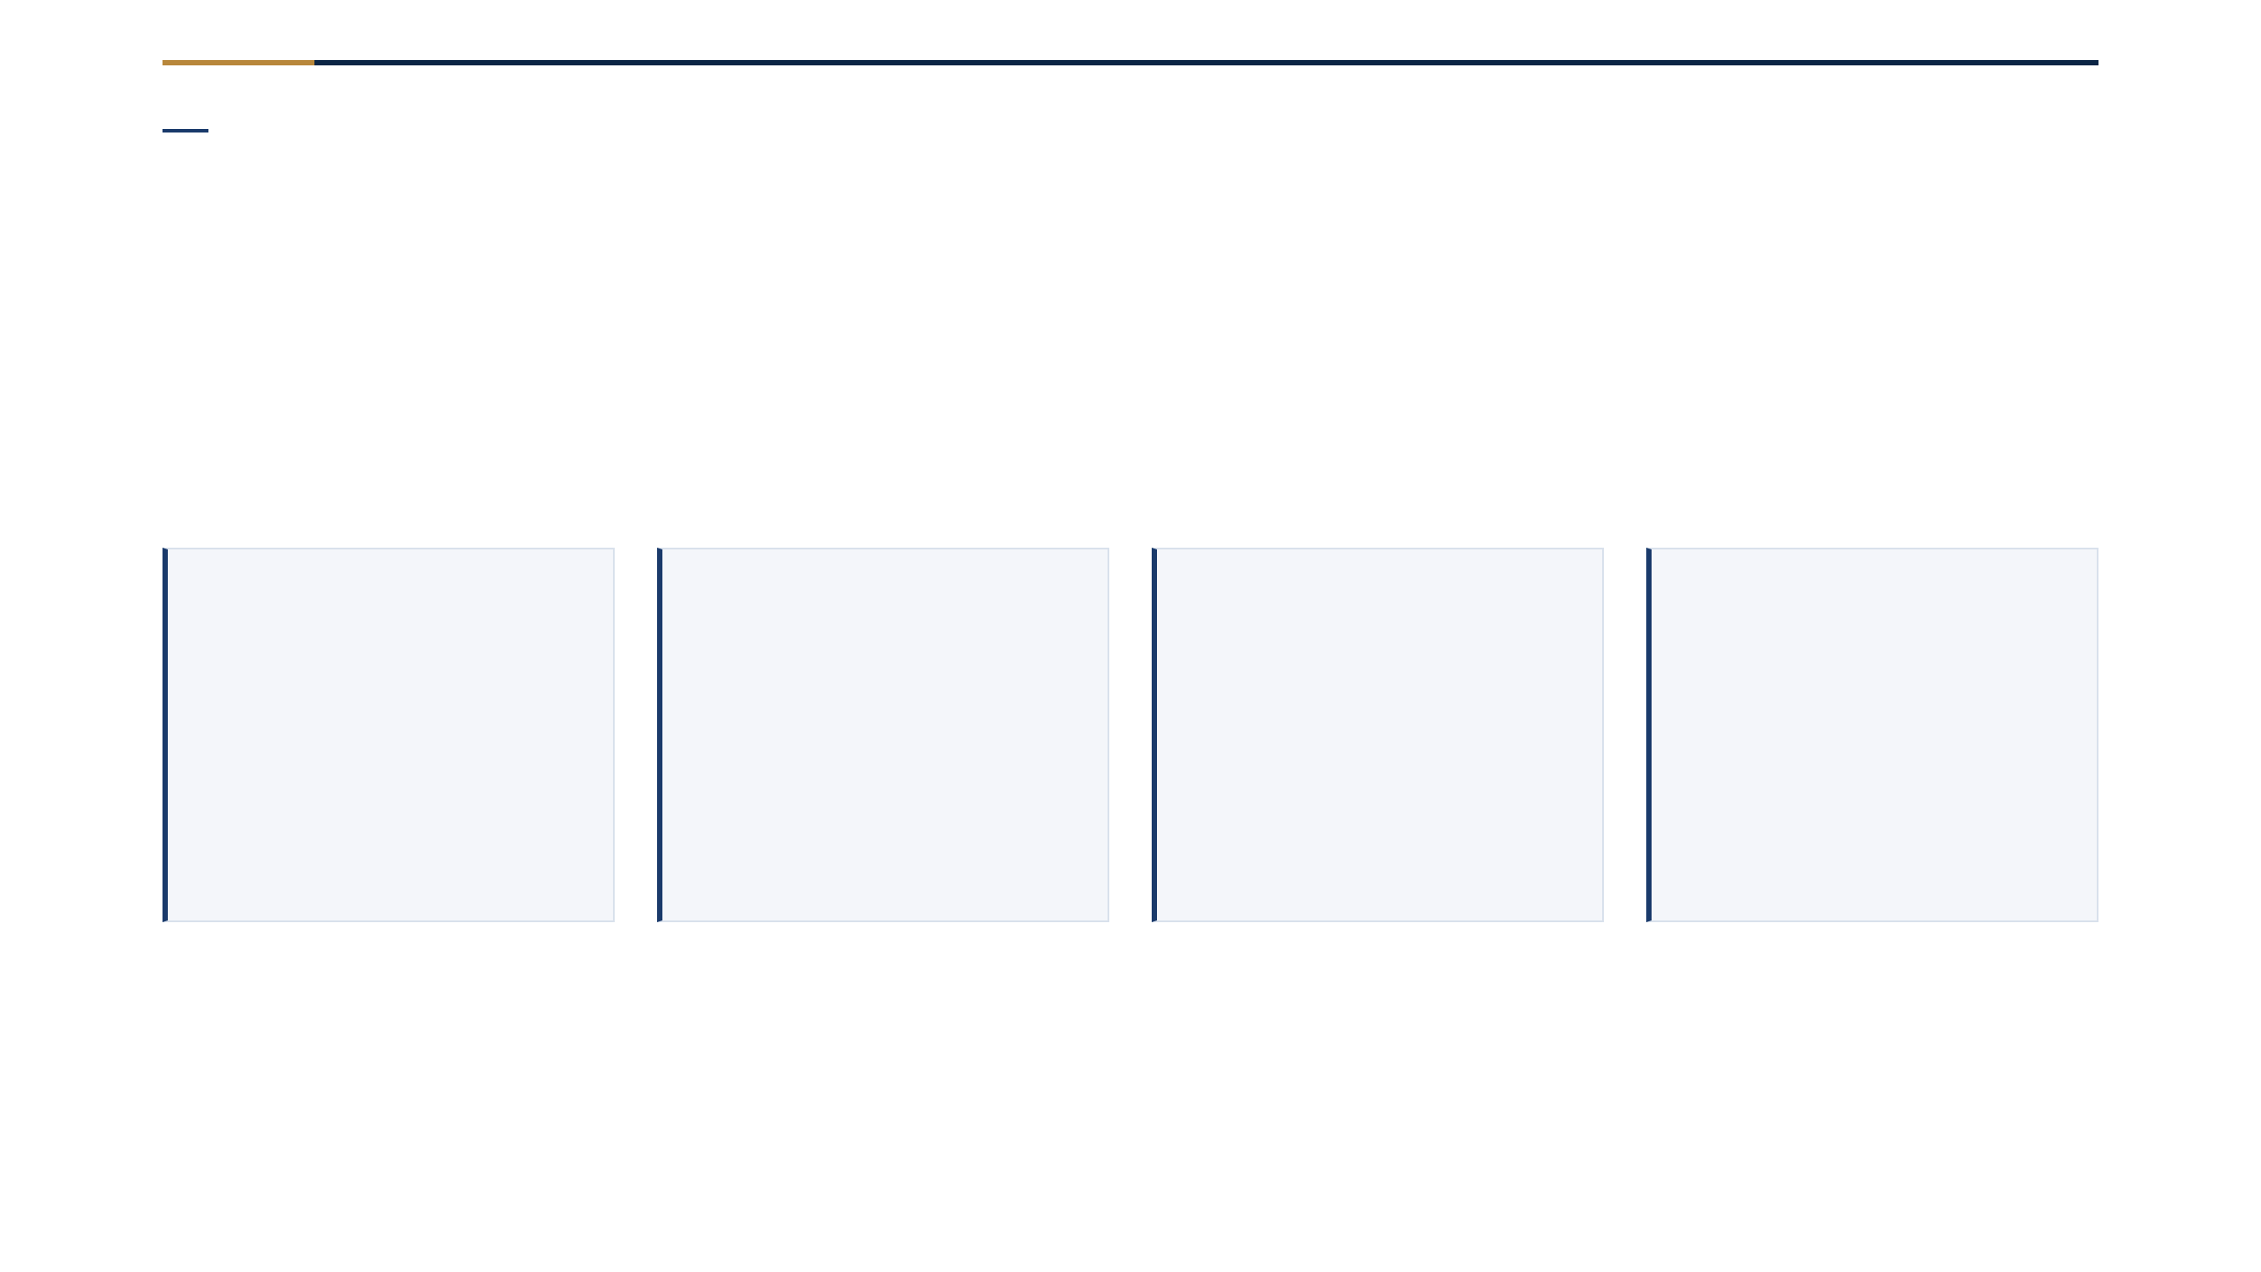
Research Questions
Four questions, one panel
RQ1
RQ2
RQ3
RQ4
Cause mix
Cascade
Archetypes
Act
How are minutes split across five BTS causes?
How much delay is inherited from earlier legs?
Do airports form delay-risk profiles?
Can a web tool let a traveller act on it?
RQ1–RQ4 · each with a verifiable statistic
05 / 16
Notes:
四个研究问题：归因、级联、机场画像、可操作的网页工具。

Slide 6
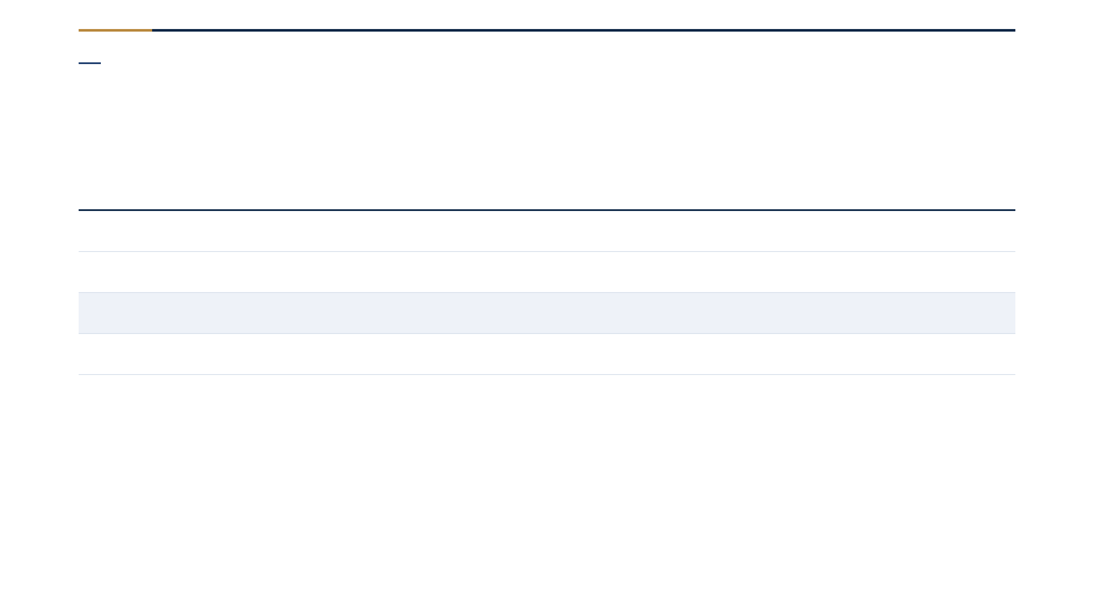
Data Context
Five public sources · 63 million rows
ID
Source
Role in the analysis
D1
BTS On-Time Performance
63.1M flight rows, 2015–2024
D2
BTS Delay Cause
attribution cross-check
D3
NOAA Integrated Surface
hourly weather, 40 airports
D4
OurAirports
coordinates, state, type
D5
BTS carrier decode
code → name
Region: US (50 states + DC) · commercial aviation · all public, no API key
06 / 16
Notes:
五个公开数据源，覆盖航班级记录到天气、机场、承运人解码表。

Slide 7
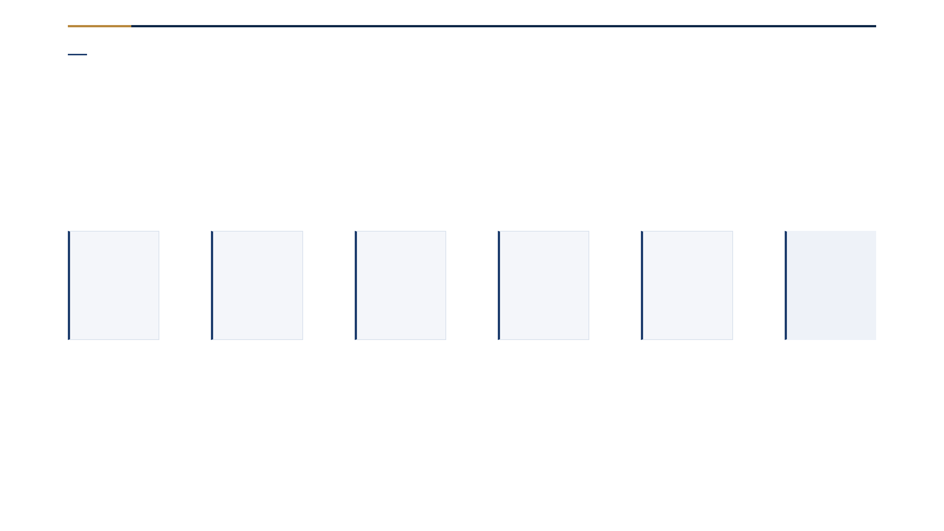
Method
Six stages, one command, 53 tests
1
2
3
4
5
6
Acquire
→
Attribute
→
Analyse tail
→
Cascade
→
Model
→
Communicate
Every stage is a script, not a notebook cell — one command regenerates every figure, and a 53-test suite pins each number to its source file.
Reproducible · every number traced to a source file
07 / 16
Notes:
六阶段流水线：获取→归因→尾部→级联→建模→沟通。一条命令重现所有图，53 个测试锁定数字。

Slide 8
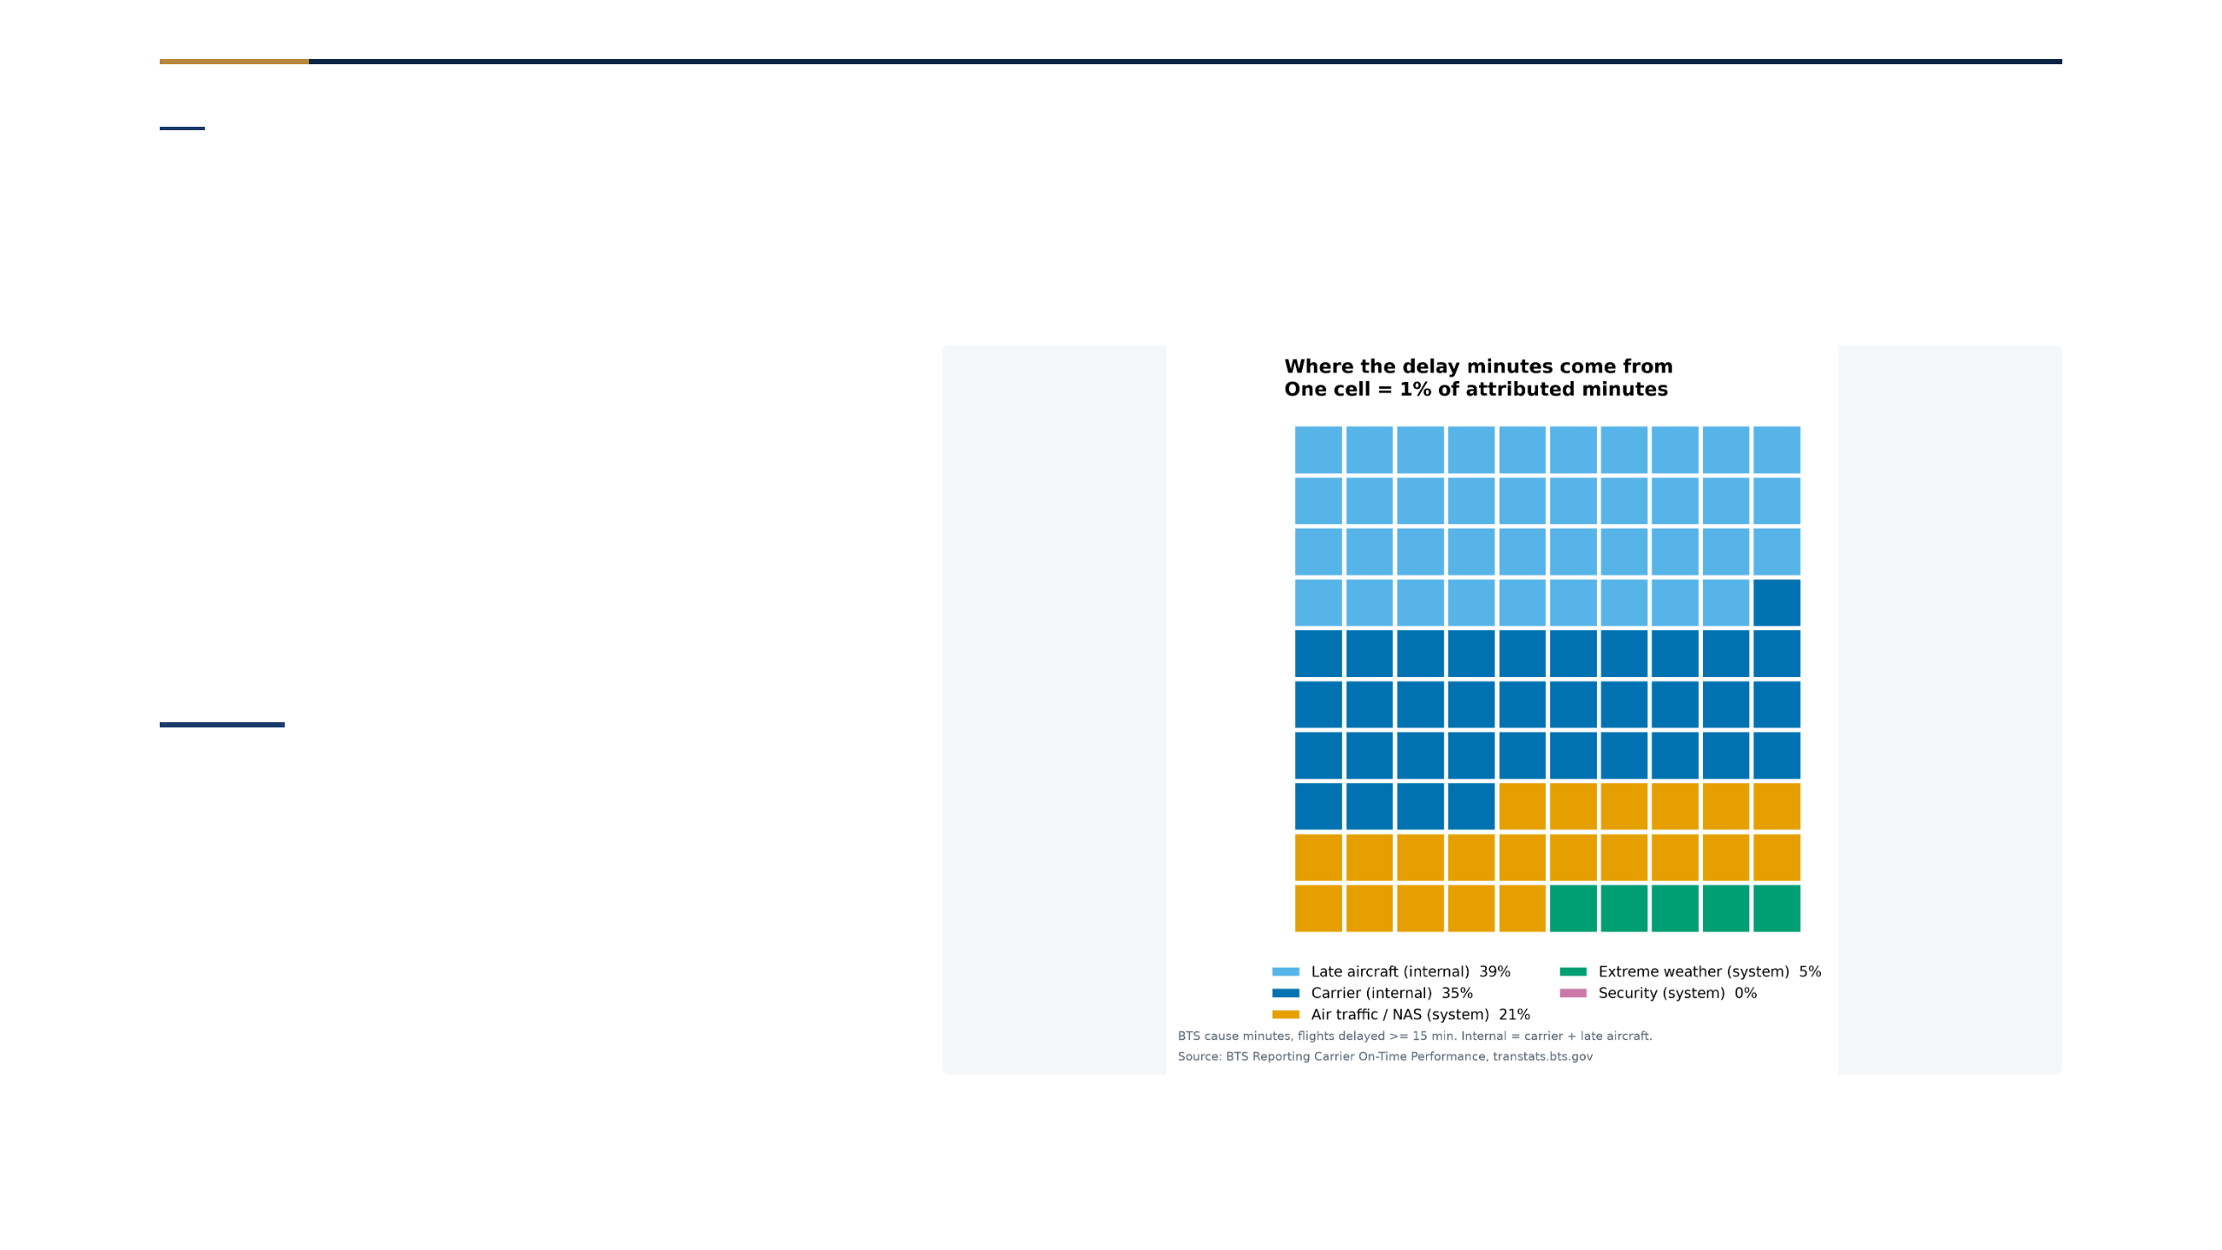
Finding 1 · RQ1
73.3% of delay minutes are airline-controlled
73.3%
airline-controlled delay
bootstrap 95% interval: 73.0–73.6%
Stable across the decade — the yearly internal share moves only between 69.7% (2018) and 77.4% (2022).
Scope: flights ≥15 min late only · source: BTS Delay Cause
08 / 16
Notes:
发现一：73.3% 延误分钟归因于航空公司可控原因，十年稳定。

Slide 9
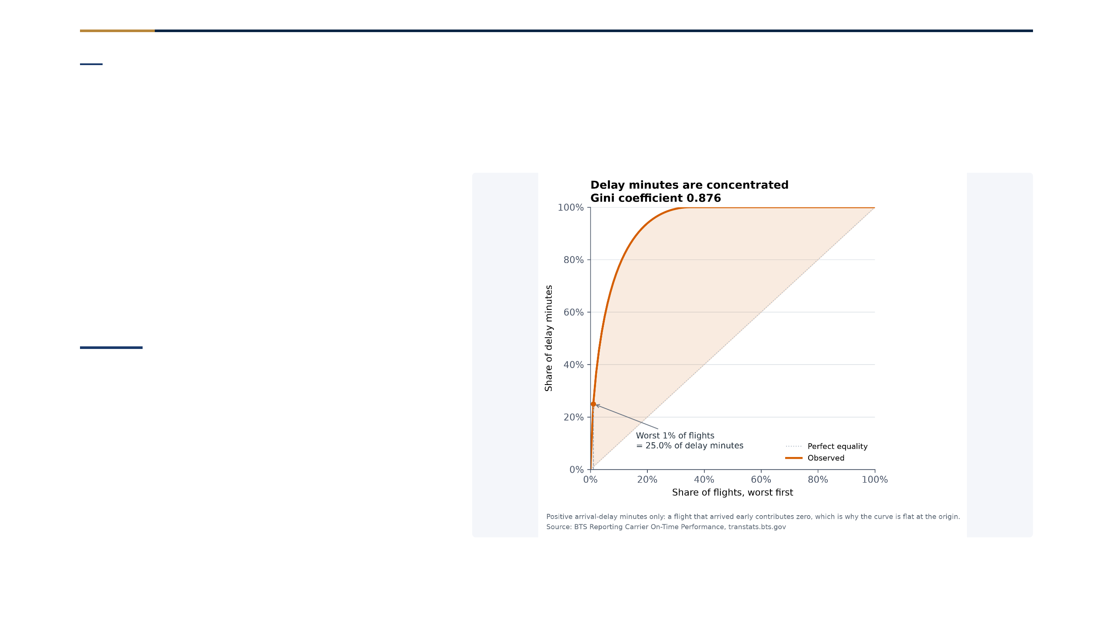
Finding 2 · The tail
A few flights carry most of the delay
0.876
Gini index of delay minutes
near-perfect concentration
So we report percentiles and the tail, and recompute every headline with the pandemic years excluded — the shift is reported, not hidden.
Lorenz curve · delay concentration · 61.7M completed flights
09 / 16
Notes:
发现二：Gini 0.876，延误高度集中，少数航班承担大部分延误。

Slide 10
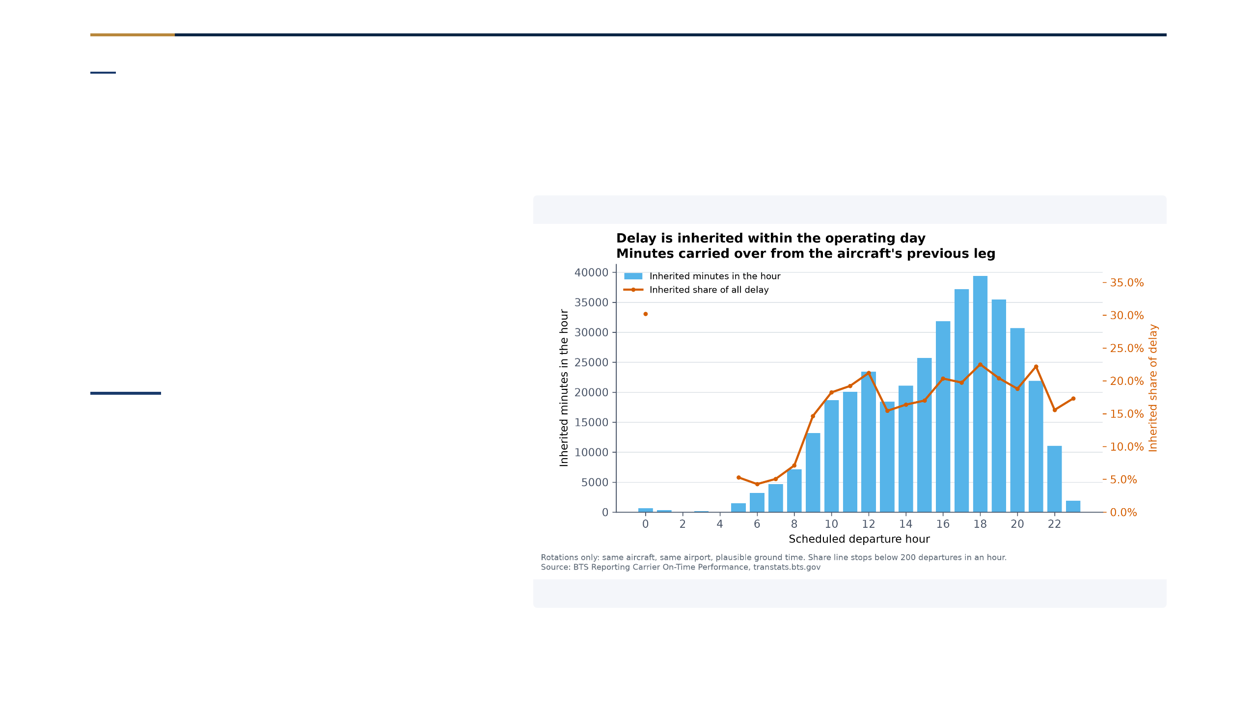
Finding 3 · RQ2
Delay is inherited within the operating day
38.8%
late aircraft
the single largest cause
6.0% of flights sit in a rotation already carrying delay; 17.1% of those minutes are inherited from an earlier leg. Delay accumulates toward evening.
Within-day cascade · delay propagates across the day
10 / 16
Notes:
发现三：晚到飞机是最大单一原因（38.8%），延误在一天内级联累积。

Slide 11

Findings 4 & 5 · RQ3 / RQ4
Five profiles · risk ranked, not promised
RQ3
RQ4
Airport archetypes
Severe-delay risk
k = 5 over 195 airports; silhouette 0.2045. Reported unstable — ARI 0.69 vs a 0.70 threshold.
AUC 0.685 (logit) / 0.691 (GBM) at a 6.1% base rate. Departure hour = 49.9% of importance.
Clustering reports its evidence · model reports baseline, held-out, ranks-not-predicts
11 / 16
Notes:
发现四：机场分五类，但如实报告为不稳定。发现五：风险可排序，不能承诺到达时间。

Slide 12
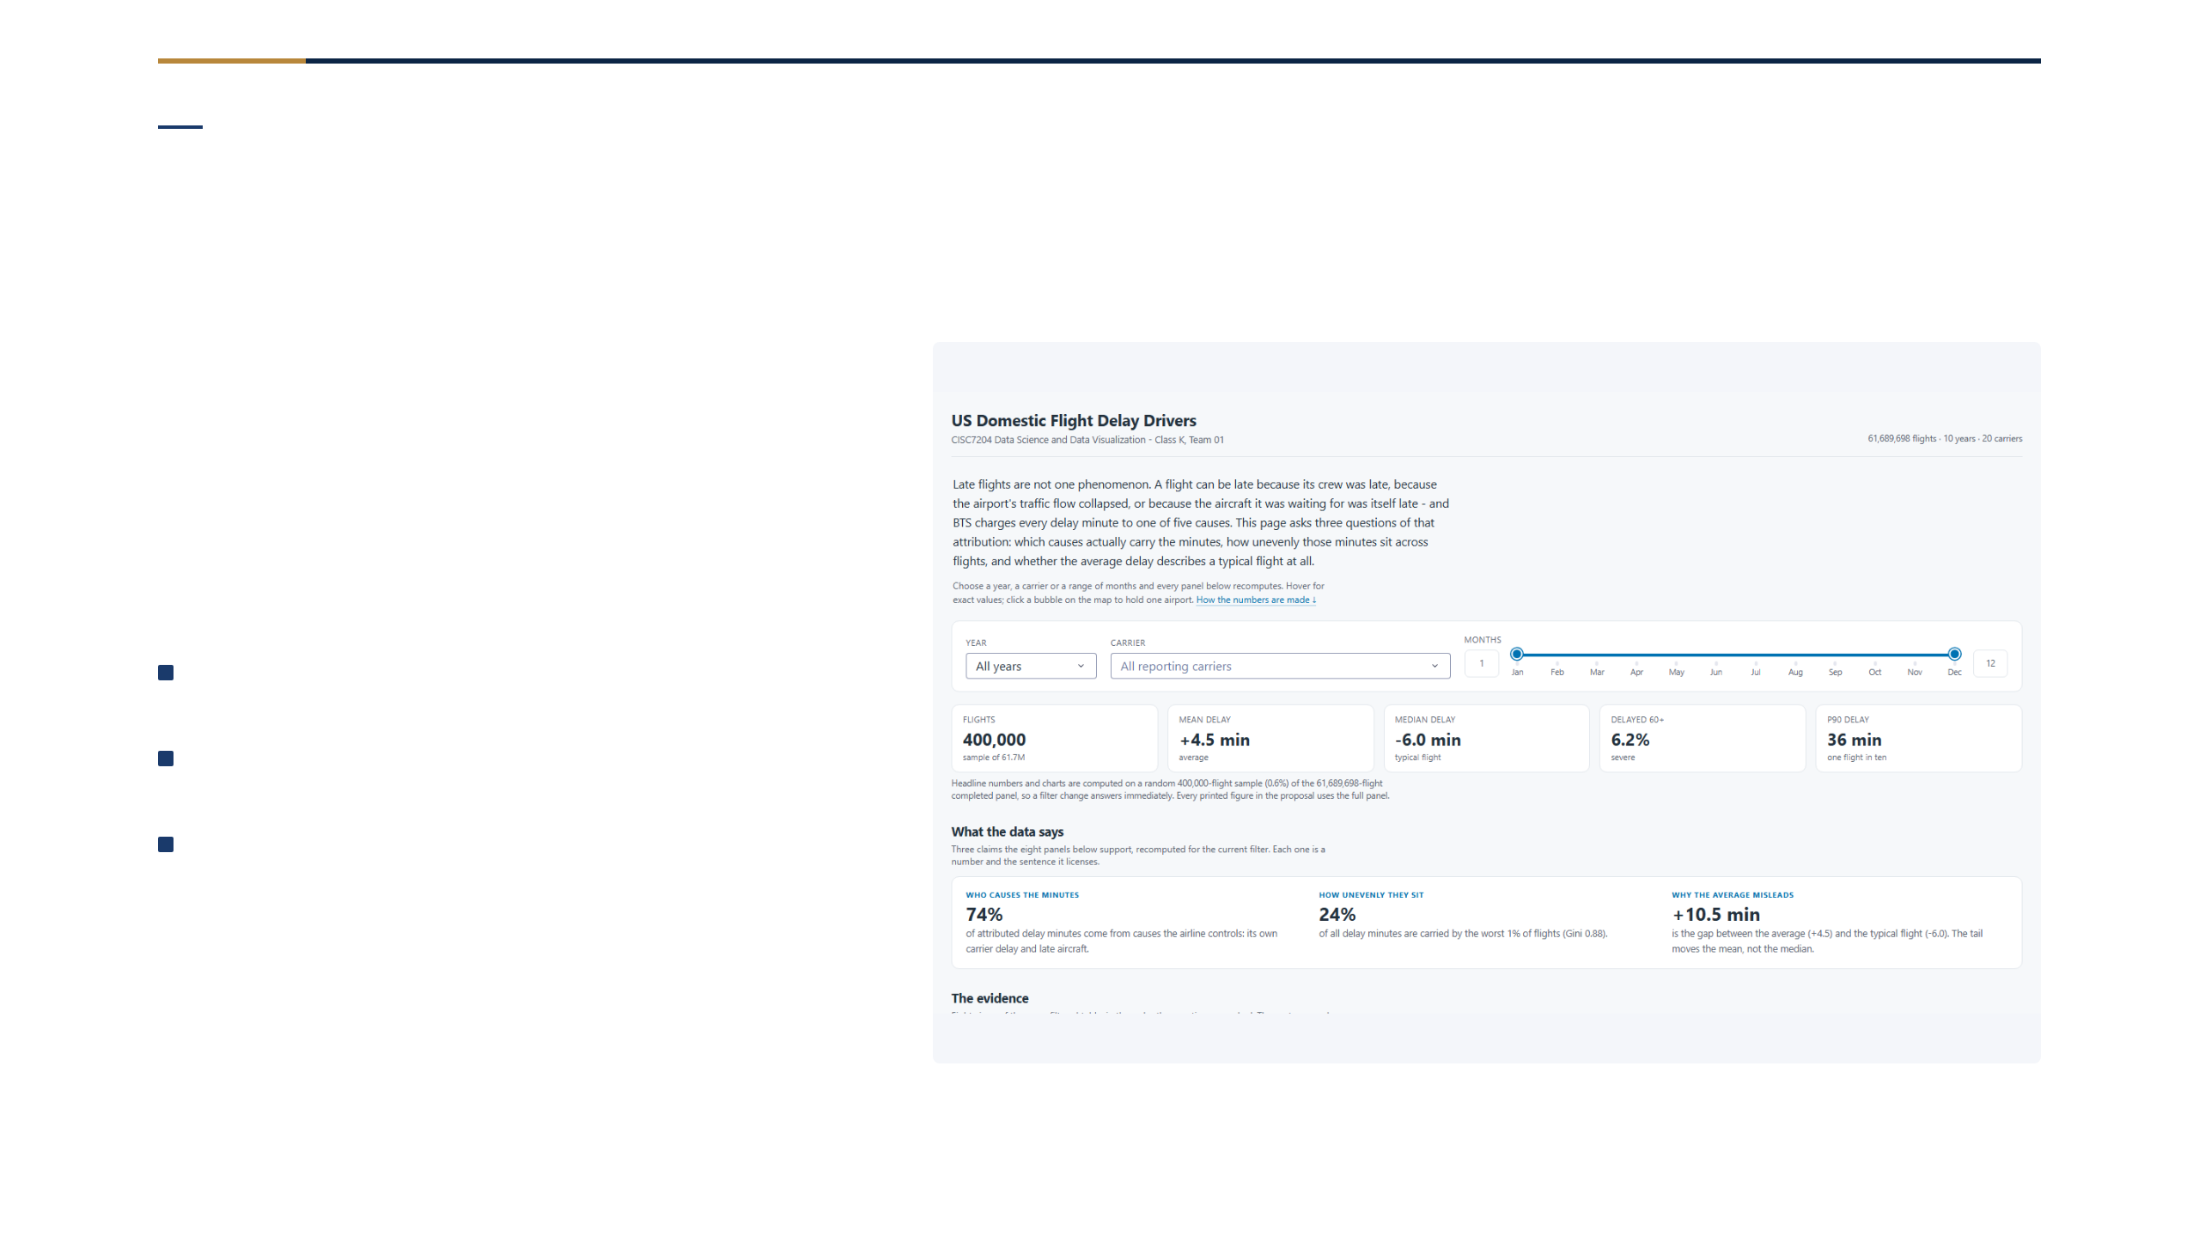
Communication Layer
One linked dashboard, live filters
Three filters, one view
year · carrier · month
every panel recomputes live
usability on 3 timed tasks
Change a filter → every metric recomputes · not pre-rendered
12 / 16
Notes:
交互式看板：筛选器实时重算所有面板，非专家在三个计时任务上完成可用性测试。

Slide 13
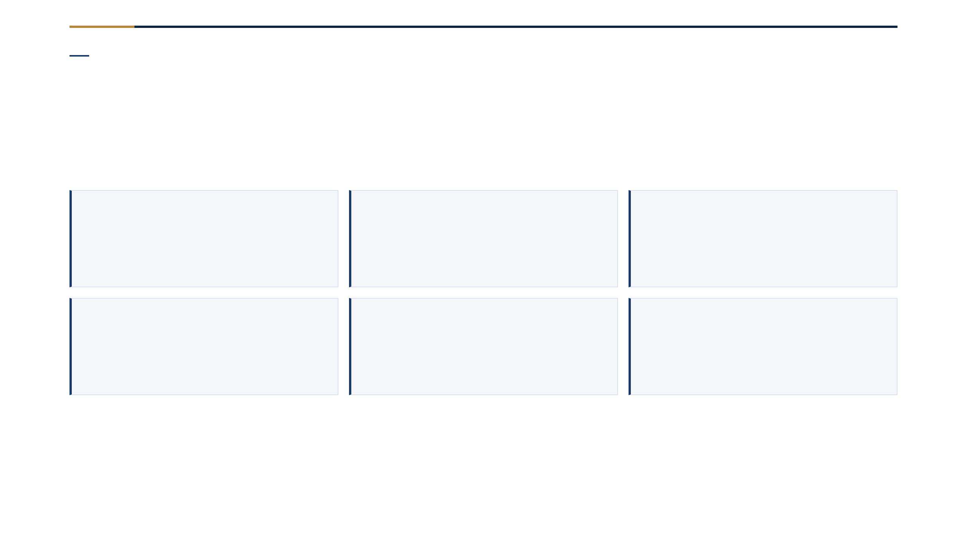
Teamwork · Work Plan 1
Eight roles · independent review
AO KIT I
LI YING FANG
SAVIDI AVRAM
Coordinator & Tracker
Lead Developer
Developer
HO MAN HOU
WU PEI YE
LI TIAN HAO
Team Scribe
Reporter & Liaison
Analyst & Reviewer
Consensus by default (quorum 5, scope 6); after two rounds a majority. Disputes by data, not seniority — no member approves their own work.
Roles rotate at the midpoint · every artefact has an independent reviewer
13 / 16
Notes:
八个课程角色分给六人；共识 + 少数服从多数；技术分歧用数据裁决；产审分离。

Slide 14
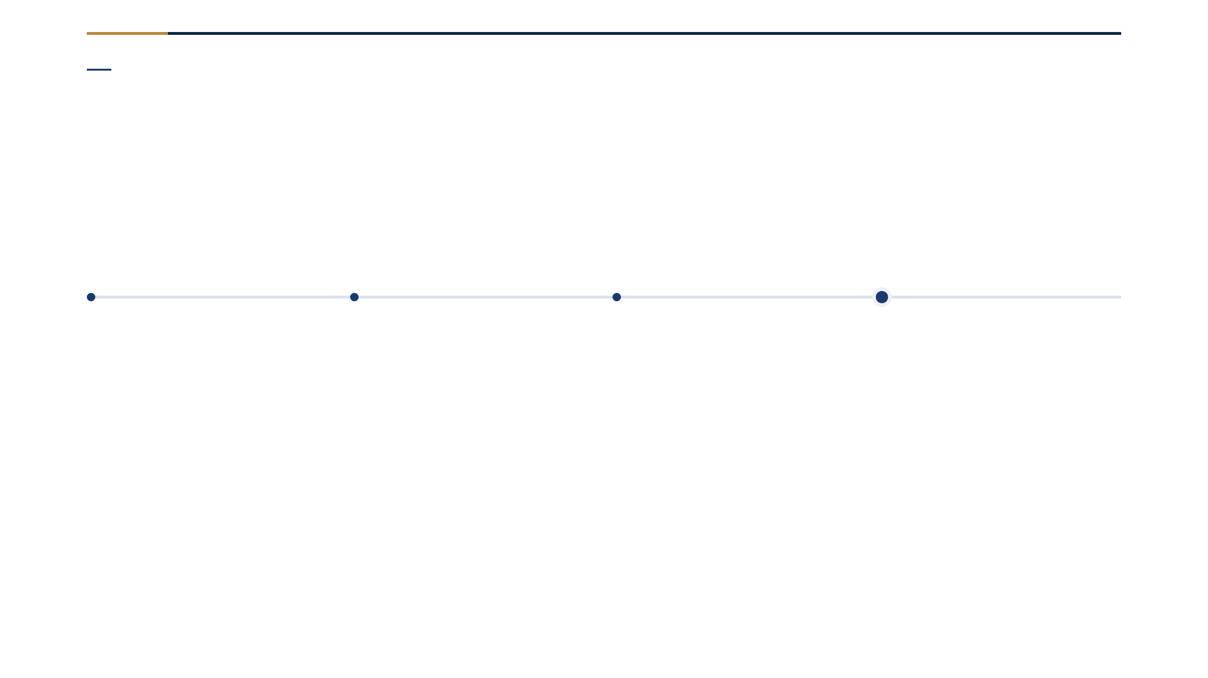
Schedule
Built backward from the deadline
28–29 Oct
30 Oct–2 Nov
3–4 Nov
5 Nov
Form
Scope
Build
Submit
Team, roles, photo set, Work Plan 1
Topic, scope, data sources
Proposal + video in parallel, review & rehearsal
Three artefacts by 23:00
Then: five weekly meetings · presentation 11/18/25 Nov · close 5 Dec.
Each 5-Nov artefact has an owner and a reviewer
14 / 16
Notes:
从截止日倒排：10/28-29 组队，10/30-11/2 定题，11/3-4 并行制作，11/5 提交；之后五次周会、11/18/25 演示、12/5 结项。

Slide 15
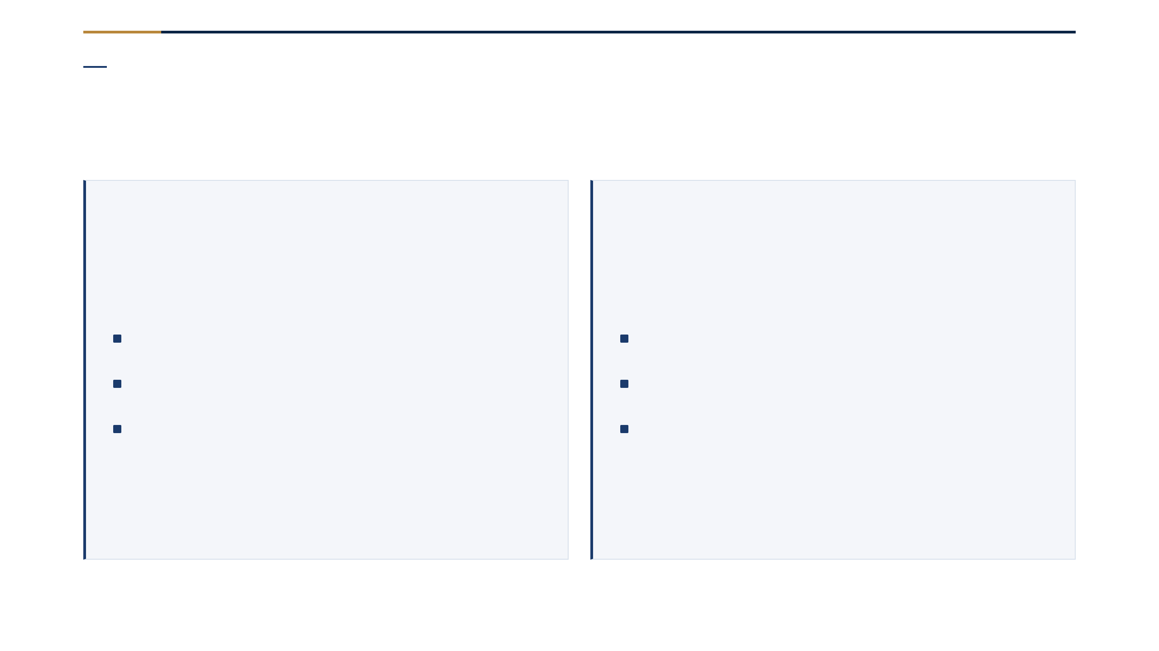
Quality & Honesty
How we judge it · what it cannot say
Quality gates
Stated limits
counts reconcile · 53 tests pass
R² 0.022 → rank, not promise
baseline + held-out + ranks, not predicts
cause minutes: ≥15 min flights only
usability on 3 timed tasks
observational → ranking, not causation
Success criteria as a checklist · limits stated, not hidden
15 / 16
Notes:
成功标准可验收；局限诚实声明：R² 0.022、只排序不预测、观察性数据不证明因果。

Slide 16
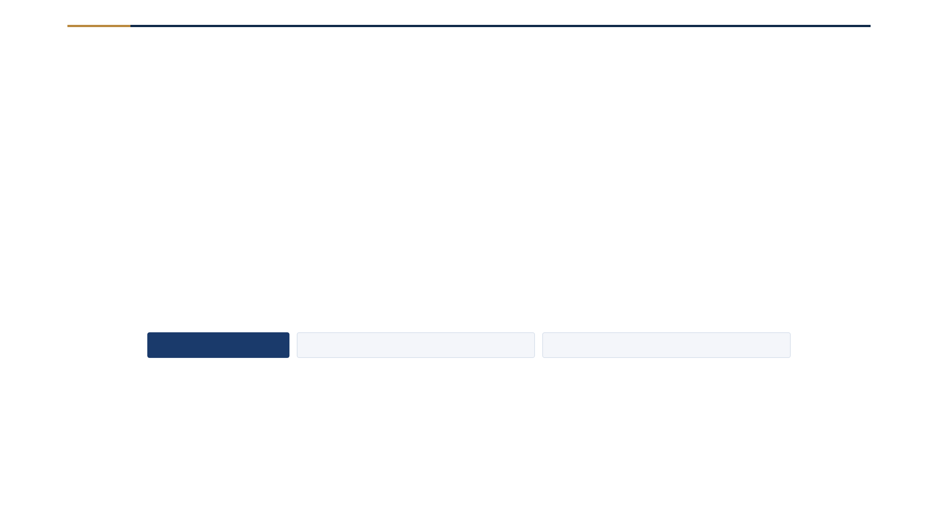
CISC7204 · Class K — Team 01
US Domestic Flight Delay Drivers
Five findings · one pipeline · one dashboard
2026/2027 Semester 1
AO KIT I · LI YING FANG · HO MAN HOU
WU PEI YE · LI TIAN HAO · SAVIDI AVRAM
Notes:
收尾：课程、团队、项目、学期，感谢。六人学号已在前 20 秒合规页出现，此处再次列出姓名。

