Slide 1
Software Design
"...specification of a software artifact, intended to accomplish goals, using a set of primitive components ..." [wikipedia]
Notes:
Question: From the perspective of evolutionary biology, are organisms designed? Why or why not?

Slide 2
Agenda
30 min: Lecture
Design: why & how
More on use cases
Component specification
Team component specification
Last ~15 min: Informal team reports

Slide 3
Design: Why & How

Slide 4
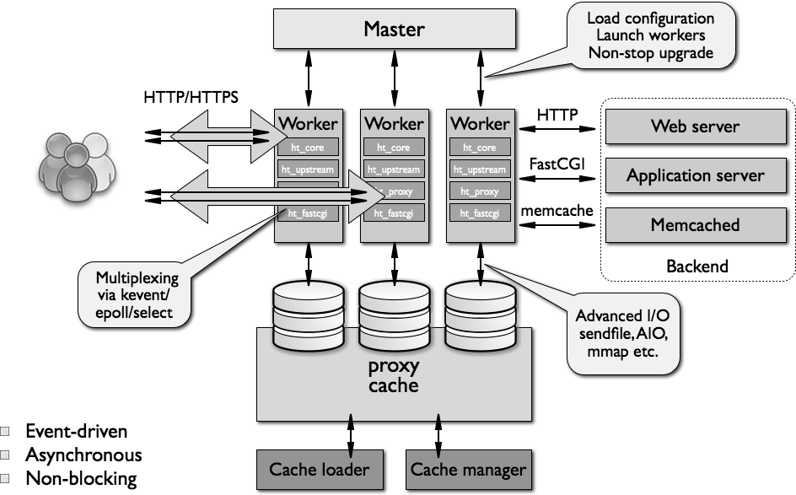
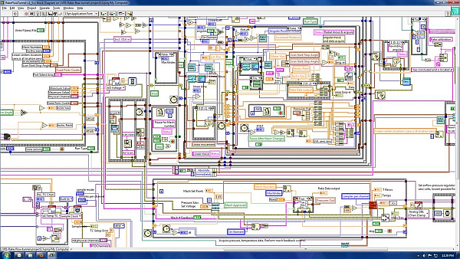
What Makes A Design Understandable?
Few components with clear roles
Use abstraction hierarchies
Few interactions between components
Carefully choose the features and interfaces
Similarity with other designs
Use design patterns

Slide 5
Benefits of a Software Design
Provides a systematic approach to a complex problem
Finds bugs before you code
Enables many people to work in parallel
Promotes testability

Slide 6
Steps in Design
Functional design:
Describe what the system does (use cases)
Component design: Specify the components
Each use case has a "Top level" component.
Sub-components implements portions of the use case
Ideally want many components that are common across use cases
Iterate. Iterate. Iterate.

Slide 7
Functional Design

Slide 8
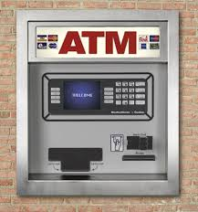
Running Example: Design of ATM

Slide 9
What Do We Do With ATMs?
Get cash
Deposit checks
Check balances
These are examples of Use Cases.
Implied use case – User authentication.

Slide 10
Describing a Use Case
What information the user provides
E.g., command entered with its options
What responses the system provides
E.g., prompts, plots, error messages
Authenticate User Use Case
User: Put ATM card in reader
ATM: Display 'Enter PIN'
User: Enters PIN on keyboard
ATM: [if correct] Show main menu
[if incorrect] Display 'Enter PIN'

Slide 11
Component Design

Slide 12
Specification of Components
Describe components with sufficient detail so that someone with modest knowledge of the project can implement the code for the component.
Name
What it does
Inputs (with type information)
Outputs (with type information)
How use other components

Slide 13
Developing Component Specifications
What are the components in the use cases?
What components are already available?
What are the sub-components needed to implement those components that aren't already available?
Do 1-2 for each such component

Slide 14
Example Component Specification Find Primes < N
Name
FindPrimes
What it does:
Finds the primes that are less than N
Inputs (with type information)
N, an integer
Outputs (with type information)
List of integers

Slide 15
Pseudo Code: "How Use Other Components"
Pseudo code for finding the primes < N if the one component is divides
For n < N
is_prime = True
For d < n
If divides(n, d)
Then is_prime = False
If is_prime, add n to list_of_primes
"Rules" for pseudo code
Consistent use of flow control & variable names
Readable English where details are sparse
Notes:
Not executeable statements
Some logic is implied (e.g., initializing list_of_primes)

Slide 16
ATM Components by Use Case
Authenticate user
Database with user PIN
User interface that reads ATM card
User interface that reads user PIN
Control logic
Get cash
Database with users cash balance
User interface that reads user cash requested
Cash drawer interface that dispenses cash
Control logic

Slide 17
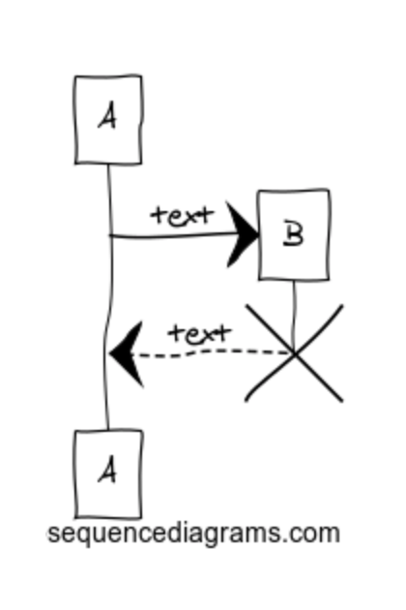
Interaction diagrams
These describe interactions between your components, users, filesystems, etc.
Very useful for describing how things relate without words
Web tools for making these
E.g. https://www.websequencediagrams.com

Slide 18
The Next ~40 Minutes
Develop the use cases for your project
List of components of their interactions
Who calls whom for each step in the use case
Component(s) design using the design template
Use a Markdown document in your repo to record your use cases, associated components, etc. This will be the first group SEDS HW.
What you'll report: Very brief
Summary of design
Issues, open questions

Slide 19
Informal team report to instructors

