Slide 1

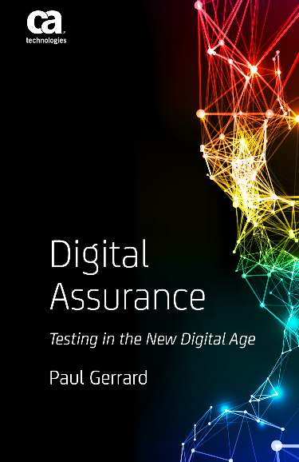
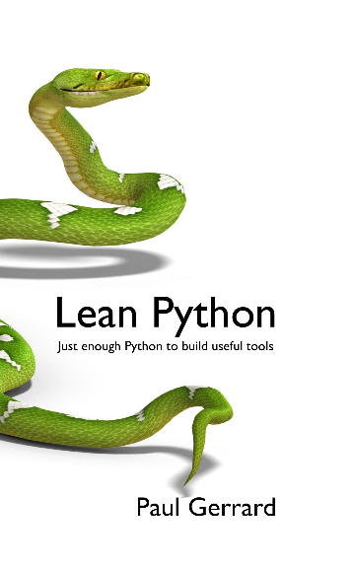


Do Testers Think Differently?
Paul Gerrard
paul@gerrardconsulting.com
@paul_gerrard
gerrardconsulting.com

Slide 2














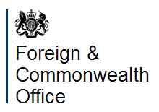







Helping clients transform their testing through
INNOVATION, COACHING and LEADERSHIP
Our CLIENTS
Want to be agile rather than follow Agile dogma
Have a pragmatic approach and are focused on delivery
Want a solution that fits, not a badly fitting suit.

Slide 3
Agenda
What’s Happening?
A New Model for Testing
Some Considerations
Close

Slide 4
When did you start testing?
We are all testers

Slide 5
What's happening?
Stampede to mobile computing - Digital
Big Data
Internet of (Every)Thing, Pervasive Computing
Continuous Delivery, DevOps
(Test) Analytics, Data-Driven Development
Shift-left, embedded testers, no test team
Did you really think Agile was the last word?

Slide 6
Where is this leading?
Your guess is as good as mine
But here's my guess anyway ☺

Slide 7
From high process to DIY process
In the past, high process was seen to be the technical solution to the software problem
But technical solutions cannot solve human problems
Agile promised flexibility, but a lot of Agile is really 'high process-in-the-small'
True agility means a team can adapt or select its process on-the-fly.

Slide 8
The old ways won't work in the future
We need a New Model of Testing (free from logistics)

Slide 9
Forget Logistics (for the time being)
Document or not?
Automated or manual?
Agile v waterfall?
This business or that business?
This technology v that technology?

Slide 10
ALL Testing is Exploratory
We explore sources of knowledge ...
... to build models ...
... that inform our testing.

Slide 11
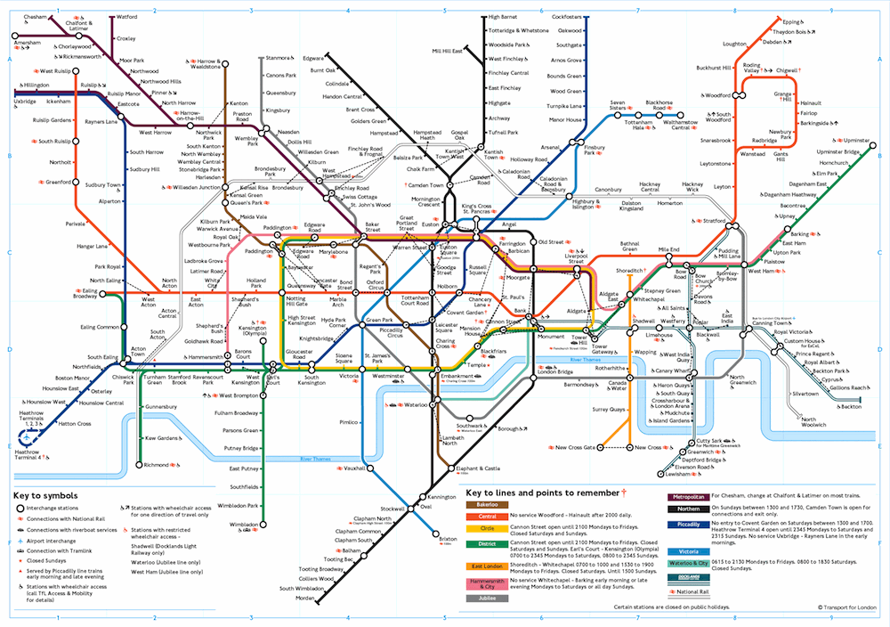
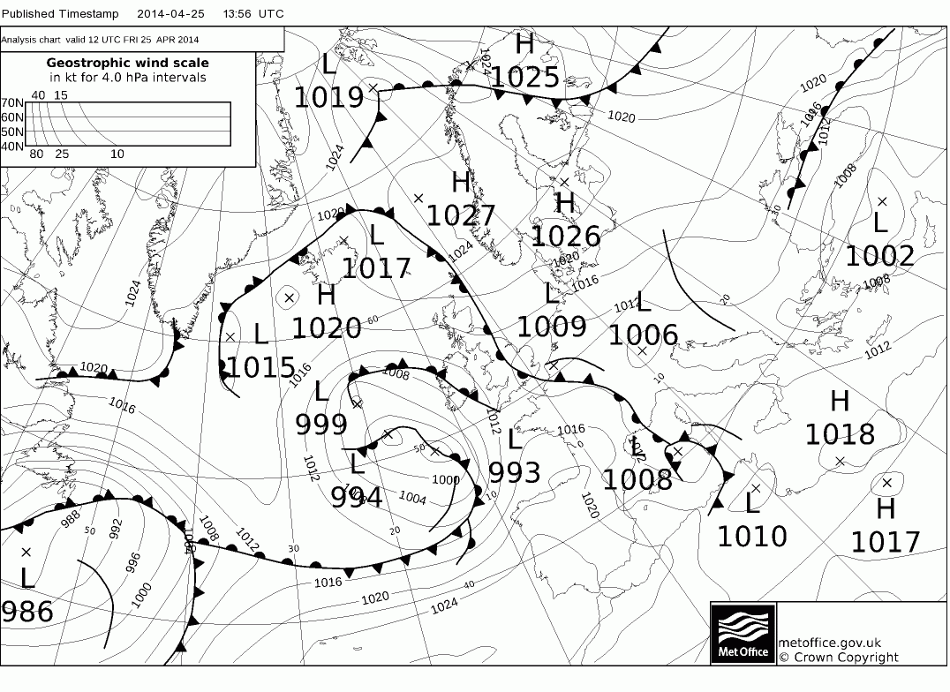
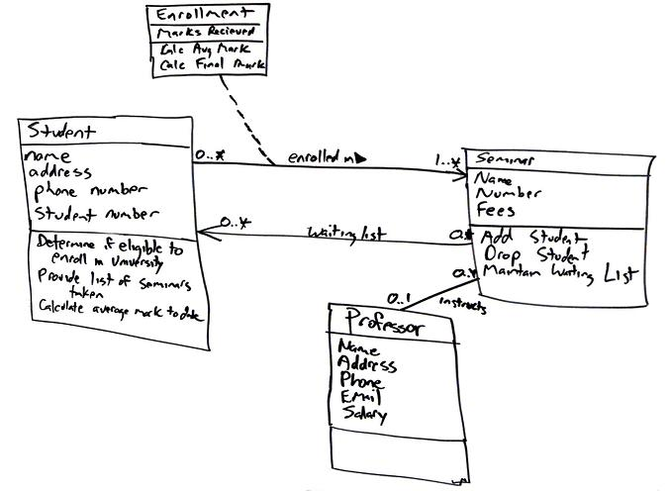
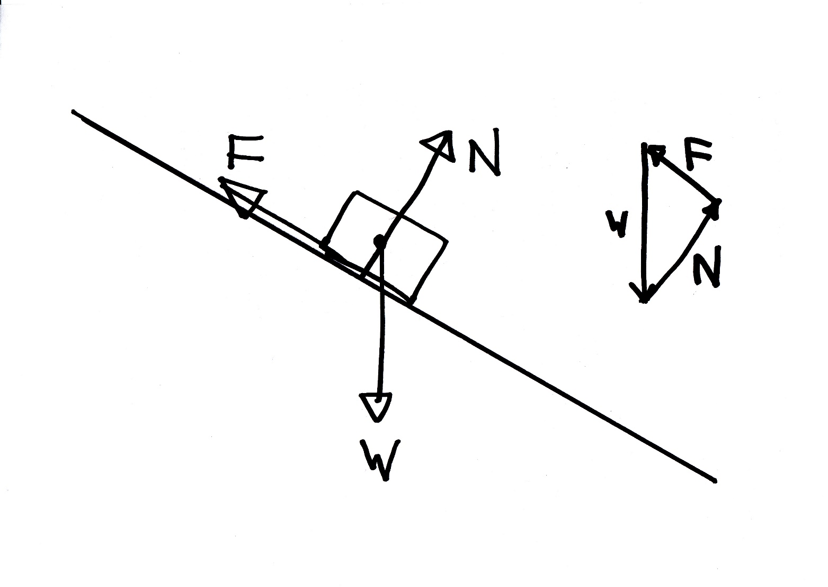
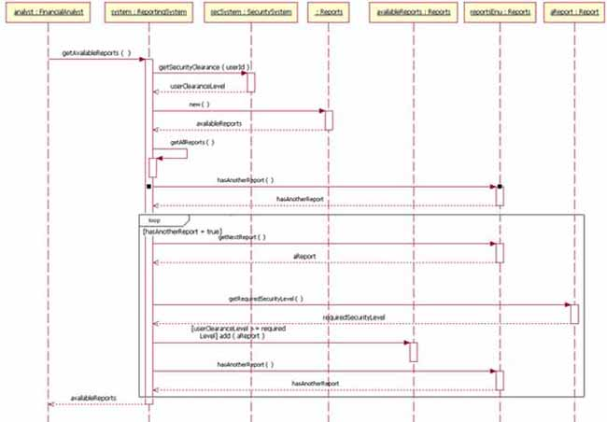
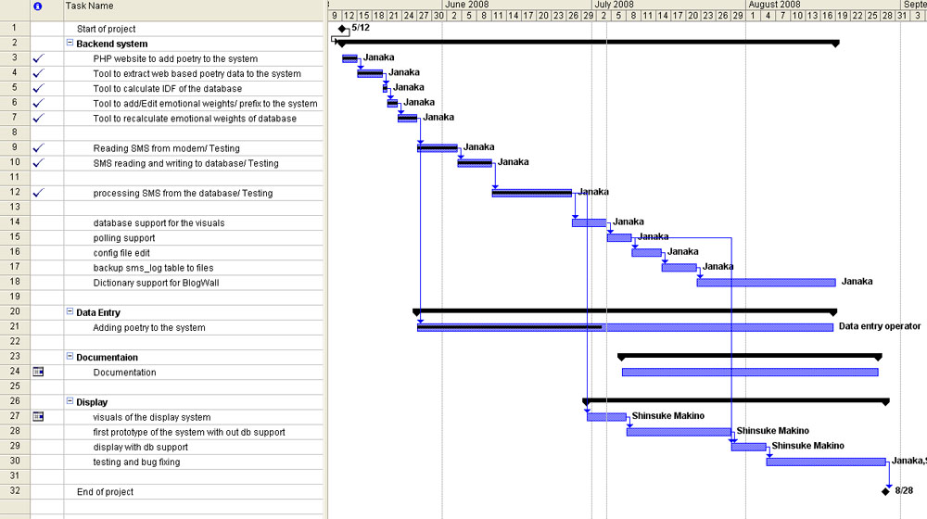

Examples of models

Slide 12


Models are innate, essential, human

Slide 13
Judgement, exploring and testing
We explore sources of knowledge to build test models that inform our testing
Our model(s) are adequate
Creates test
models
Uses test
models
Judgement
Exploring (sources)
Testing (the system)
Our model(s) are not adequate
BTW – Do Developers explore the same way?

Slide 14
Exploration process
Sources
System under test
Enquiring
Modelling
People (& you)
Exploration
Test
Models
Definitions specs/stories
Require-ments
Challenging
Predicting
Sources:
People, documents,
experience, system under test
Test Models:
Can be documented
or mental models

Slide 15
Testing process
More exploring
Reporting
Informing
Applying
Test
Models
Testing
System Under Test
Refining
Interpreting
Logging
Revising
Revise the System

Slide 16
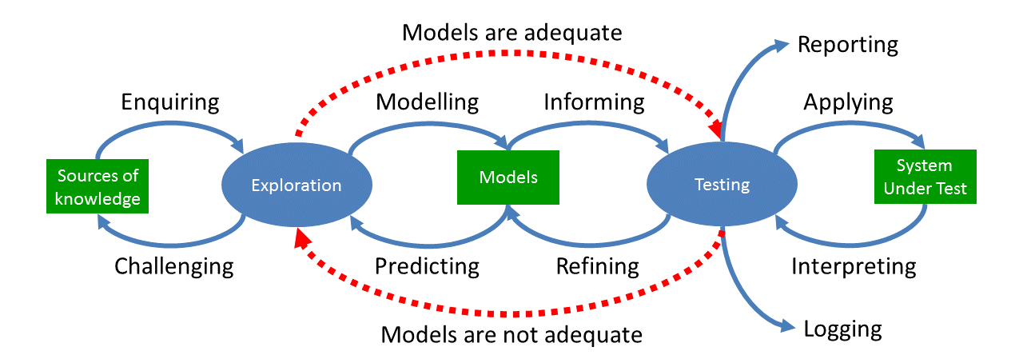
New Model Testing
My BBC talk: http://www.bbc.co.uk/academy/technology/article/art20150522113029398
29 page paper: http://dev.sp.qa/download/newModel

Slide 17
Some Considerations
There are others

Slide 18
Shift-Left means dev and test working much closer
Could the New Model help Developers and Testers to understand each other?

Slide 19
Relation to TDD and BDD?
TDD is not really testing
BDD is modelling using stories

Slide 20
Test automation from a different perspective
Automation efforts fail too often
Automation uses different models

Slide 21
Capabilities
Enquiring, Modelling, Predicting, Challenging
Informing, Applying, Interpreting, Refining
Reporting and Logging

Slide 22
A very different skillset
Analysis, enquiry and elicitation
Modelling
Creation of custom models, using heuristics, guesses, brainstorming, ideation, creative thinking
Custom test design techniques
Comparison of models, value, advantages, disadvantages, compromises
Identification, validation and use of oracles
Predicate logic and proof
Hypothesis and inference
Socratic method
Rapid Review and Inspection techniques
Test case design
Test models and the meaning of coverage
Testing as controlled experiment
Observation, Note taking, recording
Basic data analysis and statistics
Decision-making with incomplete data
Computer forensics
Fault tree analysis
Failure diagnosis
Bug advocacy, triage processes and negotiation
Meaningful software and test metrics
Visual presentation of data
Reporting and presentation skills
Understanding stakeholders
Test analytics
Risk management, risk-based testing and decision-making
Critical Thinking
Interpersonal skills
Dealing with uncertainty/fallibility

Slide 23
Perhaps testers don’t think differently after all?

Slide 24
Do Testers Think Differently?
Paul Gerrard
paul@gerrardconsulting.com
@paul_gerrard
gerrardconsulting.com

