Slide 2

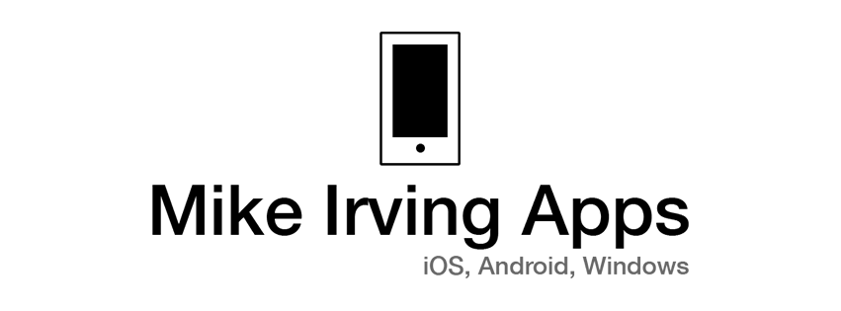
Mike Irving Software Developer, Consultant Web Development: - mainly on C# / .NET, SQL Server, Windows Server - 15+ Years Commercial Experience. Mobile Development: - iOS - Objective-C, Xamarin, Cordova / HTML5 - Android, Windows, Cross Platform with Xamarin C# - 7+ Years Commercial Experience

Slide 3

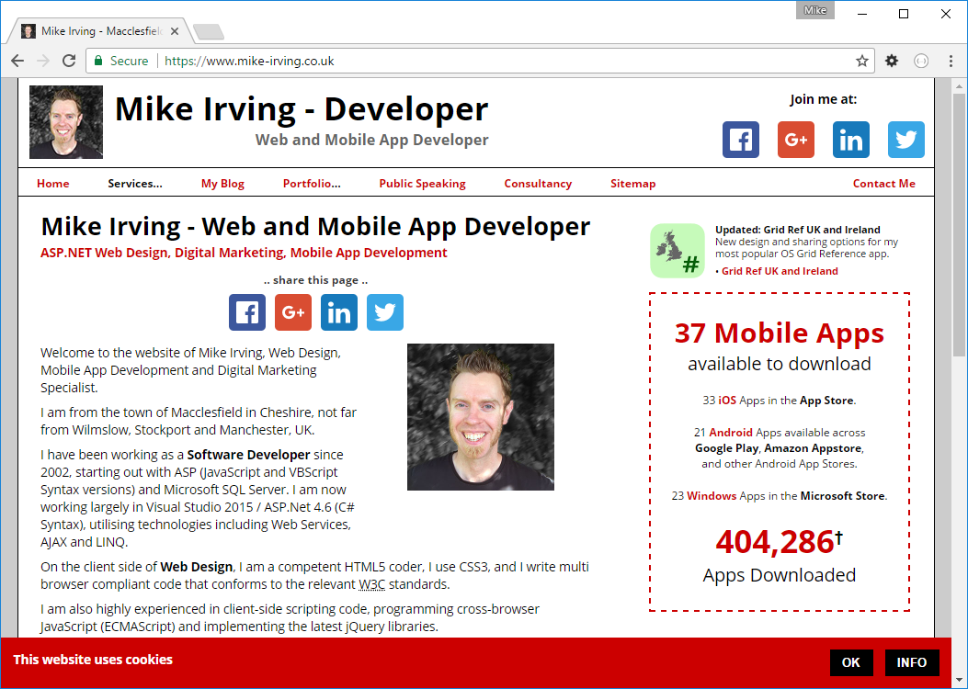
WHAT THE SSL? SSL
TLS encryption
https:// Port: 443

Slide 4
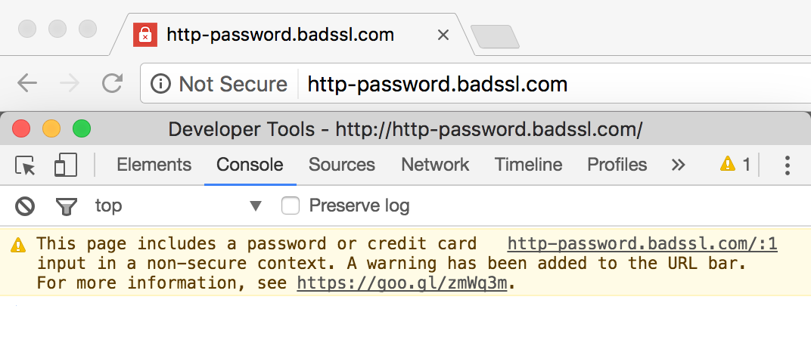
Why go secure? - Prevent ‘Insecure’ Warnings in Chrome, Browsers
- It’s a positive Google Search Ranking Factor, likely to become even more prominent - Apple not allowing any more insecure apps CONFIDENCE

Slide 5
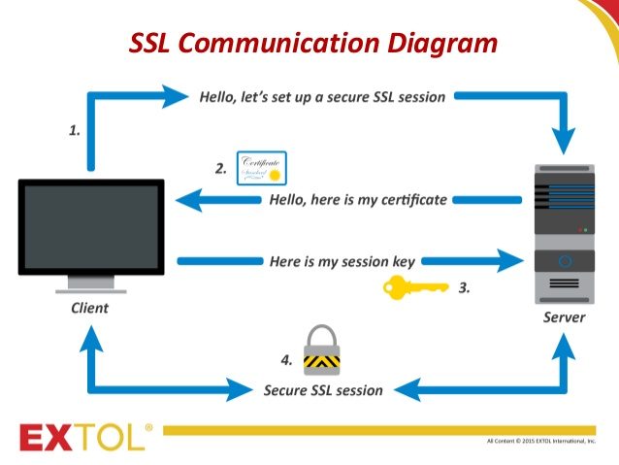

Slide 6


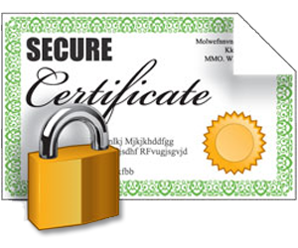
Certificate request
Web Server
Certificate Authority
Secure Certificate

Slide 7
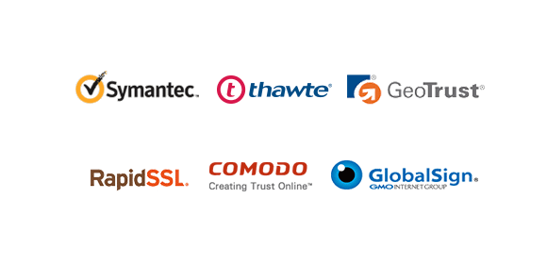
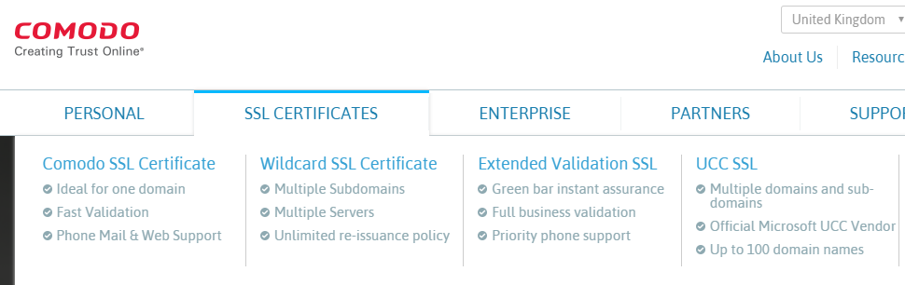

Slide 8
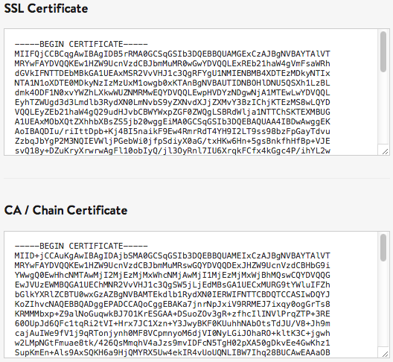
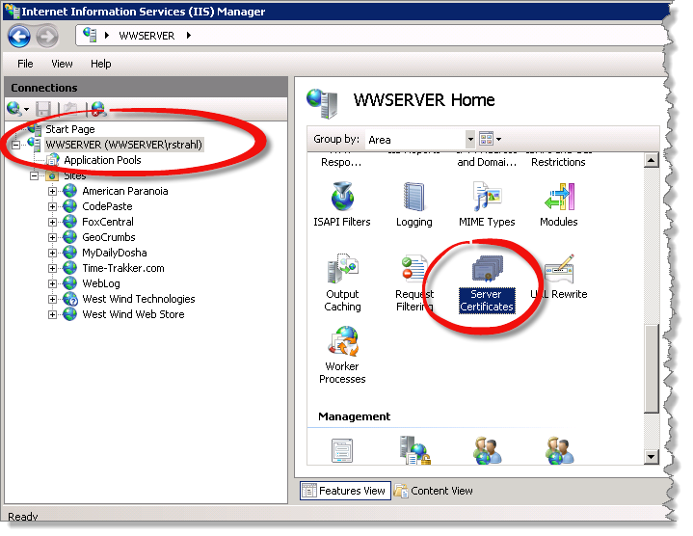
PAIN!

Slide 9
Cost + Setup Pain + Renewal Pain
=
Can’t be arsed.

Slide 10
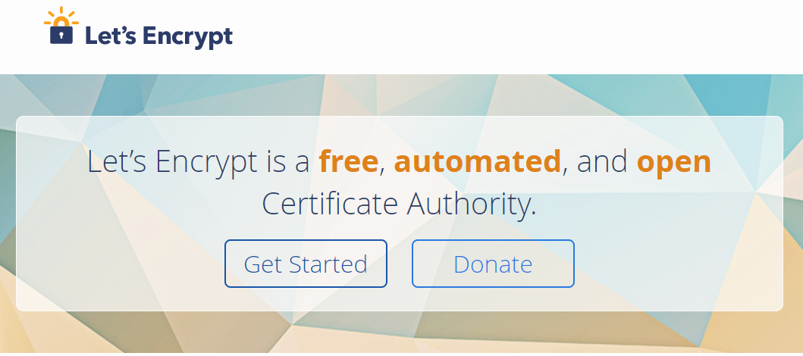

Slide 11
Let’s Encrypt Free, single domain certificates (no wildcards) Valid for 90 days Automated renewal process

Slide 12
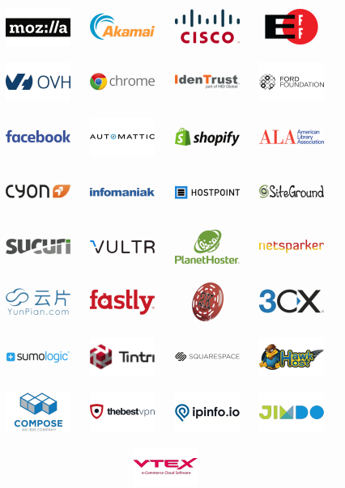
Let’s Encrypt
Universally Trusted, Supported by big players.

Slide 13
Let’s Encrypt
Uses ACME Protocol Automatic Certificate Management Environment Typical process: - Create a Vault / Identity – tied to email address - request certificate for domain name - assign certificate to web server - request renewal within 30 days of expiry date

Slide 14
Let’s Encrypt
ACME Client Implementations… ‘Certbot’ recommended Implementations available for all environments: Docker, Java, PHP, Python, Windows etc.

Slide 15
Let’s Encrypt
Options on Windows ACMESharp (.NET, Powershell) letsencrypt-win-simple (.NET) Certify GUI (.Net, WinForms, uses ACMESharp)

Slide 16
Let’s Encrypt
I have a Windows Server, Here’s what I did… - Initially Installed Certify GUI, which installed ACMESharp - now using Installed letsencrypt-win-simple (stills from) Live demo…

Slide 17
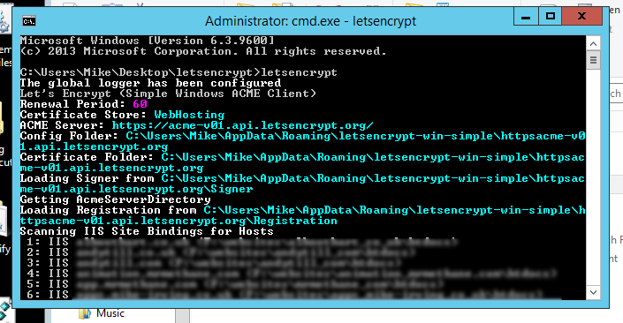

Slide 18
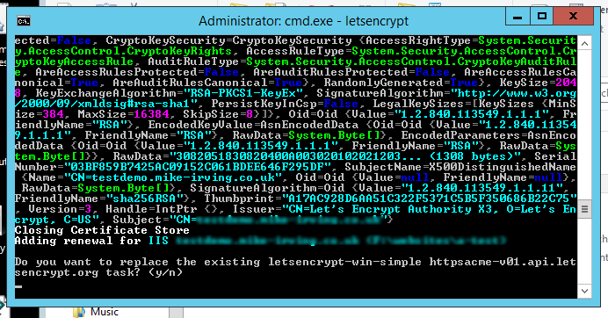

Slide 19
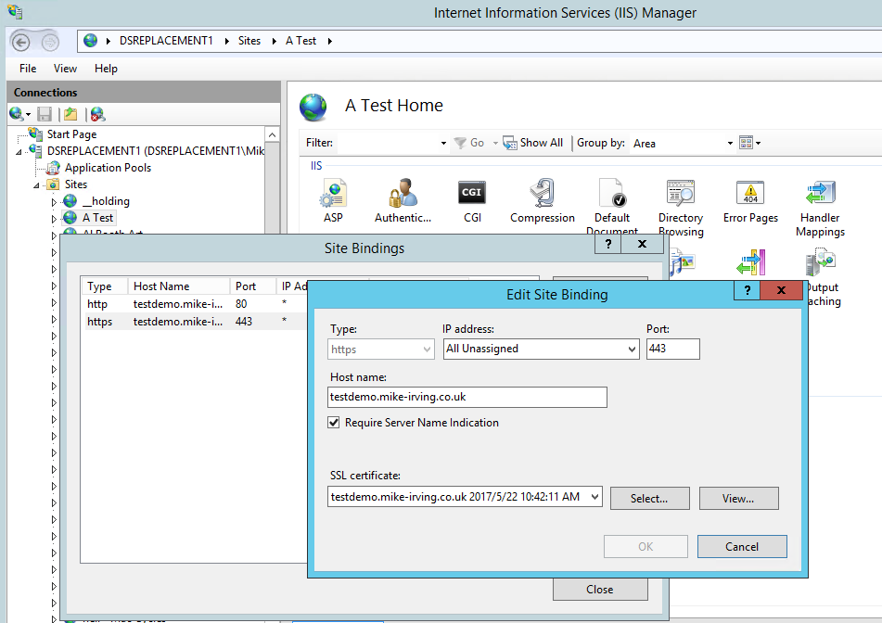

Slide 20
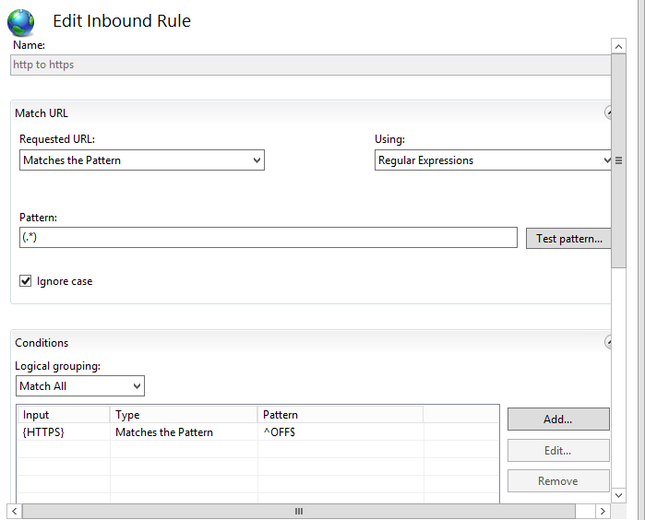
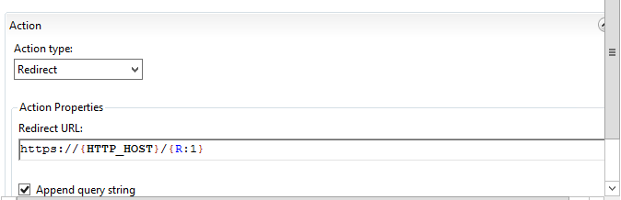

Slide 21
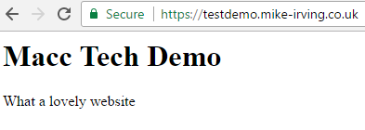

Slide 22
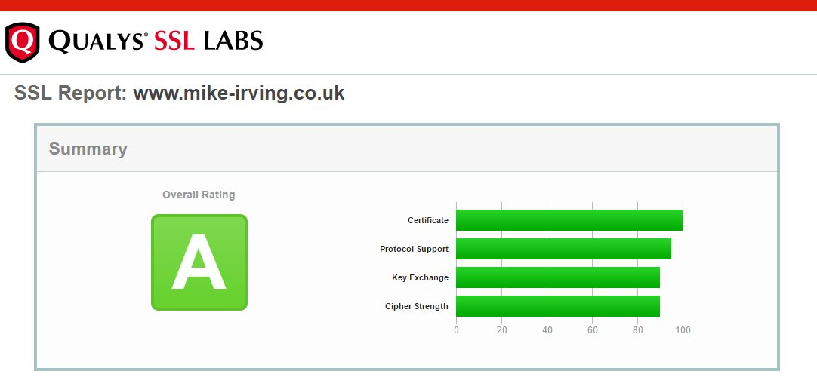
SSLLabs.com – SSL Report
Test your site Block unsafe protocols.. i.e. SSL 2, SSL 3 Remove weak Ciphers Re-test your site Improve your rating!

Slide 23
Good Ciphers
TLS_ECDHE_ECDSA_WITH_AES_256_GCM_SHA384_P384,
TLS_ECDHE_ECDSA_WITH_AES_256_CBC_SHA_P384,
TLS_ECDHE_RSA_WITH_AES_256_CBC_SHA_P384,
TLS_ECDHE_ECDSA_WITH_AES_256_CBC_SHA_P256,
TLS_ECDHE_RSA_WITH_AES_256_CBC_SHA_P256,
TLS_ECDHE_ECDSA_WITH_AES_128_GCM_SHA256_P384,
TLS_ECDHE_ECDSA_WITH_AES_128_CBC_SHA256_P384,
TLS_ECDHE_ECDSA_WITH_AES_128_GCM_SHA256_P256,
TLS_ECDHE_ECDSA_WITH_AES_128_CBC_SHA256_P256,
TLS_ECDHE_ECDSA_WITH_AES_128_CBC_SHA_P384,
TLS_ECDHE_ECDSA_WITH_AES_128_CBC_SHA_P256,
TLS_ECDHE_RSA_WITH_AES_128_CBC_SHA_P384,
TLS_ECDHE_RSA_WITH_AES_128_CBC_SHA_P256,
TLS_ECDHE_RSA_WITH_AES_128_CBC_SHA256_P384,
TLS_ECDHE_RSA_WITH_AES_128_CBC_SHA256_P256,
TLS_DHE_DSS_WITH_AES_256_CBC_SHA256,
TLS_DHE_DSS_WITH_AES_256_CBC_SHA,
TLS_DHE_DSS_WITH_AES_128_CBC_SHA256,
TLS_DHE_DSS_WITH_AES_128_CBC_SHA,
TLS_DHE_DSS_WITH_3DES_EDE_CBC_SHA,
TLS_RSA_WITH_AES_256_CBC_SHA256,
TLS_RSA_WITH_AES_256_CBC_SHA,
TLS_RSA_WITH_AES_128_CBC_SHA256,
TLS_RSA_WITH_AES_128_CBC_SHA,
TLS_RSA_WITH_3DES_EDE_CBC_SHA,
SSL_CK_DES_192_EDE3_CBC_WITH_MD5

Slide 24
Recap – Let’s Encrypt
PROS: - It’s Free.. main cost will be in setting up, automating renewals - Various options, for all platforms - Automated Renewals - Ideal if you have your own Server / VM - Lots of hosting providers support it, automated - many more have it on their roadmap
CONS: - Basic SSL only, no Wildcard SSL - Still some pain in setting up - Shared Hosting Environment? Likely you may only have one SSL option,
a paid one.

Slide 25
Any questions? I’m happy to help you. www.mike-irving.co.uk mike@mike-irving.co.uk

