Slide 1

Why Owning Matters; multi-room audio & freedom
@falken@qoto.org
https://codeberg.org/falken
Tom Chiverton
Notes:
I’m Tom, fine me
Mastadon – twitter, but like e-mail with out a child porn creation service
Codebug like github but without ai slop
Day job

Slide 2
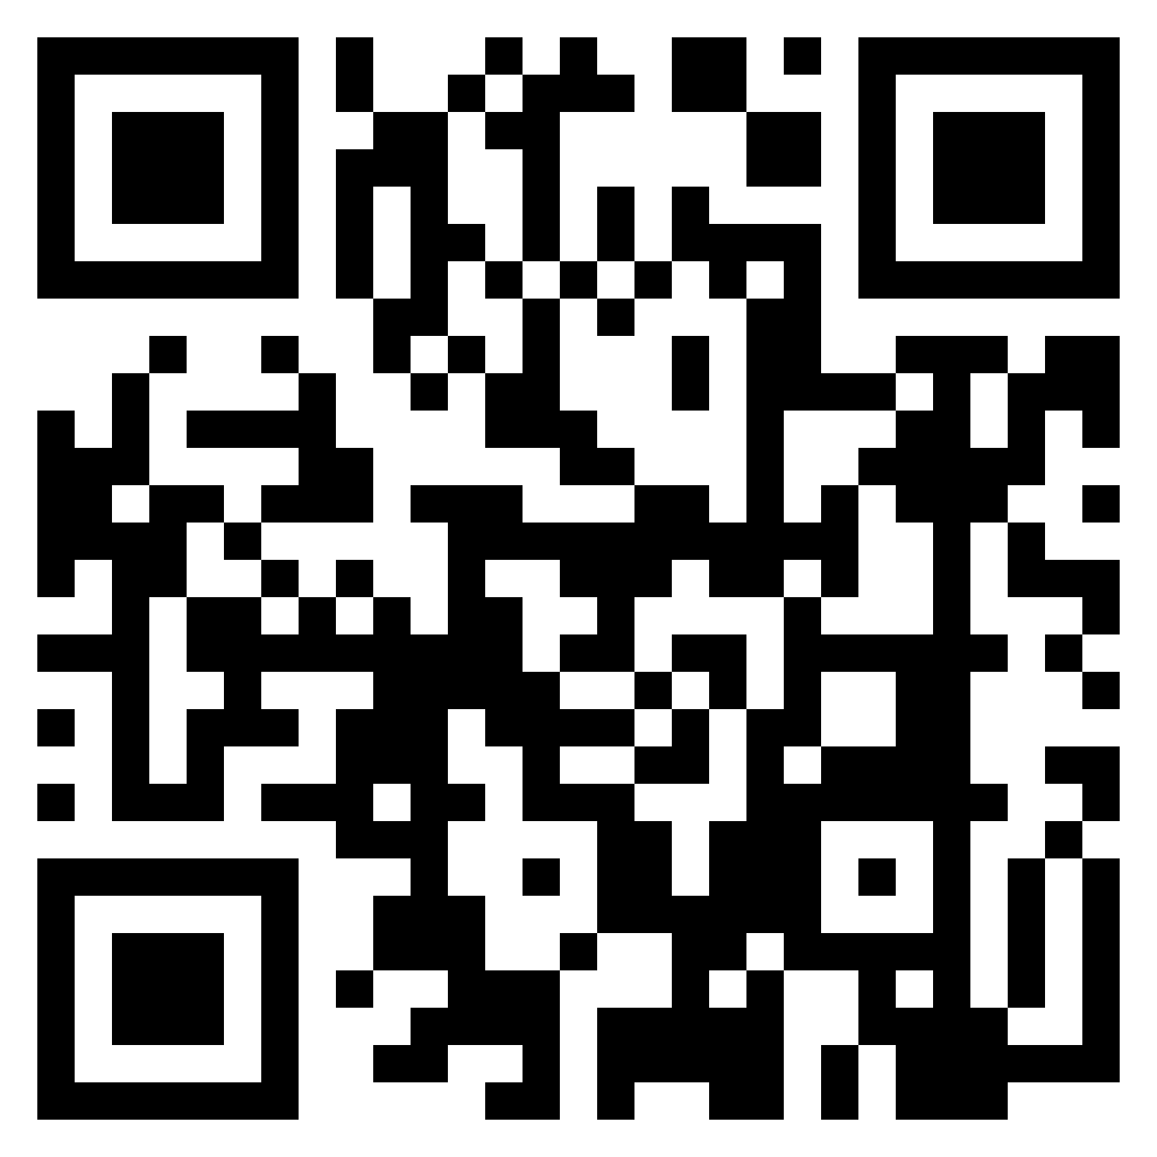
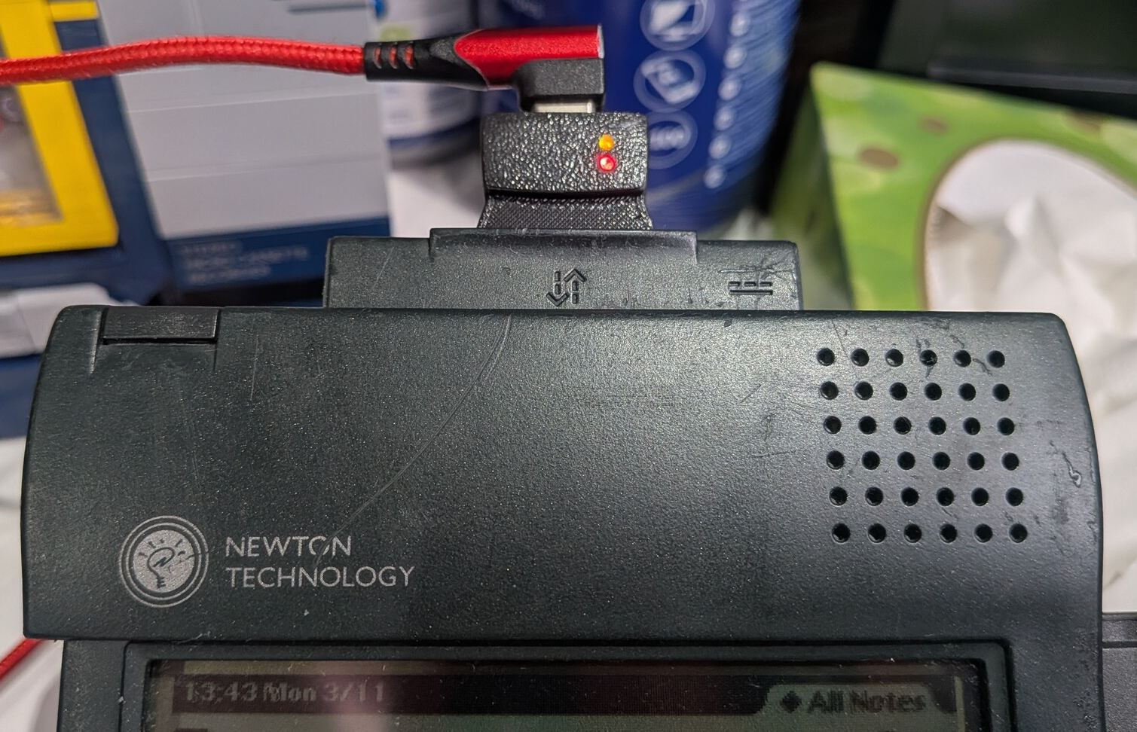
Not going to talk about...
Co-running Macclesfield SciBar
@ https://macclesfieldscibar.co.uk/
Getting an Apple Newton online
@ http://newton.falkensweb.com:3443/
Better Macc bin times
@ https://laser-pixie.falkensweb.com
Notes:
But not going to talk about work
I am not going to talk about
Listen or spreak at sci bar

Slide 3
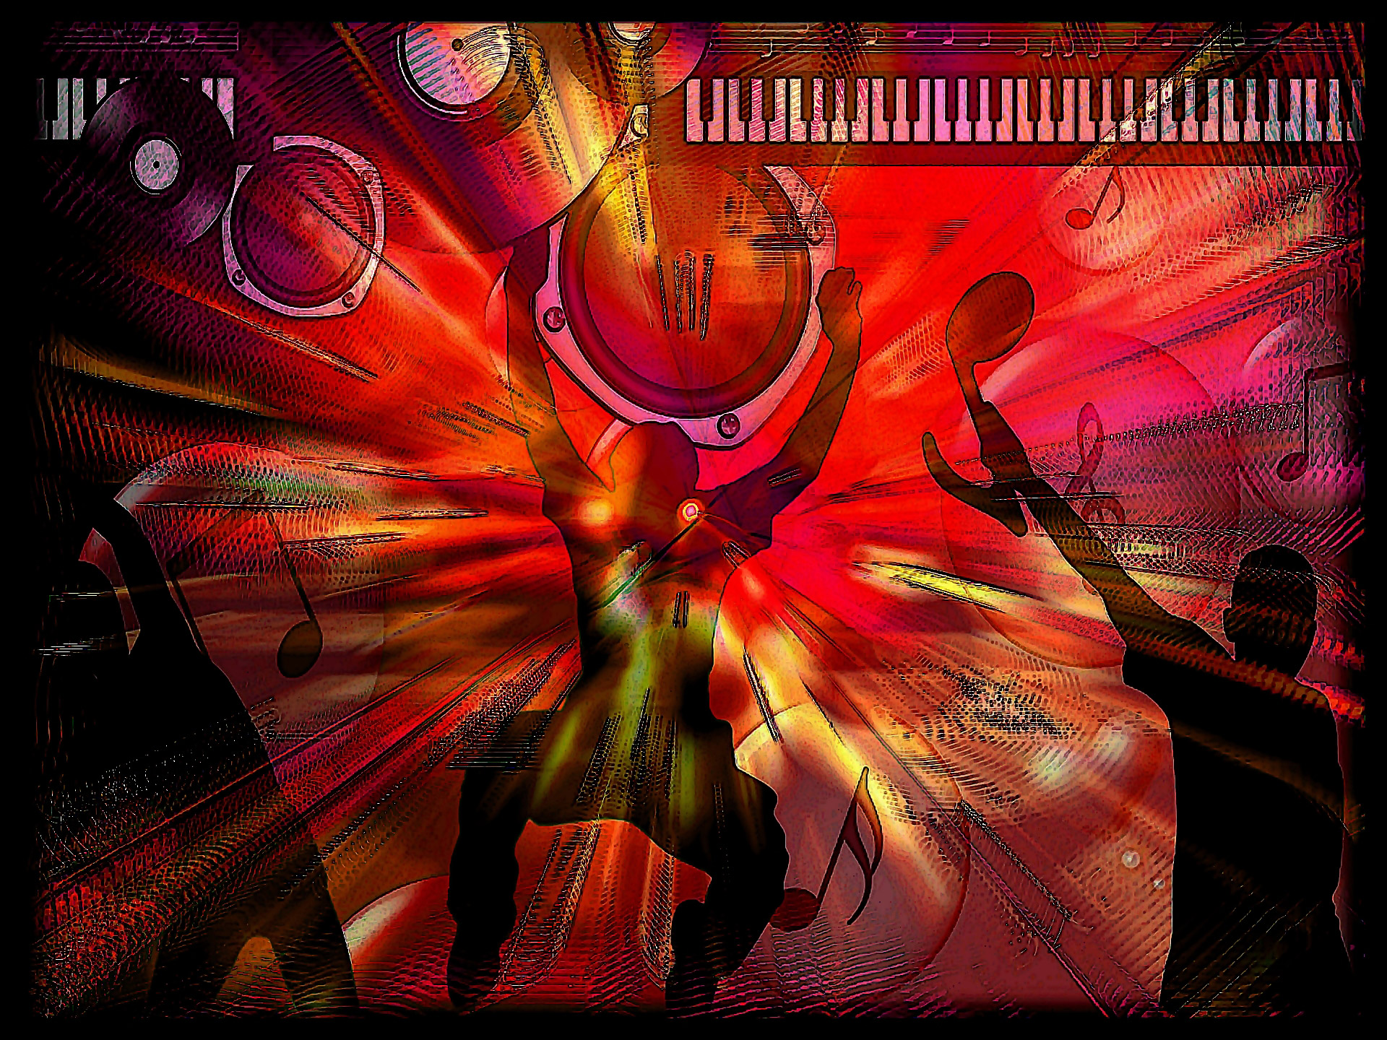
Going to talk about
Notes:
I am going to talk about music
I like music
Hands up if you like music
* Now wave you hands in the air like you just don’t care
Everyone likes some sort of music or films…
Owning music isn’t as simple as it used to be
Dunno how we got here, but will talk about those issues, and then how I leveraged alternatives with some open source to fill the hosue with music.

Slide 4

Is buying owning ?
Notes:
Bought a film or music online ?
On Netflix ?
On Sky ?
On Amzon ?
Things we all do.
What happens when you leave. We cancelled Prime, things we “bought” no longer exist.
Sky at least post you a DVD

Slide 5
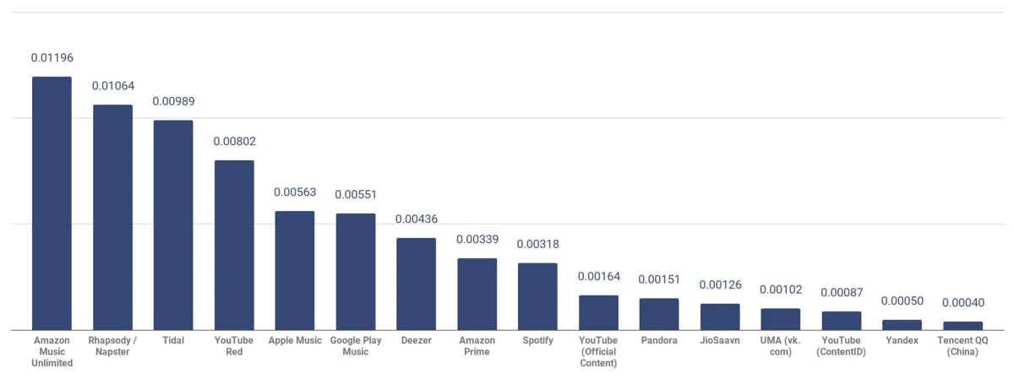
Do you have ...
Apple TV
Sonos
Bose SoundTouch
Fire TV
Google Stick
Amazon Music
Apple Music
Deezer
Soundcloud
Spotify
Tidal
Youtube Music
https://soundcharts.com/
Notes:
Hardware that becomes ewaste without servers. Subscriptions to pay for servers
Same for services
BUT
Payout to artist, per stream
US $0.01 per stream. top end, with a premium paying customer in a premium market. Spotify pay the lowest.
minimum limits for numnber of streams, monies owed before pay out

Slide 6
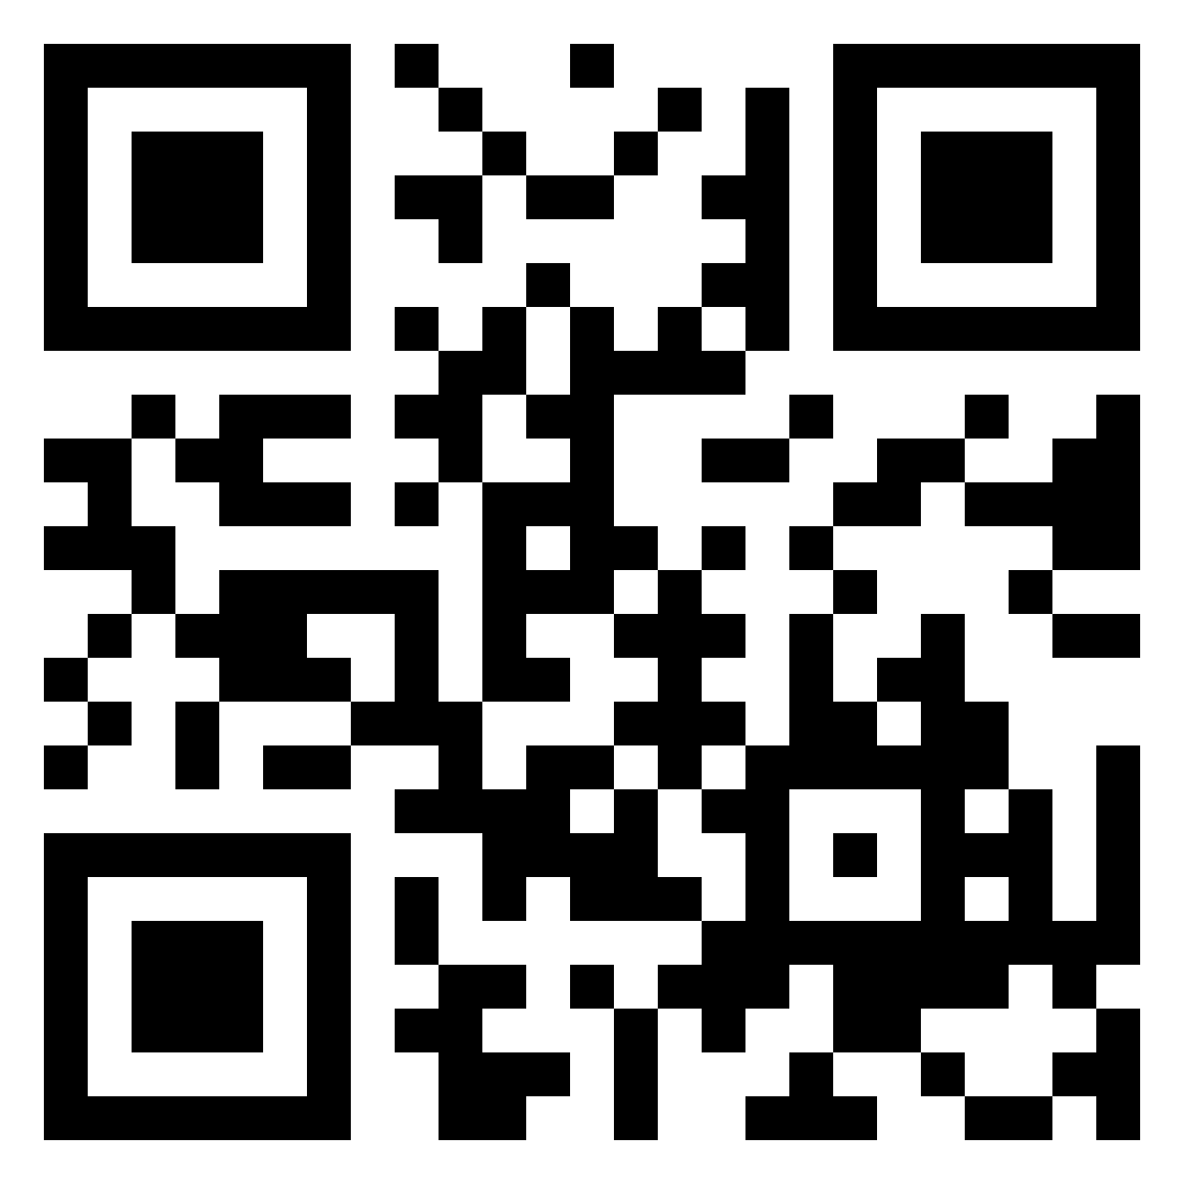

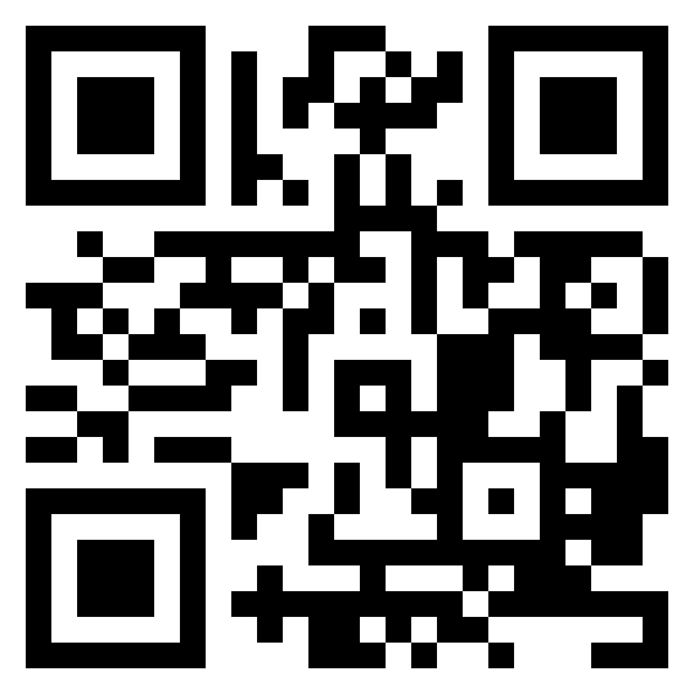


Could you have ...
Notes:
We can choose to help support artists as well as preserve our freedoms
https://di.day/ On 1. February (in german) We take back our free digital life, do not destroy democracy further and switch to democracy-friendly digital alternative
ORG @ UK
How can smaller artists get started. a massive band can run your own distribution, to keep a sensible cut
How to discover and share ? Can’t lend a tape or cd any more !
https://nham.co.uk
NHAM is an online magazine-style platform for indie musicians, fair distribution platforms and listeners
Fair Music platforms
* directly support musicians in a transparent manner.
* Ideally they are open-source
Choose things such as bandcamp
* direct connection

Slide 7
Landscape
Hardware & speakers
  Sonos
  Bose
  Fire TV
  Apple TV
  TV
  Raspberry Pi
Need software
  Phone/TV app
  Desktop
  Kodi / OpenElec
  MusicBrainz
  Jellyfin
  NetJuke Box
  MPD
Notes:
Hands up if heard or own of
Some hardware choices may fix you choice of software
And CHOICE OF BUYING FROM
Example of enshitification
heard of ?
first, they are good to their users; then
abuse their users to make things better for their business customers
and you cant leave b/c lock in
Then abuse those business customers to take all value for themselves.

Slide 8
Why O!MPD
SO approval
Plays music we have, music we buy from anywhere
Open source
Small and understandable
Light weight
Home Aassitant intergration
Notes:
Partner proof. UX
We already have home assistant so any new tech has to talk to it
* whole other talk
But free of ties
Don’t want a huge computer in every room

Slide 9

How O!MPD
https://ompd.pl
Hub
  LAMP
  Storage
MPD on spokes
  Streams from hub
  No local UI by default
Notes:
Hub and spoke
* Linux Apache MariaDB PHP
Linux optional, ymmv
Any DB will do really
Any php from last few years
SPOKE
Anything can run mpd
Long standing foss
Pi is great as small, easy to connect, cheap
Connect one to each tv or use a speaker HAT, done

Slide 10
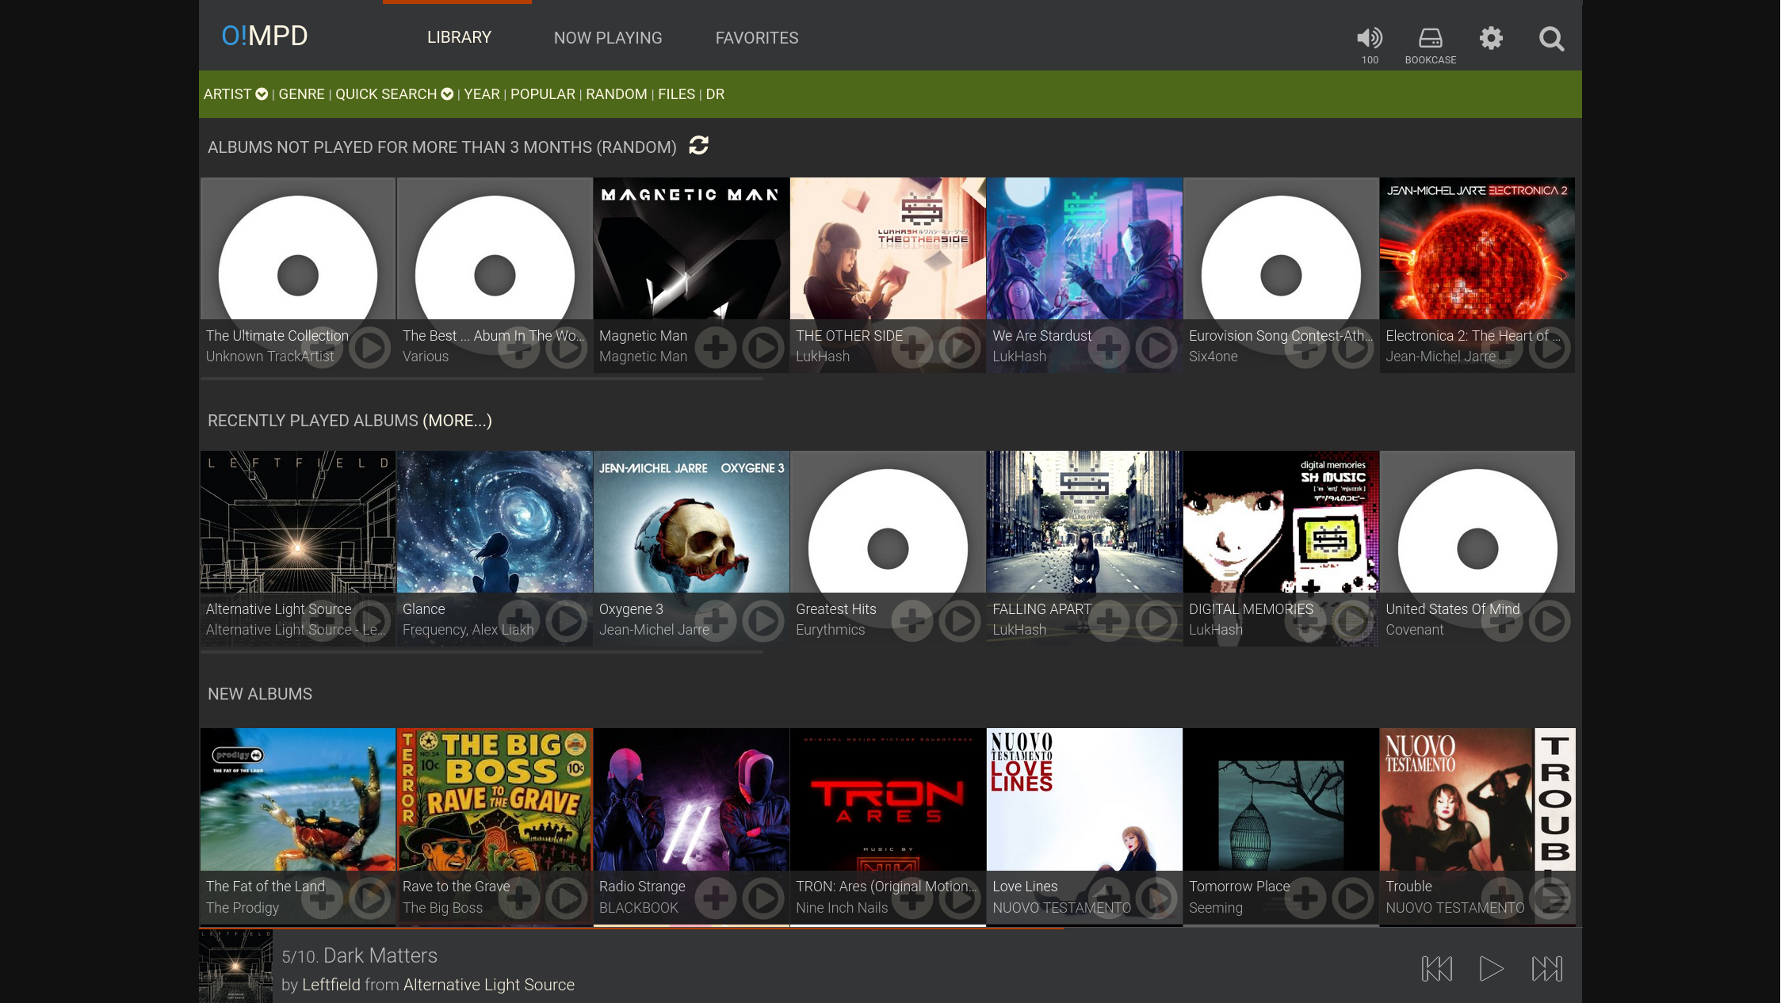
How O!MPD
Notes:
Generated by server

Slide 11
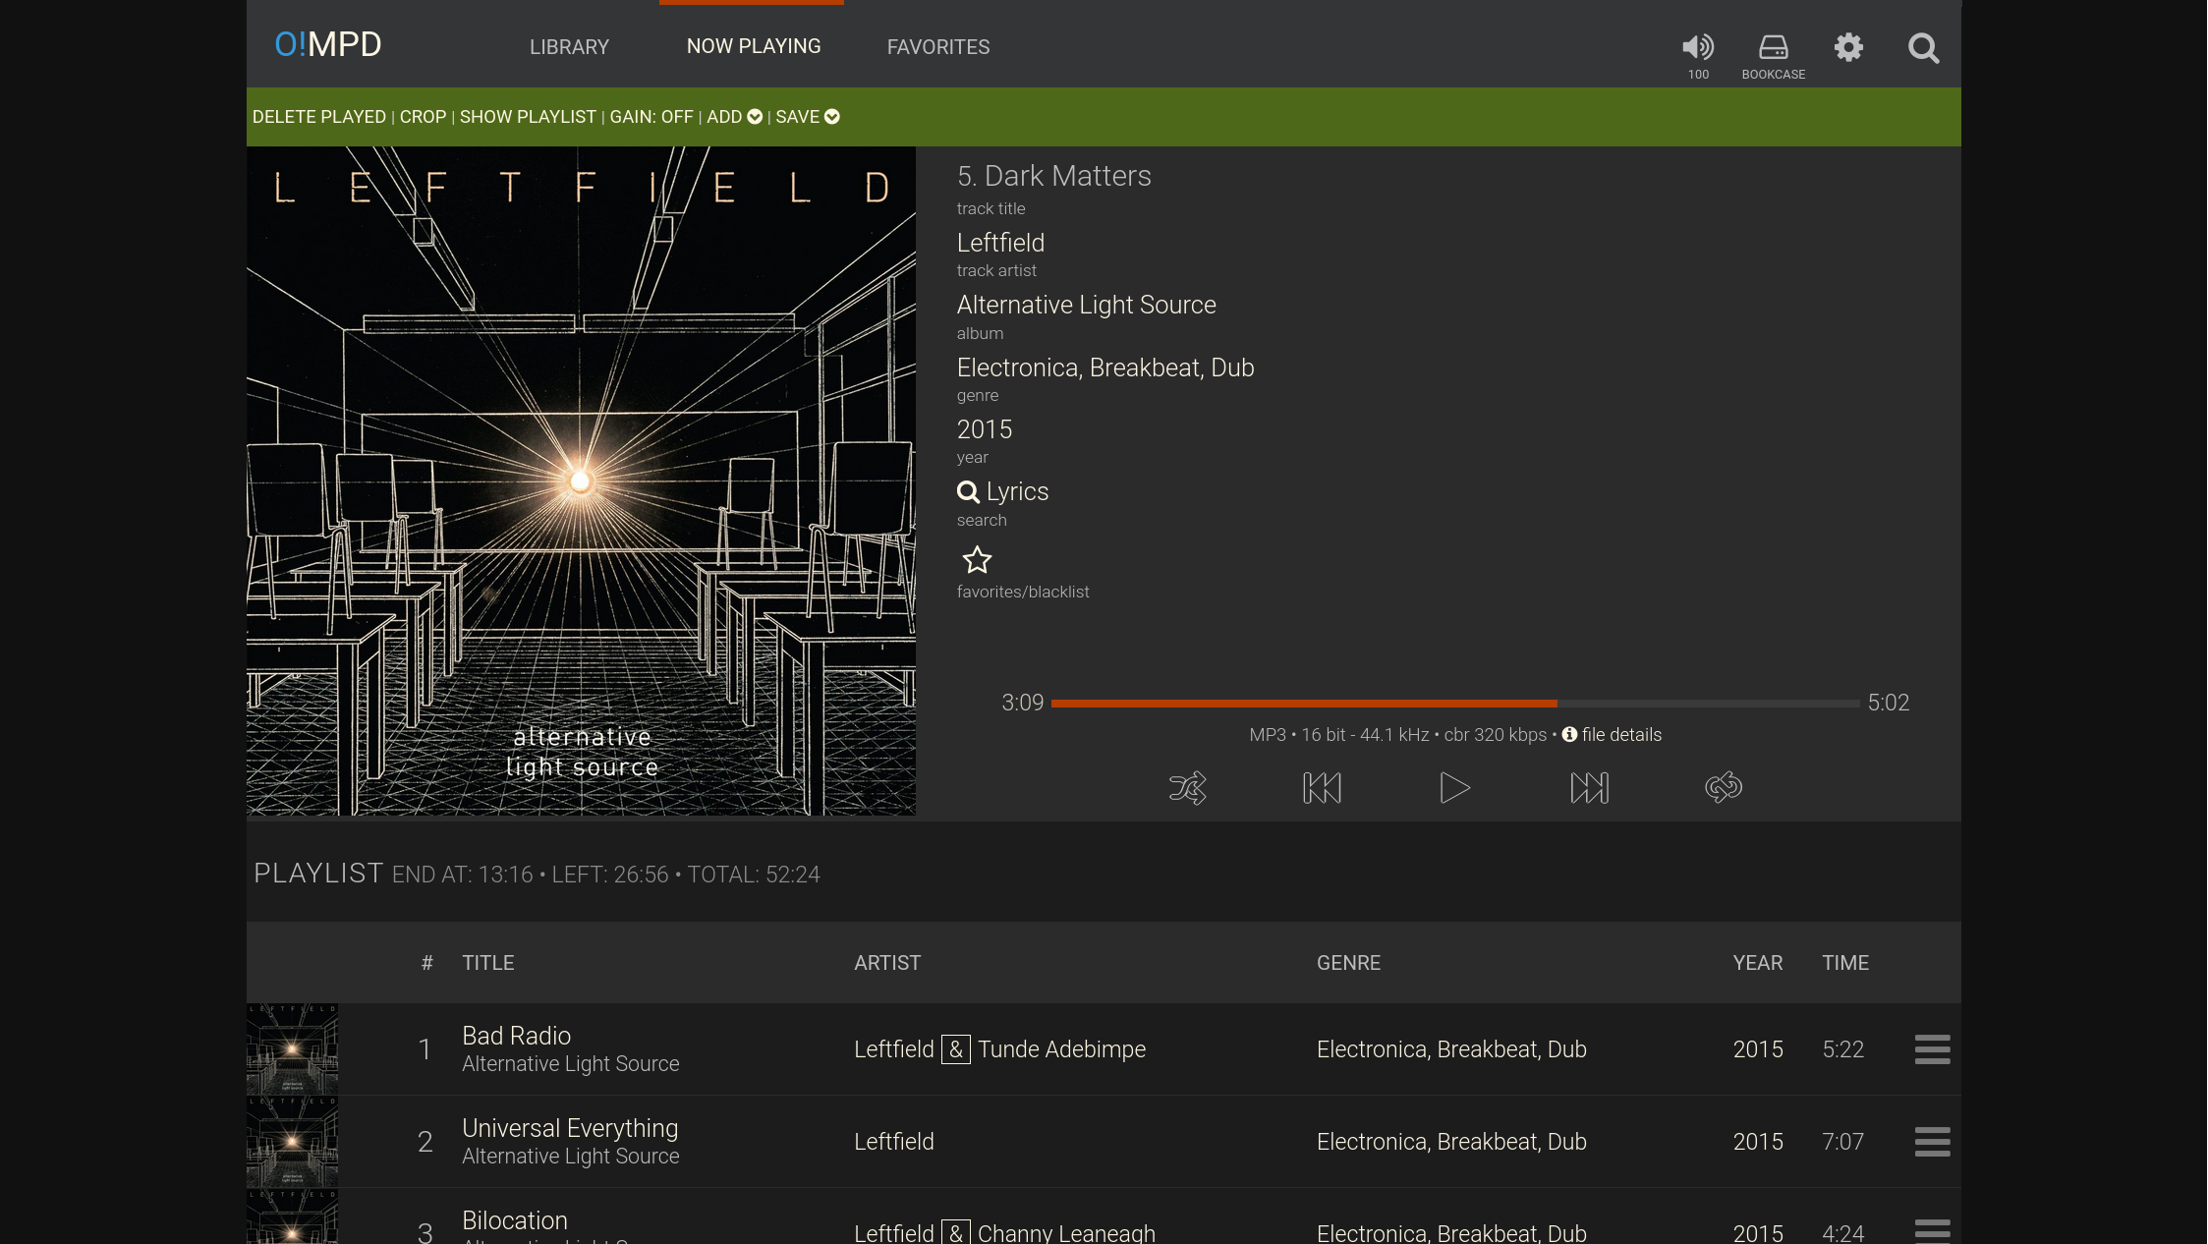
How O!MPD
Notes:
No playing
Choose output device at top

Slide 12
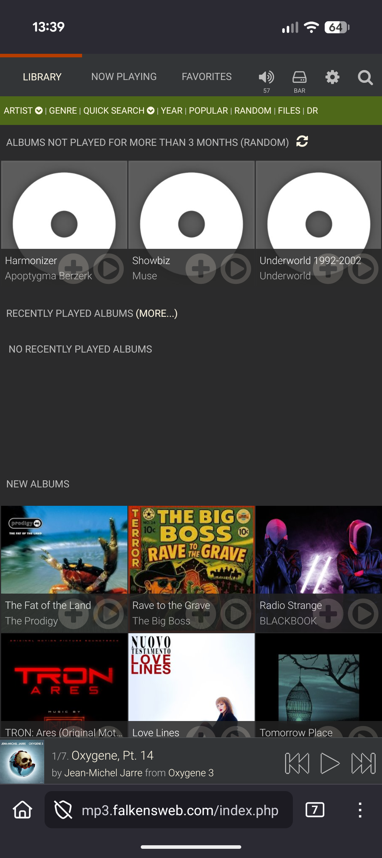
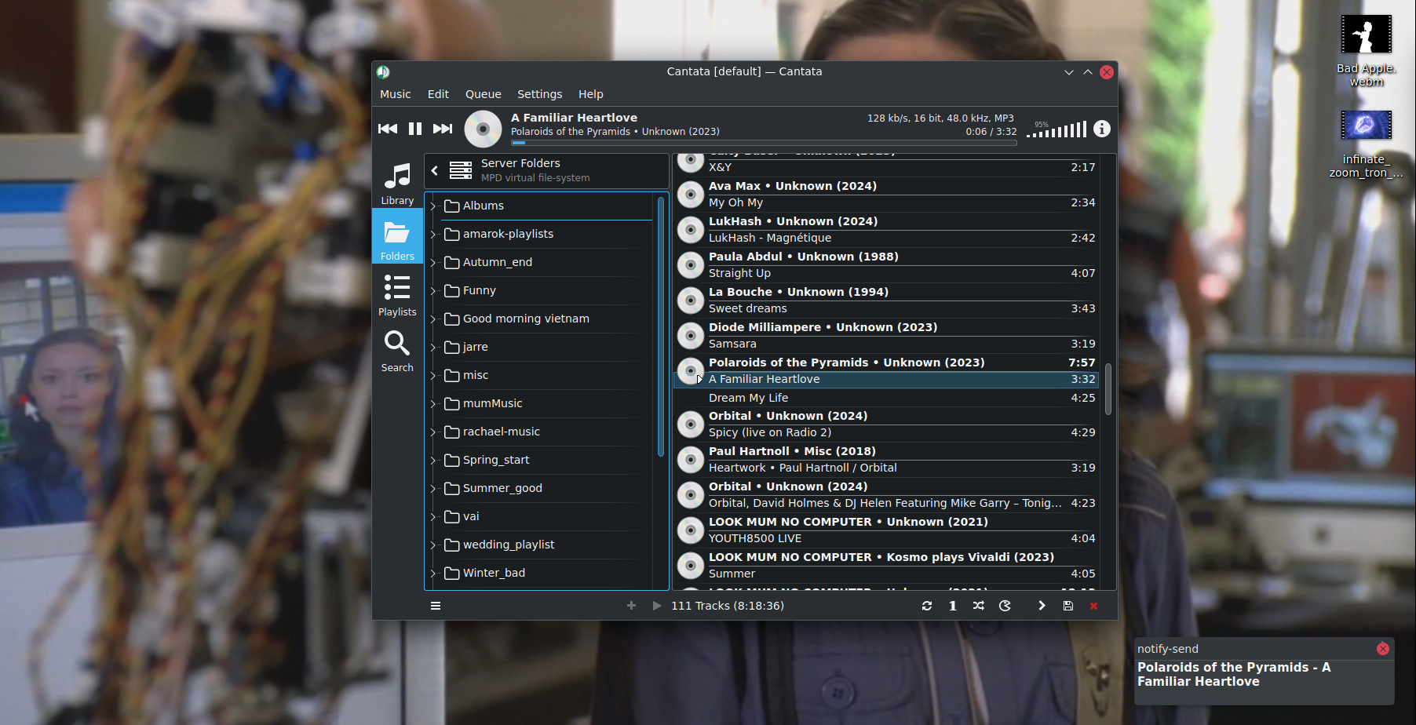
How O!MPD
Notes:
Mobie now playing. Don’t need an app.
Desktop intergration
Can have has mpd client
or can receive stream of pulseaudio
Either ways shows up as just another local audio source.

Slide 13
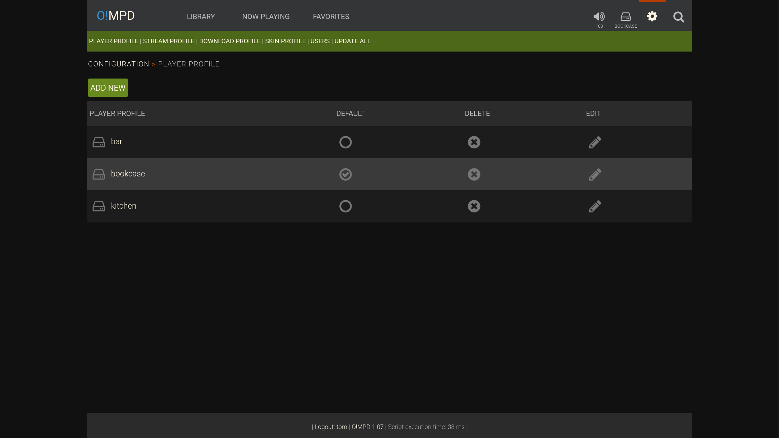
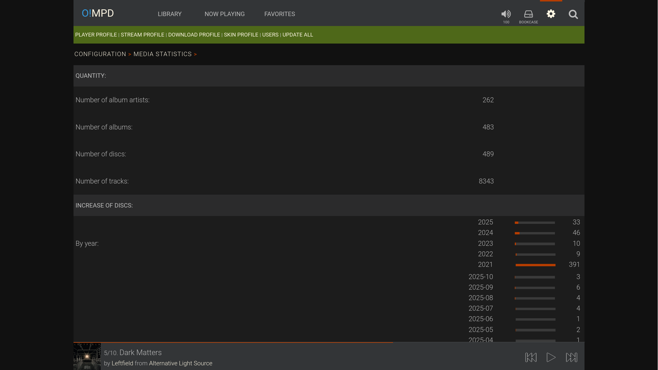
How O!MPD
Notes:
Add players
stats

Slide 14
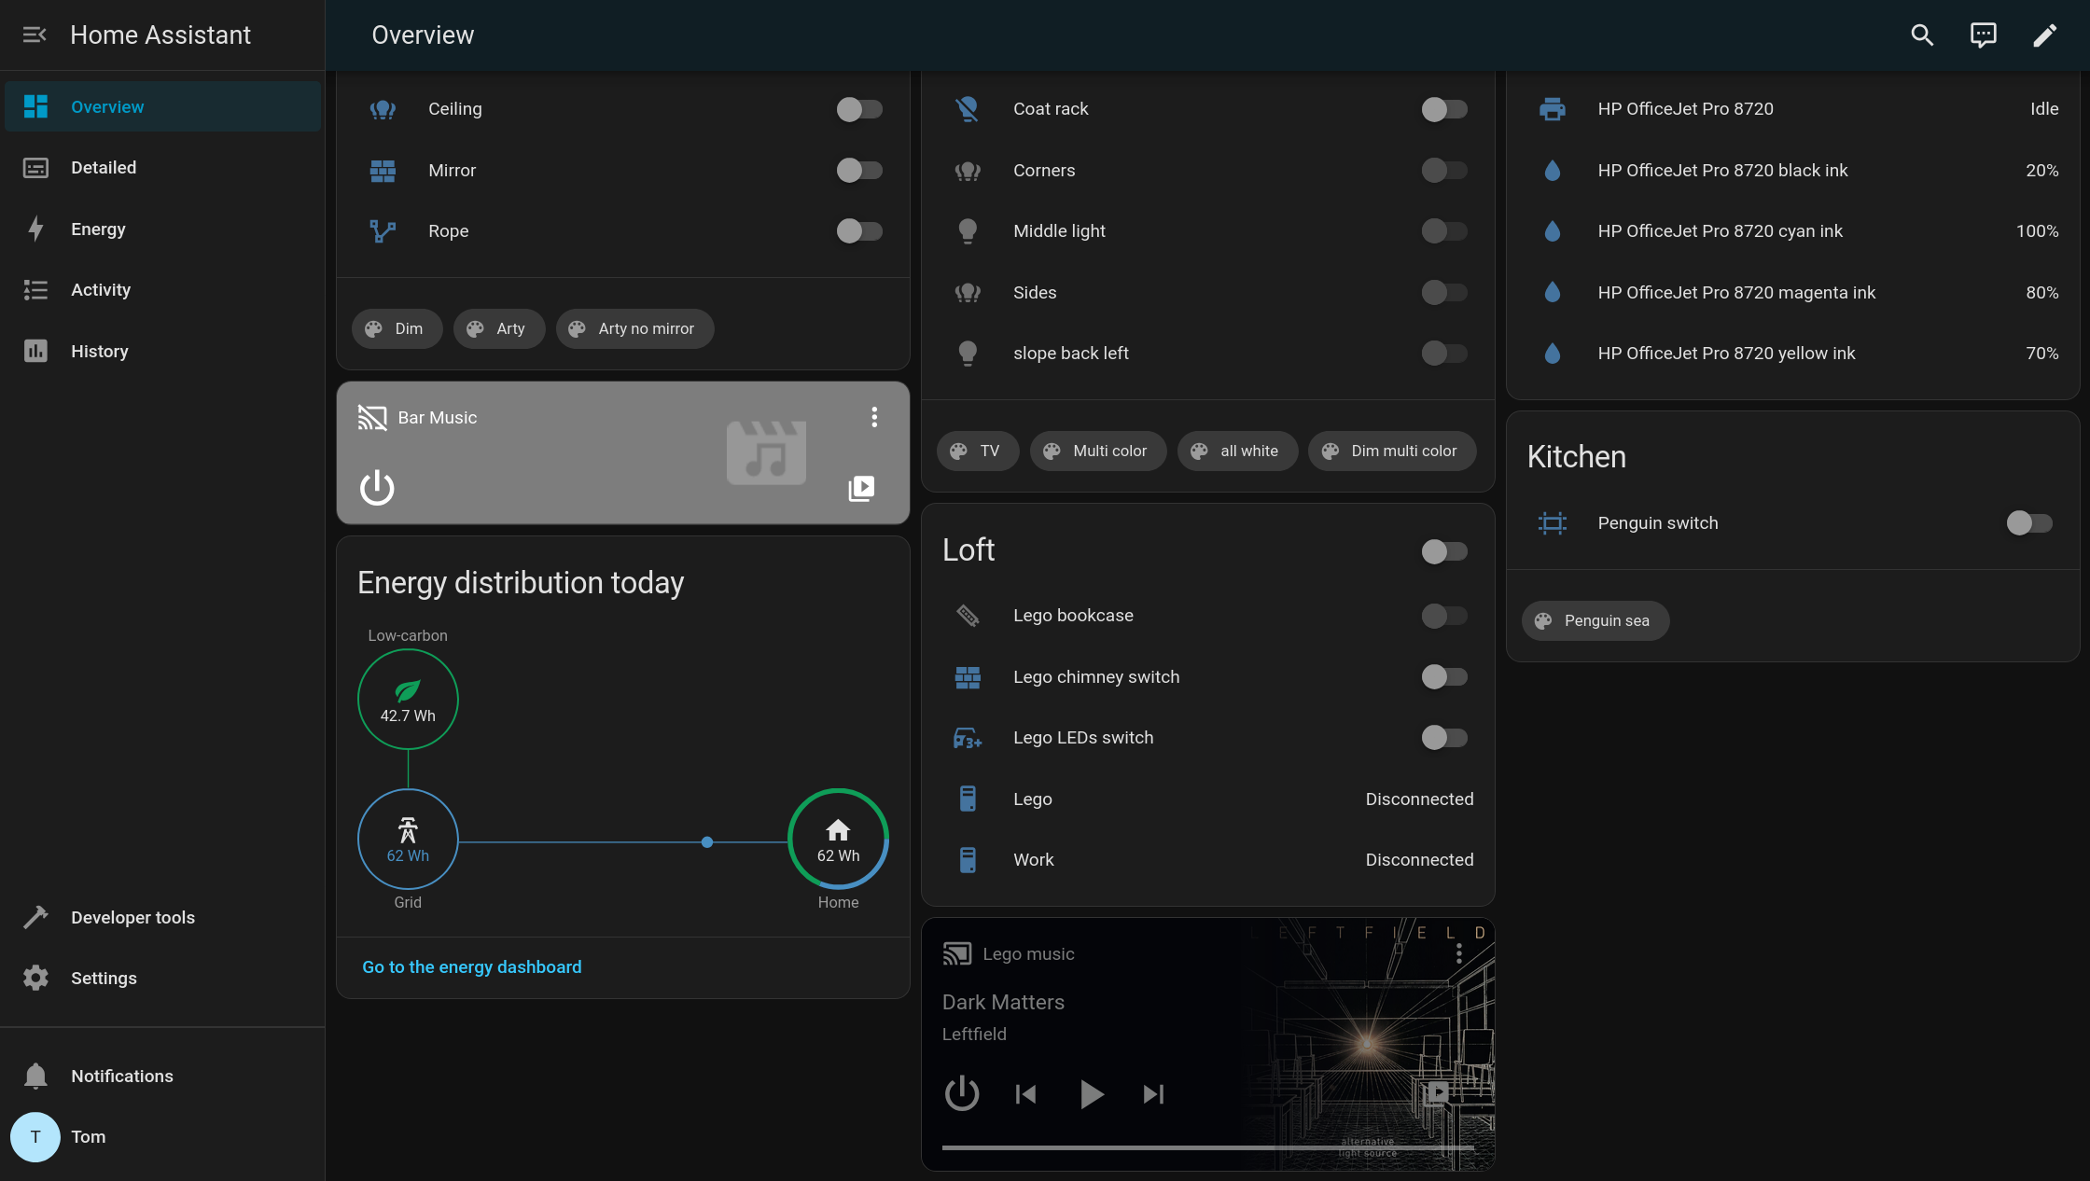
Home Assistant’s view
Notes:
Basic, but… playlist ?
And lots of pointless information, not focused

Slide 15
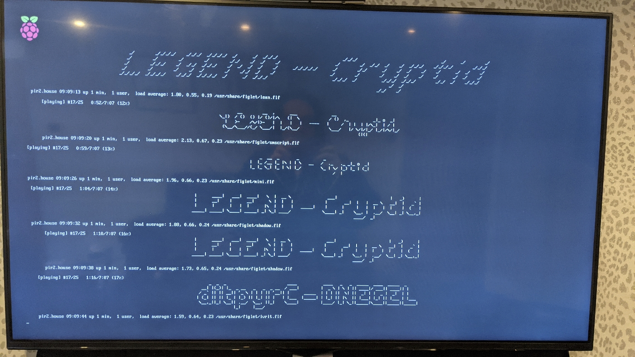
Attract mode
  https://codeberg.org/falken/mpd-now-playing
Notes:
aka get off your phone
SO proof – just turn on pi, TV
Just bash
Unix style – chain of existing tools; figlet, mpc
future
Remote control aka HDMI CEC
Have on our lounge and kitchen TVs

Slide 16
O!MPD Issues
Auto update
Folders
Video
Just the two of us
Notes:
Auto update WIP
* drop files into folder
* cron jobs to trigger
Folders – has opinons on structure – one singles folder, Then M others containing N per artist
- patches made to allow N singles
- now works fine with singles and albumns, nested or not
Video – reboot to kodi

Slide 17
Anything else ?
https://di.day/
https://nham.co.uk
https://bandcamp.com
https://ompd.pl
@falken@qoto.org
https://codeberg.org/falken
Tom Chiverton
https://openrightsgroup.org

