Slide 1
4483 CAPSTONE PROJECT PRESENTATION
TESLA Stock Python Prediction Model
Makayla Clark – U3263866
Tutorial – Tuesday 1330

Slide 2
Table of Contents
Introduction / Problem Statement
Dataset Details
EDA (Exploratory Data Analysis) Outcomes
AI/ML/PDA (Predictive Data Analytics) Outcomes
Implementation and Deployment (TkInter/Flask/Streamlit) Plan and Status Update
References/Bibliography

Slide 3
Introduction/ Problem Statement
This dataset from Kaggle contains the stock prices from TESLA during the period of 29/09/2021 – 29/09/2022.
There are 7 columns and 253 rows of data.
The goal is to use this dataset to create a prediction model to predict future closing stock prices for TESLA

Slide 4
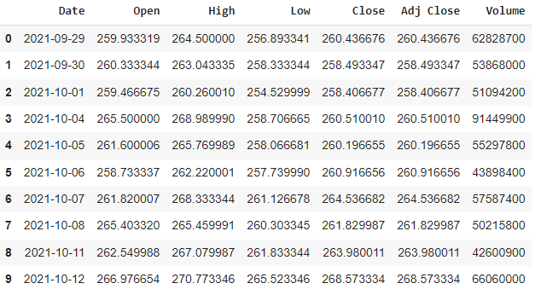
1. Introduction/ Problem Statement
Here is the first 10 rows of data:

Slide 5
2. Dataset Details
Columns:
Date – the date trading data was collected.
Open – the starting period of trading.
High – highest trading price.
Low – lowest trading price.
Close – the end of trading when the markets close for the day.
Adj Close – closing price after adjustments for applicable splits and dividend distributions.
Volume – the number of shares traded in a stock or contracts traded in futures.

Slide 6
3. EDA (Exploratory Data Analysis) Outcomes
The data is numeric.
‘Date’ is an object.
‘Open’, ‘High’, ‘Low’, ‘Close’ and ‘Adj Close’ are all floats, and are continuous variables.
‘Volume’ is an integer, and are discrete variables.
All columns and rows are non-null.

Slide 7
3. EDA (Exploratory Data Analysis) Outcomes
‘Date’ does not add useful data to the prediction model.
‘Close’ and ‘Adj Close’ are identical, so only one needs to be used. ‘Adj Close’ will be used.
‘Volume’ is not a stock value that can be used for the prediction.
The target variable is ‘Adj Close’.

Slide 8
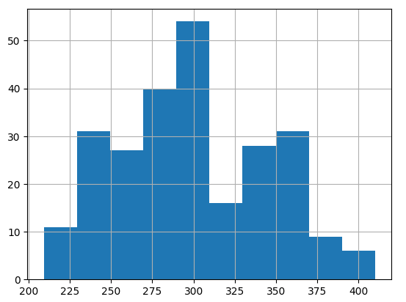
3. EDA (Exploratory Data Analysis) Outcomes
The Target Variable is ‘Adj Close’.

Slide 9
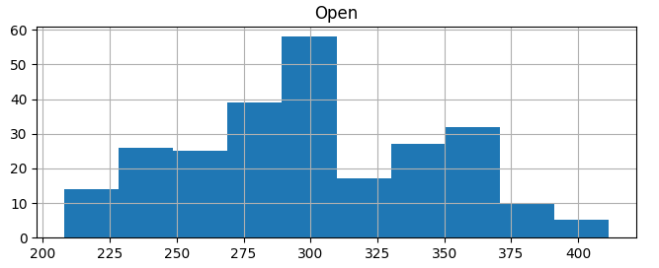
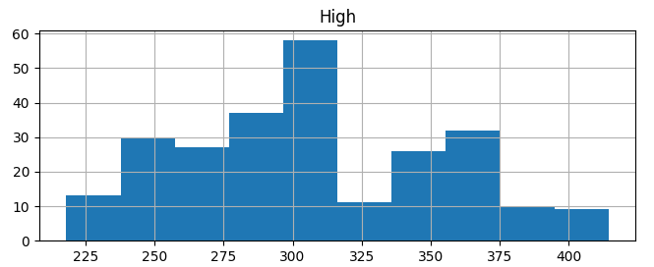
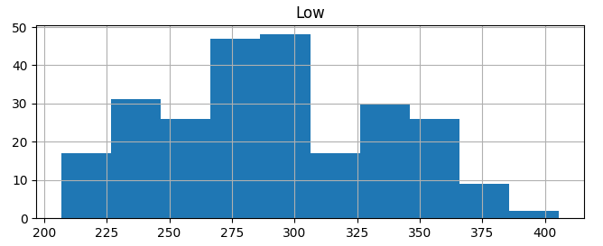
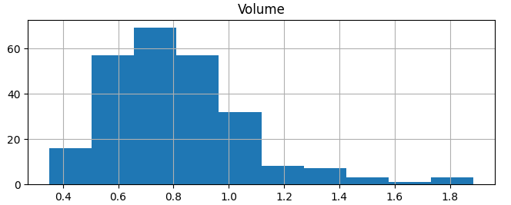
3. EDA (Exploratory Data Analysis) Outcomes
Histograms:

Slide 10
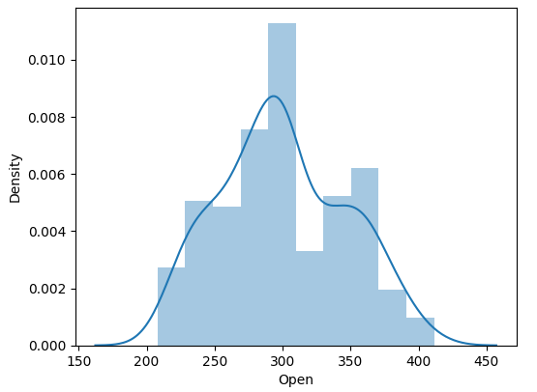
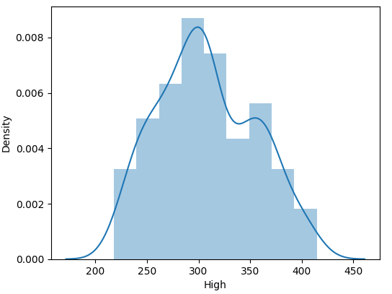
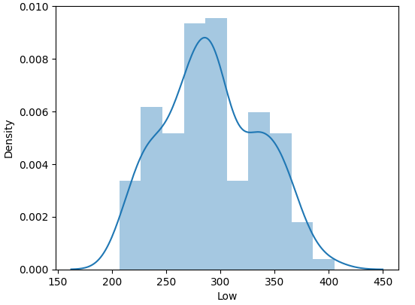
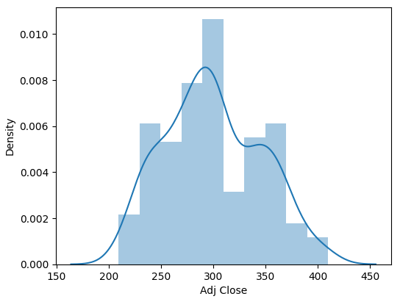
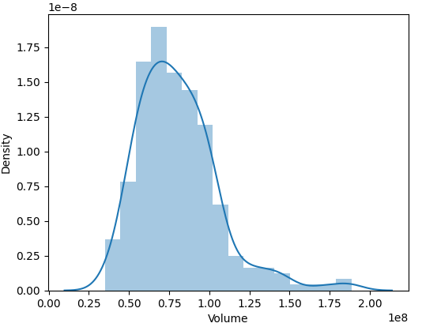
3. EDA (Exploratory Data Analysis) Outcomes
Distplots:

Slide 11
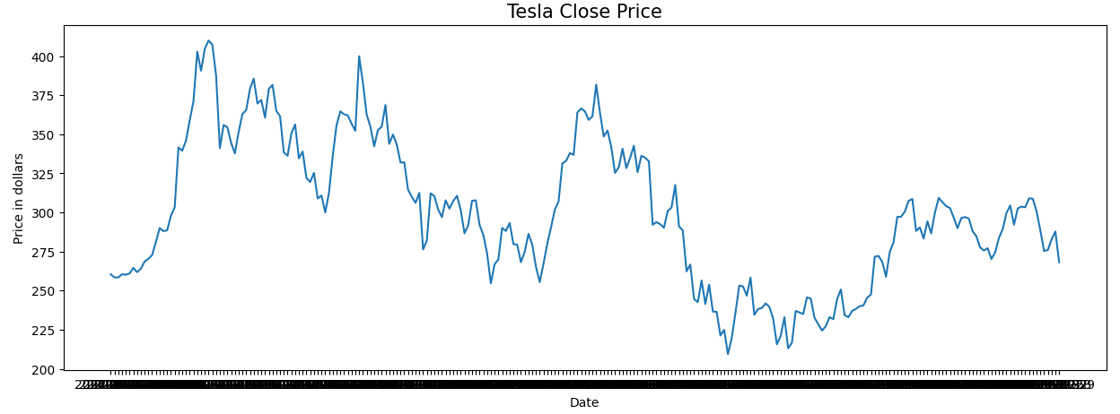
3. EDA (Exploratory Data Analysis) Outcomes
Line Graph of the whole year of Close price:

Slide 12
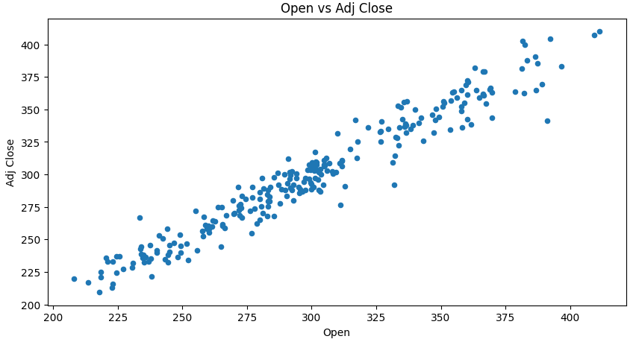
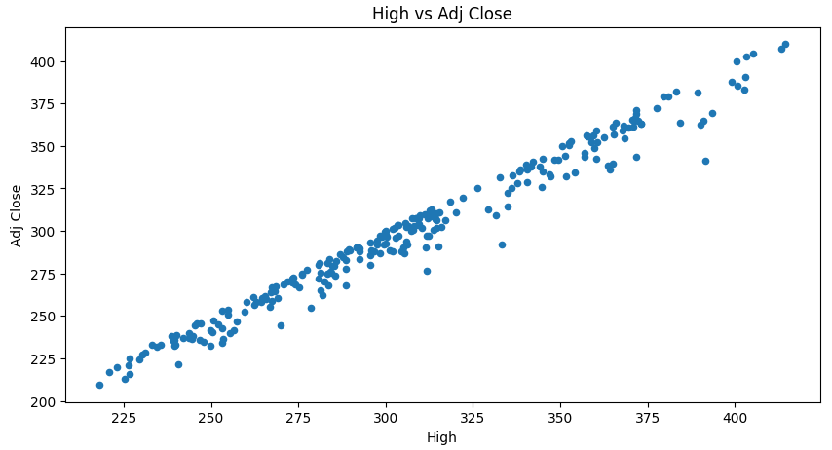
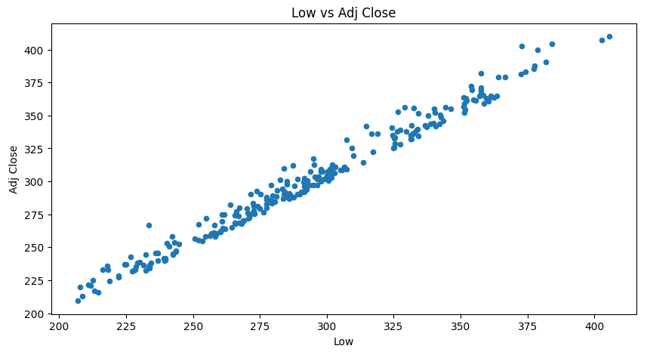
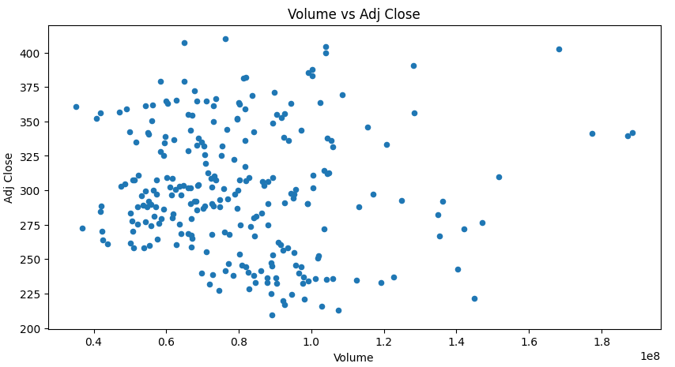
3. EDA (Exploratory Data Analysis) Outcomes
Scatter Plots:

Slide 13
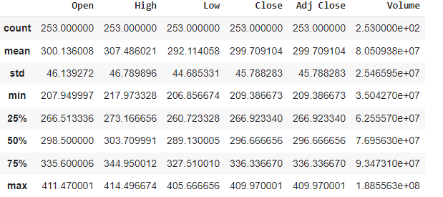
3. EDA (Exploratory Data Analysis) Outcomes
Here is some statistics for each column:

Slide 14
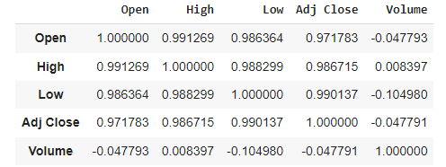

3. EDA (Exploratory Data Analysis) Outcomes
Correlation Data:
Correlation Data >0.5:

Slide 15
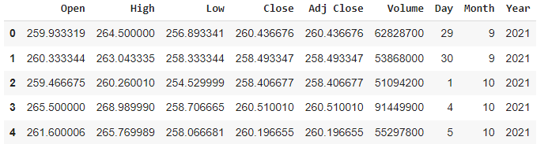
3. EDA (Exploratory Data Analysis) Outcomes
Convert ‘Date’ column to numeric columns ‘Day’, ‘Month’, ‘Year’.

Slide 16
3. EDA (Exploratory Data Analysis) Outcomes
There are no outliers or missing values.
Target Variable: ‘Adj Close’.
Continuous Predictors: ‘Open’, ‘High’, ‘Low’.

Slide 17

4. AI/ML/PDA (Predictive Data Analysis) Outcomes
K-fold Cross Validation and average accuracy of the model:

Slide 18
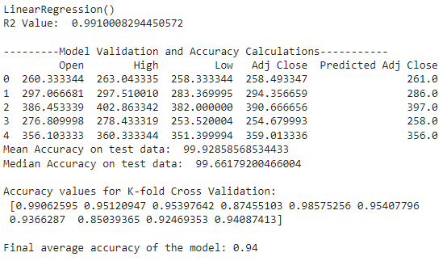
4. AI/ML/PDA (Predictive Data Analysis) Outcomes
Linear Regression Model:

Slide 19
4. AI/ML/PDA (Predictive Data Analysis) Outcomes
All performed Regression Algorithms, and final average accuracy:
Linear regression – 0.94
Decision tree regressor – 0.8
Random forest regressor – 0.85
Ada boost regressor – 0.77
XGB regressor – 0.87
KNNeighbors regressor – 0.87
Support Vector Machine (SVM) regressor - -0.12

Slide 20
5. Implementation and Deployment (TkInter/Flask/Streamlit) Outcomes
For deployment I have used tkinter.

Slide 21
PROJECT DEMO
WORKING/LIVE PROJECT
DEMONSTRATION

Slide 22
REFLECTION
I worked solo for this project.
It would have been helpful if I started working on this project earlier.
I enjoyed learning new code, and about prediction models.

Slide 23
References /Bibilography
[1] Omar Fayez, Tesla Stock Price Prediction, Kaggle, 2024, Available: https://www.kaggle.com/code/omarfayez/tesla-stock-price-prediction
[2] Shabbirg89, Python tkinter based stock prediction application using Multiple Linear Regression, Github, 2021, Available: https://github.com/shabbirg89/Python-tkinter-based-stock-prediction-application-using-Multiple-Linear-Regression/blob/master/app.py
[3] Jason Brownlee, A Gentle Introduction to k-fold Cross-Validation, Machine Learning Mastery, 2023, Available: https://machinelearningmastery.com/k-fold-cross-validation/

