Slide 1


From Data to Decision: Sales Forecasting in Action.
Discover with : Macchindranath Dabhade (239524) , Shriyash Kamble (239541)

Slide 2
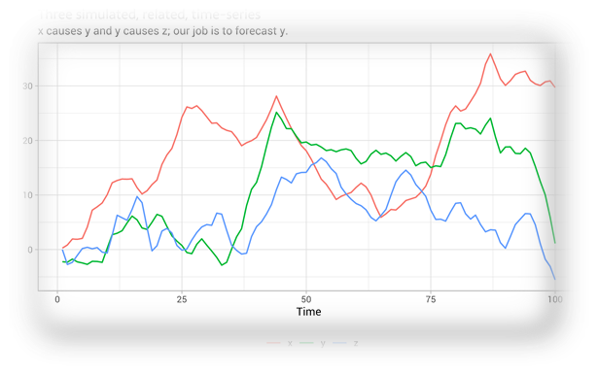
TITLE:
Large-Scale Time Series Forecasting for Enhanced Sales Insights

Slide 3
In today's dynamic business landscape, accurate sales forecasting is essential for effective inventory management, resource allocation, and informed decision-making. This project aims to leverage time series analysis techniques to forecast the quantity of products sold within the particular category based on historical sales data. By analyzing patterns, trends, and seasonality in the data, we seek to develop reliable predictive models that will empower businesses to optimize their operations and anticipate demand fluctuations.
Project Statement:

Slide 4
Objectives:
Model Selection: Identify the most suitable forecasting model for predicting [Product Category] sales, choosing from methods like ARIMA, FB Prophet, and exponential smoothing.
Accurate Forecasting: Develop a refined forecasting model that accurately predicts [Product Category] sales over a [forecast period, e.g., 7 days], and evaluate its performance using metrics like MAPE and RMSE.
Visual Insights: Create compelling visualizations that showcase historical sales trends and forecasted quantities. Extract actionable insights for inventory management and decision-making.

Slide 5
Data:
Data has been collected from Kaggle to perform :
Analysis on historical data
Train models
Forecast outcome for next 7-9 days
Data is of a Fast fashion and sweden based company H&M .
Dataset contains approximately 30 million rows and 29 columns .
Columns describe 3 important aspects of the company:
Customers
Product details
Transaction details

Slide 6
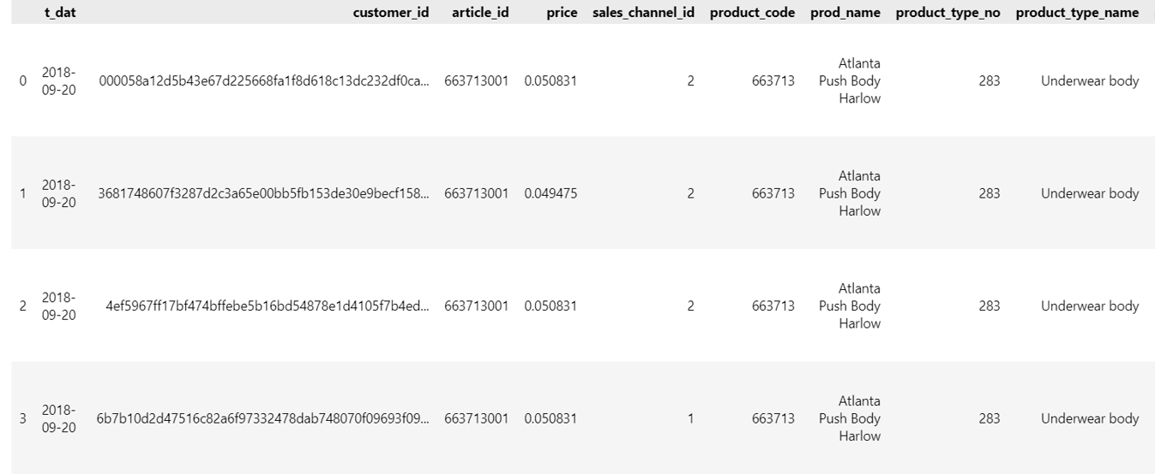
Sample Image of the Data:

Slide 7
Data Pre-processing :
As our data was divided into three csv files the first step was to merge the three csv files into one based on one common column [‘article_id] present in all the three csv files which we were able to implement using .merge() function of pandas library.
Second step was to check if there are any null values present in the merged dataset and if present handle the null values which we were able to check using .isnull() function of pandas library and there were no null values present in the dataset.
Third step was to convert the Date column into an actual Date-Time because often by default date column is considered as string data. we were able to implement using to_datetime() function of pandas library.
Fourth step : We didn’t have a sales or quantity sold column and as we need at least a sales column or quantity sold column to perform time series forecasting we used the groupby() function of pandas library to create a Quantity sold column by grouping two columns Date and Product_group_name .
Fifth Step : After creating a Quantity Sold column we wanted to do model building and forecasting on one particular type of category hence we created a data frame of just that category and checked if the data frame has any null values.

Slide 8
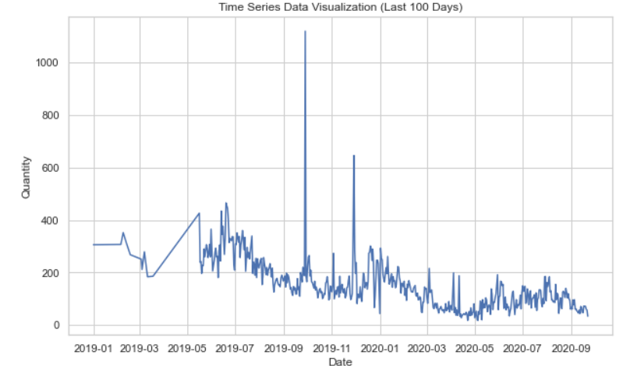
Exploratory Data Analysis (EDA) :
To perform EDA we have used Seaborn library of python.
First we have visualised the historical data of the quantities sold over past period of time.

Slide 9
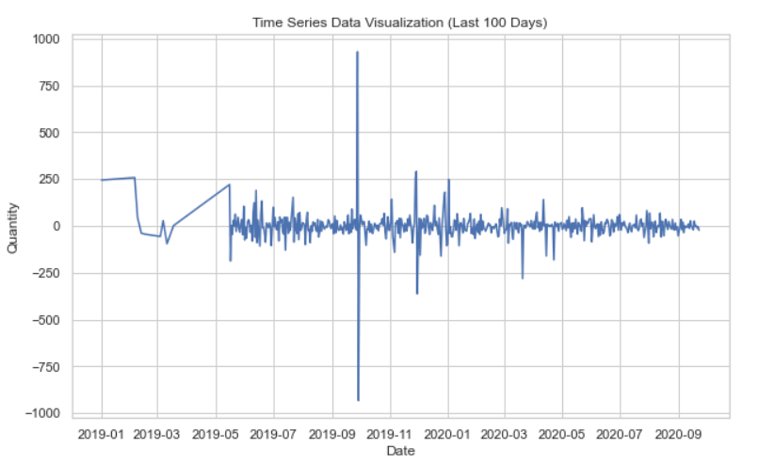
After making the data stationary:

Slide 10
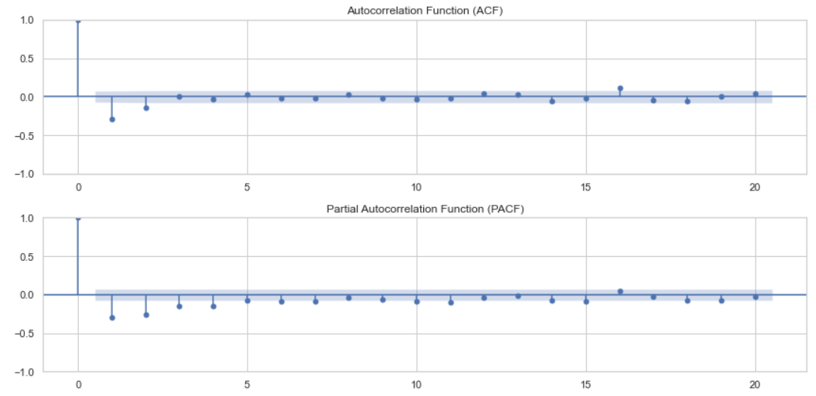
Plotting ACF and PACF graphs to define P and Q values later on when using Arima model:

Slide 11
Algorithms used :
AutoRegressive Integrated Moving Average (ARIMA): ARIMA is a classical time series forecasting algorithm that models the relationship between a data point and its lagged values (autoregressive component) as well as the difference between the data point and its past values (integrated component).
Exponential Smoothing (ETS): ETS algorithms, such as Simple Exponential Smoothing and Holt-Winters' Seasonal Exponential Smoothing, were employed to recognize the underlying patterns of level, trend, and seasonality. ETS proved effective when ARIMA assumptions weren't fully met or when dealing with non-linear relationships.

Slide 12
Algorithms used :
Facebook Prophet: Facebook Prophet, a powerful time series forecasting tool, was integrated into the project to handle various sources of uncertainty, such as holidays and special events, along with capturing changepoints in the data. It excels in accommodating the flexibility of trends and seasonality, making it ideal for handling complex patterns in [Product Category] sales.
The hybrid ETS-ARIMA : This approach combines the strengths of Exponential Smoothing (ETS) and AutoRegressive Integrated Moving Average (ARIMA) models to enhance time series forecasting accuracy. ETS handles seasonal patterns and exponential trends, while ARIMA addresses autocorrelation and irregular patterns. By fusing these methods, the hybrid model provides more robust predictions, suitable for capturing various complexities in real-world time series data.

Slide 13
Why to use these models?
Prophet: Prophet is a forecasting tool developed by Facebook that excels at capturing time series patterns with multiple seasonalities. It's designed to handle various data components like holidays and special events, making it suitable for business scenarios with specific calendar effects.
ARIMA (AutoRegressive Integrated Moving Average): ARIMA is a classic time series forecasting model that combines autoregressive and moving average components. It's effective for data with trend and seasonality. ARIMA models can be tuned for optimal parameters to make accurate predictions.

Slide 14
Why to use these models?
ETS (Exponential Smoothing State Space Model): Exponential Smoothing State Space models are a family of methods that include popular techniques like Simple Exponential Smoothing (SES), Holt's Linear Exponential Smoothing, and Holt-Winters' Exponential Smoothing. ETS models capture different components of time series data, including trend and seasonality, using exponential smoothing methods.
The hybrid ETS-ARIMA : The hybrid ETS-ARIMA model synergizes Exponential Smoothing's adaptability to trends and seasonality with ARIMA's effectiveness in handling autocorrelation, offering a powerful solution for precise and versatile time series forecasting.

Slide 15
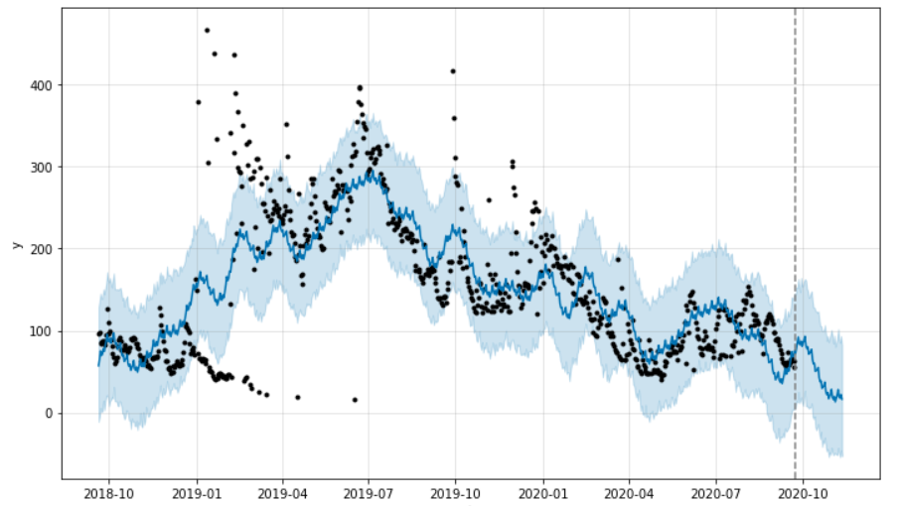
Forecasted graphs along with RMSE Value:
Root-Mean-squared-Error (RMSE):
Quantifies the average difference between predicted and actual values in a dataset, providing a measure of how well a model's forecasts align with the observed data.
Lower RMSE values indicate better predictive accuracy.
FB PROPHET:
RMSE:88

Slide 16
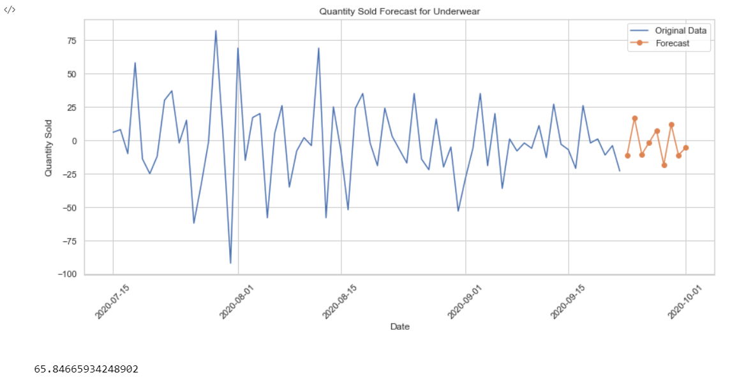
Forecasted graphs along with RMSE Value (ARIMA):
Forecasted values for next 9 days:[ 11.16,1,10,7,18,11,11,5]

Slide 17
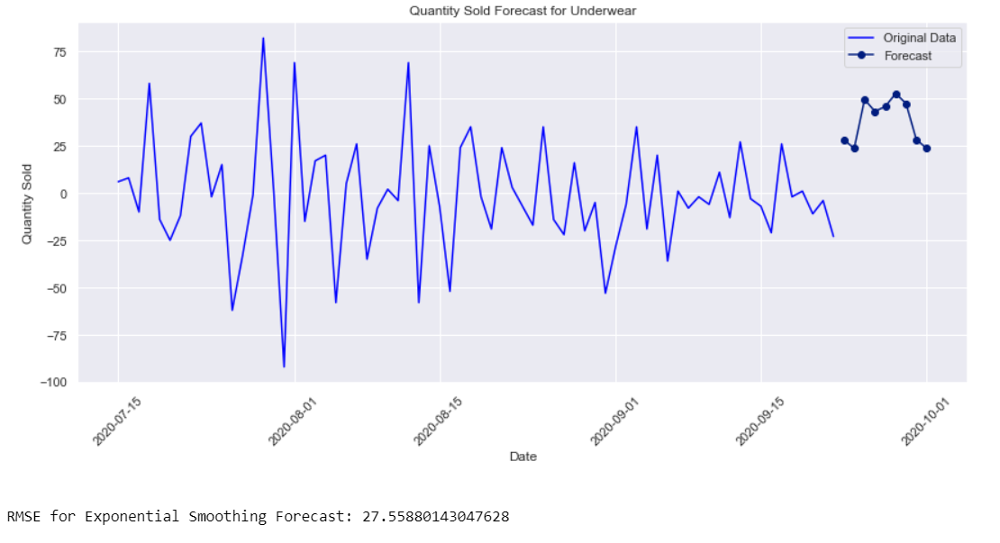
Forecasted graphs along with RMSE Value (ETS):
Forecasted values for next 9 days:[ 28 ,23, 49, 43, 45, 52, 47, 28, 23 ]

Slide 18
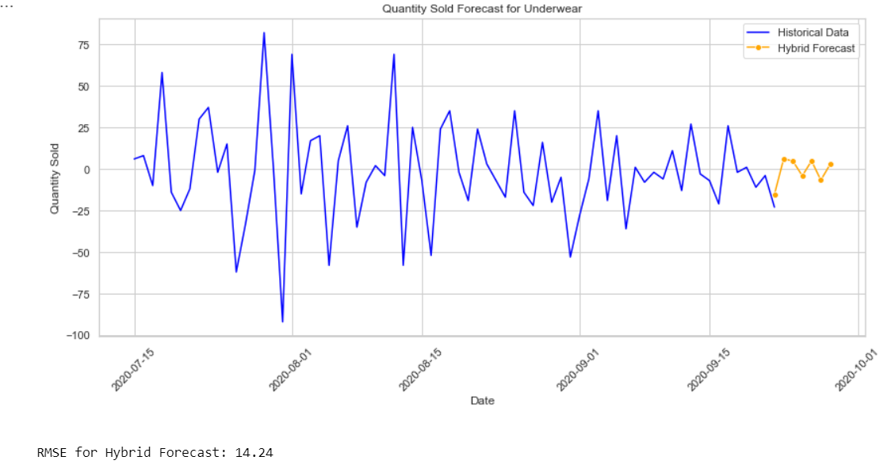
Forecasted graphs along with RMSE Value (ETS-ARIMA):
Forecasted values for next 9 days:[ 15,6,4,4,4,6,2,15,4 ]

Slide 19
Conclusion:
In conclusion, after evaluating the performance of various forecasting models including Prophet, ARIMA, ETS, and the hybrid ETS-ARIMA, it is evident that the hybrid ETS-ARIMA model outperformed the others for our current dataset.
Future work could involve leveraging deep learning techniques like LSTM and Ensemble technique for time series forecasting, investigating advanced feature engineering methods, and integrating external data sources to enhance the predictive power of our models.

Slide 20
THANK-YOU

