Slide 1
Handler
Mapping
choose Handler
Execute Business Logic
Handler
Adapter
Controller
Service
(Business Logic)
Dispatcher
Servlet
① Request
set processing result models
omitted
view name
②
③
View
Resolver
Thymeleaf Templates
⑨ Response
Model
View
resolve View
HTML
reference processing result models
④
set models and web objects
resolve
templates
Context
⑥
TemplateResolver
reference models and web objects
⑤
⑦
TemplateEngine
TemplateManager
Cache
… implemented by developers
⑧
… provided by Spring
TemplateHandler
… provided by Thymeleaf
… provided by Thymeleaf + Spring

Slide 2
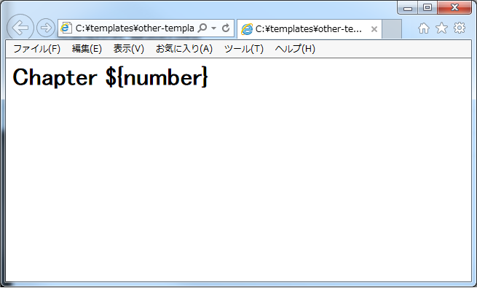
Variables are drawn.

Slide 3
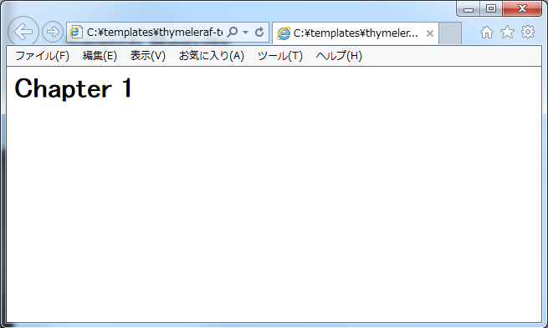
Static display is possible with the intended design!

Slide 4
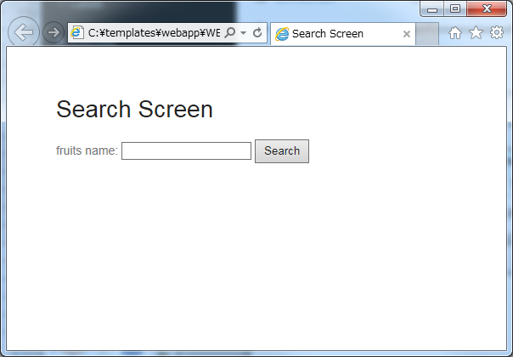
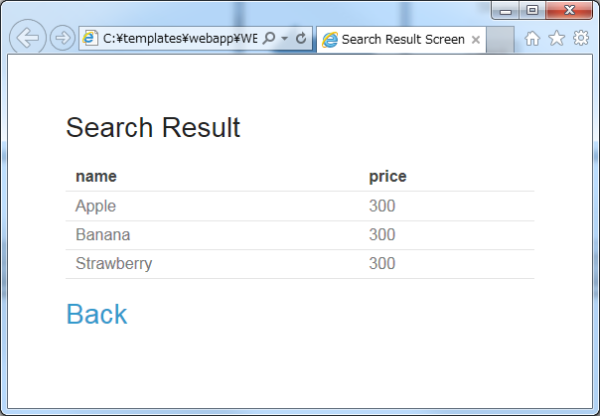
・検索画面
・検索結果画面

