Slide 1
Application Layer
Infrastructure Layer
Integration
System
Connector
Controller
O/R Mapper
use
use
Test target
use
Helper
use
RepositoryImpl
use
Domain Layer
use
Service
ServiceImpl
Repository
instantiate
use
DomainObject

Slide 2
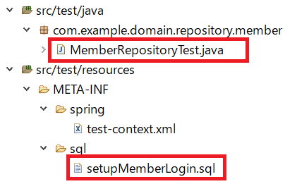

Slide 3
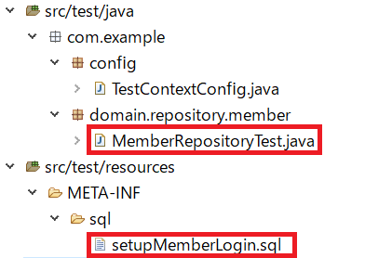

Slide 4
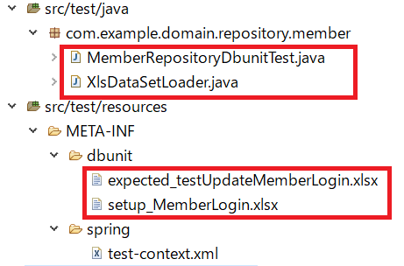

Slide 5
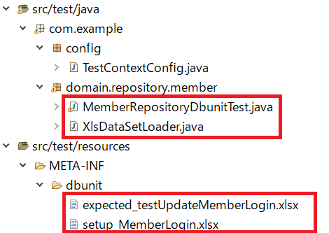

Slide 6
Test target
Application Layer
Infrastructure Layer
Integration
System
Connector
Controller
O/R Mapper
use
use
use
Helper
use
RepositoryImpl
use
Domain Layer
use
Service
ServiceImpl
Repository
instantiate
use
DomainObject

Slide 7
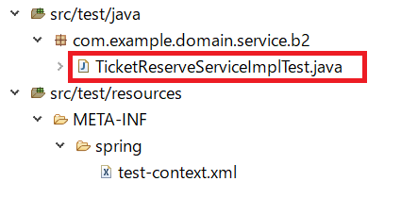

Slide 8
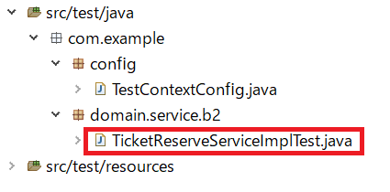

Slide 9
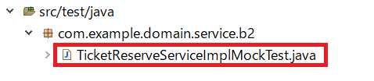

Slide 10
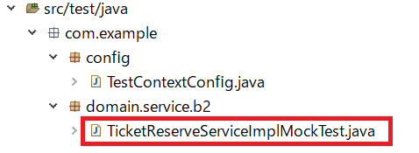

Slide 11
Application Layer
Infrastructure Layer
Integration
System
Connector
Controller
O/R Mapper
use
use
use
Helper
use
RepositoryImpl
use
Test target
Domain Layer
use
Service
ServiceImpl
Repository
instantiate
use
DomainObject

Slide 12
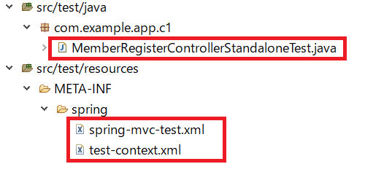

Slide 13
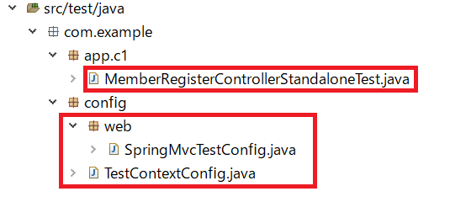

Slide 14


Slide 15
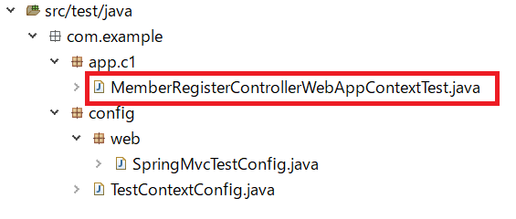

Slide 16


Slide 17
