Slide 1
Application
Modules
O/R
Mapper
JDBC
Interfaces
JDBC
Implementations
Persistence
Layer
Repository
Repository
Impl
Service
TERASOLUNA
DAO
JDBC
Basic APIs
MyBatis
JDBC Driver
Database
DataSource
Configuration
for
connect
・oracle
・DB2
・PostgreSQL
・and more …

Slide 2
Service
(1)
(1’)
Repository
RepositoryImpl
SQL ID
(1’)
Object of
bind values
TERASOLUNA
DAO APIs
Configure
Mybatis.
SQL ID
Implementation
of SQL.
(2)
Object of
bind values
sqlMapConfig.xml
Mybatis
sqlMap.xml
(3)
SQL
Bind values
JDBC
Basic APIs
(4)
Database
JDBC Driver
SQL
Bind values

Slide 3
(2)
<table>
t_order_item
(4)
(5)
<table>
m_item
<table>
m_category
order_id
(1)
item_code
code
code
<table>
t_order
(8)
(6)
<table>
c_order_status
<table>
m_item_category
id
status_code
code
item_code
category_code
(3)
<table>
t_order_coupon
(7)
<table>
m_coupon
order_id
coupon_code
code

Slide 4
(2)
(4)
(5)
1…n
<model>
OrderItem
1
<model>
Item
1…n
<model>
Caretory
(1)
(7)
<model>
Order
1
<model>
OrderStatus
(3)
(6)
<model>
OrderCoupon
1
<model>
Coupon
1…n

Slide 5
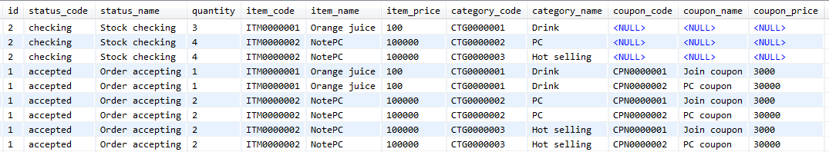
Records for
“1” of order id
Records for
“1” of order id

Slide 6
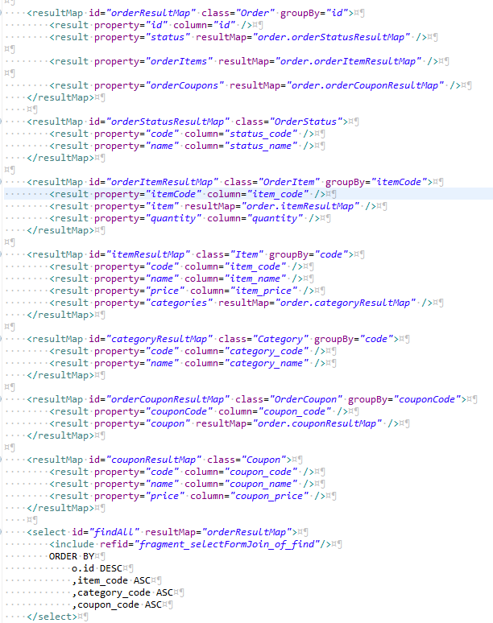
(1)
(2)
(3)
(4)
(5)
(6)
(7)

Slide 7
Key of GroupBy
Mapping is delegated to
“order.orderStatusResultMap”
Mapping is delegated to “order.orderCouponResultMap”
Targt of Mapping
Mapping is delegated to “order.orderItemResultMap”

Slide 8
Keys of GroupBy
Targt of Mapping

Slide 9
Keys of GroupBy
Targt of Mapping
Mapping is delegated to “order.itemResultMap”

Slide 10
Keys of GroupBy
Mapping is delegated to “order.categoryResultMap”
Targt of Mapping

Slide 11
Keys of GroupBy
Targt of Mapping

Slide 12
Mapping is delegated to “order.couponResultMap”
Keys of GroupBy
Targt of Mapping

Slide 13
Keys of GroupBy
Targt of Mapping

Slide 15
OrderItem
itemCode=ITM0000001
quantity=1
Item
code=ITM0000001
name=Orange juice
Price=100
1
Caretory
code=CTG0000001
name=Drink
2
OrderItem
itemCode=ITM0000002
quantity=2
Item
code=ITM0000002
name=NotePC
Price=100000
Caretory
code=CTG0000002
name=PC
2
Order
Id=1
OrderStatus
code=accepted
name=Order accepting
Caretory
code=CTG0000003
name=Hot selling
OrderCoupon
couponCode=CPN0000001
Coupon
code=CPN0000001
name=Join coupon
Price=3000
2
OrderCoupon
couponCode=CPN0000001
Coupon
code=CPN0000001
name=PC coupon
Price=30000

Slide 16
OrderItem
itemCode=ITM0000001
quantity=1
Item
code=ITM0000001
name=Orange juice
Price=100
1
Caretory
code=CTG0000001
name=Drink
2
OrderItem
itemCode=ITM0000002
quantity=2
Item
code=ITM0000002
name=NotePC
Price=100000
Caretory
code=CTG0000002
name=PC
2
Order
Id=2
OrderStatus
code=checking
name=Stock checking
Caretory
code=CTG0000003
name=Hot selling
0
OrderCoupon
OrderItem
itemCode=ITM0000001
quantity=1
Item
code=ITM0000001
name=Orange juice
Price=100
1
Caretory
code=CTG0000001
name=Drink
2
OrderItem
itemCode=ITM0000002
quantity=2
Item
code=ITM0000002
name=NotePC
Price=100000
Caretory
code=CTG0000002
name=PC
2
Order
Id=1
OrderStatus
code=accepted
name=Order accepting
Caretory
code=CTG0000003
name=Hot selling
OrderCoupon
couponCode=CPN0000001
Coupon
code=CPN0000001
name=Join coupon
Price=3000
2
OrderCoupon
couponCode=CPN0000002
Coupon
code=CPN0000002
name=PC coupon
Price=30000

