Slide 1
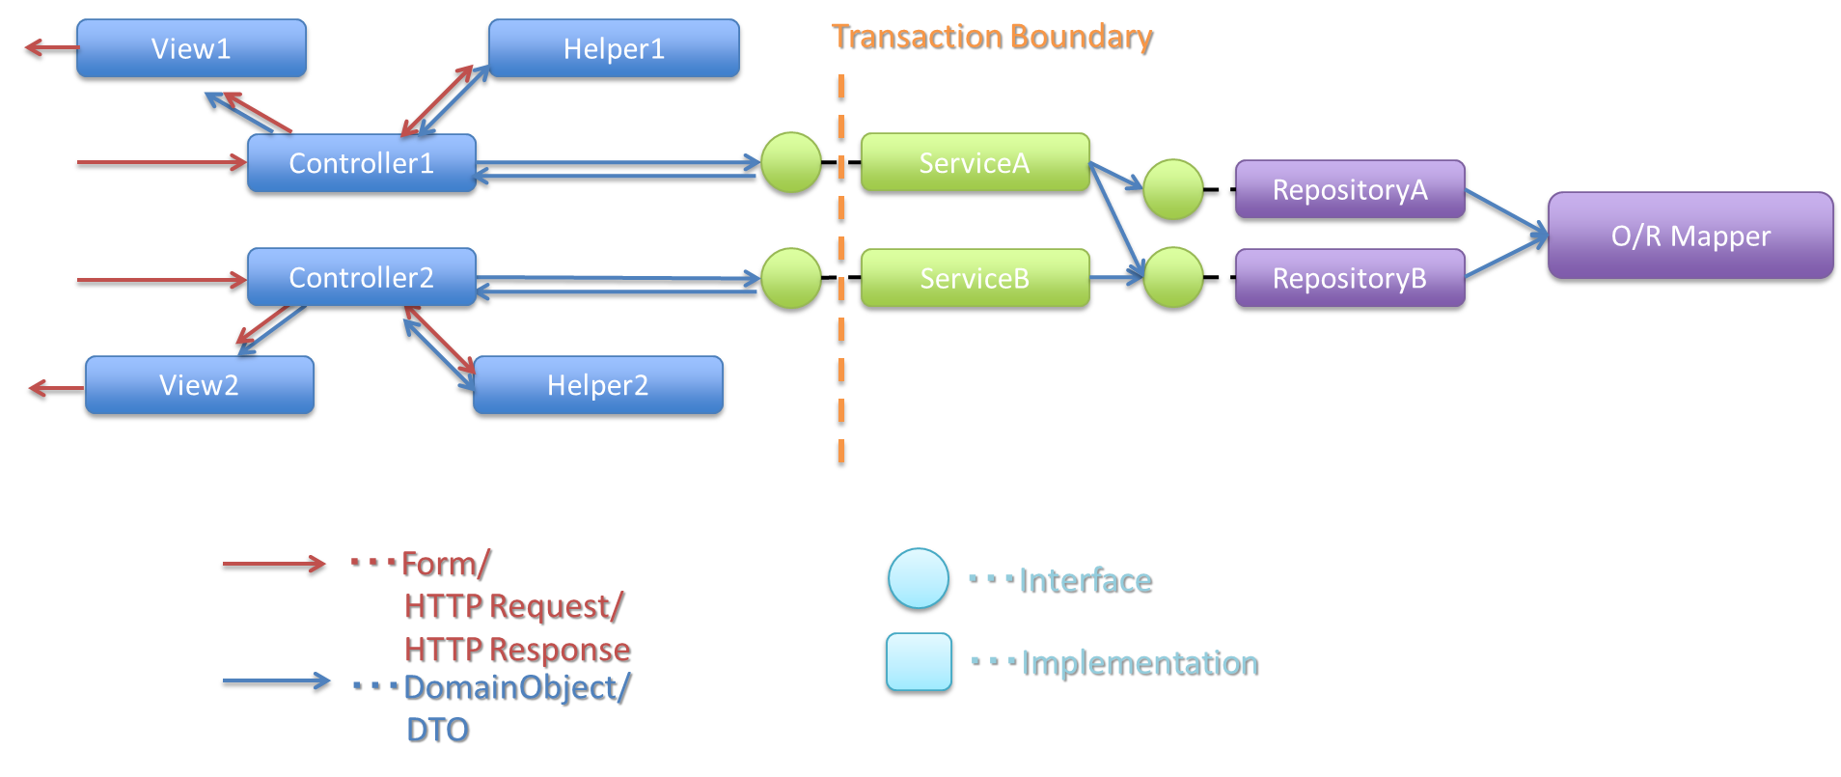
Application Layer
Domain Layer
Bean Mapping
Form is unavailable in this layer
Form
DomainObject
Form
DomainObject

Slide 2
Dozer
BeanMapper
Convert datatype
& Copy values
Source
Destination
id: String
when property names are same
id: String
personForm: PersonForm
when property names are different
person: Person
code: String
code: Integer
name: String
name: String
orders: List<OrderItemForm>
when type of collection is different
orders: Set<OrderItem>
orders[0]: OrderItemForm
orders[0]: OrderItem
orderId: String
each property of a collection
orderId: String
…
…
orders[1]: OrderItemForm
orders[1]: OrderItem
orderId: String
orderId: String
…
…

Slide 3
Source
Destination
Id = 1001
Age = 25
FirstName = “John”
LastName = “AfterUpdate”
Id = 1001
Age = 25
FirstName = “John”
LastName = “BeforeUpdate”
Id = 1002
Age = 30
FirstName = “Carl”
LastName = “Walters”
Id = 1003
Age = XX
FirstName = “XXXX”
LastName = “XXXX”
UPDATE
Id = 1001
Age = 25
FirstName = “John”
LastName = “AfterUpdate”
Id = 1003
Age = XX
FirstName = “XXXX”
LastName = “XXXX”
NO CHANGE
Id = 1002
Age = 30
FirstName = “Carl”
LastName = “Walters”
ADD

Slide 4
application
domain
controller
Should not use Form
Form⇔Entity
JSP
Service
Repository
Jsp
Form
controller
Form⇔Entity
XxxWeb
Service
Entity
XxxWeb
ServiceForm

Slide 5
default behavior(cumulative)
Source (AccountForm)
Destination (Account)
Email
Email
Email
Email
Email
Email
a
b
c
a
d
e
Dozer
Bean Mapping
Destination (Account)
Email
Email
Email
Email
Email
Email
a
d
e
a
b
c

Slide 6
non-cumulative
Source (AccountForm)
Destination (Account)
Email
Email
Email
Email
Email
Email
a
b
c
a
d
e
Dozer
Bean Mapping
Destination (Account)
Email
Email
Email
Email
Email
a
d
e
b
c

Slide 7
non-cumulative & remove-orphans
Source (AccountForm)
Destination (Account)
Email
Email
Email
Email
Email
Email
a
b
c
a
d
e
Dozer
Bean Mapping
Destination (Account)
Email
Email
Email
a
b
c

Slide 8
non-cumulative & remove-orphans
Source (AccountForm)
Destination (Account)
Email
Email
Email
Email
Email
Email
a
b
c
a
d
e
Dozer
Bean Mapping
Destination (Account)
Email
Email
Email
a
b
c

Slide 9
non-cumulative & remove-orphans
Source (AccountForm)
Destination (Account)
Emails
Emails
a
b
c
a
d
e
Dozer
Bean Mapping
Destination (Account)
Emails
a
b
c

Slide 10
copy-by-reference
Source (AccountForm)
Destination (Account)
Emails
Emails
a
b
c
a
d
e
Dozer
Bean Mapping
Destination (Account)
Emails
a
b
c

