Slide 1
adjustedValueQuery=
SELECT diff * 24 * 60 * 60 * 1000 FROM operation_date
Integration Test
TODAY:
2012/10/1
UPDATE operation_date SET diff=0;
9:00
Other
System
1
2012/
10/1
UPDATE operation_date SET diff=9;
11:00
2
2012/
10/10
UPDATE operation_date SET diff=30;
13:00
3
2012/
10/31
UPDATE operation_date SET diff=31;
15:00
4
2012/
11/1

Slide 2
System Test
1
2
3
4
Actual Date
2012
adjustedValueQuery=
SELECT diff * 24 * 60 * 60 * 1000 FROM operation_date
10/1
10/2
10/3
10/4
Test
Date
2015
1/1
1/15
1/31
2/1
UPDATE operation_date SET diff=822;
UPDATE operation_date SET diff=836;
UPDATE operation_date SET diff=852;
UPDATE operation_date SET diff=853;

Slide 3
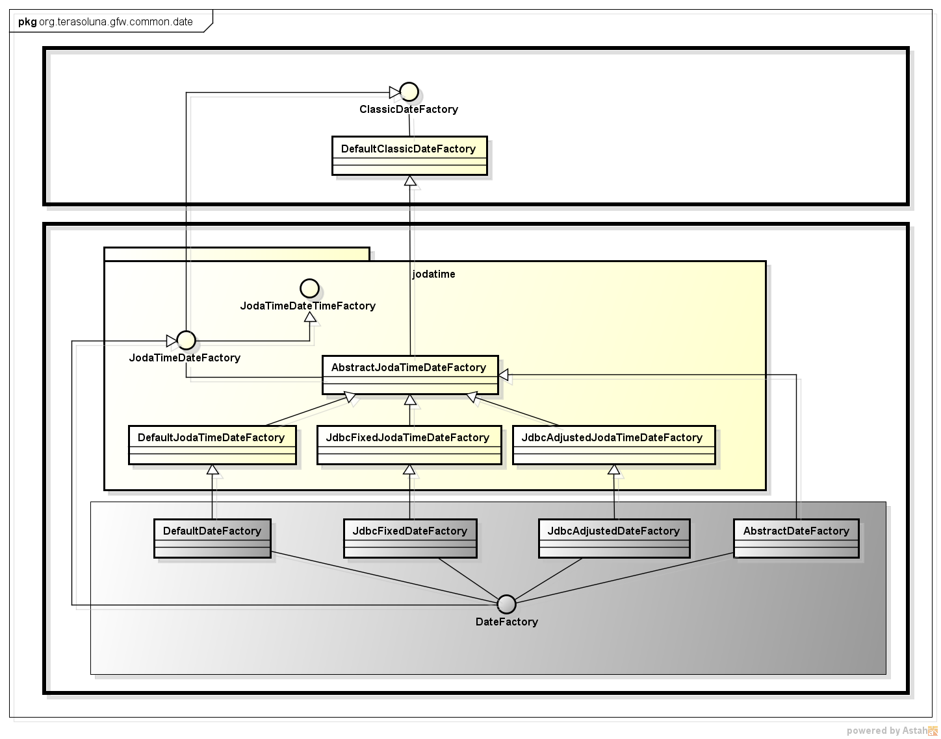
terasoluna-gfw-common
terasoluna-gfw-jodatime
Deprecated classes which exists for backward compatibility with 1.0.x

