Slide 1

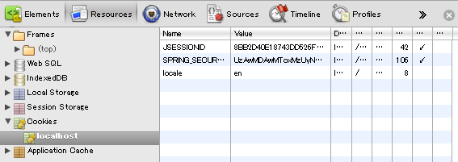

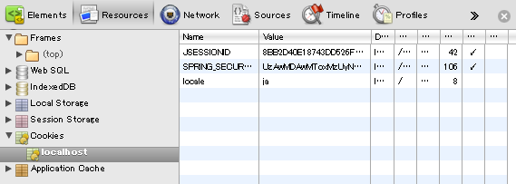
Change locale on screen
frist
click
Cookie
second
frist
Cookie
click
second

Slide 2
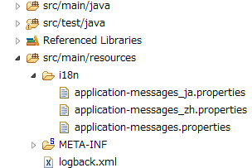
click
click

