Slide 1
Layout.jsp
header
header.jsp
menu
body
menu.jsp
business.jsp
footer
footer.jsp

Slide 2
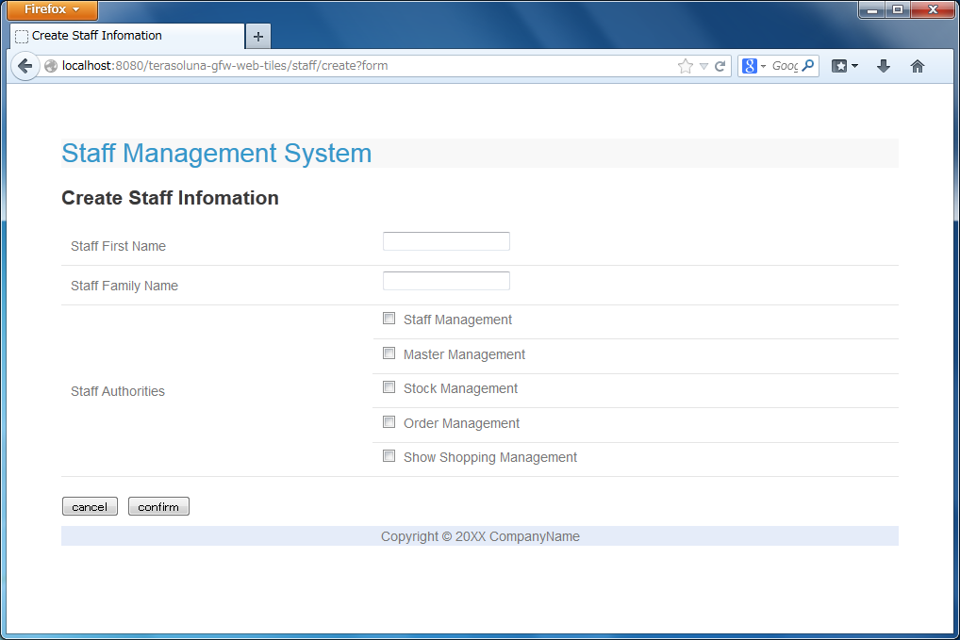
title
template.jsp
header.jsp
createForm.jsp
footer.jsp

Slide 3
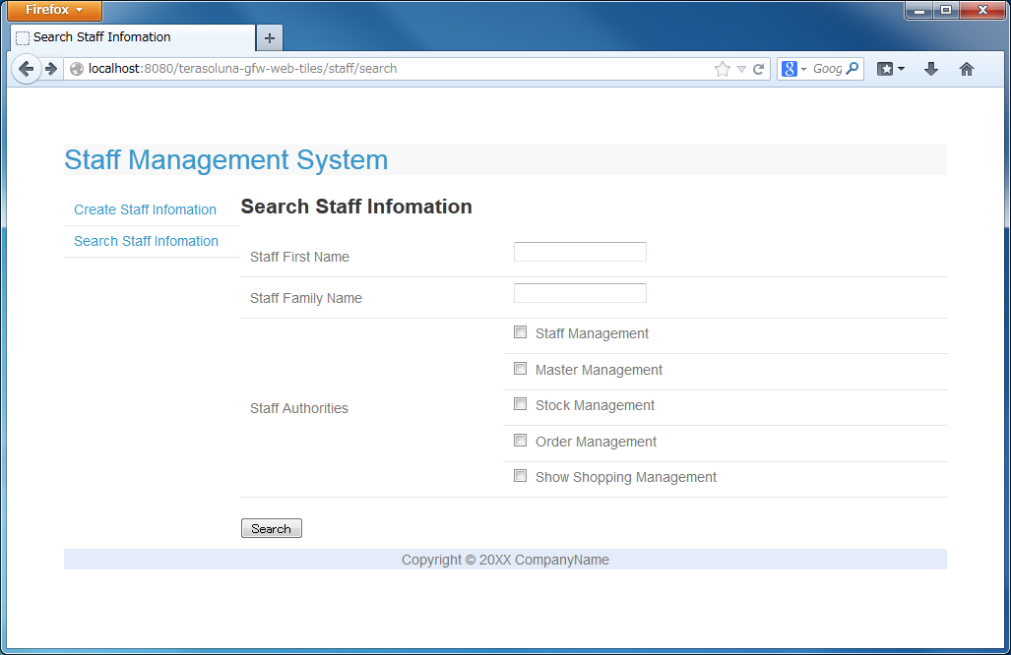
title
templateSearch.jsp
header.jsp
searchStaff.jsp
menu.jsp
footer.jsp

