Slide 1
Time
FailedAuthentication
username | authenticationTimestamp
userA | 13:07
userA | 13:10
3 Record
userA | 13:11
2 Record
(1)
13:16
(2)
13:18
Timeline
Insert query
Authentication failure (invalid password)
Authentication failure (account is locked)
Authentication success

Slide 2
Time
FailedAuthentication
username | authenticationTimestamp
userA | 13:07
userA | 13:10
0 Record
userA | 13:11
Delete
(1)
13:16
Timeline
Insert query
Authentication failure (invalid password)
Authentication success
Deleted
Delete query
Unlock

Slide 3
(2) make PasswordData
(1) prepare PasswordValidator
PasswordData
PasswordValidator
password
(3) validate
Rule
username
Rule
Rule
Reference
Reference
Reference
(3’) get RuleResult
(5) get messages
RuleResult
(4) confirm result

Slide 4
PasswordData
(1) new
password
username
Reference
Reference
・・・
Histories …
PasswordValidator
(2’) reference
Application
(2) validate
Rule
Rule
Rule
(3) new
(4) isValid
RuleResult

Slide 5
(2) Create
New Account
(3) Create New Account
(Confirm)
(4) Create New Account
(Complete)
(6) Create
Password Reissue Information
(Complete)
(1) Login
(5) Create
Password Reissue Information
Y
Should the password
be changed?
(7) Reissue Password
(8) Reissue Password (Complete)
N
(9) Top
(10) Show Account Information
(14) Change Password
(Complete)
(11) Unlock
(13) Change Password
(12) Unlock
(Complete)
Page
Authentication required
Conditional Branch
Transition
Authorization required

Slide 6
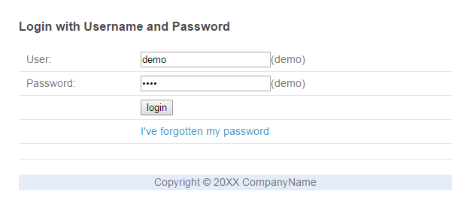
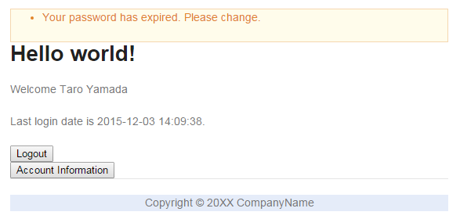
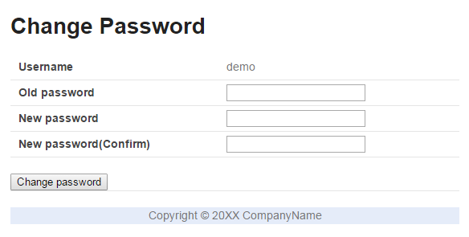
force to
change password
show a message

Slide 7
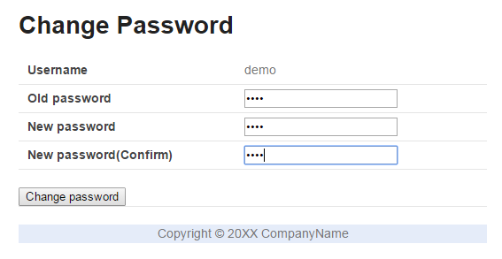
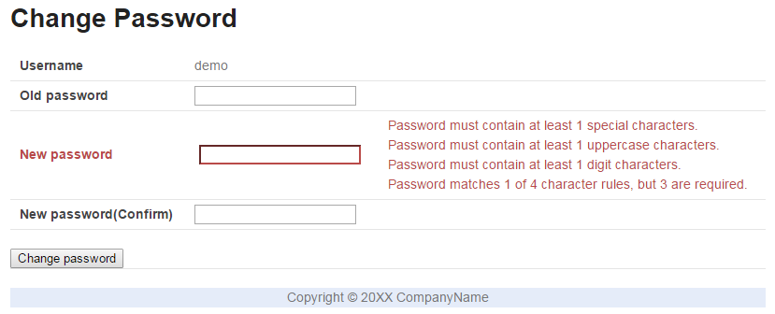
weak password
show messages

Slide 8
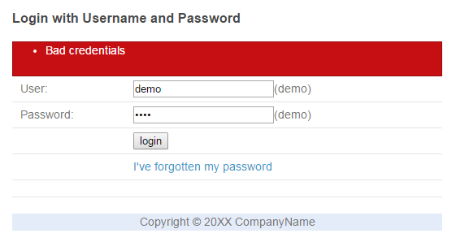
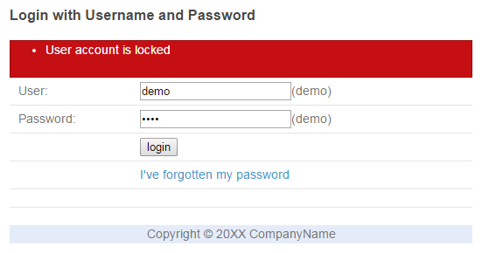
many times
in a short period
account has been locked

Slide 9
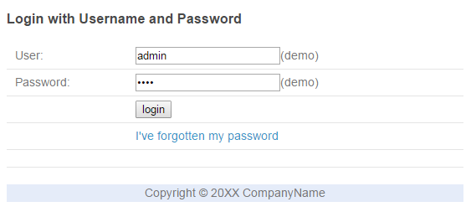
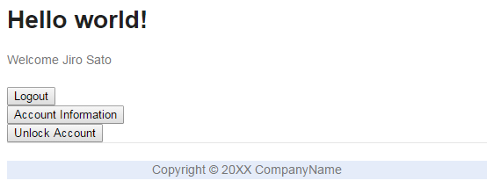
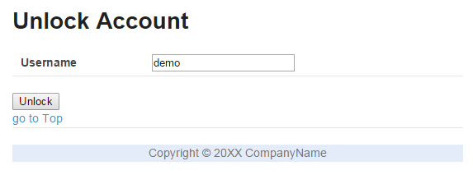
login as administrator

Slide 10
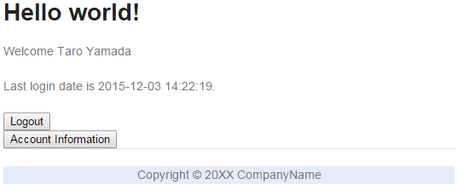
show last login date

Slide 11
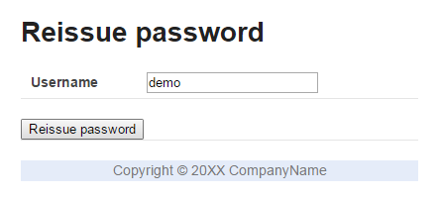
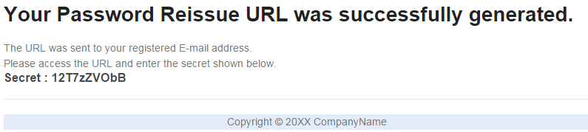
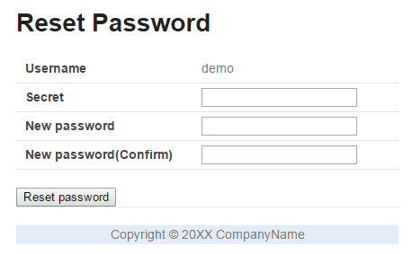
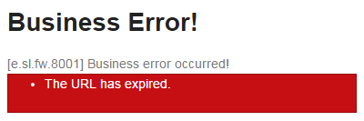
generate token and secret
show the secret
send URL (token is included)
token is valid
token has been expired

Slide 12
generate token and secret
show the secret
send URL (token is included)
token is valid
token has been expired

Slide 13
generate token and secret
show the secret
send URL (token is included)
token is valid
token has been expired

Slide 14
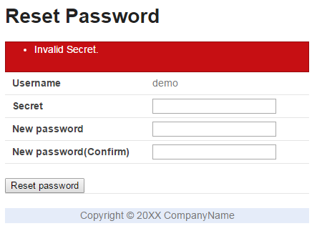
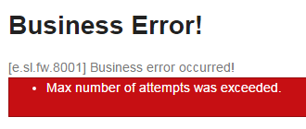
too many times
the URL has been invalidated

Slide 15

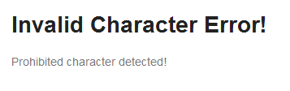
prohibited character
・・・
prohibited character
go to error page

Slide 16
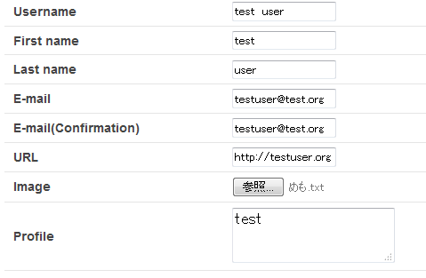
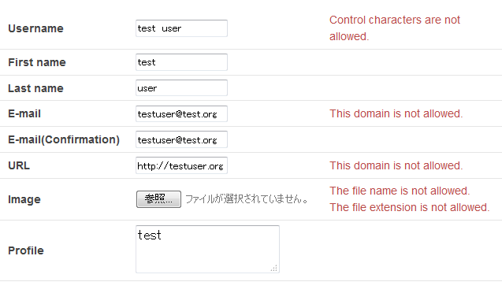
control character
invalid domain
invalid domain
invalid file extension
invalid file name
show messages

Slide 17
2016-07-01 13:20:33
USER: demo
[START SERVICE] SomeService.doX
2016-07-01 13:20:34
USER: demo
[START SERVICE] AnotherService.doY
Controller
SomeService
AnotherService
2016-07-01 13:20:33
USER: demo
[SERVICE THROWS EXCEPTION]
SomeService.doX
2016-07-01 13:21:10
USER: demo
[COMPLETE SERVICE] AnotherService.doY

