Slide 1
Intro to Vibe Coding
or Agentic Development if you’re fancy
Mason Grimshaw

Slide 2

Mason
MIT, AI Engineer at Ode, VP at IndigiGenius
Building agentic chatbots and vibe coding for over a year

Slide 3


Slide 4




Where We’re Going
Intro Demo
What Vibe Coding is
What Vibe Coding isn’t
Demos

Slide 5
First Demo
Landing Page for This Session

Slide 6
Installs (the most boring slide)
Mac
Windows
⌘+Space and type "Terminal“
nodejs.org → LTS → run .pkg
git --version
npm install -g @openai/codex
Win key and type "PowerShell“
nodejs.org → LTS → run .msi
git-scm.com → run installer
npm install -g @openai/codex
codex → "Use API key" → paste (⌘+V)

Slide 7
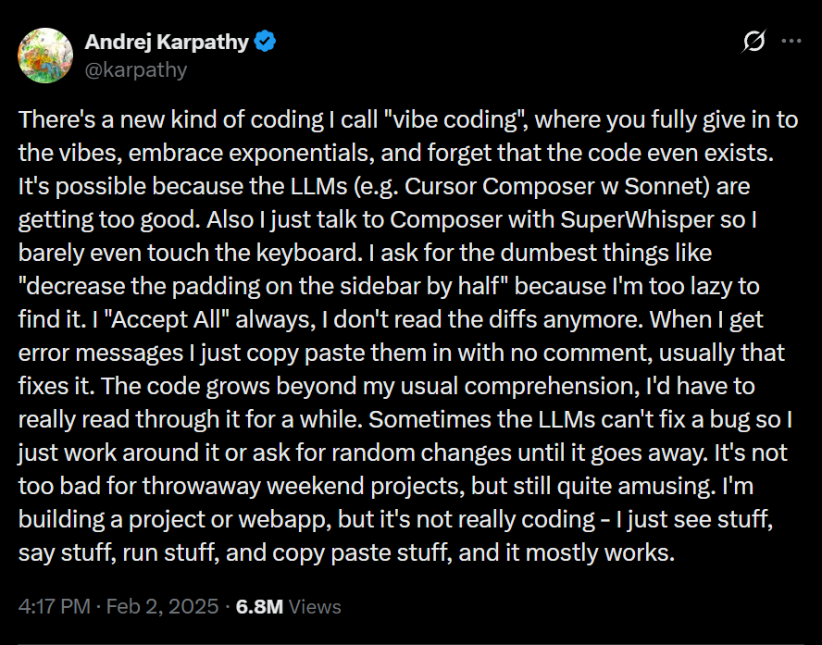

Slide 8
Large Language Model 101
LLMs are very intelligent interns with no institutional knowledge and very bad memories.
Context: What your model knows
Everything in your conversation, your prompt, prior messages, files, tool outputs, system prompts
This does not persist across sessions
Training: What they can remember
Roughly, the public internet up to some date. Usually about 6 months ago. This persists across sessions. Without intention, it can confidently give outdated answers
Tools: What they can do
Tools are about going beyond text and having deterministic functions that enable interaction with the real world.
Calculators, web search, and running code are all tools.

Slide 9
What Vibe Coding Is
The best versions of Vibe Coding have an inquisitive human and an AI on a short leash.
1. State the goal
2. Give context and constraints
3. Let the agent inspect, plan, and act
4. Review changes
5. Test and verify
Spec -> Steer -> Inspect -> Verify

Slide 10
Planning is Critical
Planning is the highest leverage interface point between you and the agent. Treat the plan like a contract and, as best as you can, require quantitative or verifiable outputs from it.
Often, this looks like a markdown file that you both reference and agree upon, but it can also look like smaller lists of in-context todos.
People disagree on HOW MUCH planning you should do, but not on the idea that you should.

Slide 11
Anatomy of a Prompt
Bad Prompt
Breakdown
Make me a personal website with my name, a bio, and links to Github and LinkedIn. It should look good.
Goal is vague: What is a personal website?
No context: Who are you? Where should it link to?
No constraints: It’ll probably pick standard frameworks, but it may not
No acceptance criteria: “Looks good” doesn’t count

Slide 12
Anatomy of a Prompt
Good Prompt
[Goal] Build me a single-page personal landing site.
[Context] I'm Mason, a data scientist at Ode Partners. This is my "home on the internet" — a page I'll link from email signatures and social bios. Audience is other technical people and potential clients.
[Constraints] Static HTML + CSS only. No frameworks, no build step, minimal JavaScript. Hosted on GitHub Pages. One index.html + one style.css. Style: warm and personal, not corporate — muted palette, generous whitespace, one accent color. Mobile-responsive.
[Acceptance criteria] Page contains (1) my name as the main heading, (2) a 1–2 sentence bio, (3) a profile photo placeholder, (4) four links: GitHub, LinkedIn, Twitter, email. Readable on mobile and desktop. Lighthouse accessibility score > 90.
[Process guidance] Before writing code, show me your plan as a bulleted list and wait for me to confirm. If you have design questions that would meaningfully change the result, ask — don't guess. Don't add extras I didn't ask for.
[Verification] After writing the files, describe what index.html will render. Then give me the three commands to deploy to GitHub Pages.

Slide 13
The Core Loop
Good agentic guidance is very similar to good prompting.
1. Define the task clearly
2. Add guardrails or constraints
3. Ask for a plan when the task is non-trivial
4. Execute in small steps
5. Inspect the diff
6. Run checks

Slide 14
What to Avoid
It’s easy to convince yourself that “it just works”, but you want to improve the probability that your generations work every time.
Skip planning. You’ll get a feel over time for what needs planning, but it’s a good practice to do as you start.
Getting too far ahead without reviewing. You don’t want to get some unexpected behavior after 10k lines of code and realize the problem was somewhere around line 1k.

Slide 15
Advanced Agentic Assisted Development
Make your setup work for you!
Customized System Prompt: AGENTS.md is a file that guides everything you do. They exist for your machine AND each project.
Skills: Commands that you AND the model can call when needed.
Hooks: Deterministic functions that are called at specific times

Slide 16
Advanced Agentic Assisted Development
Using the tool is how you get better at the tool.
If you’re stuck, ask it how to get unstuck
Use it to plan, but also use it to surface what you don’t know “I want to do X, but I’m new to this space. What am I missing or might not know as a novice at building websites?”
Have it interview you about what you’re exactly trying to do “I want to build X with these constraints … Interview me until you feel like you understand EXACTLY what I want to build, why, and how.”

Slide 17

Where to Go Next
This is a good base, but there’s so much more to learn!
PUSH it. Ask it to do really hard things and evaluate the outputs.
Build time-on-task. Any task!
Stay curious! Ask it questions about itself. “Can you help me do X? How?”

Slide 18
Demos
Whatever we want

