Slide 1
Introducing LoserBot
By Chris Grabowski and Nick Tackowiak

Slide 2
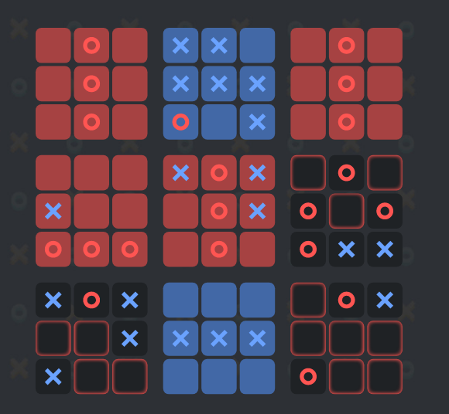
Ultimate TicTacToe
Get three tiles in a row to win small board
Get three small boards in a row to win
Can only play in board in same relative position to last tile claimed, or anywhere if that board is already won
http://theaigames.com/competitions/ultimate-tic-tac-toe/games/590b73ce4ee9c605a9d7799d

Slide 3
General Approach
Use a heuristic function to assign values to states (boards)
Search for move that will result in the best state with minimax

Slide 4
Minimax
Need to be able see how moves change the game state
Search depth of 2-3 is max feasible within 0.5 second time limit
Usually ~9 moves available, sometimes as many as 81
When too many moves are available, we decrease our depth limit

Slide 5
Neural Network as a Heuristic
Training set: record states in matches against self + random move bot, output is whether we won or lost the match
Use game state 81 tiles + 9 boards as inputs to NN
Too slow to train and hard to understand relationship between 81 tiles
Use 9 boards as inputs to NN
Kinda works

Slide 6
Heuristic Success Rates
Greedy Algorithm : Give value to winning boards
95% winrate
Greedy Algorithm : Give value to winning boards or getting 2 in a row
80% winrate
Neural Network 90 input nodes/90 hidden nodes:
Essentially random- ~55% winrate
Neural Network 9 input nodes/2 hidden nodes:
Best results seen 70% winrate
Worst results 5% winrate

